Slide 1
Module 02: Operators, Functions and Regular Expressions
Northeastern University
BINF6200 – January 24, 2017
Notes:
To run modules in Modern Perl book, you may need to install the Modern::Perl module from cpan with the command $sudo cpan Modern::Perl
And also use Test::More module to test your program
ok(), like(), and is()

Slide 2
This week
Review
Bracket alignment
Runaway code
Refactoring
Pass hash reference in subroutine
Defined-or operator
Regular expression named capture

Slide 3
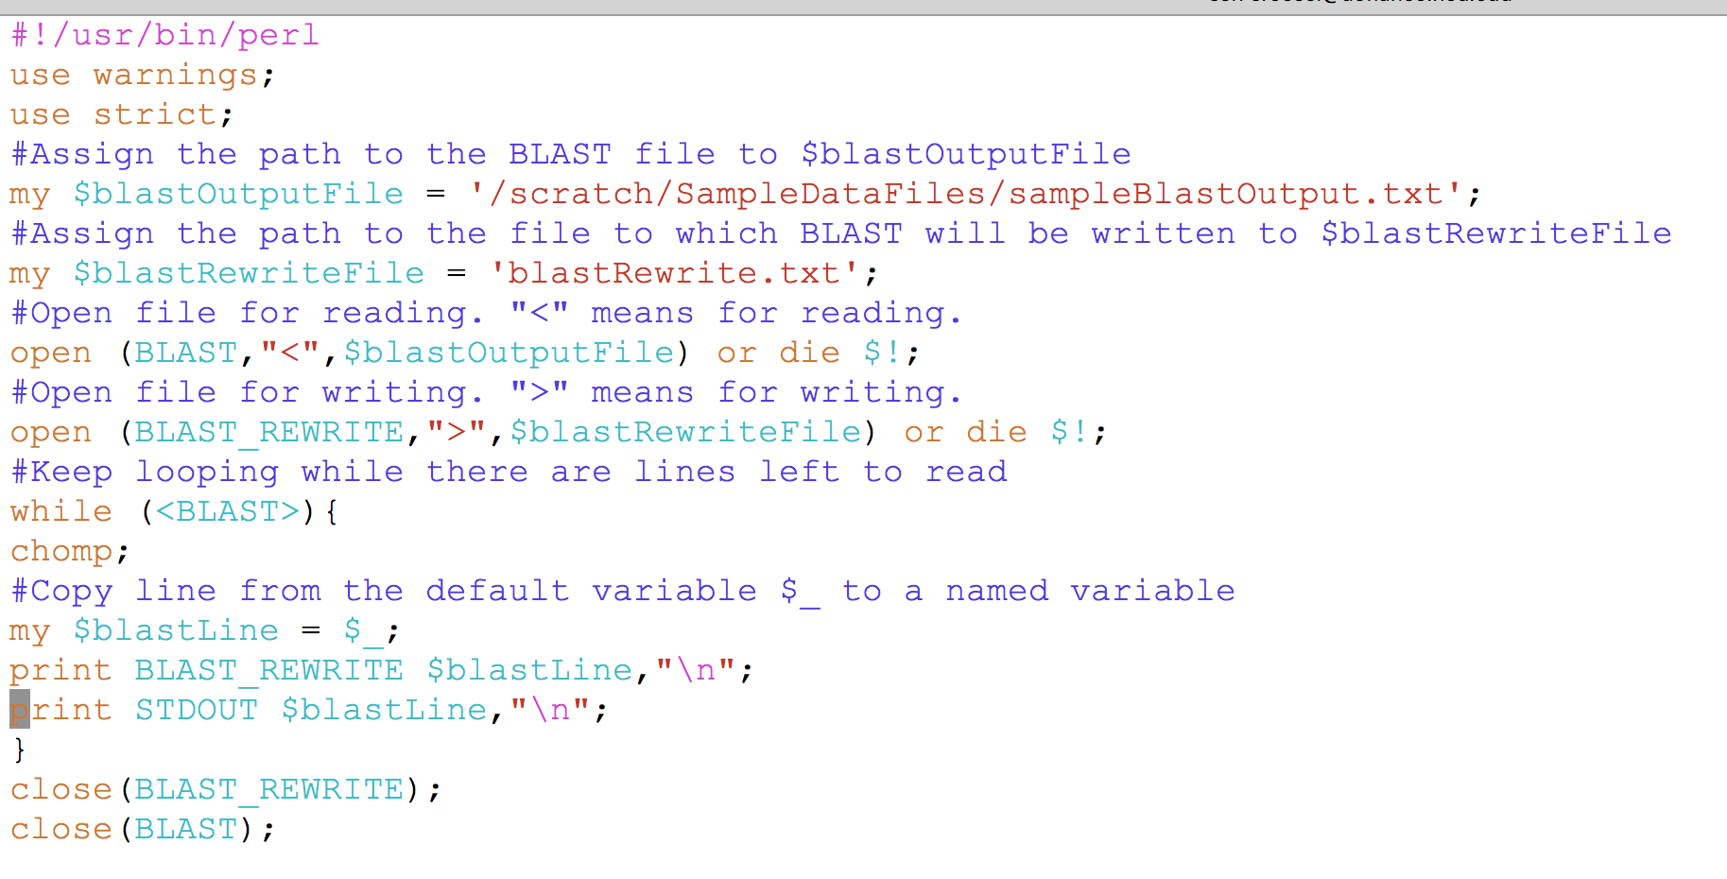
Bracket Alignment and Indentation
No indentation at all

Slide 4
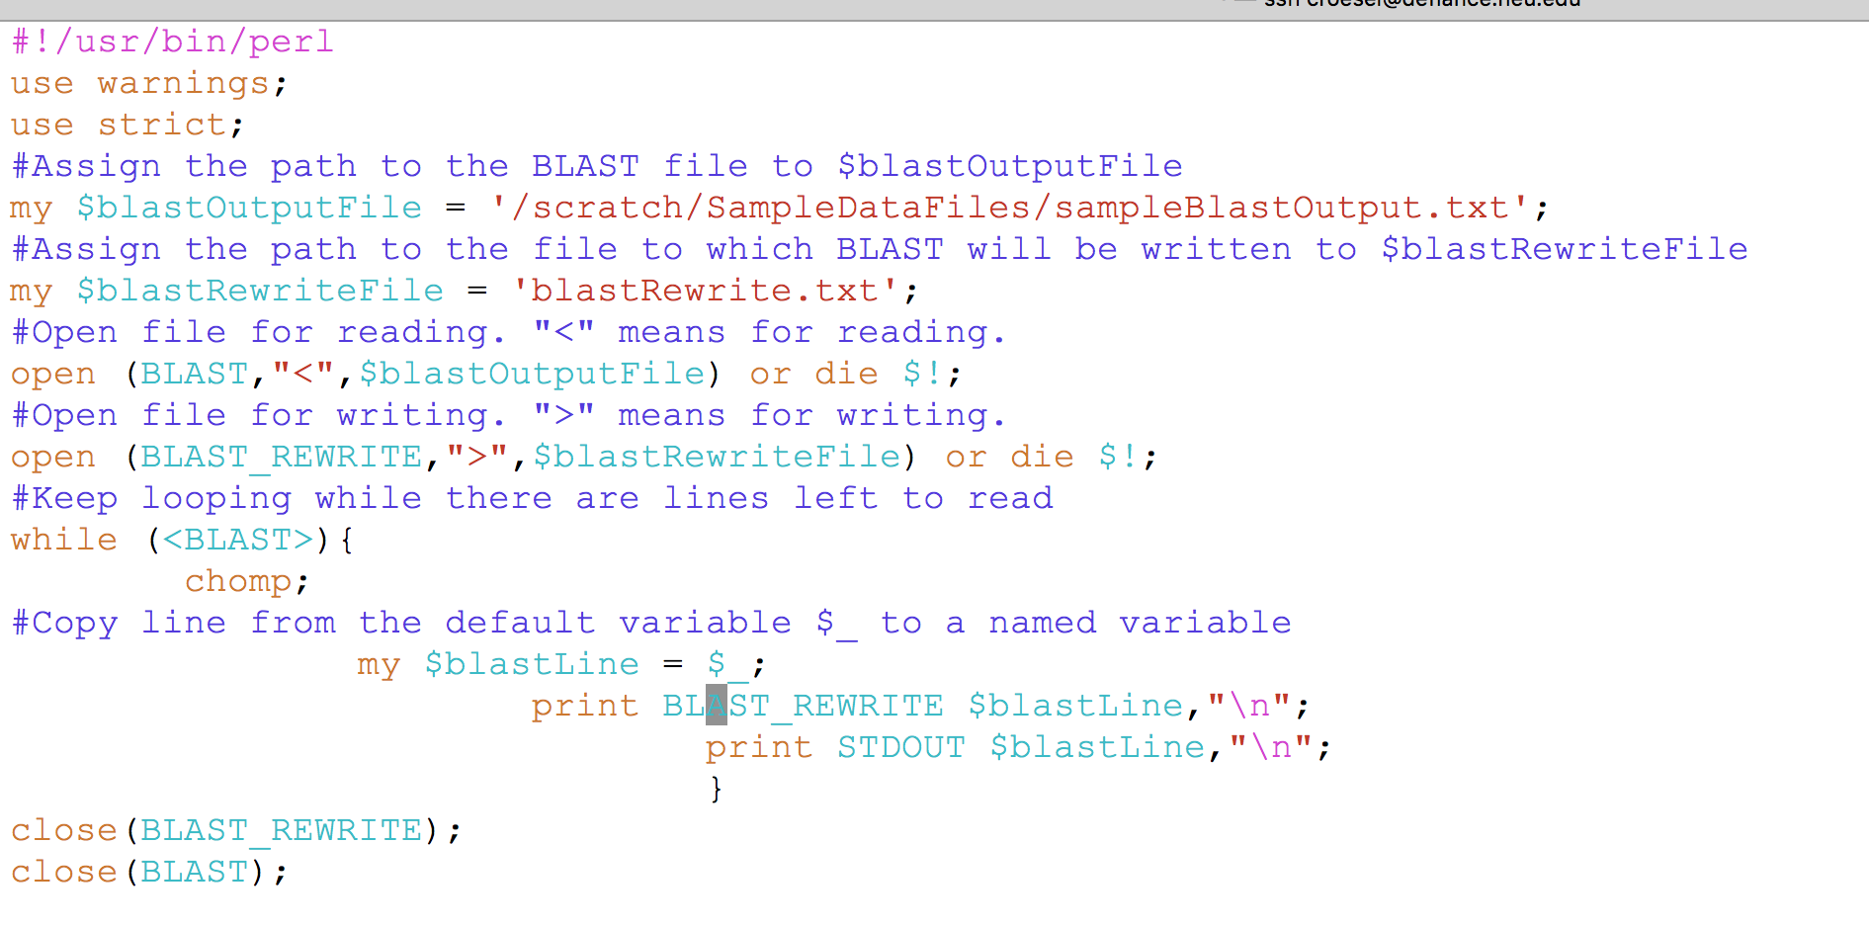
Bracket Alignment and Indentation
Too much indentation

Slide 5
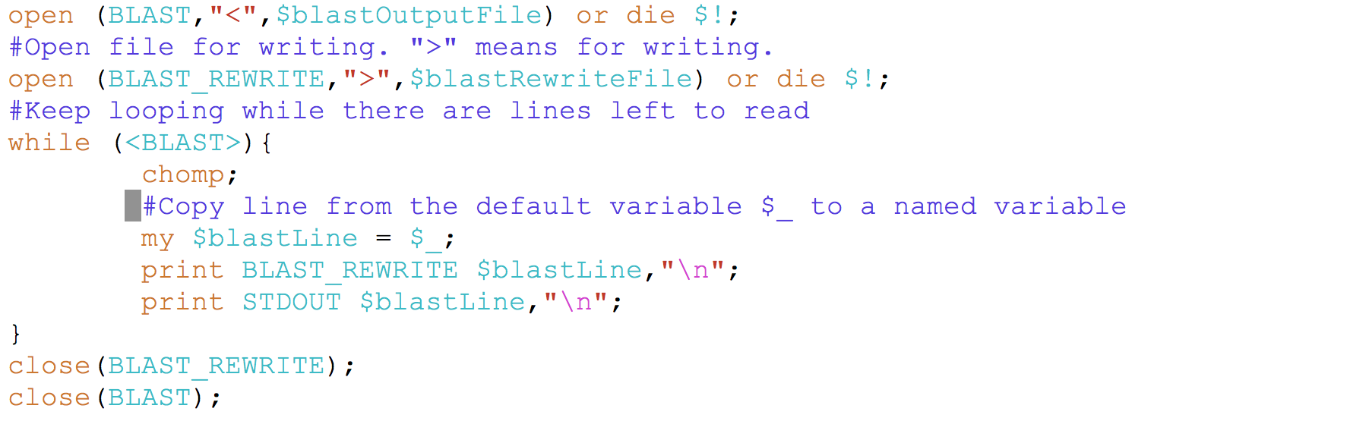

Bracket Alignment and Indentation

Slide 6
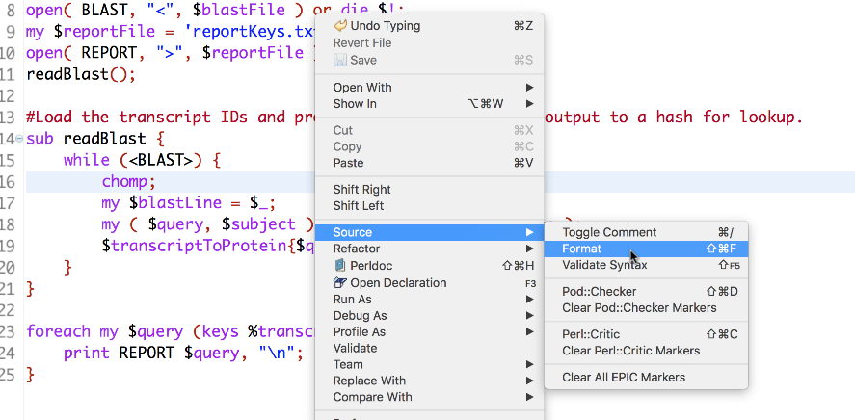
Align Brackets with Eclipse
In vim use gg=G in command mode

Slide 7
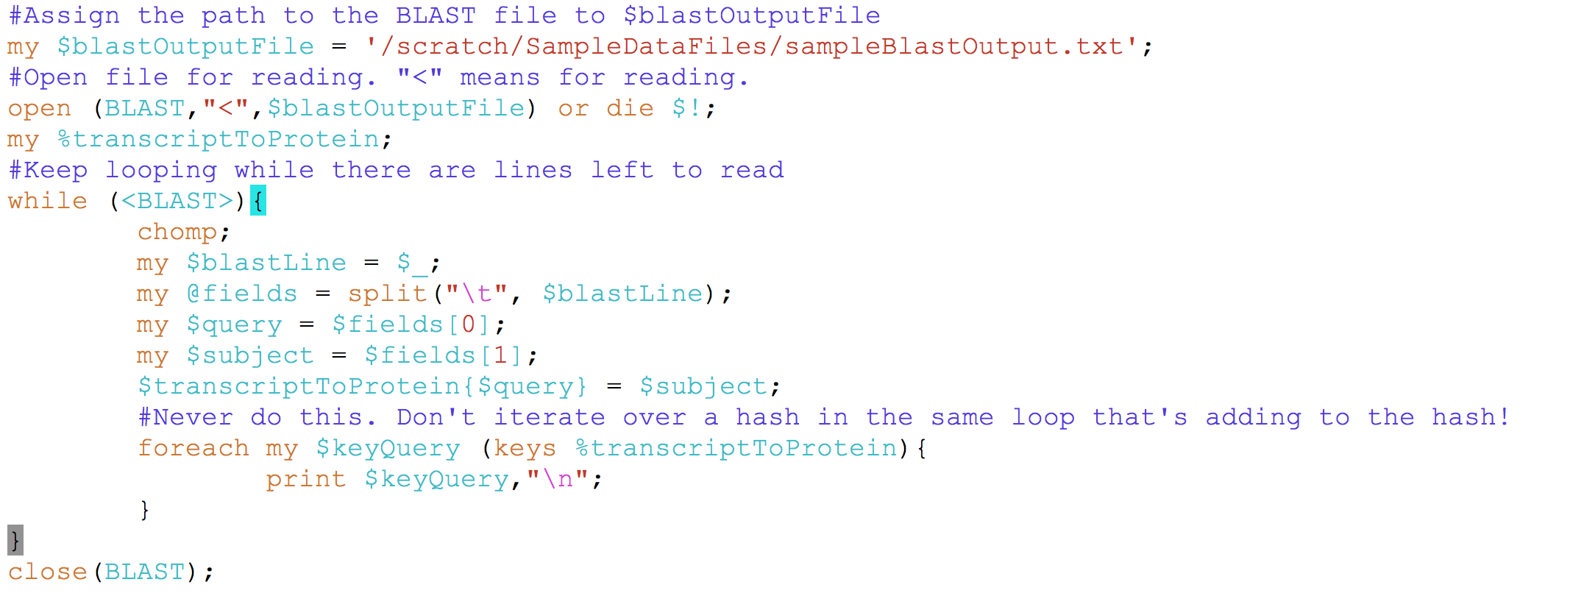
Runaway Code (Bad!)

Slide 8
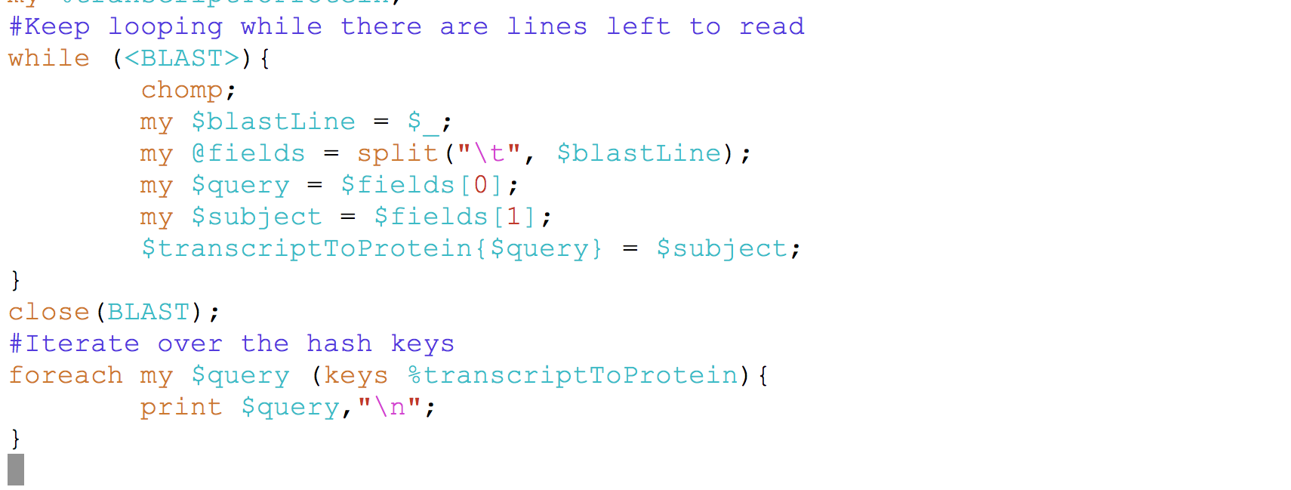
Runaway Code Fixed
Foreach loop that reads hash keys is moved out of the while loop that initializes value in the hash

Slide 9
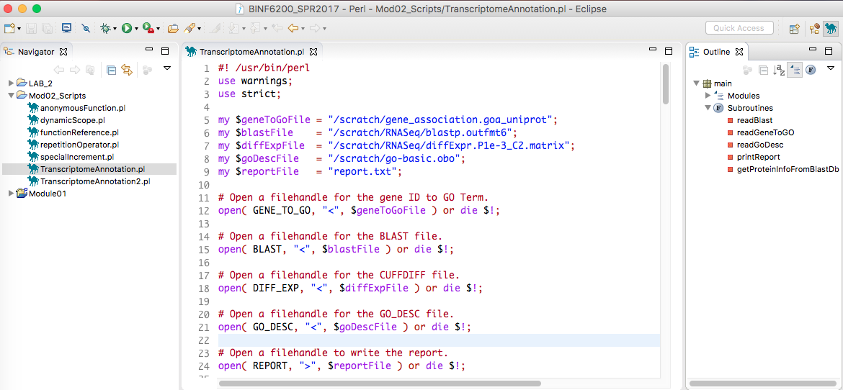
Eclipse Perl Perspective
Outline panel lists subroutines in the program. Navigate through by clicking on subroutine name.
Notes:
The image below is the Eclipse Perl perspective. You can move panels around to your liking
navigator for all my projects and files on the left, the program files in the middle, and the outline on the right.
The outline lists the subroutines in a program, and you can quickly navigate to the subroutine in the code panel by clicking the subroutine name in the outline panel

Slide 10
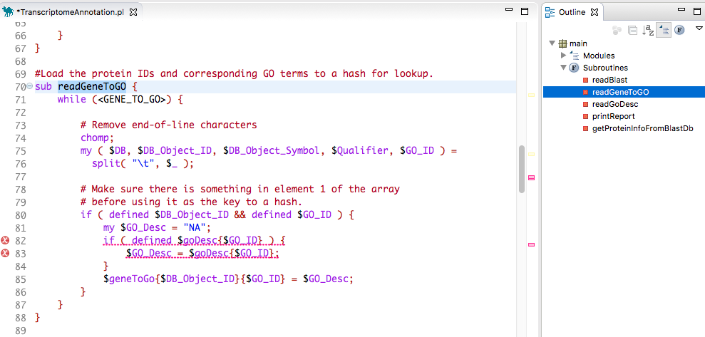
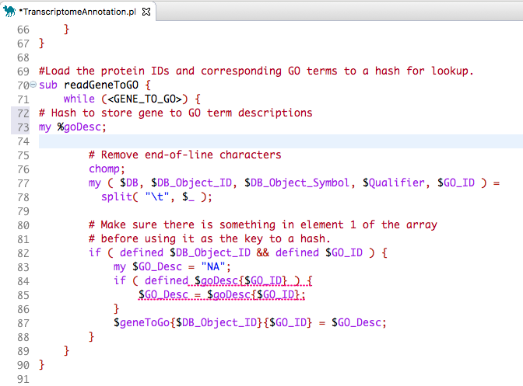
Refactoring with Eclipse
Refactoring is rearranging code to make it more readable, modular, and maintainable.
Especially important for object-oriented programming
Refactoring may bring variables out of their previous scope or require adjustments to previous data structures.
“my %goDesc” was previously declared in the main package name space. Cutting out that declaration will bring up error flags in the subroutine that uses it.
Pasting it into the subroutine (line 73) will clear the flags. But how can %goDesc be accessed outside of that subroutine?
Notes:
When you start moving code around, it's easy to end up with code that references variables that are out-of-scope. With vim you'll catch those errors when you run the program. In Eclipse, they will be highlighted with errors as soon as you save the change. In the image below, I cut the declaration of %goDesc from its global location so I could move it to a subroutine. I save the file and Eclipse shows me where the variable is needed:
I paste the declaration in its new location, and the errors in the subroutine are cleared when I save:
That’s fine, no errors, but now how do you access the %goDesc hash outside of that subroutine

Slide 11
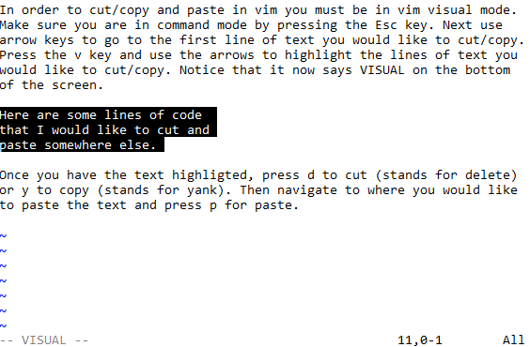
Refactoring with vim Visual Mode
Notes:
If you are refactoring in vim, make sure you are using vim visual mode. This video demonstrates. Key points to remember:
You must be in command mode, not insert mode.
Press v to start selecting
Press d to cut.
Press y to copy.

Slide 12
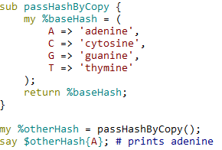
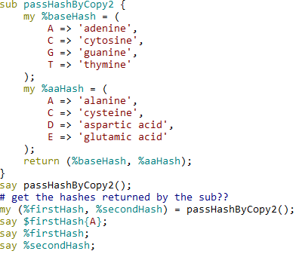

Pass Hash by Copy in Subroutine
Remember: When given an explicit return statement, a subroutine returns in void, scalar, or list context. Otherwise it returns the last expression evaluated.
What would happen if one subroutine returned two hashes?
pass-by-copy would flatten them into a single hash
Solution: pass a hash by reference from one subroutine to another.
Requires less memory
Returns hashes/arrays while maintaining original data structure
Pass by copy works for returning a single hash.
Pass by copy does not work for multiple hashes. What happened to adenine?

Slide 13
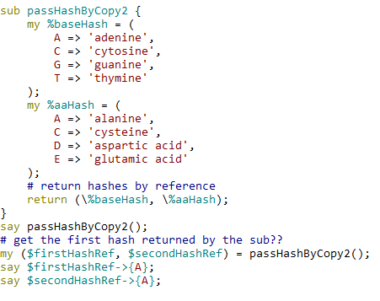

Pass Hash by Reference in Subroutine
Output:
Return multiple hashes using hash references, \%hashName
Remember to dereference with dereferencing arrow ->
Original hash key/value pairs can be retrieved

Slide 14
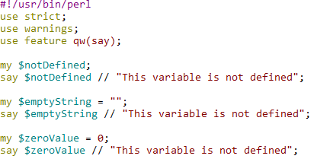

Operators
Type | Operators
Numeric | +, -, *, /, **, %, +=, -=, *=, /=, **=, %=
String | =~, !~, .
Numeric comparison | ==, >, >=, <, <=, !=
String comparison | eq, gt, ge, lt, le, ne, cmp
Logical | &&, ||, and, or, xor, //, ?:, !, not
Special | ++, --, .., x, ,, =>, …
Bitwise | <<, >>, &, |, ^, <<=, >>=, &=, |=, ^=
The defined-or operator, //, tests whether the operand is defined, not if it’s true.
Read more about special cases in Modern Perl Chapter 4
Notes:
A Perl operator is a series of one or more symbols used as part of the syntax of a language. Each operator operates on zero or
more operands. Think of an operator as a special sort of function the parser understands and its operands as arguments.
Bitwise Operators
Bitwise operators treat their operands numerically at the bit level.
Defined or operator //
The precedence of an operator governs when Perl should evaluate it in an expression. Evaluation order proceeds from highest to lowest precedence.
The associativity of an operator governs whether it evaluates from left to right or right to left. Addition is left associative, such that 2 + 3 + 4 evaluates 2 + 3 first, then adds 4 to the result. Exponentiation is right associative, such that 2 ** 3 ** 4 evaluates 3 ** 4 first, then raises 2 to the 81st power. As usual, grouping with parentheses will let you change the order of evaluation. Used when two operators have the same precedence
grouping with parentheses will let you change the order of evaluation.
The arity of an operator is the number of operands on which it operates. A nullary operator operates on zero operands. A unary operator operates on one operand. A binary operator operates on two operands. A trinary operator operates on three operands. A listary operator operates on a list of operands.
say ( 1 + 2 + 3 ) * 4; . . . which prints the value 6 and (probably) evaluates as a whole to 4 (the return value of say multiplied by 4). Perl's parser happily interprets the parentheses as postcircumfix (Fixity, pp. 67) operators denoting the arguments to say, not circumfix parentheses grouping an expression to change precedence.
An operator's fixity1 is its position relative to its operands:
Infixoperatorsappearbetweentheiroperands.Mostmathematicaloperatorsareinfixoperators,suchasthemultiplication
operator in $length * $width. • Prefix operators precede their operands. Postfix operators follow their operands. These operators tend to be unary, such
as mathematic negation (-$x), boolean negation (!$y), and postfix increment ($z++). • Circumfix operators surround their operands, as with the anonymous hash constructor ({ ... }) and quoting operators
(qq[ ... ]). • Postcircumfixoperatorsfollowcertainoperandsandsurroundothers,asseeninhashandarrayelementaccess($hash{$x}
and $array[$y]).
addition (+), subtraction (-), multiplication (*), division (/), exponentiation (**), and modulo (%), their in-place variants (+=, -=, *=, /=, **=, and %=), and both postfix and prefix auto-decrement (--)
Assignment, incremnet/decrement
The auto-increment operator has special string behavior (Special Operators, pp. 68). If the value is obviously a string (and has no numeric component), the operator increments the value's string component such that a becomes b, zz becomes aaa, and a9 becomes b0.
Comparison: numeric and string comparison operators
<=>
Several comparison operators impose numeric contexts upon their operands. These are numeric equality (==), numeric inequal- ity (!=), greater than (>), less than (<), greater than or equal to (>=), less than or equal to (<=), and the sort comparison operator (<=>).
String operators impose string contexts on their operands. These operators are positive and negative regular expression binding (=~ and !~, respectively), and concatenation (.).
Logical Operators
Logical operators impose a boolean context on their operands. These operators are &&, and, ||, and or. All are infix and all exhibit short-circuiting behavior (Short Circuiting, pp. 28). The word forms have lower precedence than their punctuation forms.
The defined-or operator, //, tests the definedness of its operand. Unlike || which tests the truth of its operand, // evaluates to a true value even if its operand evaluates to a numeric zero or the empty string. This is especially useful for setting default parameter values:
sub name_pet { my $name = shift // 'Fluffy'; ... }
The ternary conditional operator (?:) takes three operands. It evaluates the first in boolean context and evaluates to the second if the first is true and the third otherwise:
my $truthiness = $value ? 'true' : 'false'; The prefix ! and not operators return the logical opposites of the boolean values of their operands. not is a lower precedence version of !.
The xor operator is an infix operator which evaluates to the exclusive-or of its operands.
Bitwise operators (When would you ever use bitwise operators in Perl?)
Bitwise operators treat their operands numerically at the bit level. These operations are uncommon. They consist of left shift (<<), right shift (>>), bitwise and (&), bitwise or (|), and bitwise xor (^), as well as their in-place variants (<<=, >>=, &=, |=, and ^=).
Special Operators
Repetition operator x
The repetition operator (x) is an infix operator with complex behavior. When evaluated in list context with a list as its first operand, it evaluates to that list repeated the number of times specified by its second operand. When evaluated in list context with a scalar as its first operand, it produces a string consisting of the string value of its first operand concatenated to itself the number of times specified by its second operand. In scalar context, the operator repeats and concatenates a string:
Range operator can only produce simple, incrementing ranges of integers or strings.
In boolean context, the range operator becomes the flip-flop operator. This operator produces a false value until its left operand is true. That value stays true until the right operand is true, after which the value is false again until the left operand is true again. Imagine parsing the text of a formal letter with:
while (/Hello, $user/ .. /Sincerely,/) { say "> $_"; }
The comma operator (,) is an infix operator. In scalar context it evaluates its left operand then returns the value produced by evaluating its right operand. In list context, it evaluates both operands in left-to-right order.
The fat comma operator (=>) also automatically quotes any bareword used as its left operand (Hashes, pp. 45).
The triple-dot or whatever operator stands in for a single statement. It is nullary and has neither precedence nor associativity. It parses, but when executed it throws an exception with the string Unimplemented. This makes a great placeholder in example code you don't expect anyone to execute:
sub some_example { # implement this yourself ... }

Slide 15
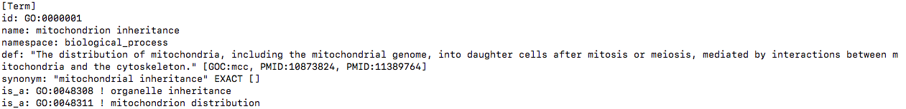
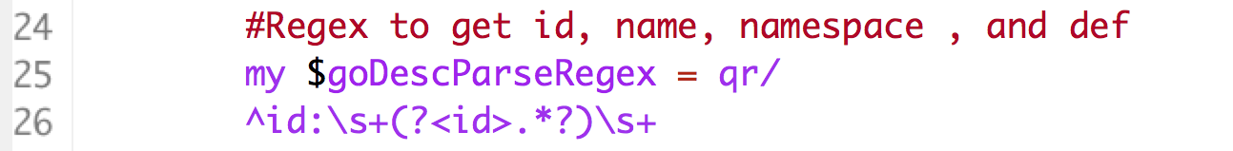
Regular Expression Named Capture
Name the capture with ?<name> within the parentheses used to capture.
Retrieve with $+{name}
Use x modifier so you can insert line breaks and comments in your regular expression.
Notes:
Previously looked at numbered captures, now you can name them.
Perl regular expressions are powerful tools to parse files in a variety of formats. This is a short exercise to build on your regular expression skills before we get into object-oriented programming. Regular expressions can become hard to read as they become more complicated, but there are several modifiers and techniques that can help improve readability.
The x modifier allows you to insert line breaks and comments in your regular expression. Regex modifiers appear at the end of the match, substitution, or qr operators. You’ve seen m, g, I,
m the multiline operator allows the ^ and $ anchors to match any new line embedded within a string.
Treat the string as single line. That is, change "." to match any character whatsoever, even a newline, which normally it would not match.
The qr operator allows you to save your regular expression as a scalar
Named capture allows you to save parts of the match between () as named variables rather than numbered variables ($1, $2, etc.)
Qr operator creates first-class regexes, it allows you to assign a regular expression to a variable.
X regular expression modifier
Named capture

Slide 16
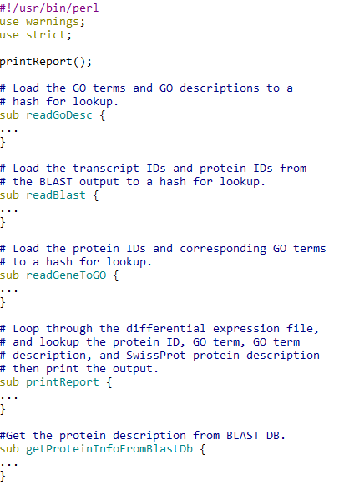
Assignment Task 1: Refactoring and Hash References
Besides printReport(), there should be no code outside of a subroutine!
Using refactoring, hash references, and the defined-or operator modify DiffExpAnnotation2.pl and rename it DiffExpAnnotation3.pl so that:
There are no variables declared in the main package name space.
There is only one subroutine call at the top of the program: printReport();
Start slowly with the code changes, changing just one subroutine at a time, testing to make sure your program still works before changing other subroutines.
Move variables , including filehandles, into the subroutines where they are used
Initialize hashes in the subroutines where they are updated.
Return a reference to the hash at the end of the subroutine.
To get access to a hash, call the subroutine that creates it from inside the subroutine that reads it.

Slide 17
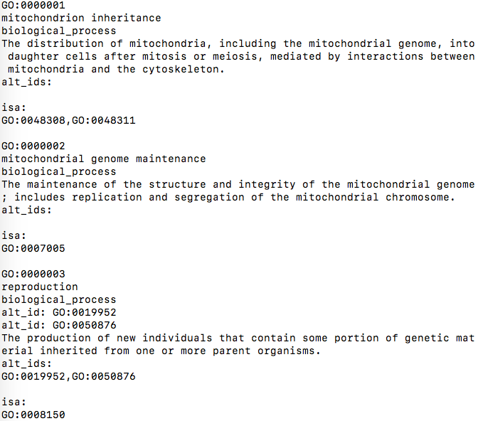
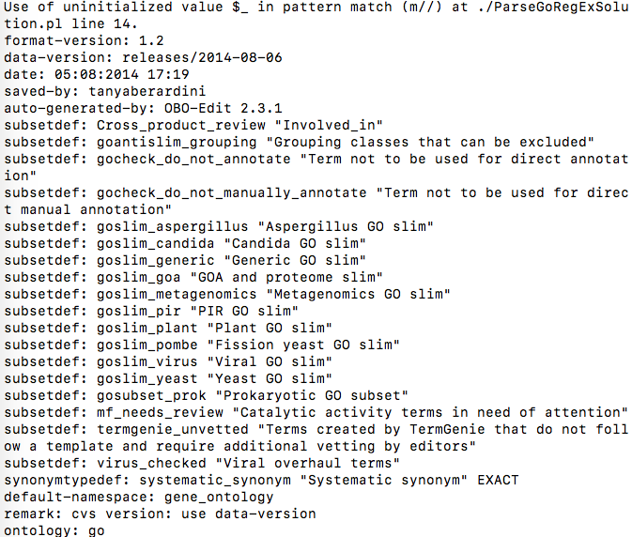
Task 2: Regular Expressions
parsed.txt
Use the x regular expression modifier, qr operator, and named capture to fill in missing code in ParseGoRegEx.pl. ParseGoRegEx.pl should parse /scratch/go-basic.obo with three regular expressions to extract:
id
name
namespace
def
multiple alt_id entries
multiple is_a entries
ParseGoRegEx.pl will be part of an object you'll create in the next module.
When I ran the solution using the command:
./ParseGoRegEx.pl 1>parsed.txt 2>not_parsed.txt
not_parsed.txt

Slide 18
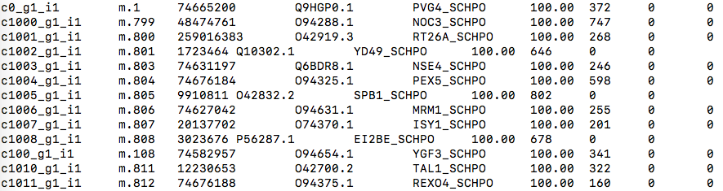
Task 3: Regular Expressions
parsedBlast.txt
Next, write a similar program (parseBlast.pl) that parses /scratch/RNASeq/blastp.outfmt6 completely with a regular expression, printing a tabular output file with these fields:
transcript (c1000_g1_i1 in sample line below)
isoform (m.799 in sample line below)
gi (48474761 in sample line below)
sp (O94288.1 in sample line below)
prot (NOC3_SCHPO in sample line below)
pident (100.00 in sample line below)
length (747 in sample line below)
mismatch (0 in sample line below)
gapopen (2 in sample line below)
c1000_g1_i1|m.799 gi|48474761|sp|O94288.1|NOC3_SCHPO 100.00 747 0 2 5 751 1 740.0 1506
Remember to escape | in your regular expression (\|).
./parseBlast.pl 1>parsedBlast.txt 2>notParsedBlast.txt
notParsedBlast.txt
- should be empty

