Slide 1
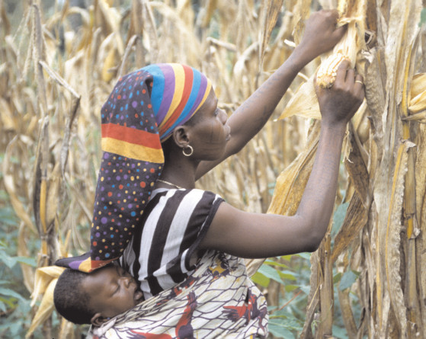
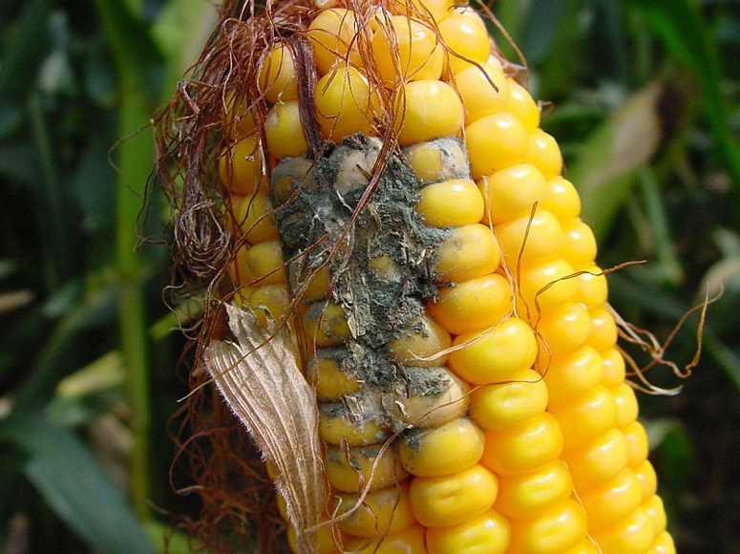
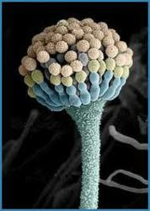
Agricultural Species Diversity to Mitigate Aspergillus Crop Infection and Aflatoxin B₁ Human Exposure
Clint valentine
A MOST POTENT CARCINOGEN, PRODUCED BY Aspergillus flavus, AND A TECHNIQUE TO LIMIT EXPOSURE
2015

Slide 2
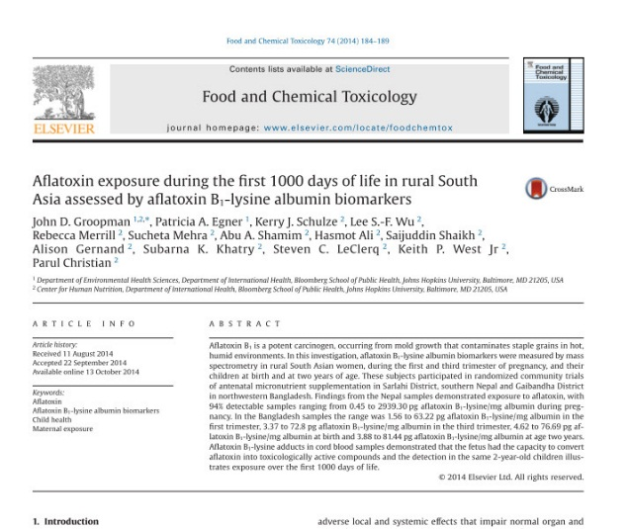
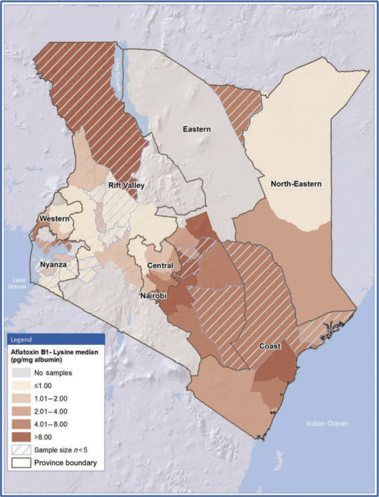
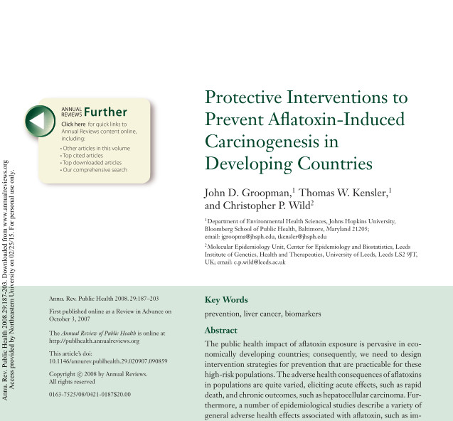
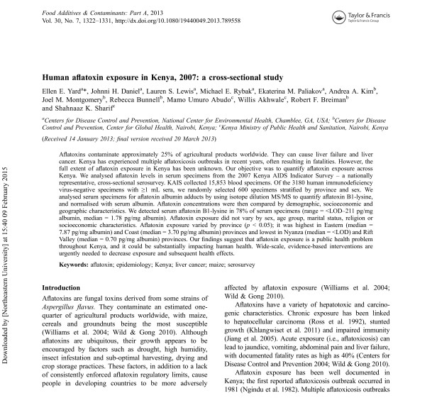
Global Impact
10,000+ Publications
Africa
Kenya
Southeast Asia
Worldwide

Slide 3
Contamination and Vulnerability
Aflatoxin-producing A. flavus spores are found throughout the world in soils and the atmosphere
Aspergillus infects cereal grains, legumes, and tree nuts during:
Harvest
Storage
Transportation
A. flavus grows throughout a temperature range of 54°-118°C and experiences rapid growth around 98.6°C
High soil moisture, drought conditions, increased insect herbivory, and other crop stressors increase A. flavus prevalence

Slide 4
Pathology
Aflatoxin exposure has been linked with:
Acute hepatic necrosis and cirrhosis
Carcinoma of the liver
Stunting
Immune suppression
Immune suppression in HIV positive individuals poses a multiplicative risk and affects many in African nations
Recent studies show teratogenesis of aflatoxin B₁

Slide 5
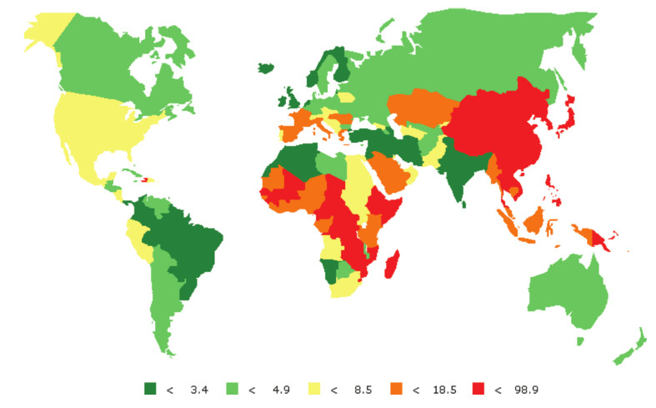
Population Susceptibility
Acute outbreaks of aflatoxin can claim 100s of lives. Kenyan outbreak of 2004-05 had a sum of 150 fatalities
US CDC estimates 4.5 billion people chronically exposed
Age-standardized incidence rate of liver cancer per 100,000 men worldwide (Groopman, 2008). Data shows a high degree of correlation between aflatoxin exposure and liver cancer rates.

Slide 6
Hypothesis and Methods
We expect to model and support the hypothesis that, under the same spatial dimensions, a diversity of crop species with varying infection and transmission rates will have a lower prevalence of infection compared to a monoculture of crop.
To examine this we have developed a mathematical model based up with components of the predator-prey model in discrete time and components of the logistic map.
We will also keep one crop with a maximal infection and transmission rate constant throughout both studies to better compare the results.

Slide 7
Model Assumptions
These assumptions were made to simplify the dynamics:
Aspergillus spores are ubiquitous in all soils at high levels
Spores travel easily in non-moist windy conditions and contribute to a common spore pool
Spores have an equal chance of landing on a crop but an unequal chance of infecting different species of crop
Crop infections can create more spores which contribute to a common spore pool at a rate proportional to the amount of infection

Slide 8

Discrete Time Model
$$P_{t+1}=P_{t}+{γP}_{t}\sum_{i=1}^{n}{N_{i,t}∙\left(1−\left(\frac{P_{t}+max(α_{i})P_{t}n}{K_{P}}\right)\right)}$$
$$N_{i, t+1}=N_{i, t}+{δN}_{i, t}\left(1−\left(\frac{N_{i, t}}{K_{N}}\right)\right)+α_{i}P_{t}\left(1−\frac{N_{i, t}}{K_{N}}\right)$$
$N_{i}$ = Infections in crops up to $n$ crops
$P$ = spore Pool
$γ$ = sporulation rate from all infected crops
$α$ = infection rate
$K_{i}$ = carrying capacities
$δ$ = crop recovery rate (negative rate)

Slide 9
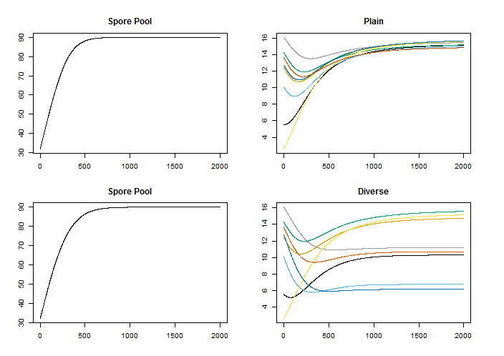
Results
X-axis: Time
Y-axis: Prevalence of Spores/Infection
Spore pool is marginally impacted in a diverse situation.
This is extremely attenuated in the parameters I chose to plot.
The maximum prevalence of infection in the Diverse set is always less than that of the Plain set.

Slide 10
Statistics
Using this model with 8 randomly generated crops
Run two coupled simulations for 100 iterations.
First simulation uses a tightly spread random parameter space, simulating multiple crops of the same species
Second simulation uses a broadly spread parameter space, simulating multiple crops of different species
The crop in focus was kept at a maximum infection rate parameter
Through 100 simulations the crop in focus remained the highest in infection prevalence, however, this prevalence was reduced by 93% when compared to the tightly coupled simulations

Slide 11
Conclusions and Future Intentions
This model, in it’s preliminary state supports the hypothesis that local biodiversity helps the overall community to resist infectious disease through variable infection rates
At the moment this research weakly supports the need for diversity in agriculture in developing countries
Improvements to the model include:
Refactoring to include current A. flavus pathology and prevalence
Spatial characteristics as suggested by the primary literature
Parameterizing the model with available data
Output to inform the agricultural community

