Slide 1
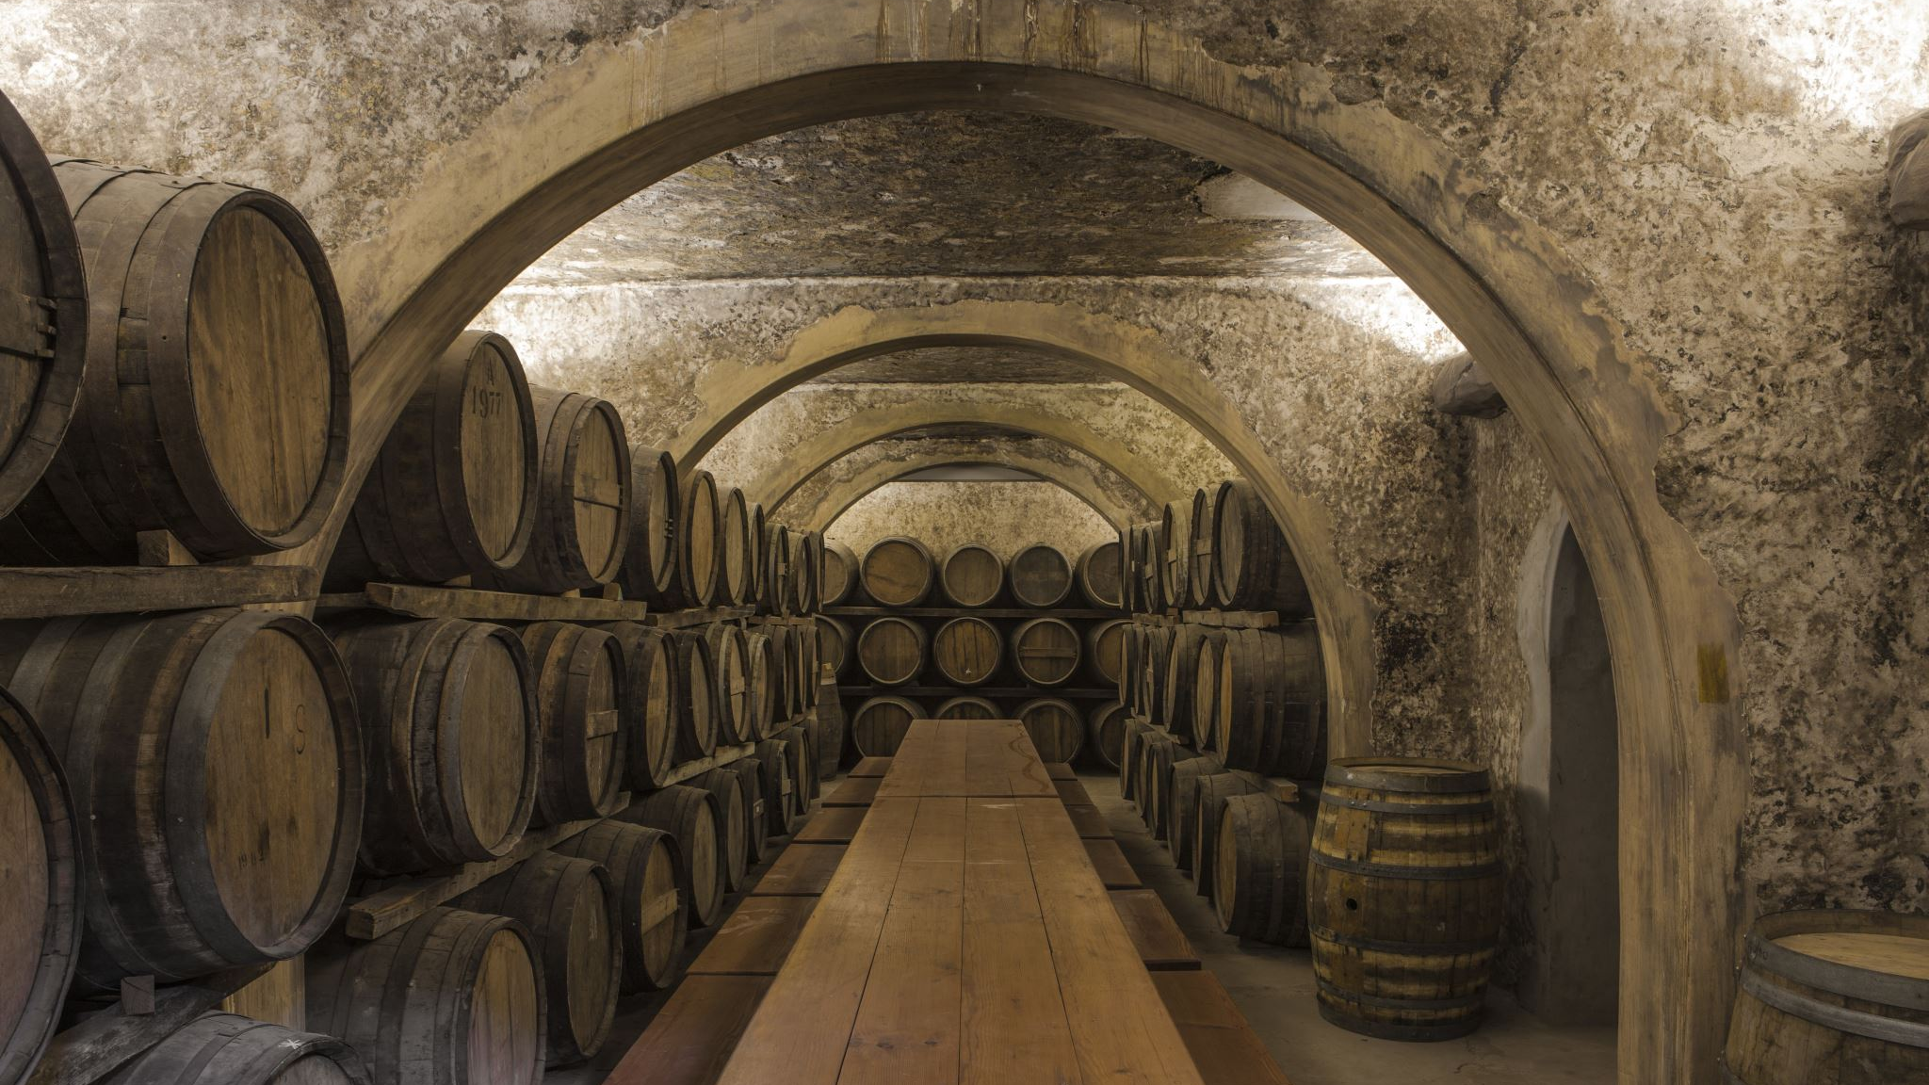

Bacchus Winery Case Study

Slide 2

Group 2
The members of Group 2 include:
Rachel Cewe
Elizabeth Fung
Scott Jenks
Clint Steadman

Slide 3
Case Study
For this case study in association with Bacchus Winery, our team was tasked with looking through the records of the company and making an analysis of the delivery, distribution, sales, cost, hours of labor and inventory using databases to discover discrepancies, gaps in time, over-abundance of hours and anything else that could be making them less efficient and profitable. The steps that were taken to discover and remedy their financial hardships were as follows.
ERD- to create a layout and plan for the elements and values that are to be looked at and inputted into an algorithm.
Databases- Tables using the information given by the company to input into the layout of the ERD, as database tables are made to show in a comprehensive and easy to visually analyze how the company is run, what resources are being used and at what rate.
Generate Reports- Reports are made using to show the important information that would be beneficial to discovering where the company's losses are coming from using the databases as they generate specific requested information and analyses.

Slide 4
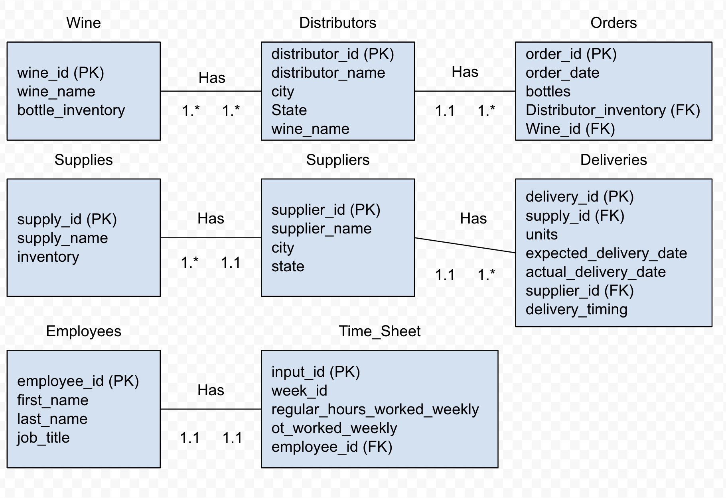

ERD
An ERD was created to breakdown and layout the Relationships between the embedded documents.
The ERD relations consisted of a one-to-many relationship between suppliers and delivery metrics as well as with the Wine to Distributors for suppliers and wine each had multiple distributors and delivery variables each.
The Employees and the Time sheets on the other hand were made up of one-to-one relationships meaning that each employee possessed only one time sheet each.
Then these variables and relationships were each plugged into a database code with the proper inserting of each of the needed items. These databases would use the variables within to calculate and show the expenditures as well as profits and time gaps and losses posed by each of the tables by generating Reports.

Slide 5
Generated Reports
Report concepts, based on case study needs, were created to comprehensively show what are the over-arching costs and expenditures that would most affect the company
Create a month-to-month report of delivery times to see where there are gaps
Create a sales report to see which wine is selling the most
Create a timesheet report that totals number of hours each employee worked

Slide 6
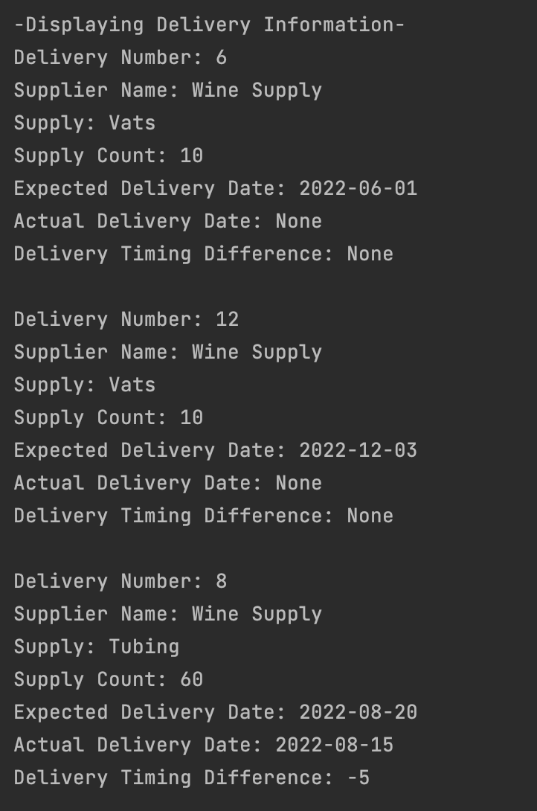
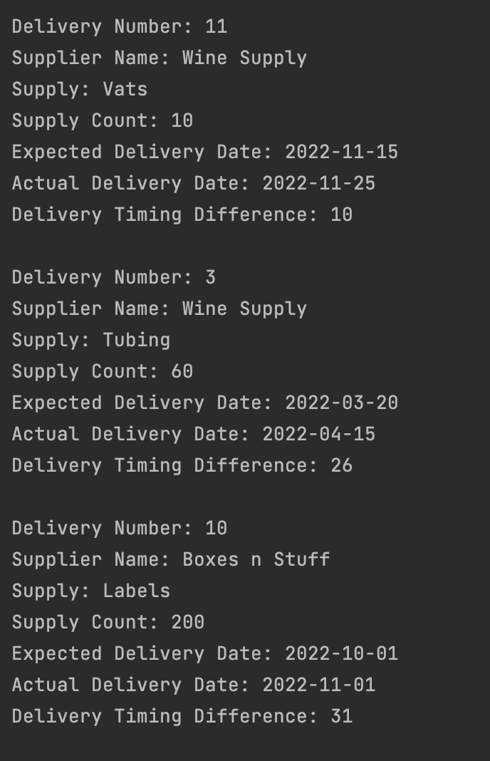

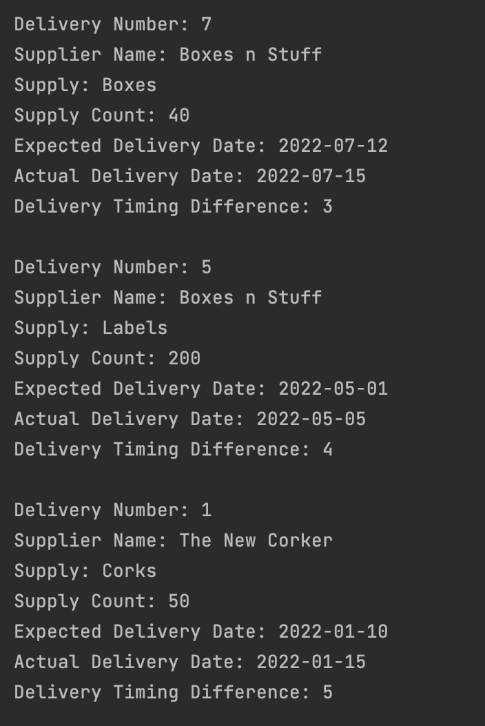
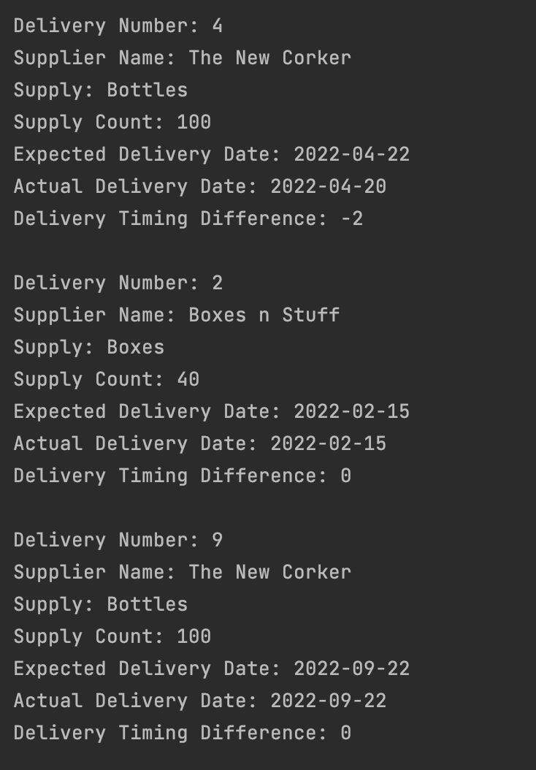
Report #1-Suppliers
Displays expected supplies that have been delivered late or on time and any large delivery gaps. This report displays information for all 12 months.
According to these reports most supplies deliver late and with a couple large gaps. The delivery timing difference shows how many days the delivery is late
March saw the delivery 26 days late
October saw the delivery 31 days late
The June and December deliveries didn’t arrive at all which resulted in understocked supplies and a re-delivery or refund required.

Slide 7
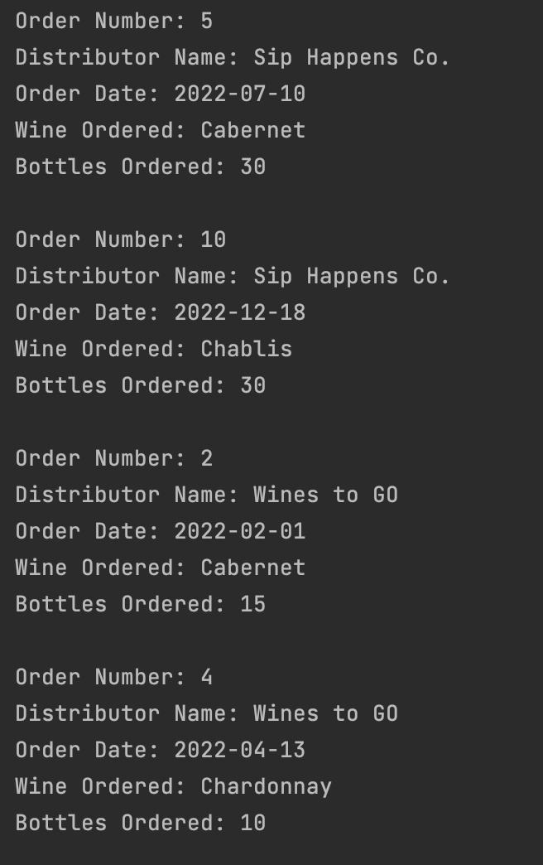
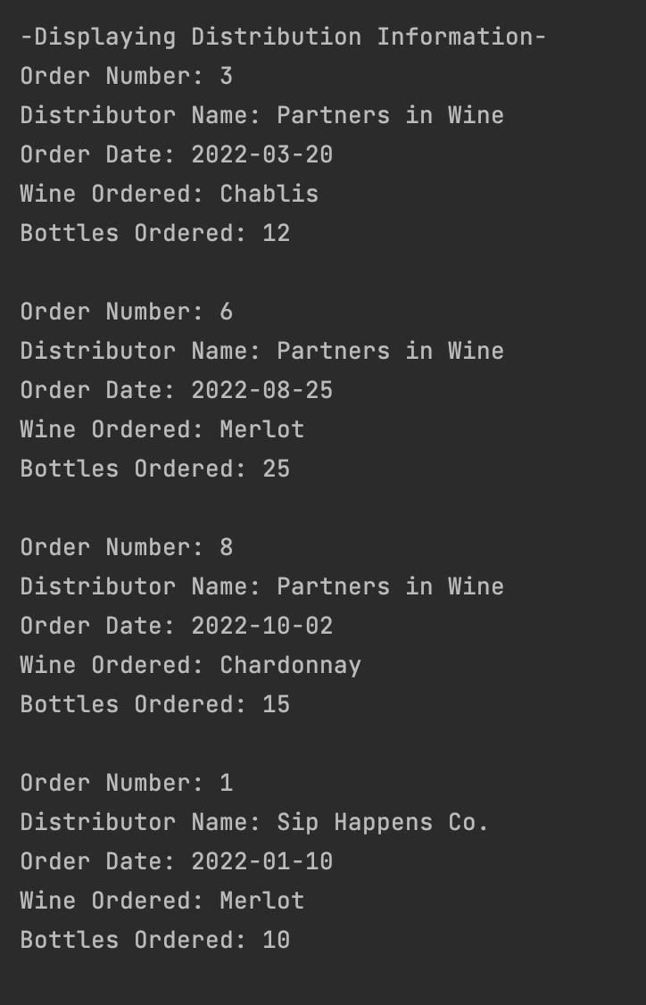
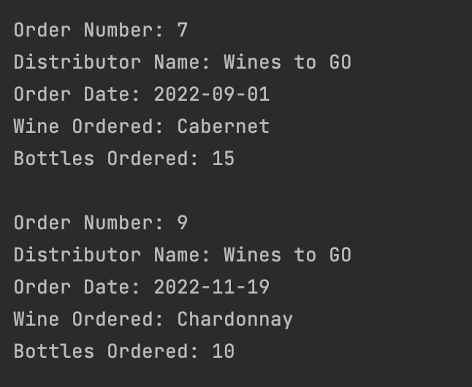
Report #2-Wine Distribution
Distributor Names and offered wine
Wines to Go
Merlot
Cabernet
Chablis
Chardonnay
Partners in Wine
Merlot
Cabernet
Chardonnay
Sip Happens Co.
Merlot
Cabernet
Chardonnay
Wine Distribution Report shows us:
- Order #
- Distributor name
- Order date
- Wine ordered
- Amount ordered

Slide 8
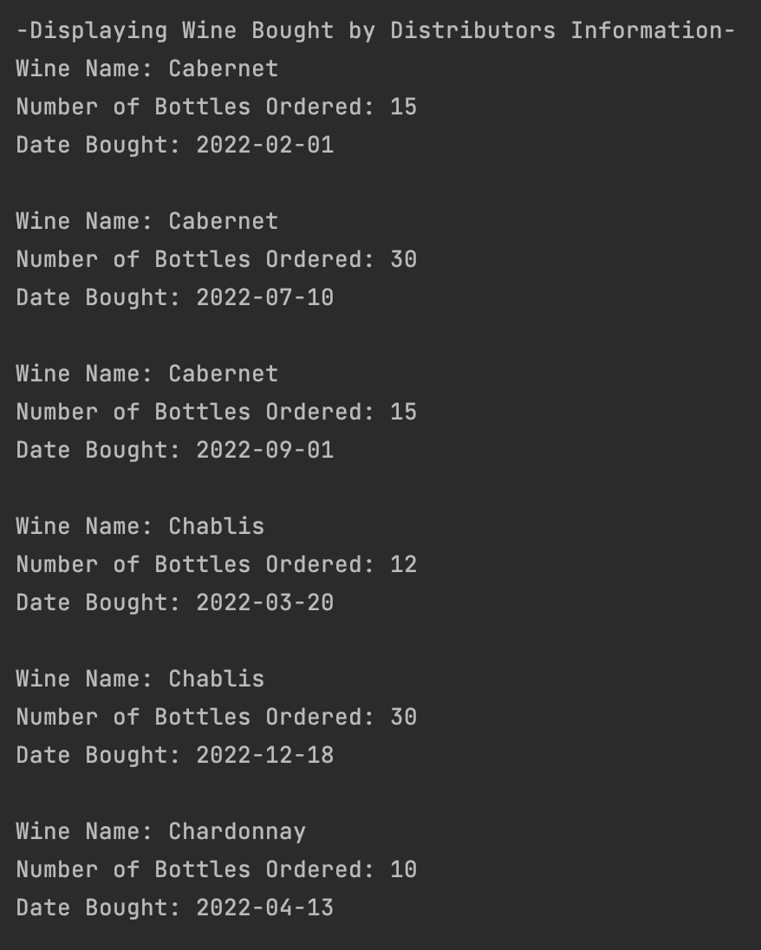
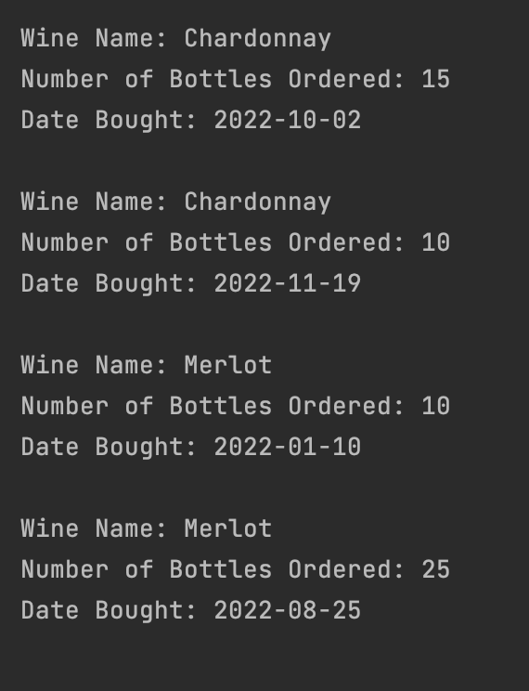
Report #3- Wine Distribution
Displays which wine is selling and how much:
Chablis - 42 sales
Cabernet - 60 sales
Chardonnay - 35 sales (tied Merlot for lease sold)
Merlot - 35 sales (tied Chardonnay for least sold)

Slide 9
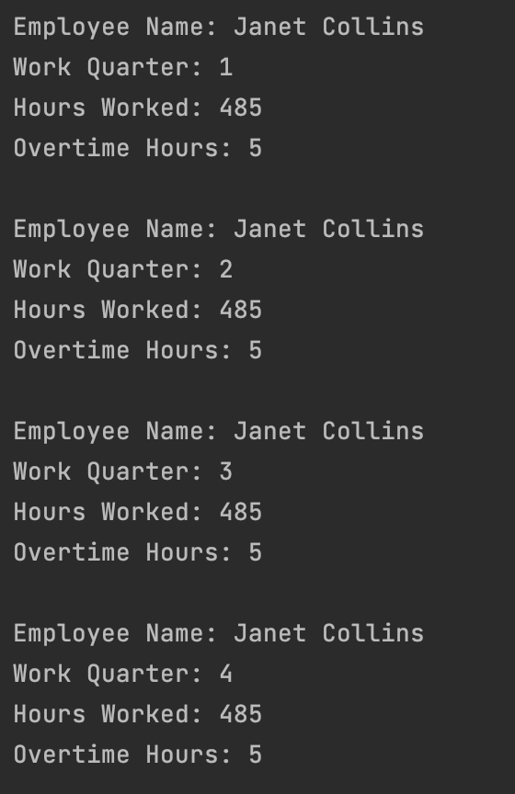
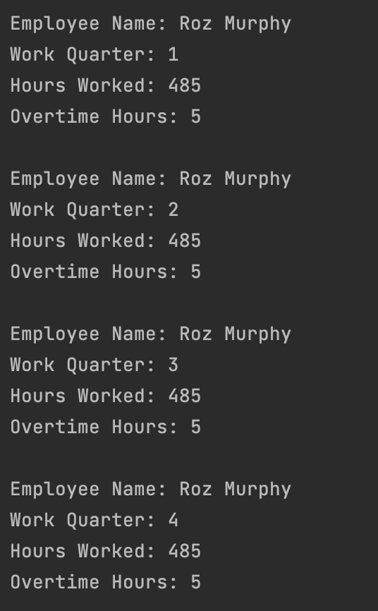
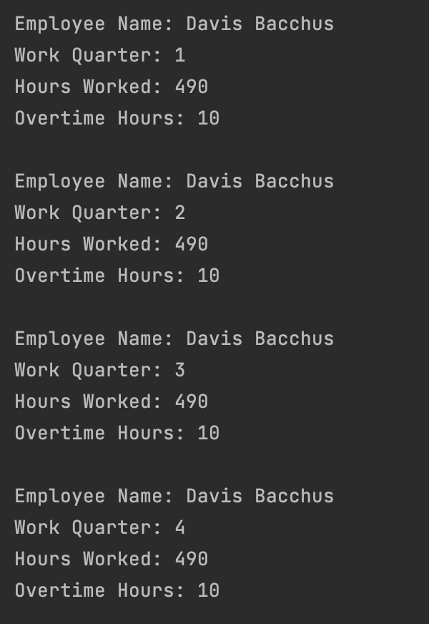
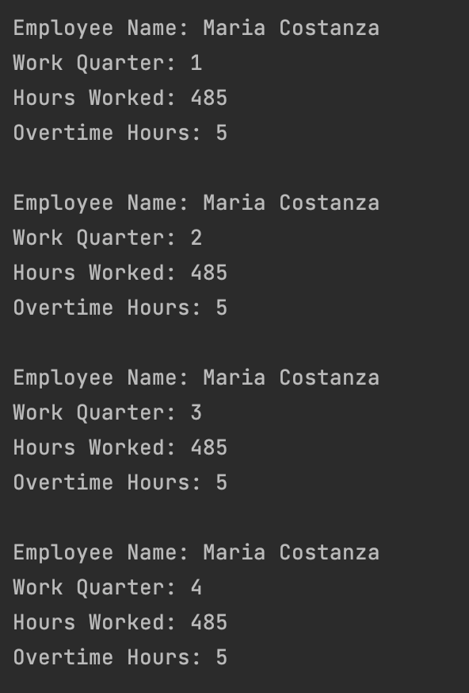
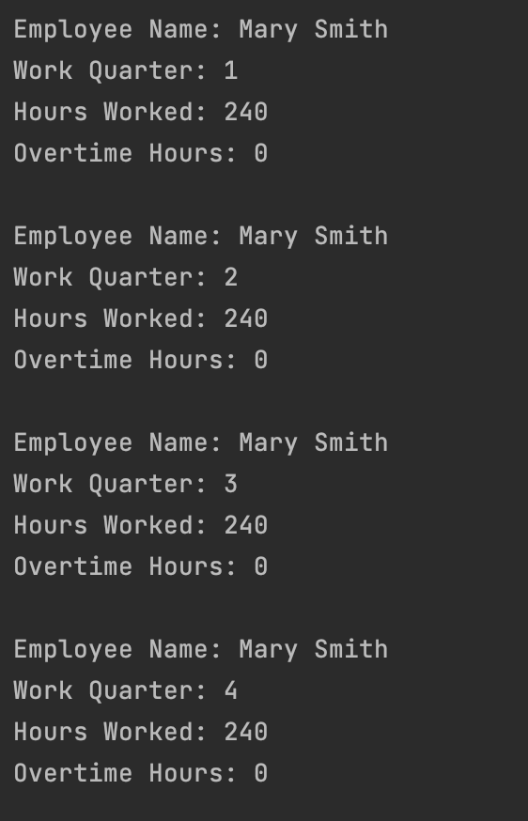
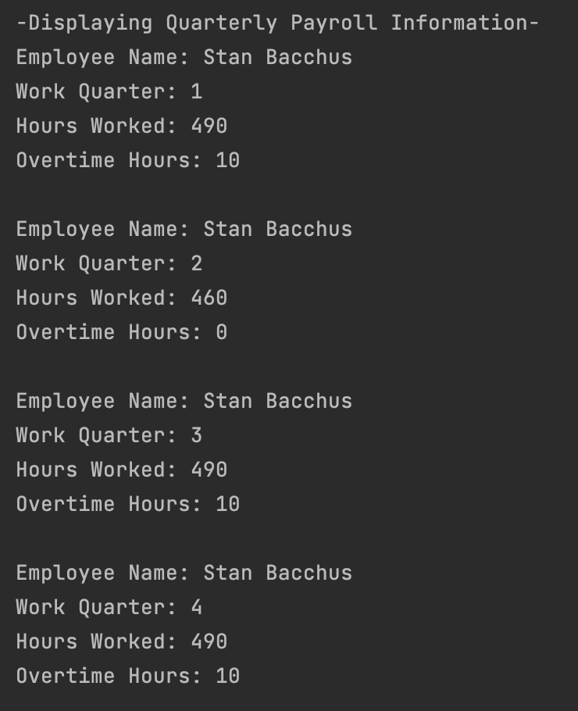
Report #4- Employee Times
In order to determine how many hours each employee has worked within each quarter, this report will generate a table of employee records that has kept track of the hours clocked. Therefore, the employers may see if the work has been equally/unequally shared amongst their employees.
The results give us valuable info for the time each employee worked. For example:
Mary worked for far less time than Stan had (for this example, let's imagine Stan is a regular employee like Mary is). In order to even the spread of hours Mary will need to take over some of the hours Stan typically works. This will provide better equal time worked among staff.
Note: Reports were made for all employees

Slide 10
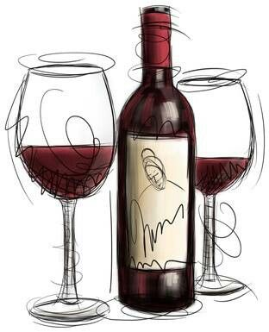
Assumptions
A large amount of financial strain would come from the overstocking of specific brands that didn't sell as well as anticipated by the size of the orders.
Each order from the distributor was only for one kind of wine. If they order different wines they have to make a separate order per wine type.
The uneven spread of hours for each employee could lead to employee burnout if not corrected. Which could lead to a higher turnover rate.
Distributors purchase wine by cases, or units, as opposed to individual bottles
A unit of wine contains the standard US amount of 12 bottles
The amount of hours an employee works is calculated over the entire quarter, as opposed to a monthly time frame
The expected supplier minimum on-time delivery performance should be no lower than 80%
Shipments are able to be tracked by Maria using wine order id.
Stan and Davis can keep track of deliveries using delivery id.
A Stock Keeping Unit or SKU is the typical number that retailers will use to differentiate products
Time clocks or time sheets are one of the more common methods to monitor employees time
Each order is only for one kind of wine

