Slide 1
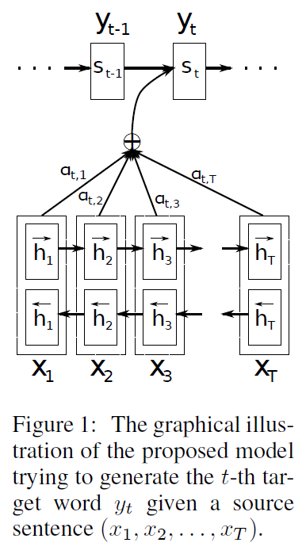
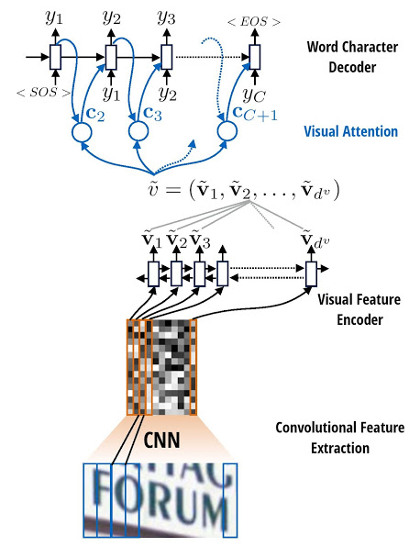
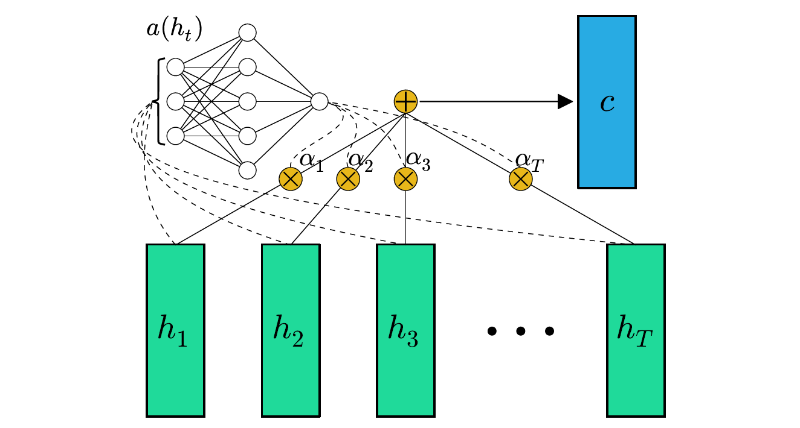
Attention Models 101

Slide 2
About Me
Communication systems engineer turned data scientist
B.S.E.E UTK and M.S.C.S Georgia Tech
Currently working for XSOLIS

Slide 3
Outline
Definition of Attention
Scoring Functions
Sequence Generation
Input Encoding

Slide 4
General Attention Definition
The compression of a value sequence,
Based on the scoring of a context sequence,
With respect to a query event.
Note:
The scores are a sequence and are usually normalized.
The query event can come from a separate sequence.
The query can also be implicit.
The context and value sequences can be the same.

Slide 5
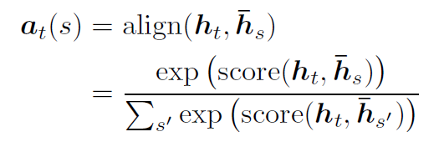
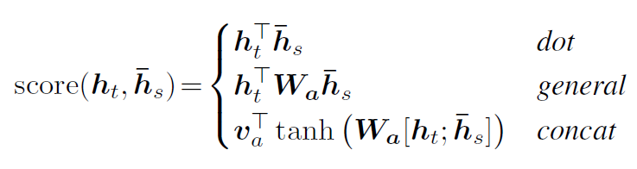
Scoring Functions
From Luong et al 2015

Slide 6
Sequence Generation with Attention
RNNs are commonly used to generate variable length sequences from large or variable sized inputs.
Attention can be a useful addition in the following cases:
The alignment between input and output is not fixed.
A single representation of the input is not sufficient for generation.
A mapping between input and output is needed for model interpretation .

Slide 7
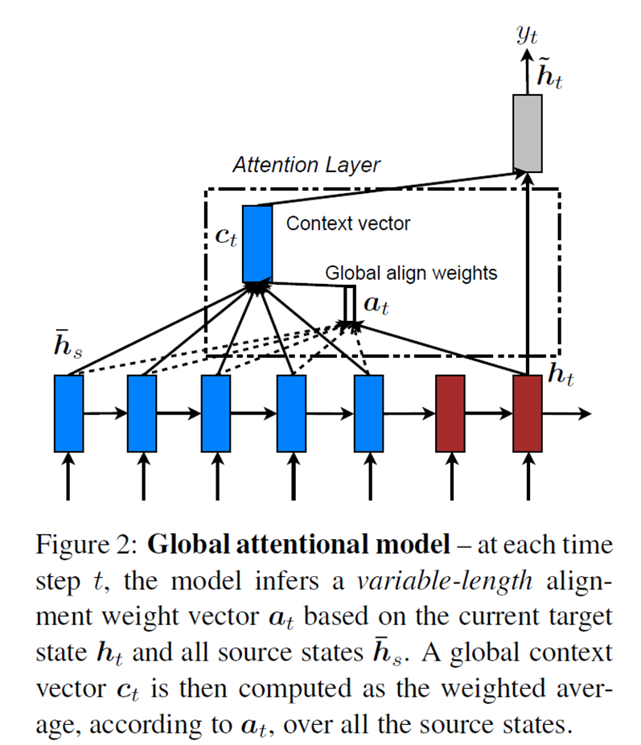
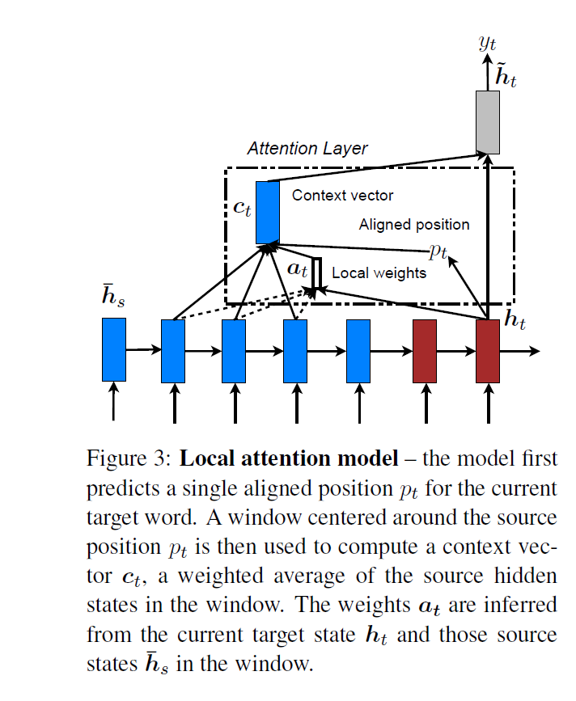
Seq2Seq Attention Decoder
The previous output or hidden state is used as the query.
Encoder outputs or hidden states form the context.
Global version:
The entire context considered
More general at the cost of sample and computation efficiency
Useful in the case of long distance dependencies
Local version:
Only a window of context is considered
More efficient when alignment is monotonic or dependencies are local
See Bahdanau et al 2014 and Luong et al 2015
Images from Luong et al 2015

Slide 8
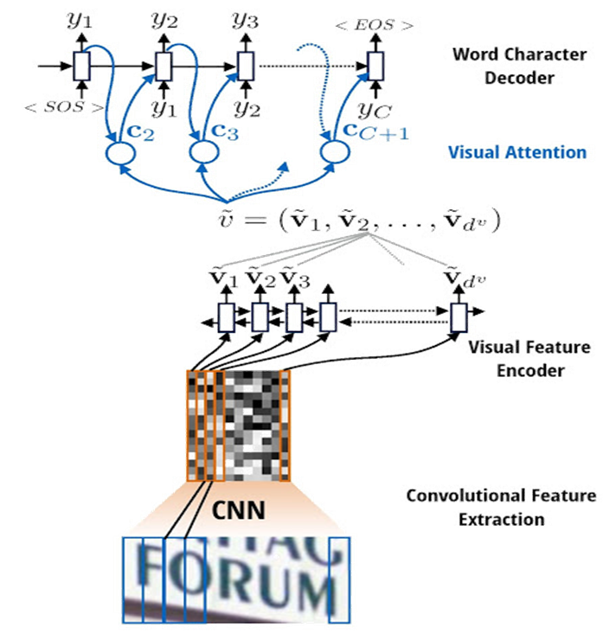
Image2Seq Attention Decoder
Similar to sequence to sequence but generalized to image like objects for context.
Useful for generation of sequences describing images with multiple objects.
Challenging to train as image features must be transformed into similar space as sequence features.
Doubly challenging if alignment between image features and sequence features is not fixed.
See Xu et al 2015
Image from https://github.com/da03/Attention-OCR

Slide 9
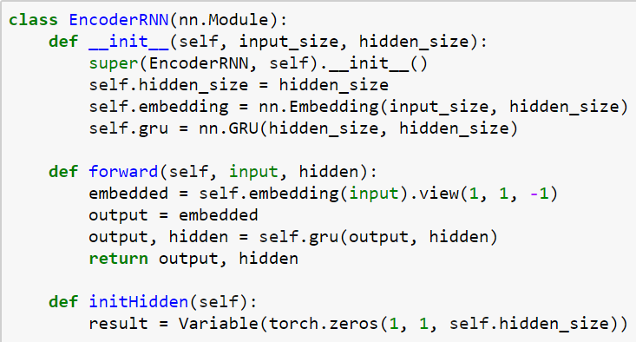
Example – Date Conversion
Encoding is done with a vanilla GRU RNN.
The final hidden layer will be used to initialize the decoder hidden layer.
The hidden layers for all time steps are used as the context.

Slide 10
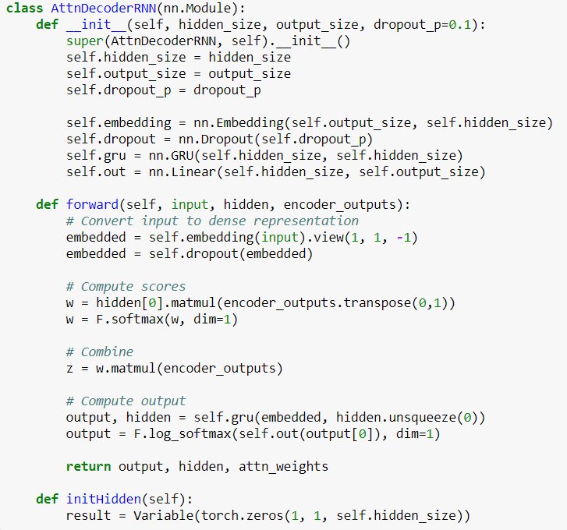
Example – Date Conversion
The decoder is also a GRU RNN.
Attention is computed as the dot product of the previous hidden layer with each context value.
The context events are then combined based on the weights, to form the new hidden layer value.

Slide 11
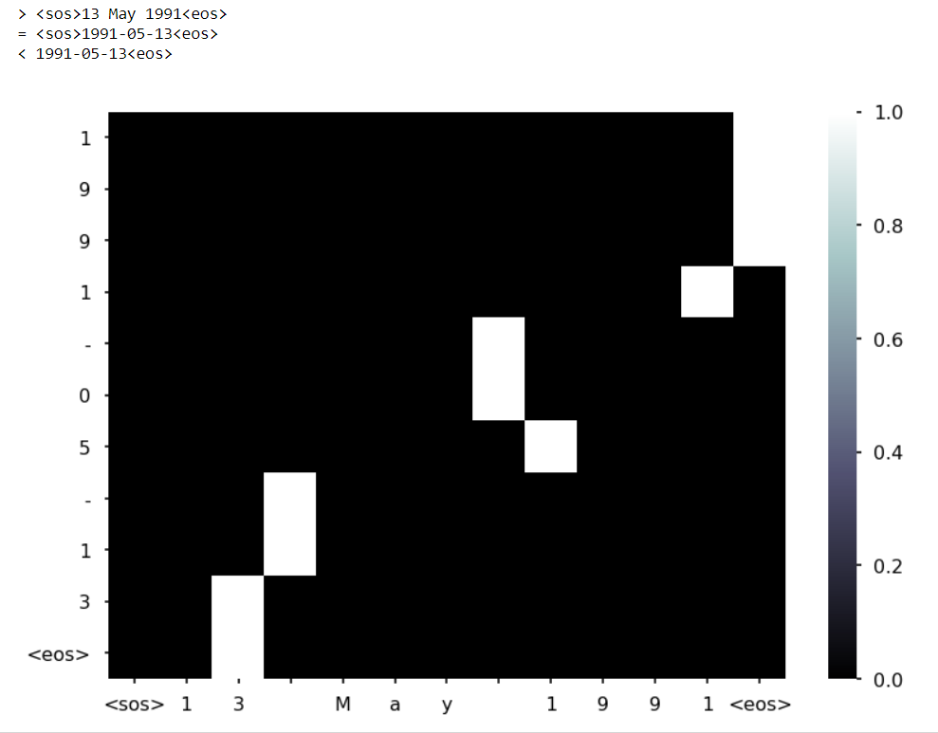
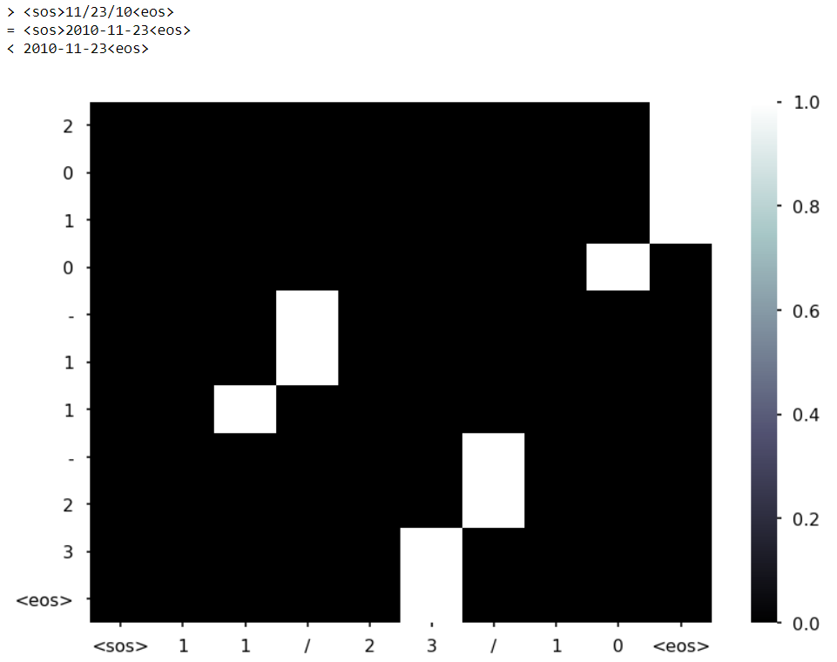
Example – Date Conversion

Slide 12
Encoding with Attention
Attention can also be used to encode an input.
This can be used to create a fixed length embedding.
This can also be used to incorporate context into individual segments.

Slide 13
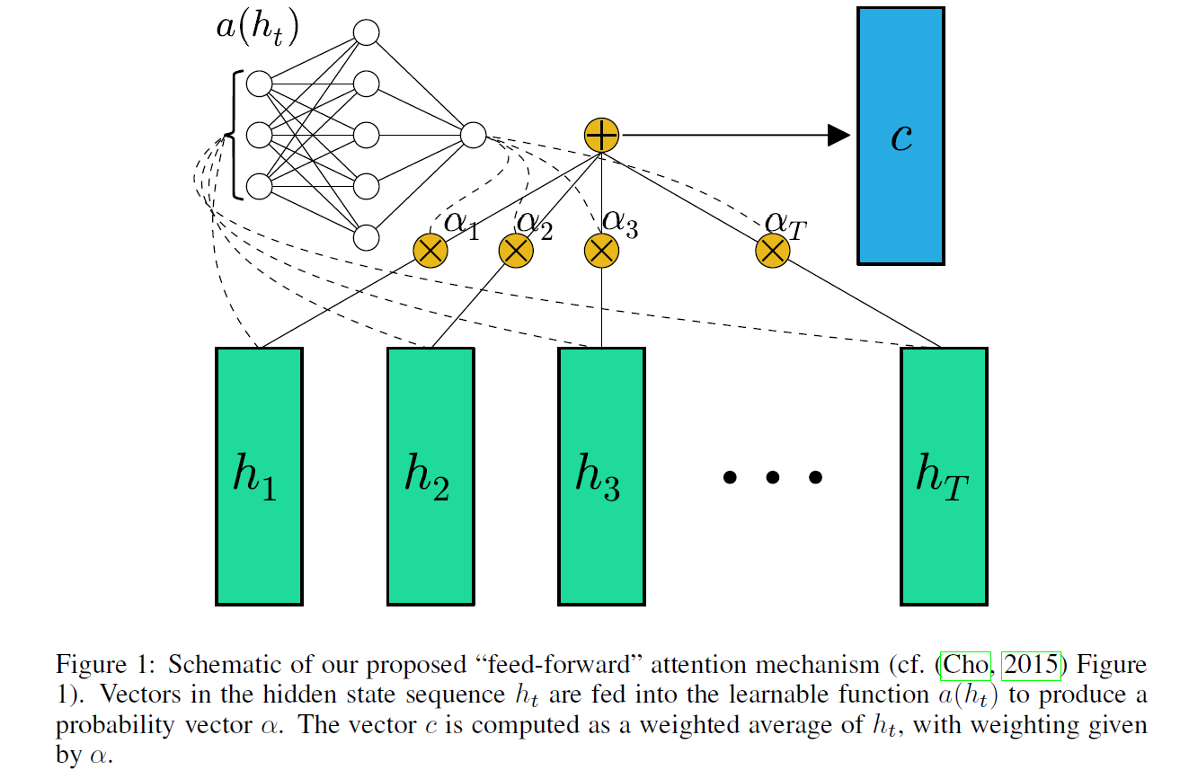
Independent Representation
An attention scoring function is scanned over the events independently
Useful for sequence classification with:
Irrelevant events
Clear indication of relevant events
See Raffel and Ellis 2015; Yang et al 2016; and Lin et al 2017
Diagram from Raffel and Ellis 2015.

Slide 14
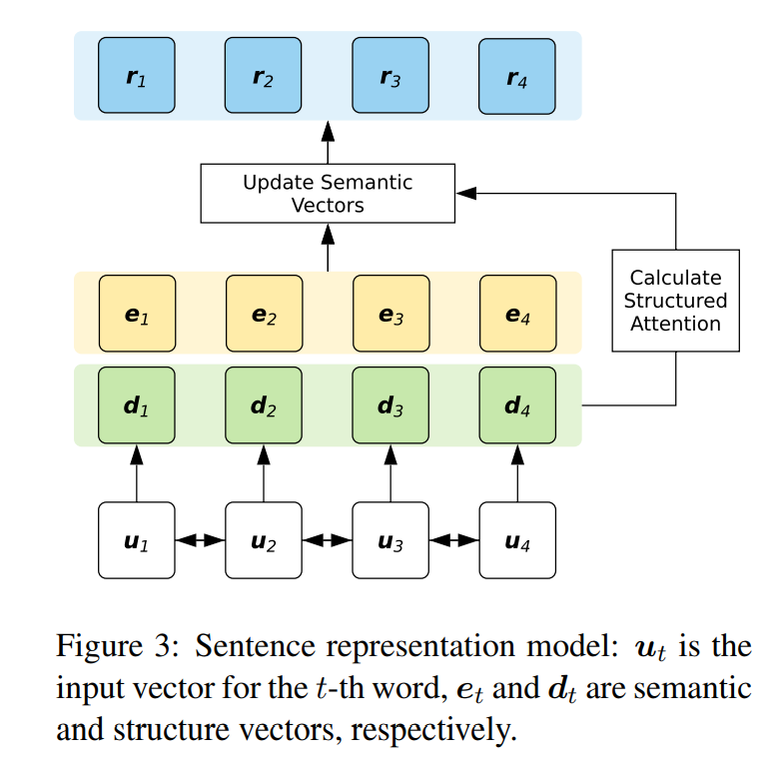
Contextual Representation
Each event is scored in the context of the others.
The events are then represented by the score weighted combination of the other events.
Useful for sequence classification with:
Some events subordinate to others
Event representations carrying clear indication of relationships
See Dozat and Manning 2016; Kadlec et al 2016; and Liu and Zapata 2017
Diagram from Liu and Zapata 2017

Slide 15
Example – FFNN with Attention Toy Problem
Input is a sequence of tuples:
First item is a number in the range (-1, 1)
Second item is a flag from the set {-1, 0, 1}
Output is 0.5 + (X +Y)/4.0, where X and Y are the numbers with a flag of 1.
This task is described in Hochreiter and Schmidhuber 1997.
I am using the implementation provided at https://github.com/craffel/lstm_problems.

Slide 16
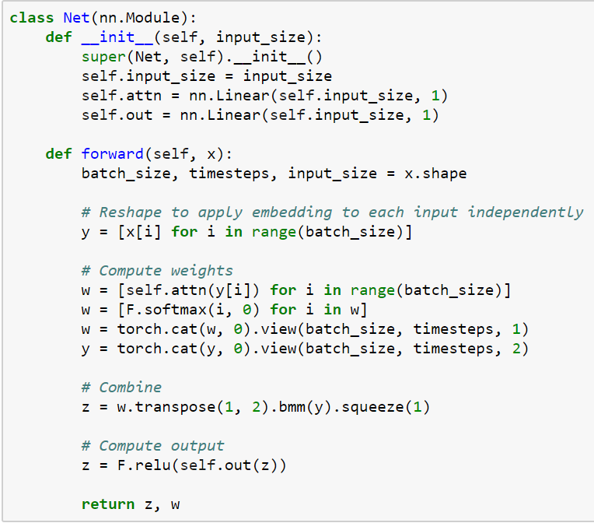
Example – FFNN with Attention Toy Problem
This architecture has two main parts as follows:
The attention layer, which produces a weighted average of the time steps with weights learned.
The output layer, which takes the resulting context vector to predict the target.
See Colin and Raffel 2015

Slide 17
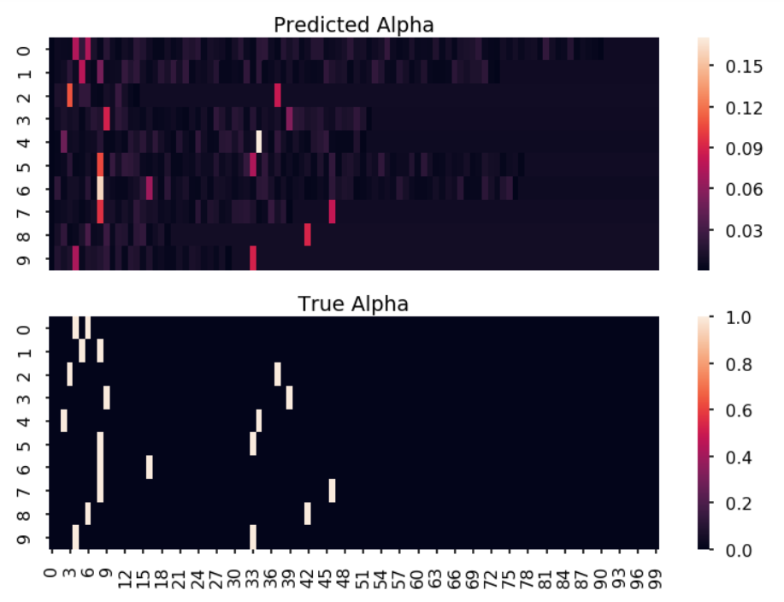
Example – FFNN with Attention Toy Problem

Slide 18
Bibliography
Bahdanau, D., Cho, K., & Bengio, Y. (2014). Neural machine translation by jointly learning to align and translate. arXiv preprint arXiv:1409.0473.
Dozat, T., & Manning, C. D. (2016). Deep biaffine attention for neural dependency parsing. arXiv preprint arXiv:1611.01734.
Kadlec, R., Schmid, M., Bajgar, O., & Kleindienst, J. (2016). Text understanding with the attention sum reader network. arXiv preprint arXiv:1603.01547.
Lin, Z., Feng, M., Santos, C. N. D., Yu, M., Xiang, B., Zhou, B., & Bengio, Y. (2017). A structured self-attentive sentence embedding. arXiv preprint arXiv:1703.03130.
Luong, M. T., Pham, H., & Manning, C. D. (2015). Effective approaches to attention-based neural machine translation. arXiv preprint arXiv:1508.04025.
Raffel, C., & Ellis, D. P. (2015). Feed-forward networks with attention can solve some long-term memory problems. arXiv preprint arXiv:1512.08756.
Xu, K., Ba, J., Kiros, R., Cho, K., Courville, A., Salakhudinov, R., ... & Bengio, Y. (2015, June). Show, attend and tell: Neural image caption generation with visual attention. In International Conference on Machine Learning (pp. 2048-2057).
Yang, Z., Yang, D., Dyer, C., He, X., Smola, A., & Hovy, E. (2016). Hierarchical attention networks for document classification. In Proceedings of the 2016 Conference of the North American Chapter of the Association for Computational Linguistics: Human Language Technologies (pp. 1480-1489).

Slide 19
See Also
Examples and slide from this presentation – https://github.com/clinzy/AttentionModels101
Colin Raffel – Doing Strange Things with Attention https://youtu.be/YtHjmm9Cx3s
Translation with a Sequence to Sequence Network and Attention - http://pytorch.org/tutorials/intermediate/seq2seq_translation_tutorial.html
Attention-OCR - https://github.com/da03/Attention-OCR
pytorch-attention - https://github.com/thomlake/pytorch-attention

Slide 20
Conclusion
Questions?

