Slide 1
Library_eProject
Members:
Nguyễn Phương Minh Thông
Mã Trung Kiên
Nguyễn Hồng Sơn

Slide 2
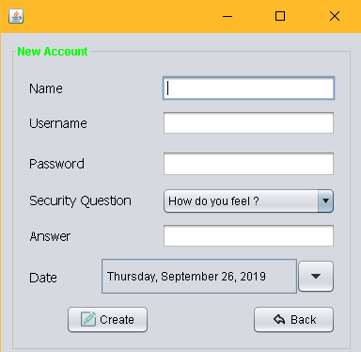
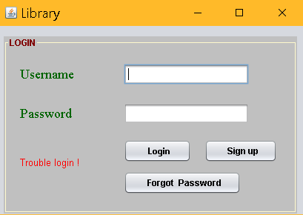

Slide 3
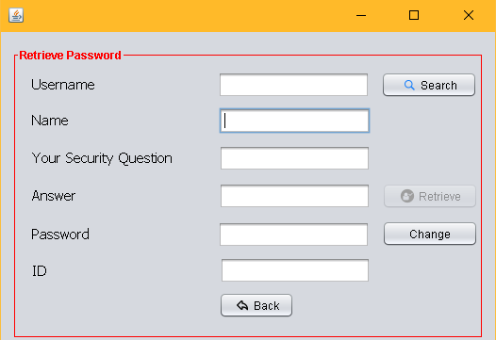

Slide 4

1.This is HomePage

Slide 5
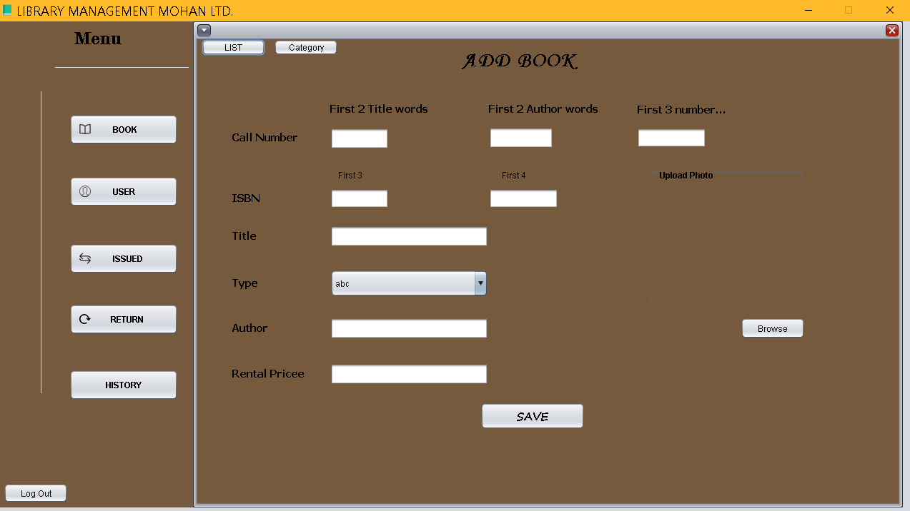

Slide 6
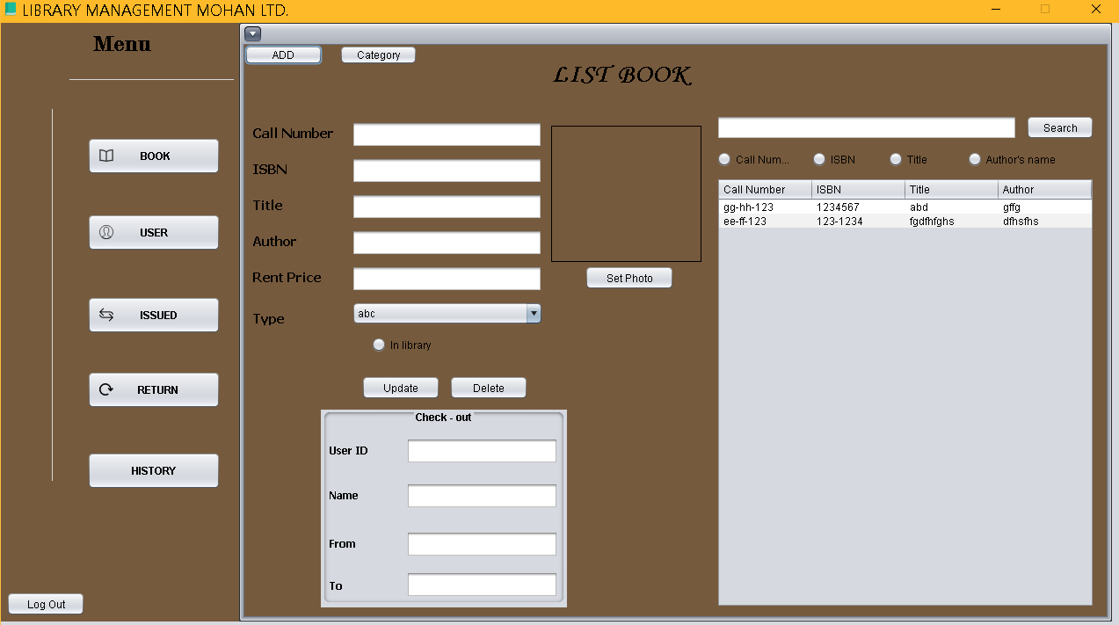

Slide 7
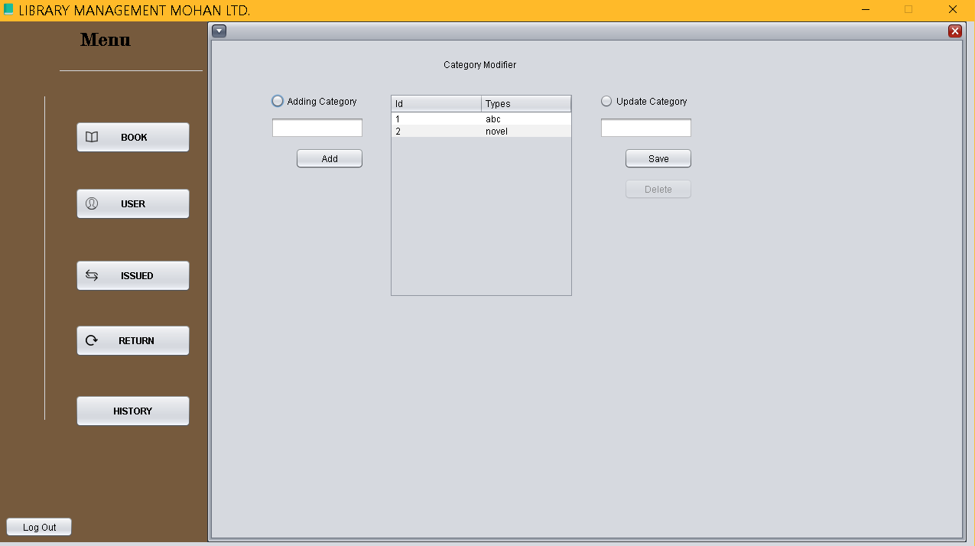

Slide 8
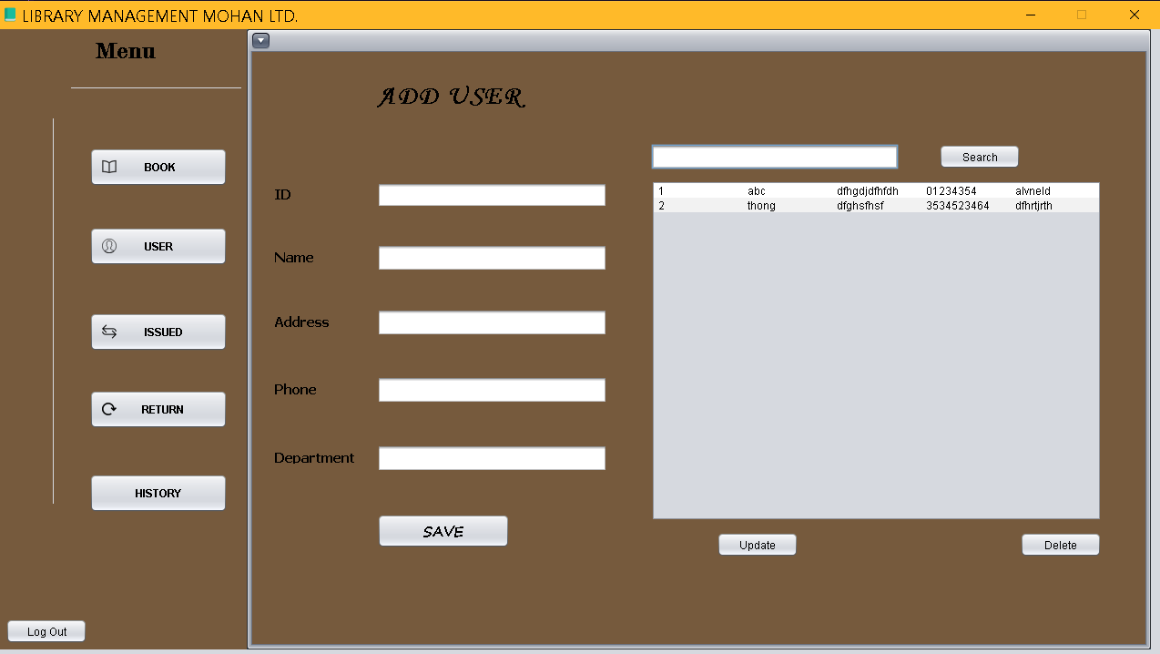

Slide 9
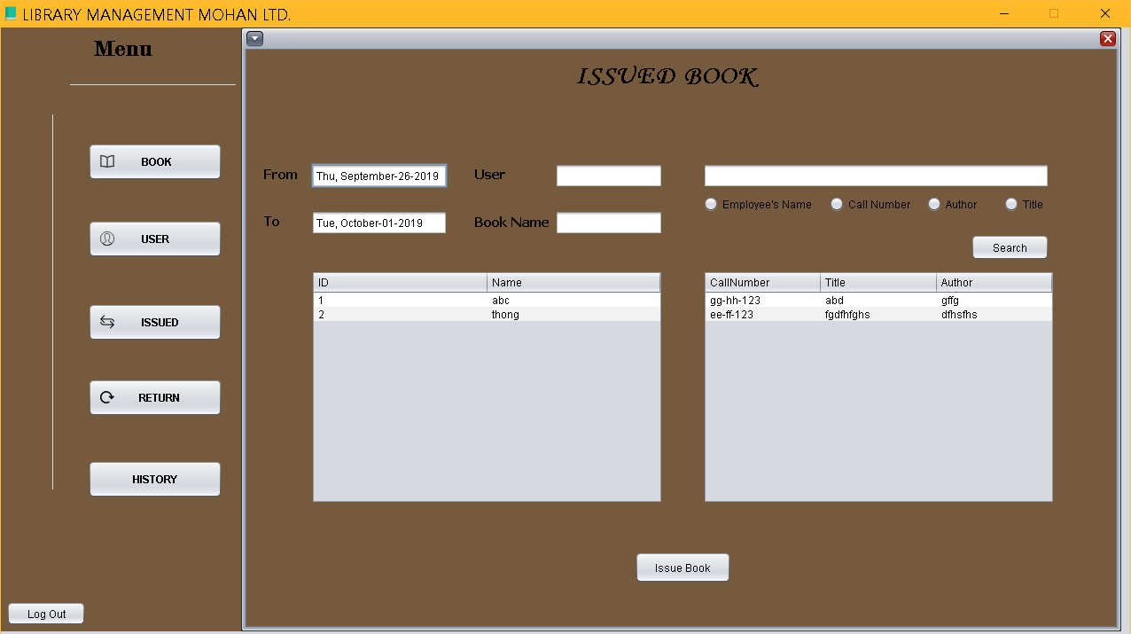

Slide 10
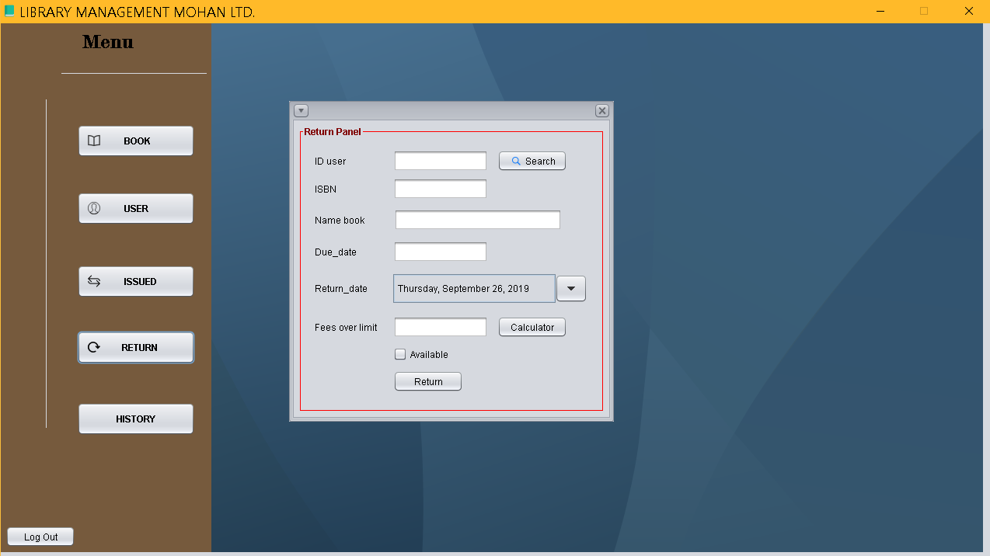

Slide 11
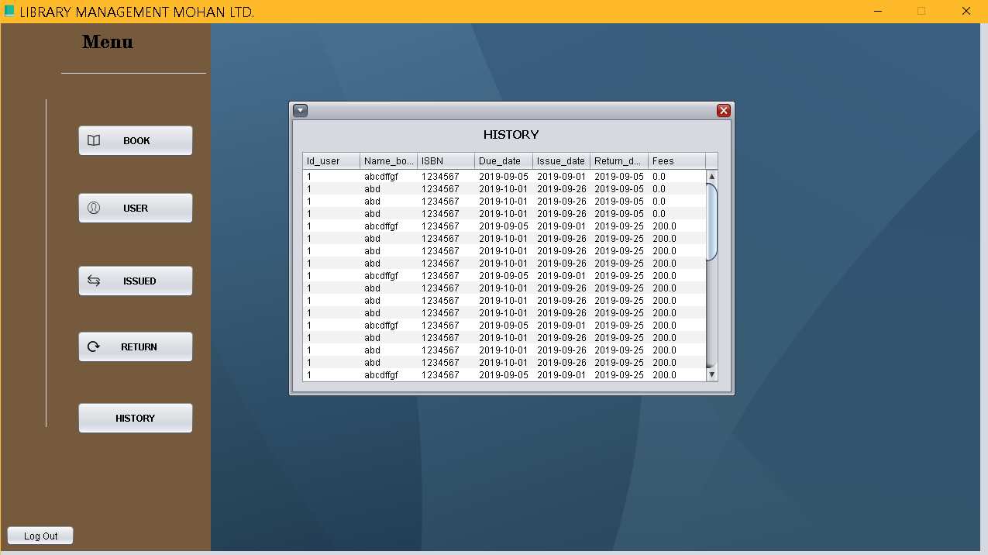

Slide 12

This is the end.
Thank you for spending your time on reading our Project.
Nguyen Phuong Minh Thong ,
Ma Trung Kien
Nguyen Hong Son
wrote this project.
Approved By(Trainer): Mr.Phan Huu Tri.

