Slide 1
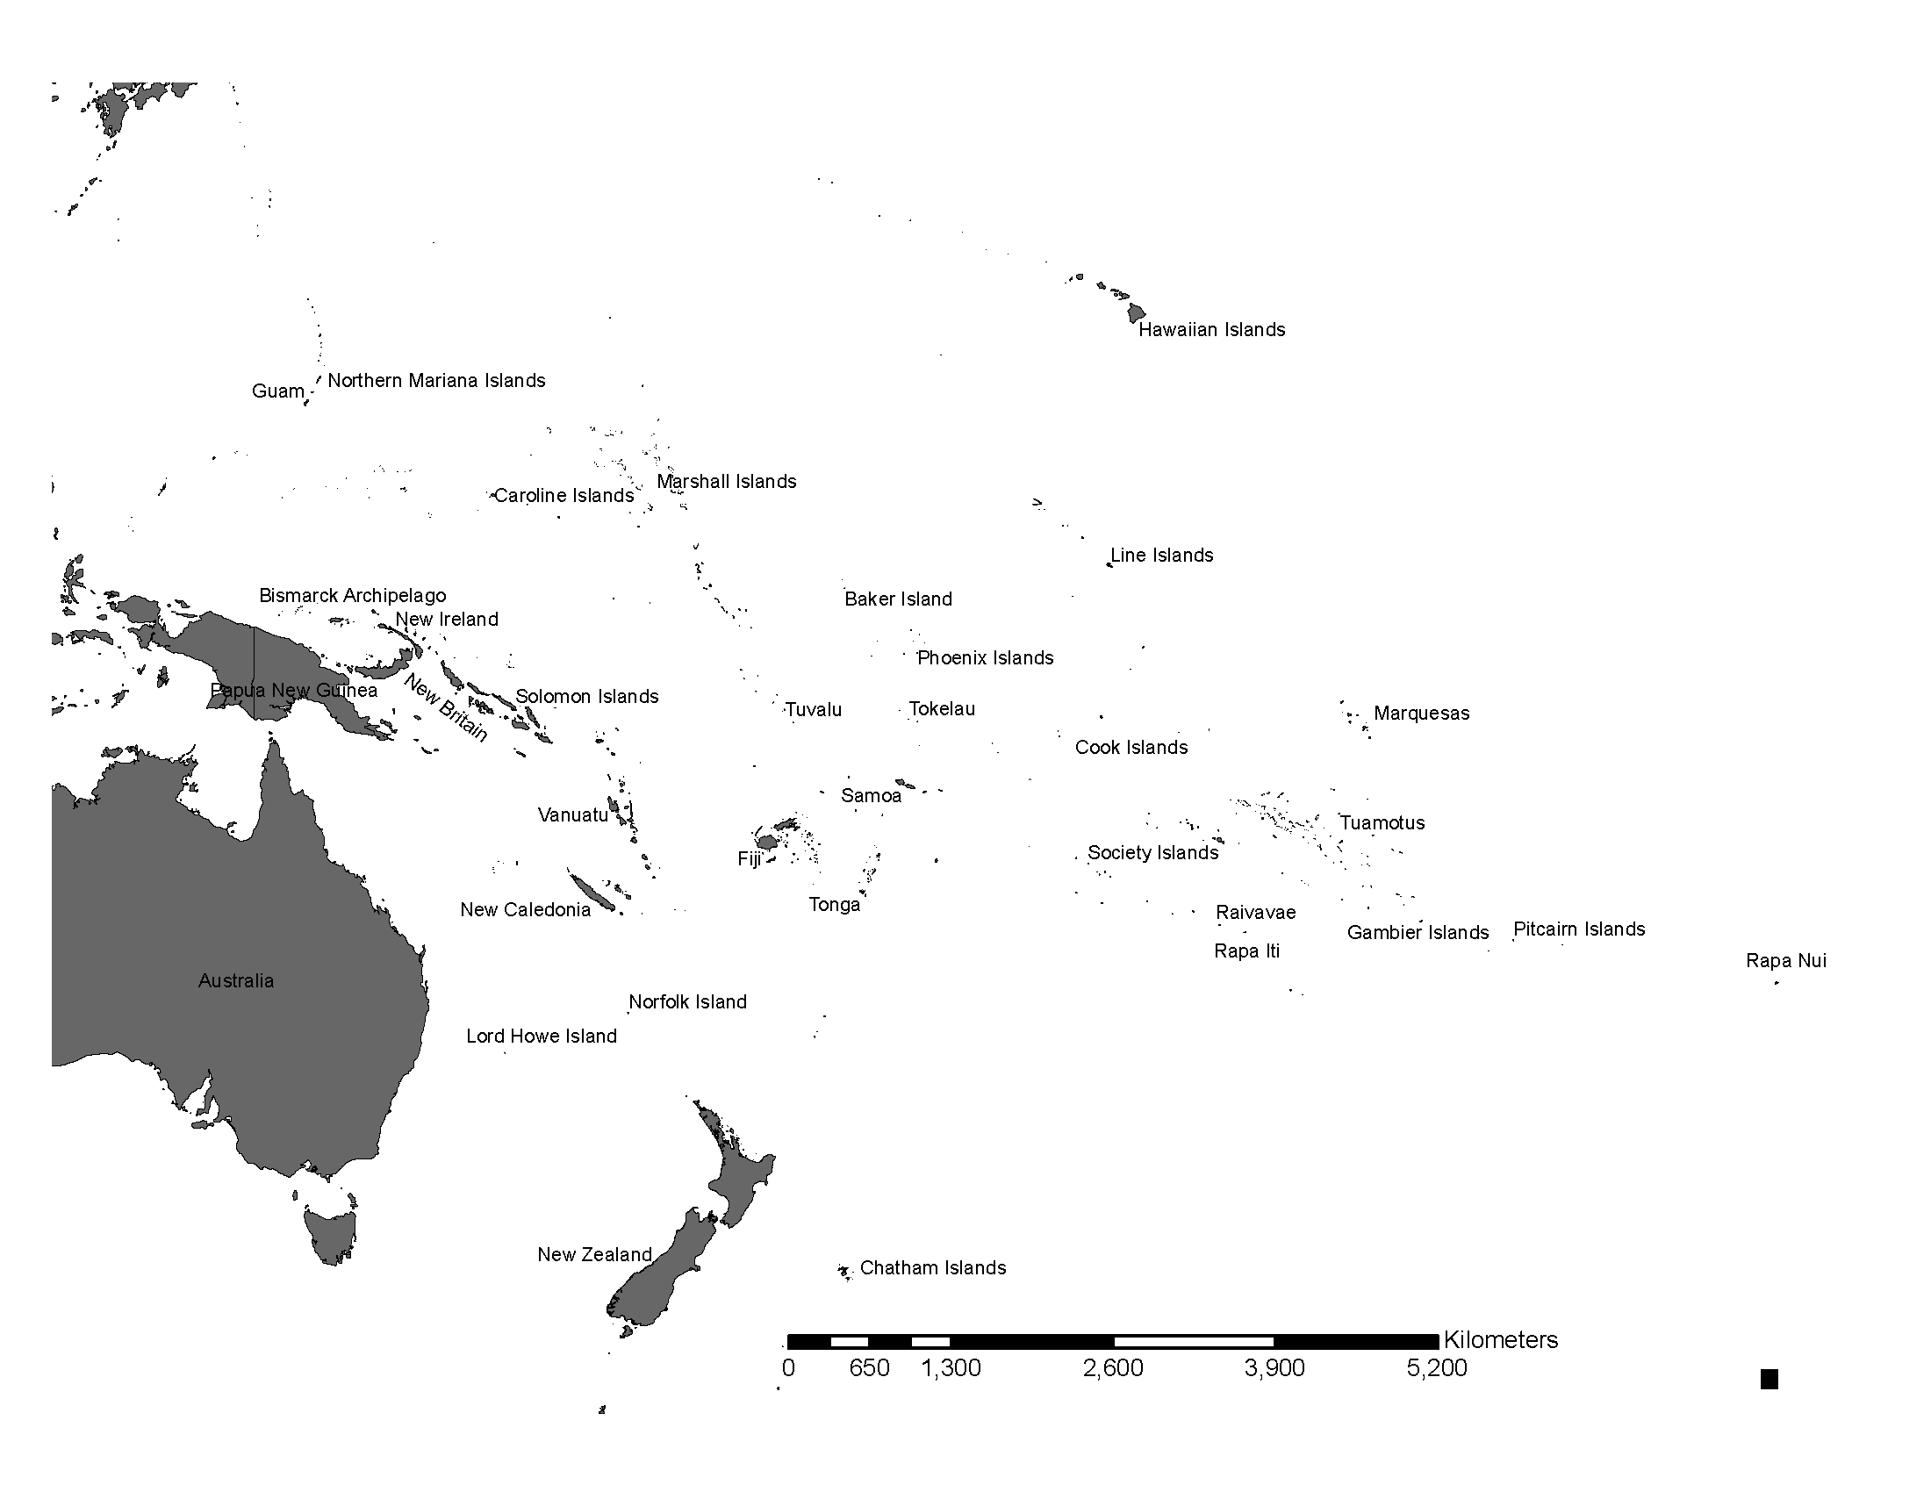
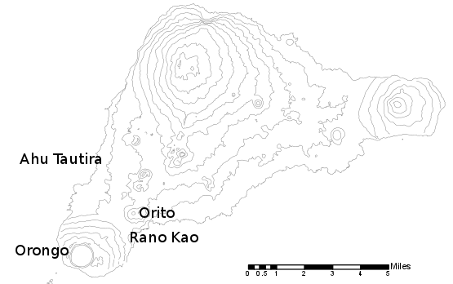
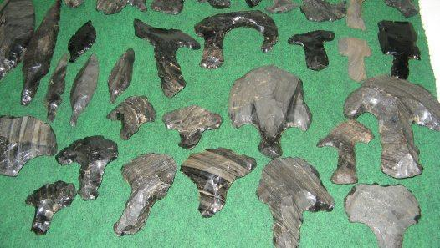
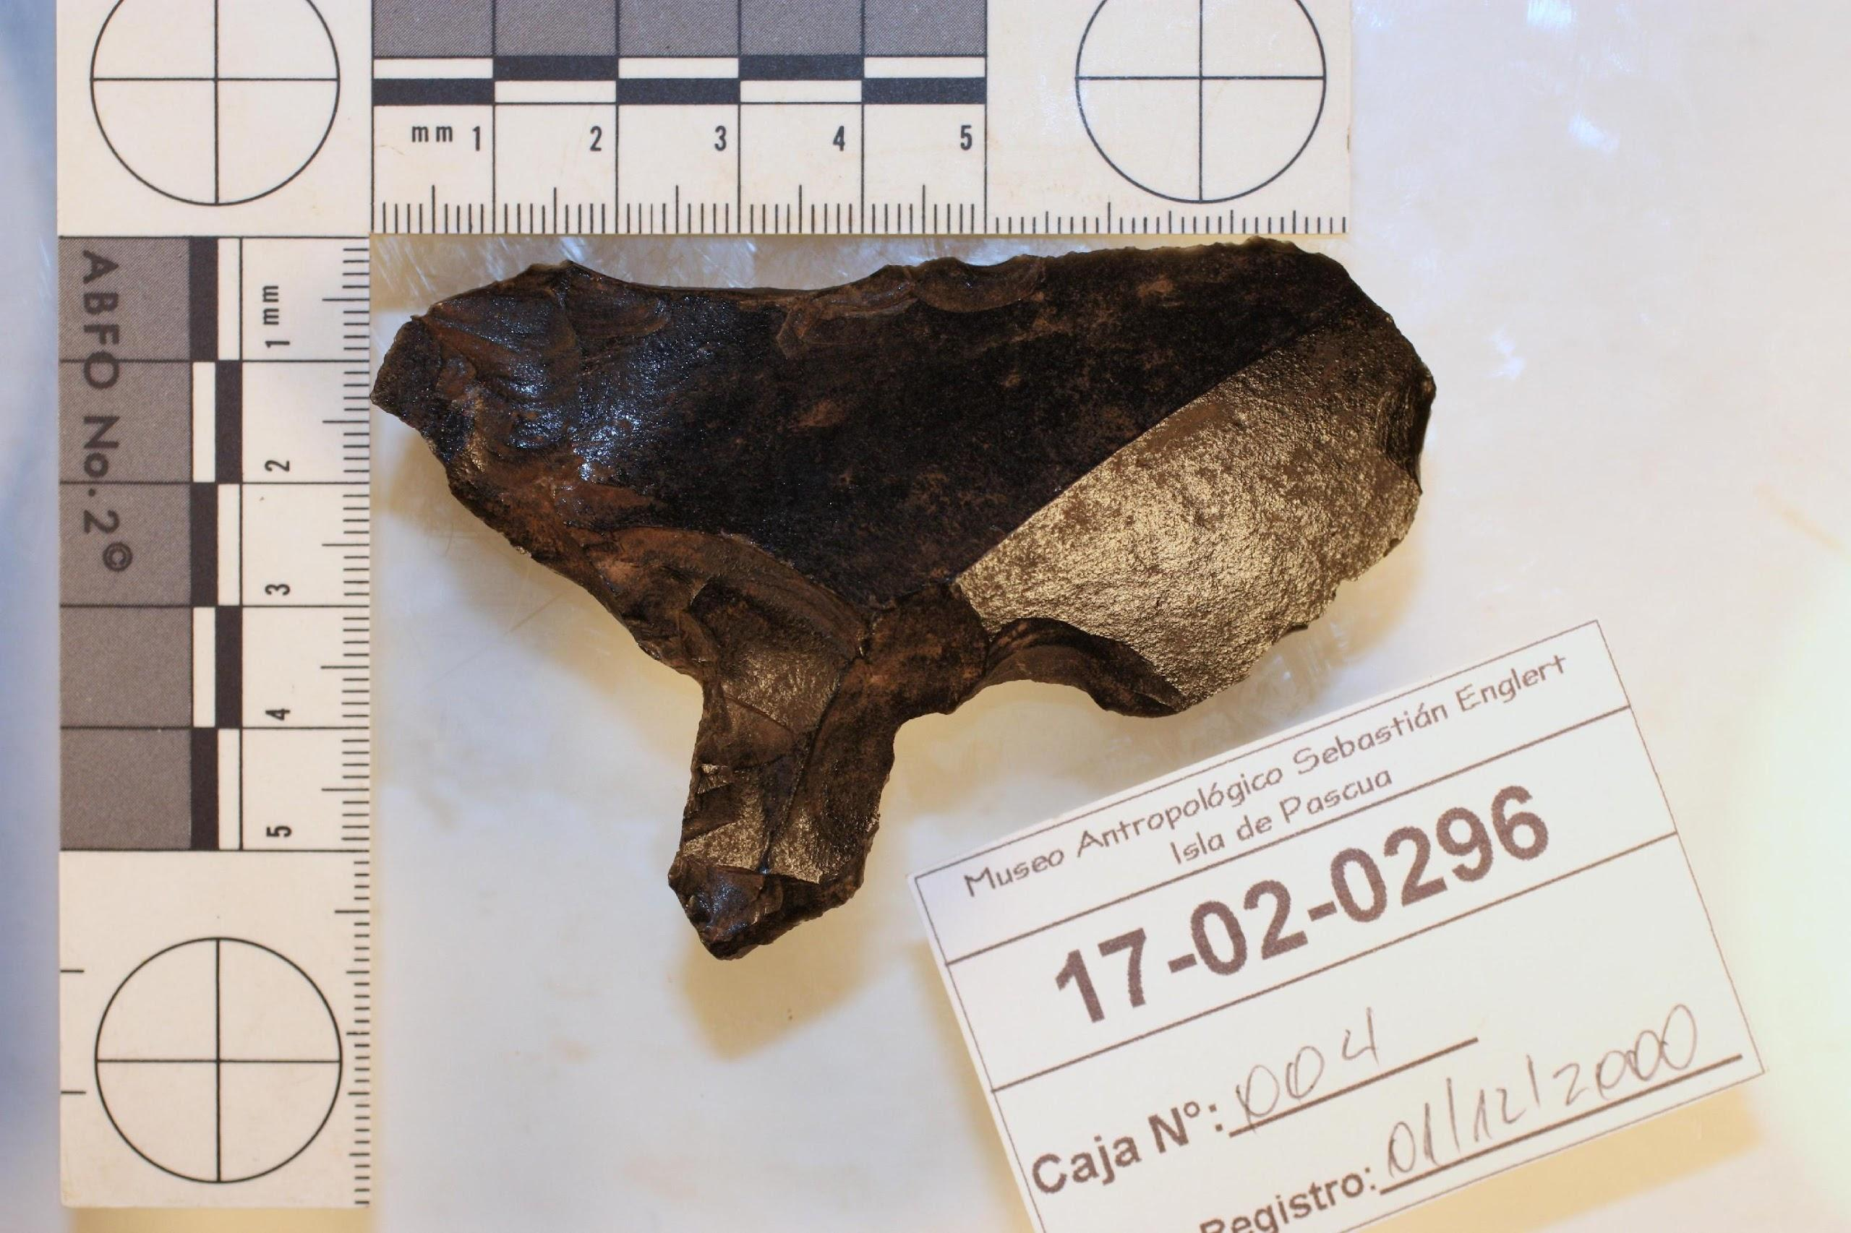
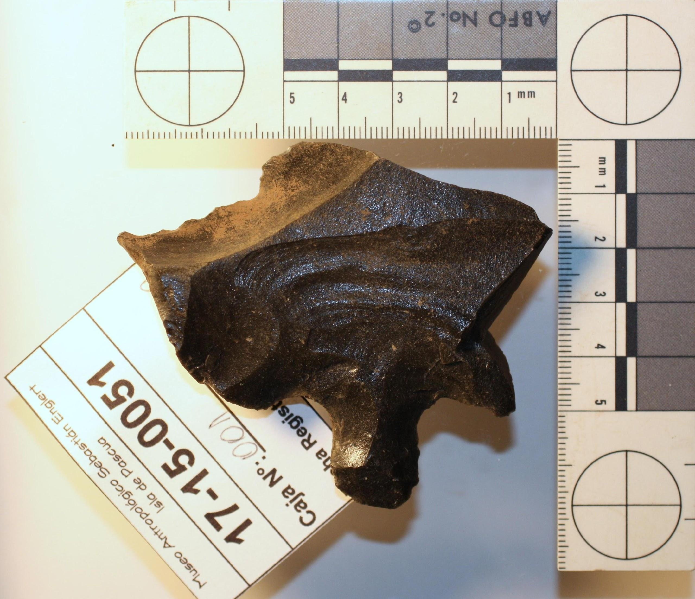
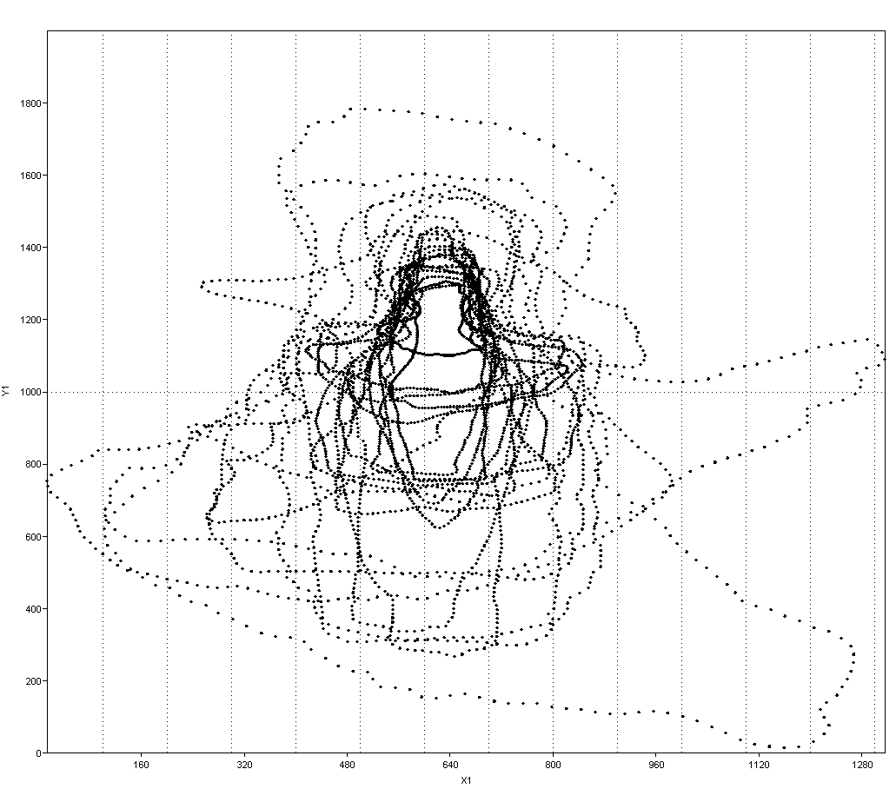
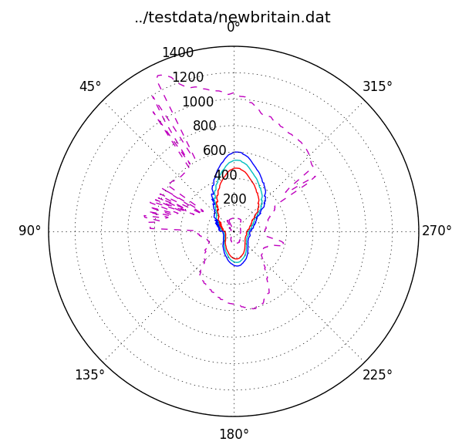
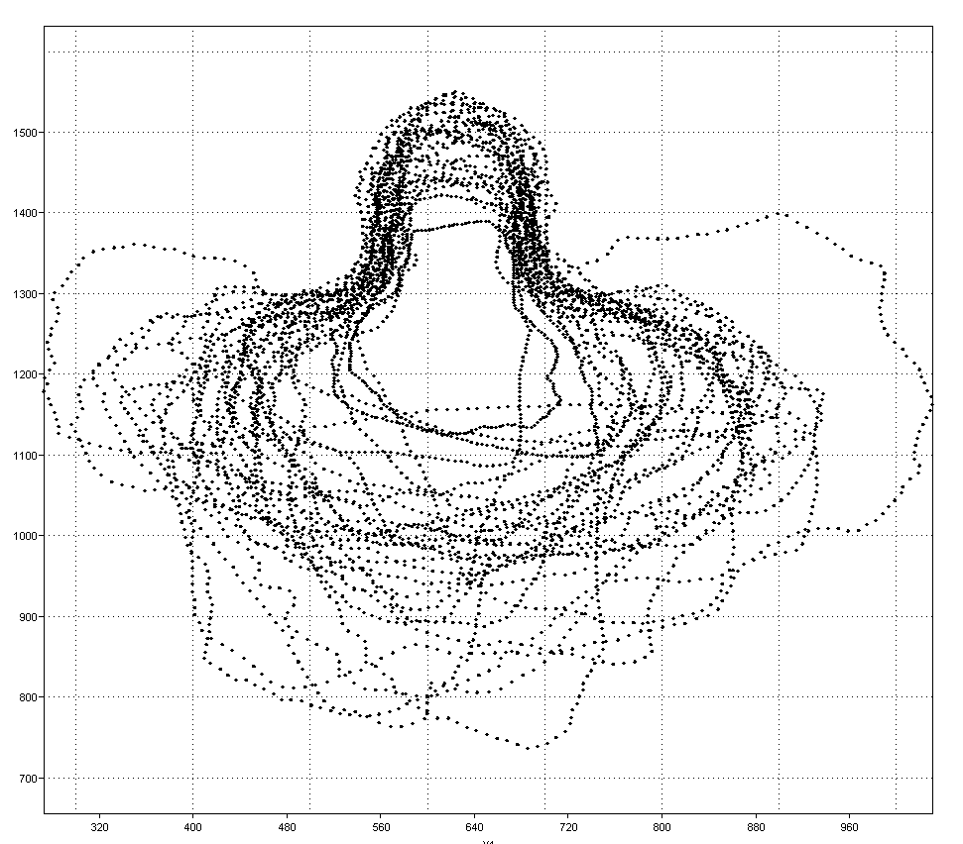
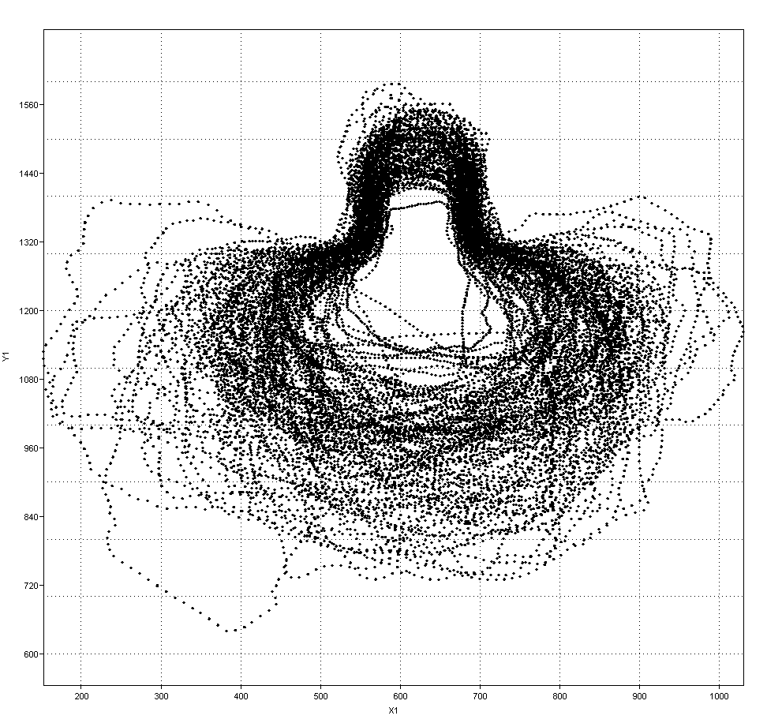
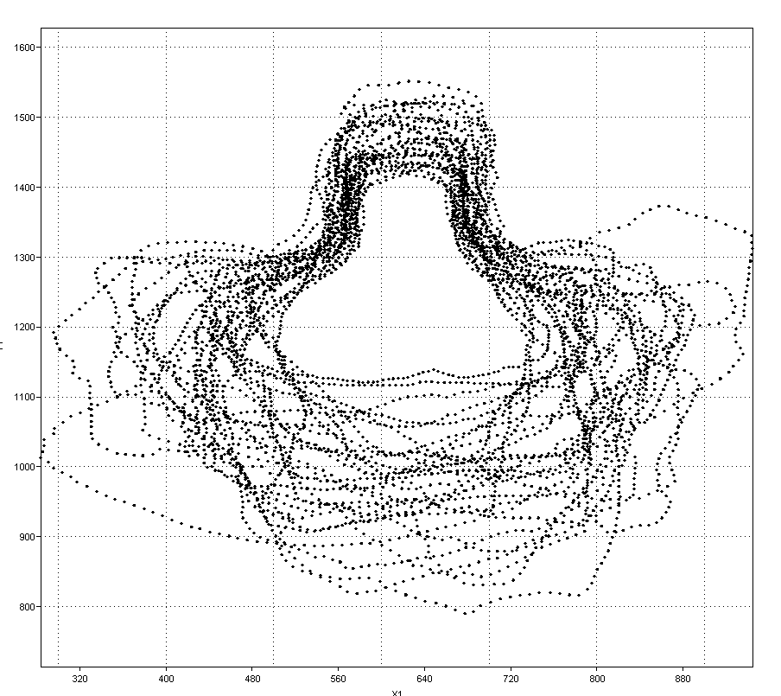
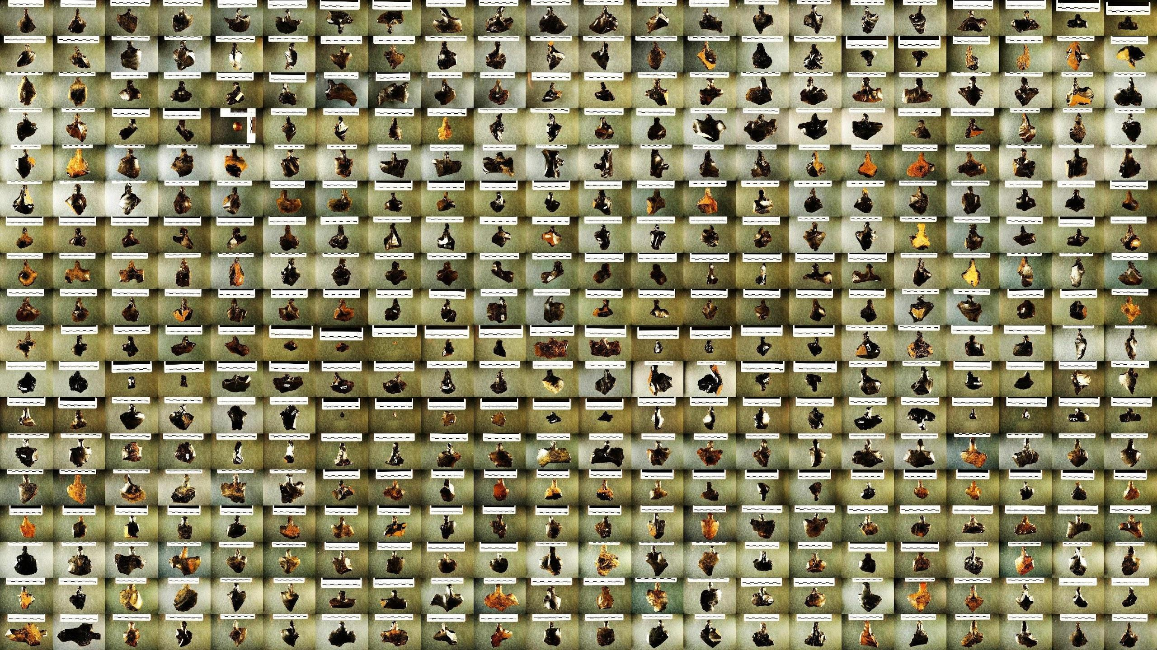
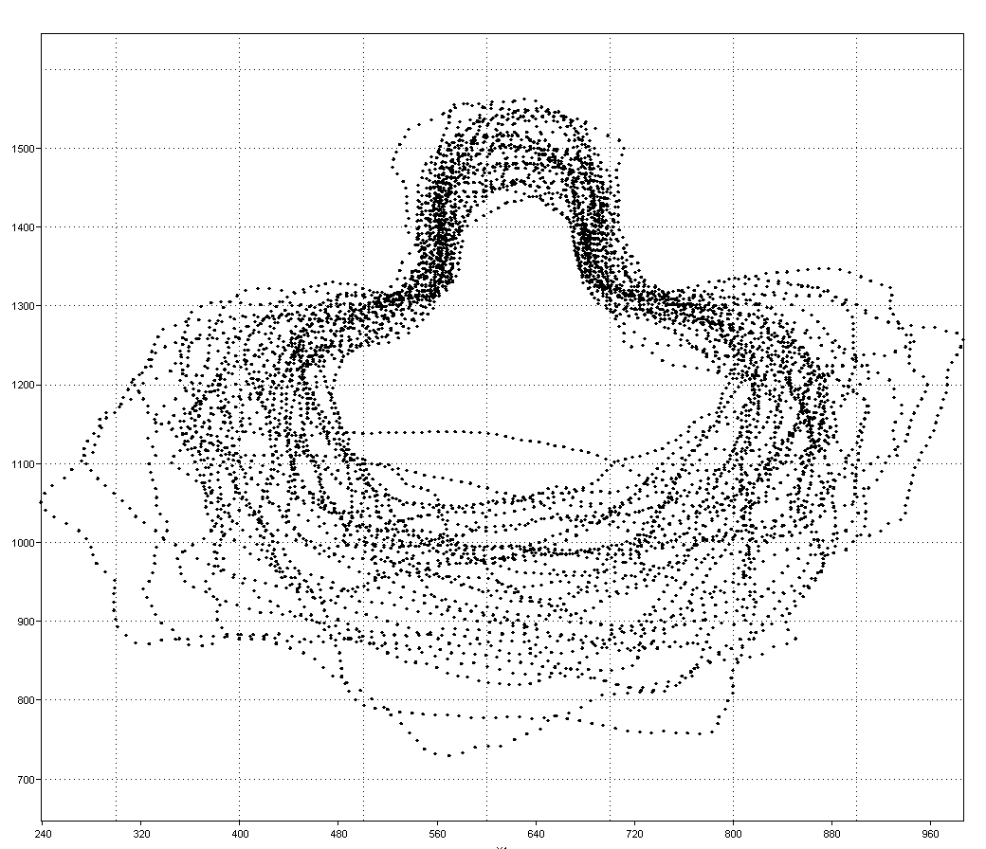
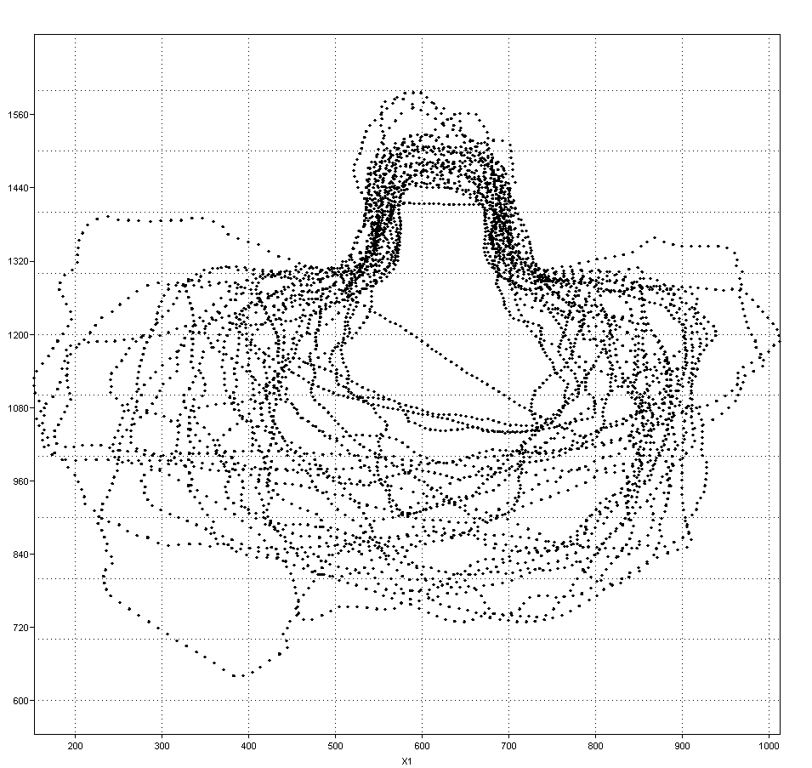
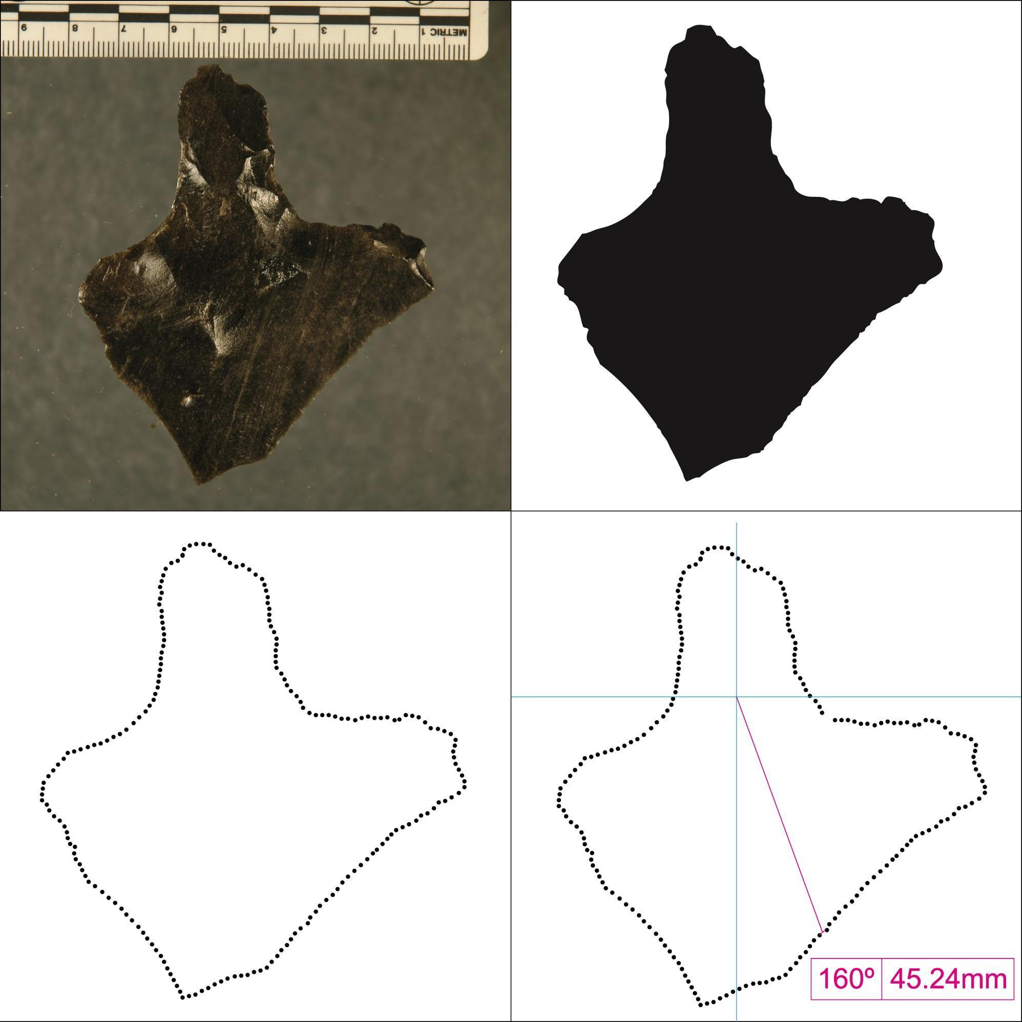
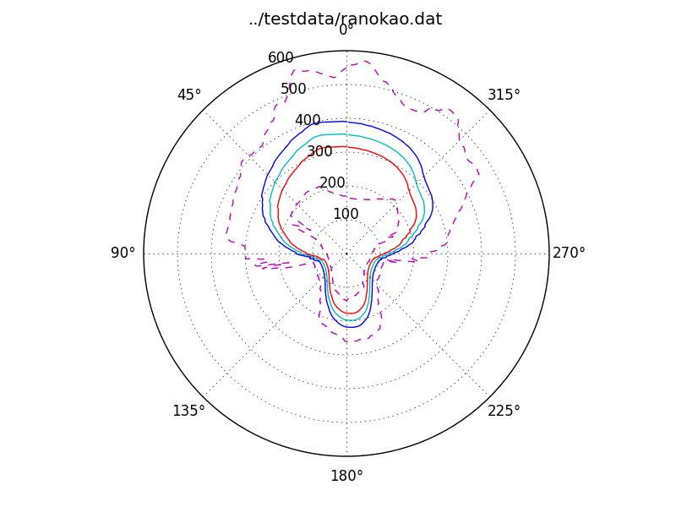
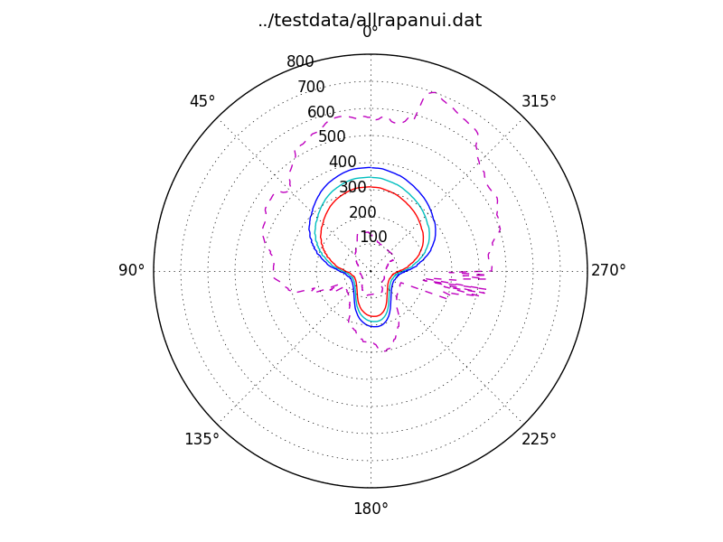
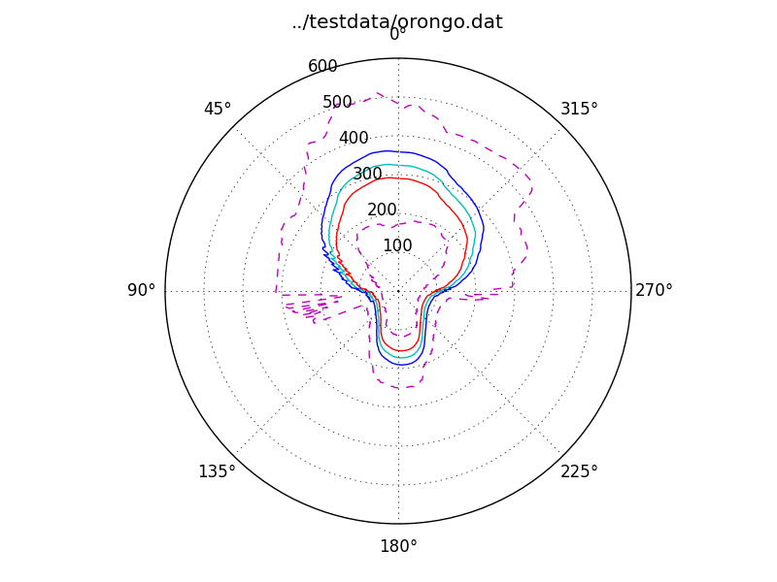
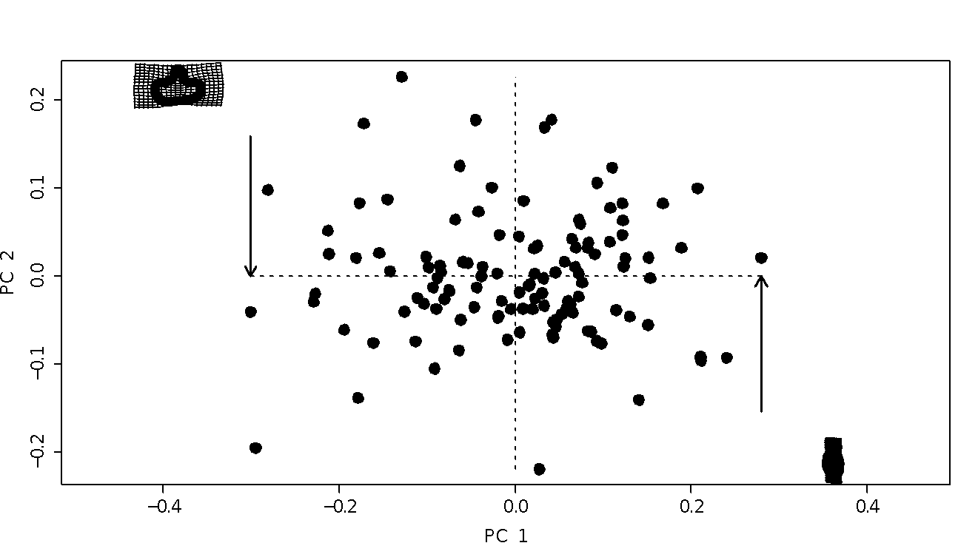
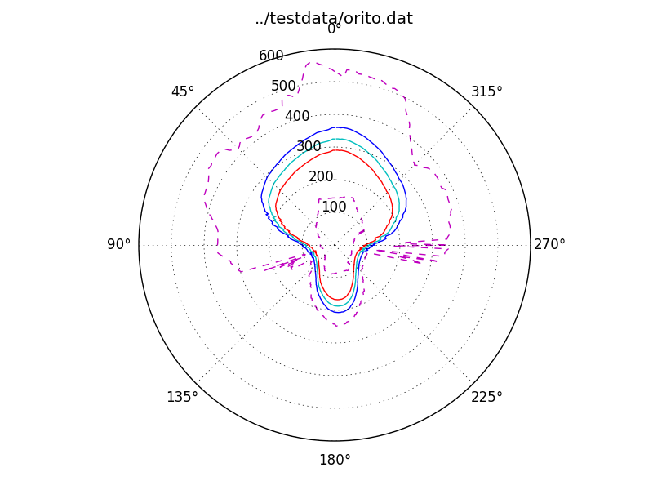
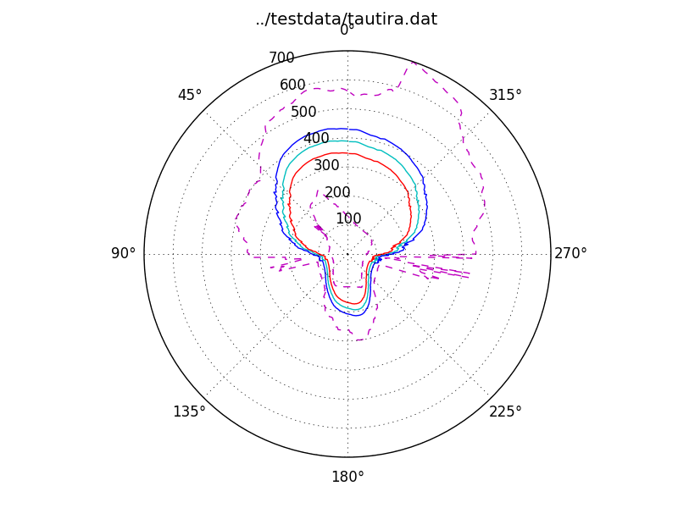
Morphometric Analysis of Shape Variability Among Flaked Stemmed Obsidian Tools (Mata’a) from Rapa Nui (Easter Island, Chile)
Rennie J. Horneman,¹ Joanne Minerbi,¹ Carl P. Lipo,¹ and Terry L. Hunt²
¹California State University Long Beach and ²University of Oregon
Introduction
Comparison with Similar Artifacts
It is often assumed that prehistoric Rapa Nui populations experienced intense warfare during late prehistory (Bahn and Flenley 1992; Diamond 1995, 2005; Flenley and Bahn 2002). One line of evidence used to make this assumption is the presence of mata’a, flaked obsidian stemmed tools. Mata’a are a class of hafted flaked obsidian artifacts that are found commonly on Rapa Nui. They are similar in form to tools found on other islands such as New Britain, Papua New Guinea (e.g., . Torrence et al. 2008).
Previous stylistic analysis and evaluation of usewear contradict claims of weapons and instead point to their use as either some kind of symbolic implement or their use in cultivation activities (Bollt et al. 2006; Lipo et al. 2010).
Here, we use shape morphometric analysis to examine mata’a shape variability and to look for areas of shape that are constrained versus those that are free to vary. Our results conclude that mata’a were only functionally constrained in terms of the haft. These results continue to support the alternative hypotheses that these artifacts were not used as weapons.
Artifacts with similar shape to Rapa Nui mata’a are found elsewhere across the Pacific. On New Britain, Papua Nu Guinea for example, stemmed obsidian tools are known and many have outlines quite similar to mata’a (Torrance et al. 2009).
As a comparison, we measured outline variability of a sample of New Britain tools using the protocol described for the Rapa Nui mata’a. In contrast to the Rapa Nui tools, the New Britain ones exhibit much greater variability suggesting more than one tool is functionally represented. In addition, the 95% confidence interval points to a somewhat diamond shape outline that is more consistent with weaponry.
Method
Rapa Nui and sites mentioned in text (Easter Island, Chile)
Results
In order to test these hypotheses, we used morphometric outline analysis. With this technique exact outlines of artifacts can be overlaid and compared making variations between artifacts readily apparent. Our assemblage consisted of photographs of mata’a (n=119) taken by Lipo on Rapa Nui from 2007 through 2009. 25 to 33 artifacts were randomly selected from each of (4) sites.
Using TPSdig software (Rohlf 2014), each mata’a was measured using 200 sets of X-Y coordinates from the perimeter of the artifact. Radial measurements were also taken every 2 degrees around the circumference.
We transferred the data to PAST 3.01 (Hammer et al. 2001) software and X-Y coordinate and radii analyses were done. The X-Y coordinates were used to create overlying images showing shape variability. The radii analysis were used to compute the standard deviation of each radius. The standard deviations were then used to graph out areas of constraint and/or variability in each group.
Each set of analysis were performed separately for each site, and collectively for the entire assemblage.
The X-Y coordinate overlay evaluations showed that each assemblage was highly constrained in the haft width.
The haft length was also quite constrained.
The blades showed no constraint, nor did they show a tendency toward a pointed shape.
The radii graphics likewise showed standard deviations from the mean of the blade to be around three (3) times greater than that of the haft.
We found shoulder angle constraint at the Rano Kau site that we interpret as stylistic in nature.
New Britain, Papua New Guinea
Stemmed obsidian tools from New Britain (Torrance 2009).
Example Rapa Nui mata’a.
As a group, mata’a vary greatly in size and shape, but average 6-10 cm in both width and length. They formed from a hard hammer flakes with the haft formed from one of the lateral margins of the flake and the blade from the remaining distal and opposite lateral margin. The haft and shoulder is formed from unifacial flakes and is generally lenticular in form. Overall, the blade shape is dominated by the shape of the parent flake though some additional shaping can be evident. Often, large areas of cortex still cover much of one face. much of one face.
Outline variability for New Britain stemmed tools. The great range of variability suggest that multiple tools are represented.
Shape variability for New Britain stemmed tools. The solid lines show the mean and 95% confidence intervals for shape.
Conclusions
ORITO
ORONGO
From the results of this study, we conclude that the hypothesis that mata’a are weapons is unsupported. Lethal weapons are expected to have shapes that would facilitate stabbing and thus have low variability in triangle distal edges. The overall degree of distal variability and lack of triangle pointed shapes is at variance with all expectation of lethal weaponry.
Morphometric analysis shows the greatest variability in shape is related to the blade edge shape, while the smallest variability centers on the width of the haft. From this we can conclude that their use is likely for cutting along the planes parallel to the blade.
RANO KAO
RAPA NUI
AHU TAUTIRA
Comparison of measurements for all mata’a (center) and for collections from across the island.
References
A sample of mata’a shape variability.
Bahn P.G. & J. Flenley 1992. Easter Island, Earth Island. New York, N.Y.: Thames and Hudson.
Bollt R., Clark J.E., Fisher P.R. & Yoshida H.K. 2006. An experiment in the replication and classification of Easter Island Mata’a. Rapa Nui Journal 20: 125-133.
Diamond J. 1995. Easter’s End. Discover 9: 62-69.
Diamond J. 2005. Collapse: How societies choose to fail or succeed. New York: Viking.
Flenley J.R. & P. Bahn 2002. The Engimas of Easter Island. New York: Oxford University Press.
Hammer, Ø., Harper, D.A.T., and P. D. Ryan, 2001. PAST: Paleontological Statistics Software Package for Education and Data Analysis. Palaeontologia Electronica 4(1): 9pp. (http://folk.uio.no/ohammer/past/)
Lipo, C. P., Hunt, T. L., Hundtoft, B., 2010. Stylistic variability of stemmed obsidian
tools (mata'a), frequency seriation, and the scale of social interaction on Rapa Nui (Easter
island). Journal of Archaeological Science 37, 2551-2561.
Rohlf, F. James, 2014. http://life.bio.sunysb.edu/ee/rohlf/software.html
Torrence, R., Swadling, P., Ambrose, W., Kononenko, N., Rath, P. and Glascock, M. 2009. Obsidian stemmed tools and Mid-Holocene interaction. Asian Perspectives 48: 118-147.
Hypothesis
We assume that due to performance the functional aspects of any tool result in shape variability that is more constrained than the non-functional or stylistic attributes. Based on this notion, we hypothesise that :
If mata’a are weapons, the distal end of the artifact will be constrained. However, if mata’a are not weapons, other areas of the tool will show greater constraint consistent with alternate functions.
If mata’a are weapons, the distal end of the artifact will show a tendency towards a pointed spear-like shape that will penetrate either enemies or prey. If mata’a are not weapons, there will be no such constrictive tendency at the distal end of the tool.
If there was inter-tribal warfare, mata’a from distinct areas may show stylistic traits of distinct groups. If natives were not divided into warring groups, distinct stylistic traits may or may not be apparent.
Measuring (1) mata’a (2) converted to a profile (3) calculate 200 evenly distributed points, (4) measuring XY radius from center of haft to each point around the outline.
Acknowledgments
Variability in mata’a shape. Magenta outlines are maximum and minimum outlines within the assemblage. The green outline is the mean. The blue and red outlines are two standard deviations above and below the mean respectively.
We thank Francisco Hochstetter Torres for kindly facilitating access to the mata’a at the P. Sebatstian Englert Museum on Rapa Nui. Undergraduate students Horneman and Minerbi would like to express our deepest and most profound gratitude to Dr. Carl Lipo without who’s guidance, advice and infinite patience this project would not have been possible.
Distribution of the first two elliptical fourier principle components for the shape outlines. The lack of grouping suggests that the Mataa fall as a single functional class of objects.

