Slide 1

PeerReview Data Model

Slide 2
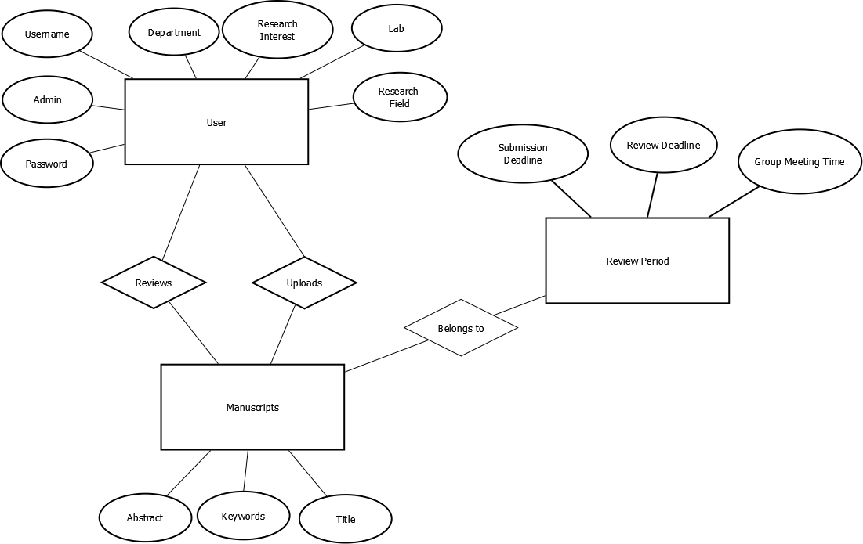

Slide 3
User
General
Department
Research Interest
Research Field
Lab
Authentication
Username
Password
Reviewer perspective
Manuscripts reviewed or being reviewed
Uploader perspective
Manuscripts uploaded or being reviewed
Admin Perspective
Match Manuscript to Reviewers

Slide 4
Manuscripts
Related Users
Uploader
Reviewers
Scientific information
Abstract
Keywords
Title
Deadlines
Review Period

Slide 5
Review Period
Manuscripts being reviewed
Deadlines
Submission deadline
Review deadline
Group meeting time

