Slide 1
Creating Accessible Presentations
Carli Spina
@CarliSpina
carli.spina@gmail.com

Slide 2

Notes:
Perhaps the most important thing I will tell you during this presentation is to please use the microphone! Though many presenters think that they are loud enough without a microphone, attendees who are Hard of Hearing (HoH) or who are interpreting your presentation for attendees who are HoH or Deaf may struggle to hear. Please be sure to always speak into the microphone during both your presentation and the question and answer period. If there is a microphone for those asking questions, ask them to also use the microphone and, if they don’t, repeat the question into the microphone before answering it.

Slide 3
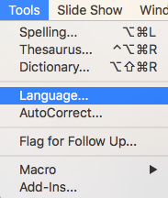
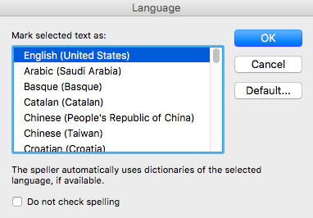
Step 1: Document Set Up - Language
Under tools in PPT, select Language
Select appropriate
language
Notes:
To ensure that screenreaders can reader your presentation, be sure to set the language of your text. In PowerPoint, this can be found in the Tools menu, under language. In Google slides, a similar option can be found in the File menu

Slide 4
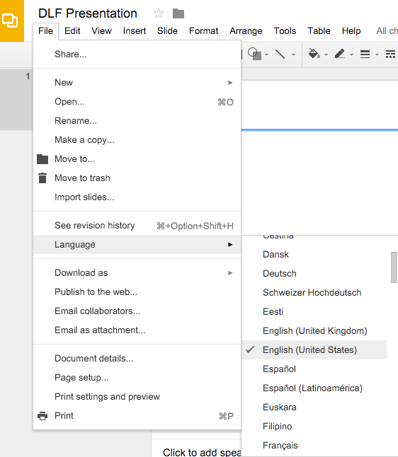
Step 1: Document Set Up - Language
In Google Slides, the same option can be found in the File menu.
Notes:
To ensure that screenreaders can reader your presentation, be sure to set the language of your text. In PowerPoint, this can be found in the Tools menu, under language. In Google slides, look in the File menu for the same option.

Slide 5
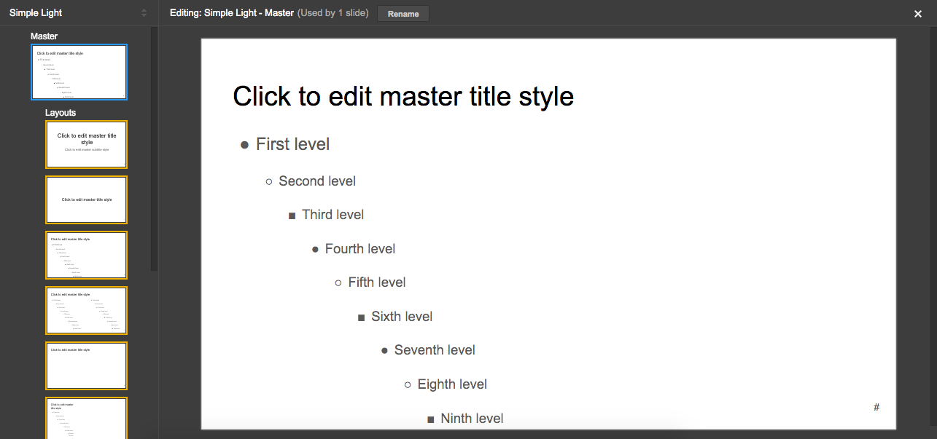
Build A Strong Structure: Master Slides
Notes:
Most slide creation tools offer an option to edit your styles at the Master Slide level rather than making changes to each slide. By editing the Master Slide, you can set a consistent style, which will make your slides more readable.

Slide 6
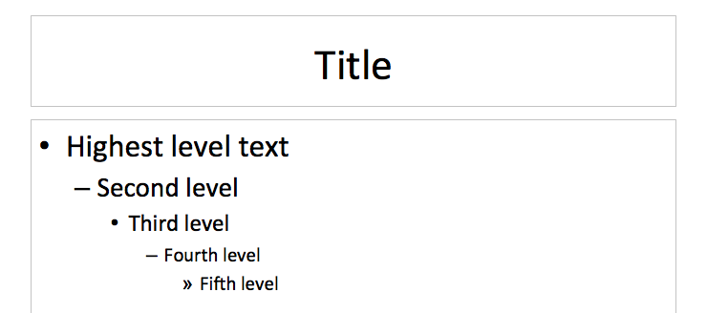
Build A Strong Structure: Hierarchy
Notes:
As you add text to your slides, keep in mind that you should always follow a consistent hierarchy of font size to make your slides easy to parse visually. Generally speaking, higher level text should be larger and no text should be used that is smaller than 24-28 points.

Slide 7
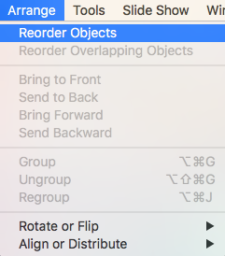
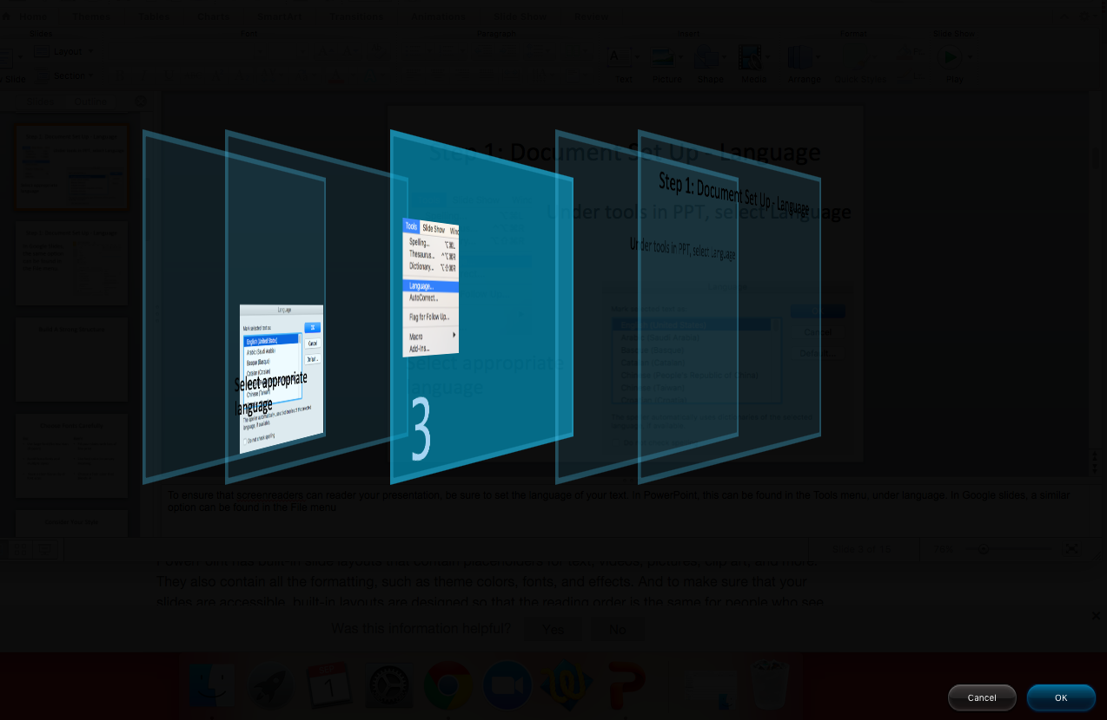
Build A Strong Structure: Order
Notes:
Screenreaders will read content in the order in which it is presented to them, so you should carefully consider the order of your text. This can be done by simply writing text or arranging elements in the order you would like a screenreader to read them, but sometimes you’ll have to rearrange the order after the fact. This is the feature that probably varies the most across tools, but this slide shows one example from PowerPoint.

Slide 8
Choose Fonts Carefully
Do:
Don’t:
Use large font (No less than 28 point)
Avoid fancy fonts and multiple styles
Have a clear hierarchy of font sizes
Fill your slides with lots of fine print
Use font color to convey meaning
Choose a font color that blends in

Slide 9
Consider Your Colors: Contrast
Low Contrast
High Contrast
Notes:
Low contrast images, text, and themes can make your presentation difficult for your audience to read.

Slide 10
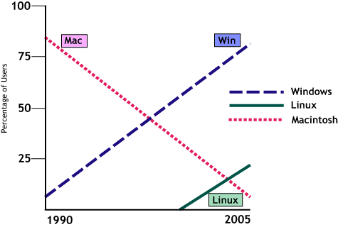
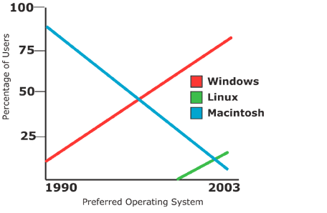
Consider Your Colors: Accessibility
Do:
Don’t
Charts from Penn State Accessibility: http://accessibility.psu.edu/images/charts/
Notes:
Make sure that you aren’t relying on color alone to convey information as this can be inaccessible to colorblind users and others with visual impairments.

Slide 11
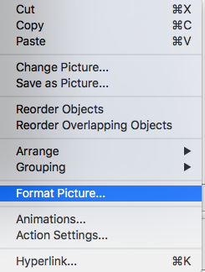
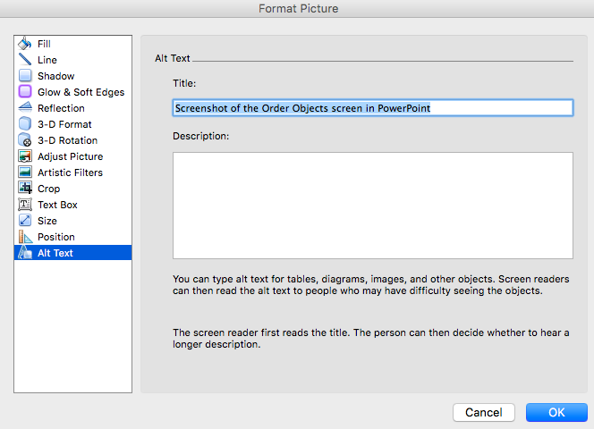
Add Alt-Text To All Images: PowerPoint
Notes:
Alt-text is vital to slide accessibility. If you don’t include alt (or “alternative”) text on every image, this image will either be (1) invisible to screenreaders or (2) will be read as simple whatever the name of the image is (i.e., chart.jpg). To add alt-text in PowerPoint, right click on the image and select “Format Picture” or go to the Format menu and select “Picture”. Then add text to the “Title” and/or “Description” fields. Click “Ok” to save the text.

Slide 12
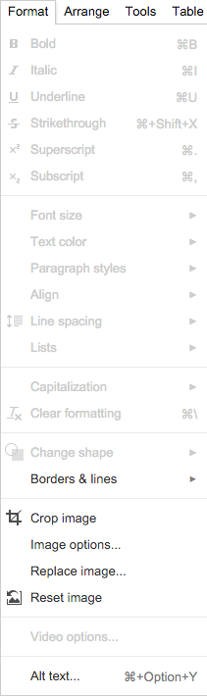
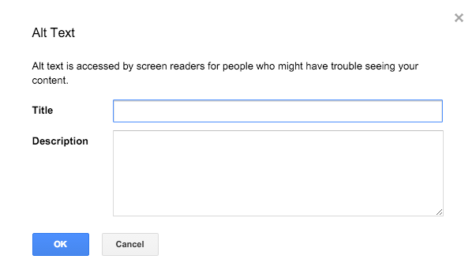
Add Alt-Text To All Images: Google Slides
Notes:
To add alt-text in Google Slides, select the image and then go to the last option in the Format menu, which is “Alt text”. A pop up screen then gives you the option to add an image title and/or description
Alt text should be written to convey what is important about the image in the least number of words necessary. So, for example, if you had a picture of book, what is important about that image would vary based on the context. If you were using that image to illustrate a point about the illustration on the front cover, you might say “image of a book with a portrait of Joan of Arc on the cover”. If you were using the image to show the type of book, you might say “image of a paperback book, approximately half and inch thick and 5.1 wide inches by 7.8 inches tall”. If you important an image of a chart or visualization, this will also need alt-text. You may wish to use the description field for additional details in situations where you want the individual using the screenreader to have the option to hear more information only if they are interested. If that isn’t possible, you can also add additional text in the notes field of your slide or behind the image itself and then indicate its location in the alt-text.

Slide 13


Caption & Audio Describe Video
Caption video content
Confirm captions are readable
Consider intro and/or audio description for visual content
Notes:
If you plan to show a video during your presentation, be sure that it has been captioned and that the captions are displayed in a way that they are readable by your audience. If your video depends on audience members being able to see specific content, consider how you can make it accessible to any visually impaired audience members. This might mean offering a brief introduction to the video before playing it or it may mean providing audio description.
If you are interested in providing closed captions or audio description for your video content, CADET (http://ncamftp.wgbh.org/cadet/), which stands for Caption and Description Editing Tool, is a free tool that supports adding these elements to videos.

Slide 14
Keep It Simple!
Avoid densely packed text or visuals
Don’t use distracting animations or transitions
Make sure your text is on the screen long enough to be read
Give your audience a chance to consider complicated content before you speak
Explain acronyms, jargon, and idioms

Slide 15

Responding to Questions
Answer questions throughout
Allow for written (or typed) questions
Repeat questions into the microphone

Slide 16
Sharing Your Slides
Share your slides before your session if possible
Give your file(s) a clear, descriptive name
Offer multiple file formats for maximum flexibility
Make sure any PDFs are accessible
Consider the accessibility of any other shared files
Notes:
Once you’ve finalized your slides, DLF asks that you share them via their instance of OSF Meetings.

Slide 17
PDF Accessibility
Accessibility means more than OCR or readable text, it also means tagging content in Acrobat and checking accessibility with a screenreader or accessibility checker.
It is often possible to take an accessible file and convert it into a PDF that retains those accessibility features, but you should still check.

Slide 18
PDF Accessibility Resources
Adobe’s Guide to Creating Accessible PDFs
Adobe’s Create & Verify PDF Accessibility (Acrobat Pro) Guide
WebAIM’s Guide to PDF Accessibility

Slide 19
Recommendation:
Given the complications of PDF accessibility, I would recommend focusing on creating an accessible document in another file format and share both file formats on the OSF Meetings site.

Slide 20
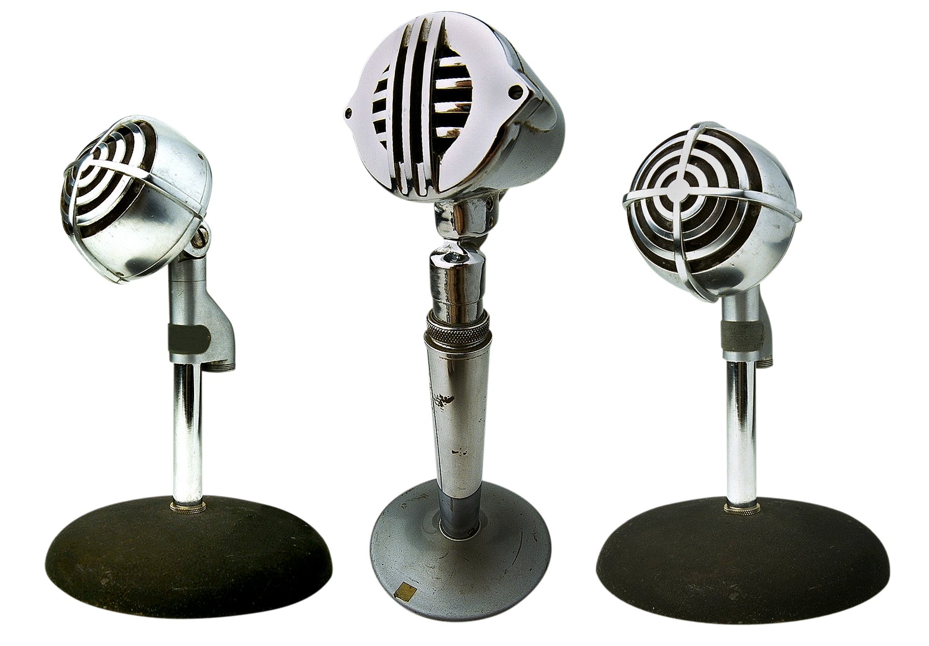
Notes:
Don’t forget the microphone!!

Slide 21
Questions?
If you have questions later, remember that there will be a Slack conversation on this topic on Tuesday, October 3 at 2pm Eastern Time.

Slide 22
Useful Tools & Resources
CADET (for captioning and audio description)
Color Contrast Checker
WAVE (web accessibility evaluation tool)
DLF’s Guide to Creating Accessible Presentations

