Slide 1
OAI User Services
Kat Hagedorn, UM
University of Michigan
11/10/2005

Slide 2
Ready, get set,…
You have your metadata ready…
You have your tools for uploading…
You’re officially a data provider…
So, how does the metadata get used once it’s available through OAI?

Slide 3
OAIster
Contains “all” OAI records
  collects only records that point to digital objects
  but does harvest all data providers
http://www.oaister.org/
549 institutions; almost 6 million records
37% US, 63% international
16% eprints, 11% DSpace, 4% ContentDM, 3% DigitalCommons

Slide 4
MODS Portal
DLF members only (development is part of DLF IMLS grant)
MODS metadata records only
http://www.hti.umich.edu/m/mods/
4 institutions (LoC, Indiana, OCLC, Univ of Chicago)
Over 330K records (mostly LoC)

Slide 5
DLF Portal
Like the MODS portal, but not specific to MODS
http://www.hti.umich.edu/cgi/b/bib/bib-idx?c=imls;page=simple
Simple DC records
43 institutions; over 880K records

Slide 6
Other harvesters/portals
Format-specific, ex. Sheet Music Portal
http://digital.library.ucla.edu/sheetmusic/
Country-specific, ex. Cyberthèses
http://cybertheses.francophonie.org/archives.php
Software-specific, ex. Eprints.org, PKP
http://www.eprints.org/software/archives/
http://pkp.sfu.ca/harvester/archives.php

Slide 7
UM system
First three portals all built at UM
Developed a system for
  harvesting records (DC, now also MODS)
  transforming/normalizing them
  ingesting them into DLXS Bibliographic Class
  search and display of records
Use DLXS: digital library creation software
Built our own harvester (in perl)

Slide 8
System design
XSL
stylesheets
(per source
type)
UM
harvester
OAI-enabled
DC records
XSLT
transformation
tool
Record
storage
Non-OAI-enabled
DC records
Search
interface
(XPAT)
BibClass
indexes

Slide 9
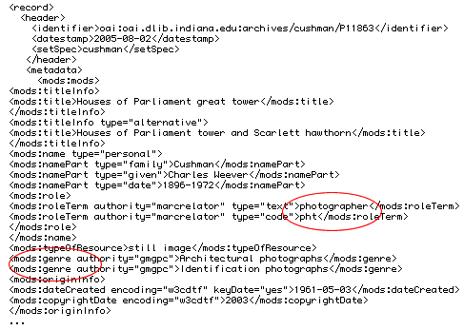
Your data in our system
MODS  DLXS BibClass
before…

Slide 10
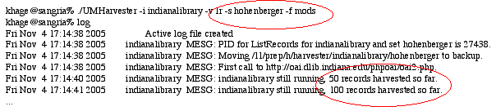
Your data in our system
MODS  DLXS BibClass
during, phase one…

Slide 11
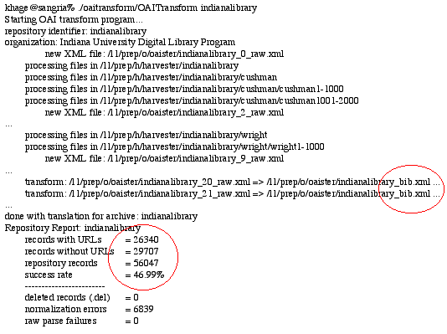
Your data in our system
MODS  DLXS BibClass
during, phase two…

Slide 12
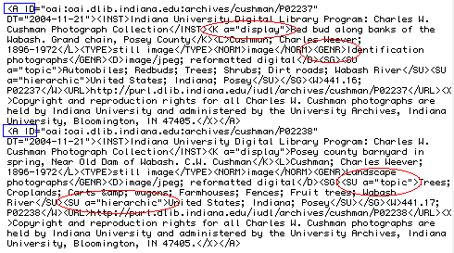
Your data in our system
MODS  DLXS BibClass
after…

Slide 13
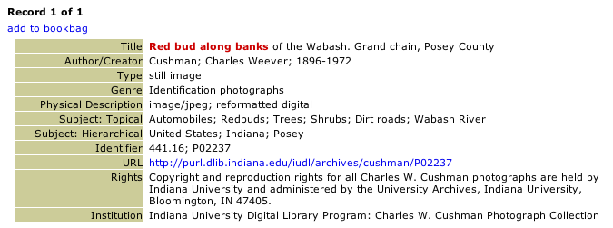
Your data in our system
MODS  DLXS BibClass
display…

Slide 14
Evidence of use
Articles, both scholarly and otherwise
Users write about it on blogs
Data providers care enough to complain ☺
User stats
  for OAIster, regularly in 18-19K+ hits/day range
  hundreds of thousands of hits/day on Yahoo!

Slide 15
Pitfalls…
Complex data gets “squashed” into simpler, flatter bibliographic data format
Especially for MODS
Working on appropriate ingest into Bibliographic Class so complex MODS elements are better reflected

Slide 16
More pitfalls…
Don’t know who users are
Tested 3 years ago, for interface issues
Need to test functionality with current grant’s Scholar’s Panel, end-users, and…
Current and potential data providers, such as yourselves

Slide 17
Next steps
Lots of things planned for all portals…
MODS/MARC integration
Thumbnail grabber: include thumbnails in results, as in CIC Portal
Date normalization
Make metadata downloadable from portal, and not just as DC or native XML
Clustering for better search/browse

Slide 18
CIC Portal
Over to Sarah… (no Caesar jokes this time!)

Slide 19
Questions
Kat Hagedorn
khage@umich.edu
University of Michigan
  Digital Library Production Service
www.oaister.org
www.dlxs.org
www.umdl.umich.edu

