Slide 1
Interoperability, OAI, and Shareable Metadata
Sarah Shreeves
University of Illinois at Urbana-Champaign
OAI Best Practices Training
Digital Library Federation Fall Forum 2005
November 10, 2005

Slide 2
The Four C’s (and lots of S’s) of Shareable Metadata
Consistency
Coherence
Context
Conformance
Metadata standards (and not just DC)
Vocabulary and encoding standards
Descriptive content standards (AACR2, CCO, DACS)
Technical standards (XML, Character encoding, etc)

Slide 3
But also…
Communication
  AND
  Documentation

Slide 4

OAI Use of Dublin Core
DC is the OAI protocol’s lowest common denominator
BUT
Data providers can and SHOULD be providing records in additional metadata formats

Slide 5

Aggregated
Environment
Aggregation
Activities
tension
Normalization, Value Added Activities
Mapping
and Exposure
Local Environment
Content Creation Activities
Digitization, application of metadata, application of controlled vocabulary
Information Design Activities
Collection decisions, Metadata scheme and controlled vocabulary selection
Notes:
Activities
Information design and creation activities (resource providers)
Value added activities (aggregator)
Use of metadata (end user)
Find, Identify, Select, Obtain
Aggregated Environment
When taken out of their native environment, metadata may lose crucial contextual information
Main activity to support is discovery
Something else about agg. env.
Change in Quality Requirements?
Think of quality in two ways
Quality to support local activity
Quality to support aggregated activity
To answer the question our title poses: Is quality metadata sharable metadata
It depends…

Slide 6
Structural inconsistency
(semantic as well….)
10/1/1991 | ca. June 19, 1901
ca. 1920. | (ca). June 19, 1901)
(ca). 1920) | 1929 June 6
2001.06.08 by CAD | [between 1904 and 1908]
Unknown | [ca. 1967]
1853 | 1918?
c1875 | 191-?
c1908 November 19 | 1870 December, c1871
[2001 or 2002] | 1920, 1921, 1922, 1923, 1924, 1925, 1926, 1927, 1928, 1929
[1919?] | 20th century

Slide 7
Example: Semantic Inconsistency
Date information included in: | Collection 1 | Collection 2 | Collection 3 | Collection 4
<date> element (used once) | 9 (26%) | 35 (100%) | 20 (57%) | 0
<date> element (used at least twice) | 20 (57%) | 0 | 0 | 0
<coverage> element (used once) | 0 | 0 | 17 (49%) | 0
Date in other element | 0 | 0 | 21 (60%) <title> | 35 (100%) At end of <source> string
Not recorded | 6 (17%) | 0 | 14 (40%) (nearly empty records) | 0

Slide 8
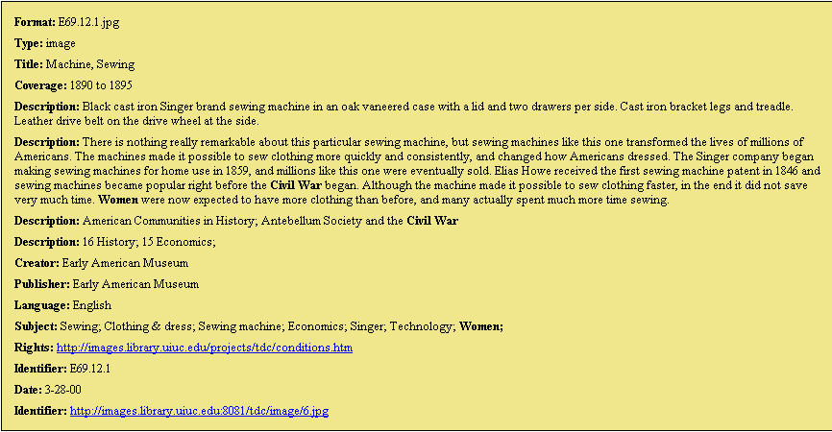
Loss of Context:
Record in OAI aggregation

Slide 9
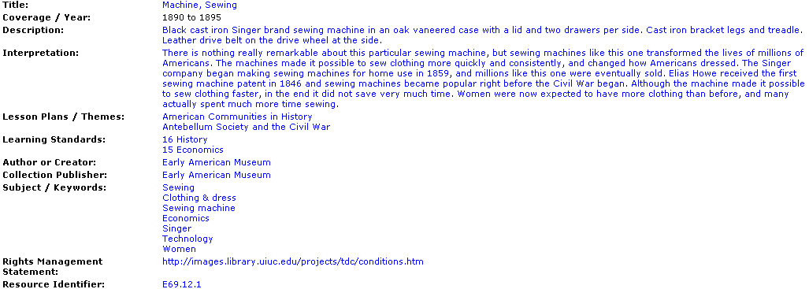
Context:
Record in native database

Slide 10
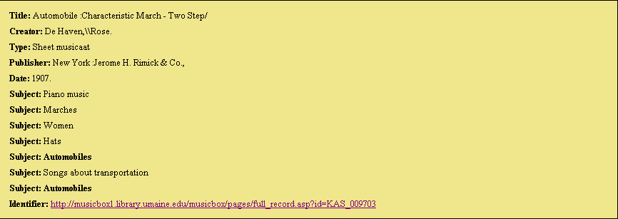
Loss of context / data

Slide 11
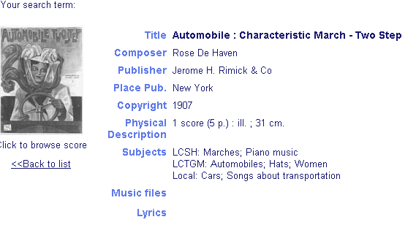
Loss of context / data

Slide 12
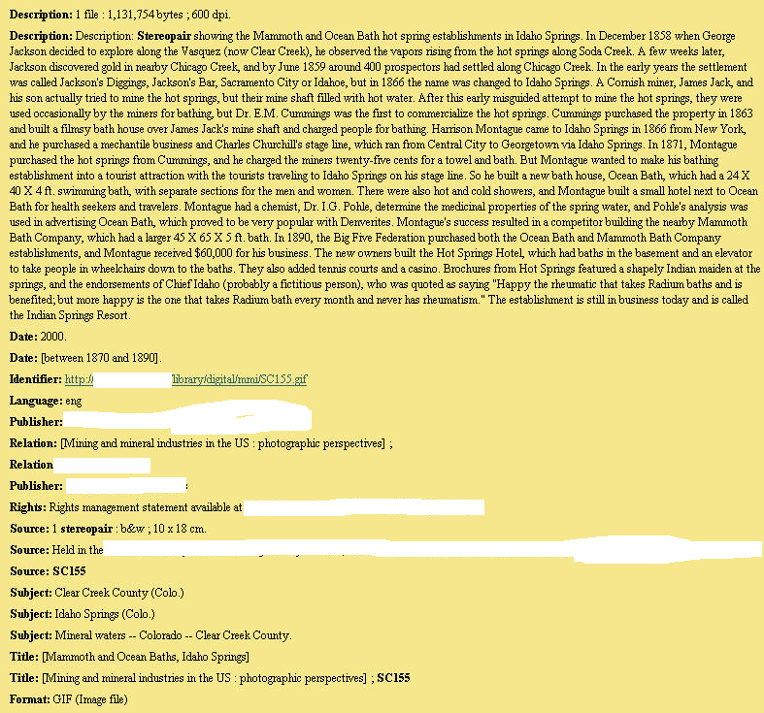
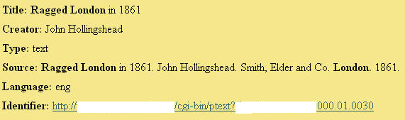
Sufficiency
 | Collection 1 | Collection 2 | Collection 3 | Collection 4
% incomplete records | 69% | 71% | 0% | 100%

Slide 13
Context and Coherency
What does this record represent?
identifier:http://images.umdl.umich.edu/cgi/i/image/image-idx?view=entry;subview=detail;cc=fish3ic;entryid=X-0802;viewid=1004_112
publisher: UMMZ Fish Division
format: jpeg
type: image
subject: 1926-05-18;1926;0812;18;Trib. to Sixteen Cr. Trib. Pine River, Manistee R.;R10W;S26; S27;JAM26-460;05;T21N;1926/05/18
language: UND
description: Flora and Fauna of the Great Lakes Region;

Slide 14
How about this one?
identifier: http://name.umdl.umich.edu/IC-FISH3IC-X-0802]1004_112
publisher: Museum of Zoology, Fish Field Notes
format: jpeg
rights: These pages may be freely searched and displayed. Permission must be received for subsequent distribution in print or electronically.
type: image
subject: ; 1926-05-18 subject: 1926; 0812; 18; Trib. to Sixteen Cr. Trib. Pine River, Manistee R.; JAM26-460; 05; 1926/05/18; R10W; S26; S27; T21N
language: UND
source: Michigan 1926 Metzelaar, 1926--1926;
description: Flora and Fauna of the Great Lakes Region;

Slide 15
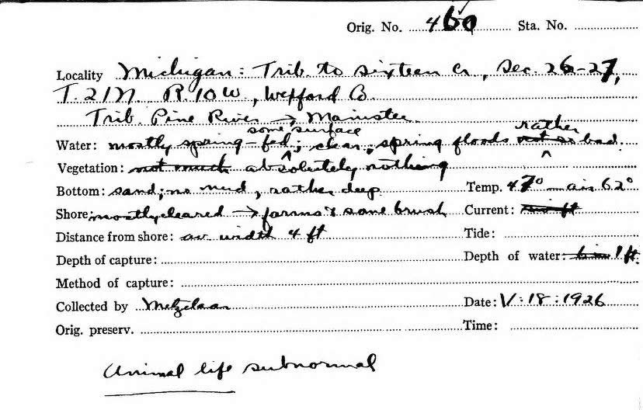

Slide 16
Can Collection Description help?

Slide 17
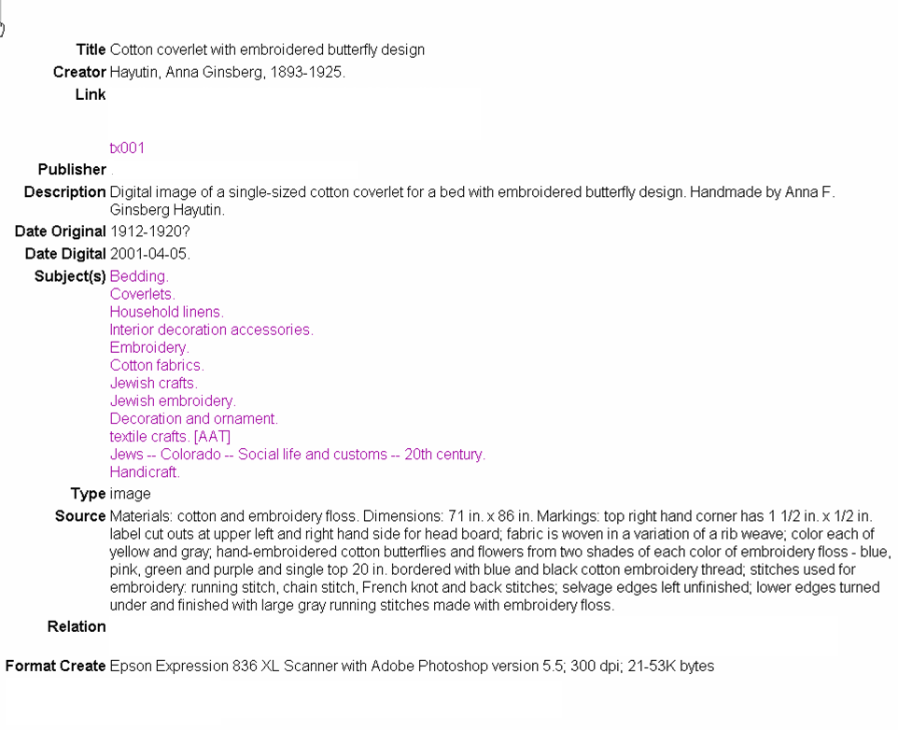
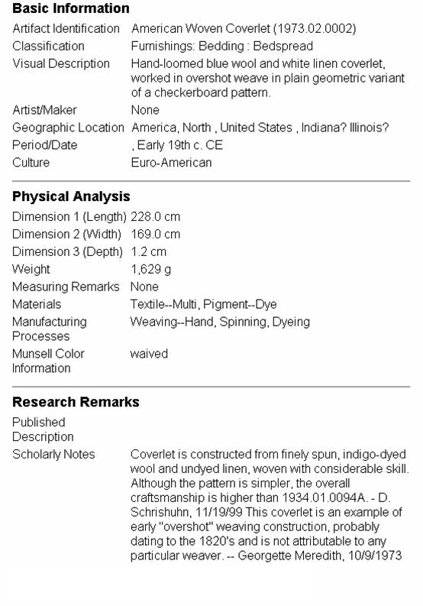
Digital? Analog? Or both?

Slide 18
Best Practices for
Shareable Metadata
http://oai-best.comm.nsdl.org/cgi-bin/wiki.pl?PublicTOC

