Slide 1
Lifecycle
…of OAI
…of DPs and SPs
Kat Hagedorn
University of Michigan

Slide 2
Funny acronyms
OAI = Open Archives Initiative
  OAI-PMH = Open Archives Initiative Protocol for Metadata Harvesting
  OAIster = an SP that allows searching of almost all DP metadata; housed at University of Michigan
DP = OAI data provider
SP = OAI service provider
Pop quiz later!

Slide 3
OAI’s history
Inception in e-prints community
Santa Fe Convention: result of 1999 OAI meeting
Became the OAI-PMH
Designed as a protocol that “develops and promotes interoperability standards that aim to facilitate the efficient dissemination of content” *
Essentially, harvesting metadata
* http://www.openarchives.org/organization/index.html

Slide 4
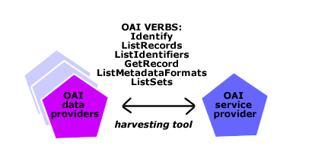
(Kinda lame) OAI graphic

Slide 5
The verbs
Verbs allow communication among DPs and SPs
Every DP must implement all 6 verbs
Not all SPs (need to) use all 6 verbs
Examples:
  http://www.hti.umich.edu/cgi/b/broker20/broker20? verb=ListMetadataFormats
  http://sunsite2.berkeley.edu:8088/oaicat/OAIHandler? verb=ListRecords&metadataPrefix=oai_dc

Slide 6
Restating the obvious
DPs use commercial or hand-grown software implementing the OAI-PMH verbs to make their metadata available to SPs
SPs retrieve, or “harvest”, the metadata using harvester software and those same OAI-PMH verbs, and use that metadata in a service

Slide 7
Sharing involves…
Institutions interested in being DPs must have
  Um, well, metadata to share
  Some level of technical expertise to install DP software
  Administrative buy-in
Institutions interested in being SPs must have
  Reason(s) for wanting to become an SP
  An infrastructure for developing a service using the harvested metadata
  Some level of technical expertise to install SP software (i.e., harvester)

Slide 8
Being a DP or SP means…
Treating it as a project, at least at first
Developing a maintenance and sustainability plan
Developing a collection development policy
Devoting some amount of programming time to it

Slide 9
Example OAI workflow: OAIster
What’s our strategy?
We’re a bit different-- we harvest everything and use anything that has a link to a digital object, whether freely available or restricted
Other SPs may choose to be subject specific, format specific or any other kind of specific

Slide 10
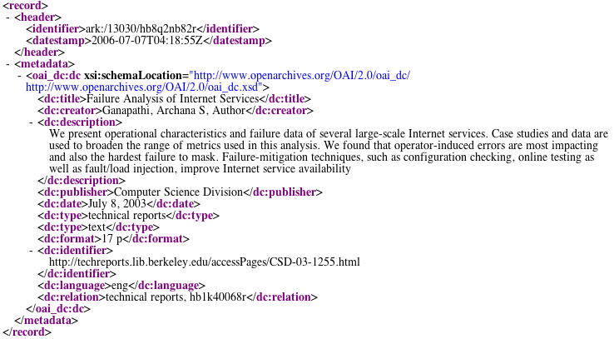
First step: harvest the metadata

Slide 11
And first sticky wicket
Metadata varies widely
Formats (dc, mods, mets, marc, qdc, olac)
Exhaustive vs. bare minimum
  (Let’s just call a spade a spade, a lot of it is bad.)
  More on this from Jenn
And also, XML and UTF-8 character errors
  About 6% of current repositories on OAIster have them

Slide 12
Example: metadata variation
Sample date values
  <date>2-12-01</date>
  <date>2002-01-01</date>
  <date>0000-00-00</date>
  <date>1822</date>
  <date>between 1827 and 1833</date>
  <date>18--?</date>
  <date>November 13, 1947</date>
  <date>SEP 1958</date>
  <date>235 bce</date>
  <date>Summer, 1948</date>

Slide 13
So, second step is to clean
Pie-in-the-sky: all DPs create perfect metadata
But…reality is that there will always be cleaning
We run metadata through a transformer
  Handles as much bad UTF-8 as it can
  Filters out records we can’t use
  Adds normalized metadata to fields can normalize

Slide 14
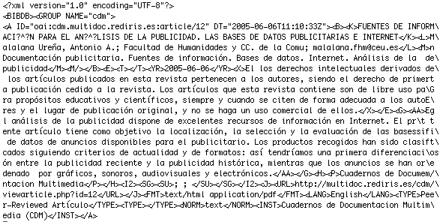
Transformation yields…
original field
normalized field

Slide 15
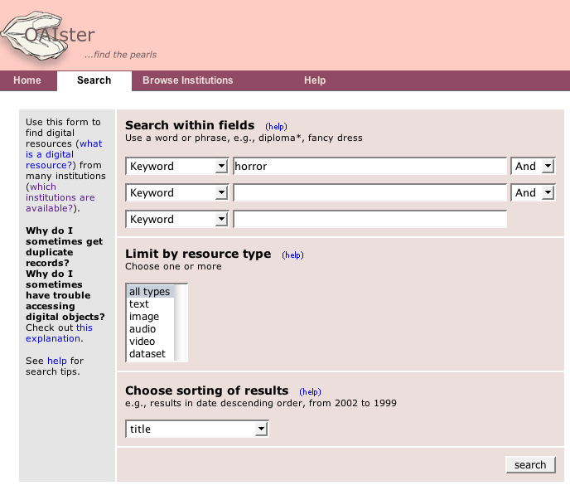
Third step: make it available

Slide 16
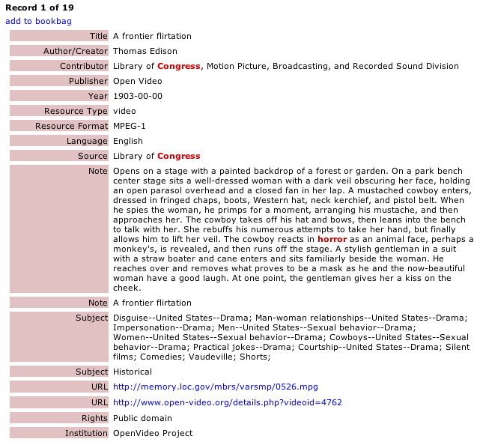
Fourth step: get the digital object

Slide 17

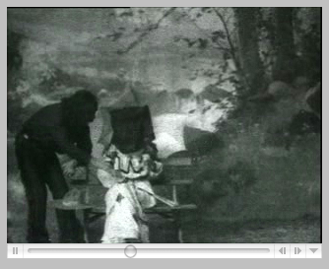
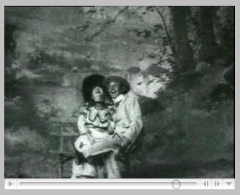
Fifth step: use
http://memory.loc.gov/mbrs/varsmp/0526.mpg
Library of Congress Digitized Historical Collections
http://louisdl.louislibraries.org/u?/AAW,22
LOUISiana Digital Library (LDL)

Slide 18
Sixth step: vicious circle
Potential to make the harvested and cleaned metadata available again to data providers, search engines, librarians, etc., for their use
Pro: availability to a wider audience
Con: Run the risk of complicating the simple harvesting model

Slide 19
The ABCs to remember
No time to show
  What other metadata formats provide
  What associated thumbnails offer
  What subject clustering looks like
But the gist is that there’s a lot we can do with metadata, as long as it
  is Available
  follows Best practices
  is used Consistently across the repository
Ask details in the breakout sessions!

