Slide 1
RLG Cultural Materials
DLF Forum
Ricky Erway
Digital Resources Manager, RLG

Slide 2
RLG Cultural Materials
What was the initial intent of the project?
Improve access to primary sources
Form an alliance to create a union resource that documents culture and civilization
  Increase visibility of collections and institutions
  Protect and support institutional rights
  Create a framework for targeted digitization initiatives
Help to transform research and learning in the digital environment
  Create a reliable, web-based discovery environment
  Integrate heterogeneous works and artifacts in all formats, enhancing the usefulness of individual collections
Notes:
<number>##
11/07/2607/16/96

Slide 3
RLG Cultural Materials
How was it funded?
Largely RLG-funded, supplemented by
  A planning grant from the Ford Foundation
  An infrastructure grant
  A grant to digitize collections reflecting the History of Science and Technology
  Seeking grants for other digitization initiatives
Notes:
<number>##
11/07/2607/16/96

Slide 4
RLG Cultural Materials
What was the timeframe?
Began planning in 1999
  Alliance formed in 2000
  Available for testing late 2001
  Available for subscription January 2002
Ongoing development
  Continued growth in content
  Continued enhancement of interface
Notes:
<number>##
11/07/2607/16/96

Slide 5
RLG Cultural Materials
What is the current status?
  It is available for use
  It continues to grow
  Continual interface improvements
  Policy advisory group investigating additional audiences
Notes:
<number>##
11/07/2607/16/96

Slide 6
RLG Cultural Materials
How many institutions participated or contributed?
Currently 51 Alliance Members...
Notes:
<number>##
11/07/2607/16/96

Slide 7
RLG Cultural Materials
American Antiquarian Society
Bayerische Staatsbibliothek
Bibliothèque nationale de France
Brigham Young University
British Library
Brooklyn Museum of Art
Chicago Historical Society
Clark Art Institute
Columbia University
Cornell University
Duke University
Hebrew Union College - Jewish Institute of Religion
Huntington Library, Art Collections, and Botanical Gardens
Imperial College of Science, Technology, and Medicine
Indiana University, Bloomington
International Institute of Social History
Keio University
Library of Congress
Linda Hall Library
London School of Economics
Museum of Fine Arts, Boston
National Gallery of Canada
National Library of Australia
National Library of New Zealand
National Library of Scotland
Notes:
<number>##
11/07/2607/16/96

Slide 8
RLG Cultural Materials
National Library of Wales
New York Academy of Medicine
Natural History Museum
New York Academy of Medicine
New York State Archives and Records Administration
New York University
Pennsylvania State University
Smithsonian Institution
Swiss National Library
Syracuse University
Temple University
Trinity College Dublin
University of California, Berkeley
University of Cambridge
University of Chicago
University of Edinburgh
University of Florida
University of Glasgow
University of Hawaii at Manoa
University of London Library
University of Minnesota
University of Oxford
University of Pennsylvania
University of Southern California
University of Toronto
Wisconsin Historical Society
Yale University
Notes:
<number>##
11/07/2607/16/96

Slide 9
RLG Cultural Materials
What is the extent of the resource?
  Currently 142,500 works
  Currently 60 collections
  Currently 23 contributors
  Working on another 37 collections from 23 contributors
  When finished with those will total about 350,000 works
  Over a million works proposed for inclusion so far…
Notes:
<number>##
11/07/2607/16/96

Slide 10
RLG Cultural Materials
Who is using it?
  About 35 institutions have subscribed in the first year (many others are currently evaluating it)
  Mix of North American and non-North American
  Mostly universities; some museums national libraries
  Too soon to know who at those institutions is using it and how they are using it
Notes:
<number>##
11/07/2607/16/96

Slide 11
RLG Cultural Materials
What if any future plans are there for this particular resource?
Interface and functionality enhancements:
  Complex object navigation
  More powerful searching
  Enhanced downloading support
Planning for individual service
  Policy group discussions
  Free access with pay per use
  Revenue returned to contributor
Additional collections
Additional funding for digitization
Additional Alliance participants
Notes:
<number>##
11/07/2607/16/96

Slide 12
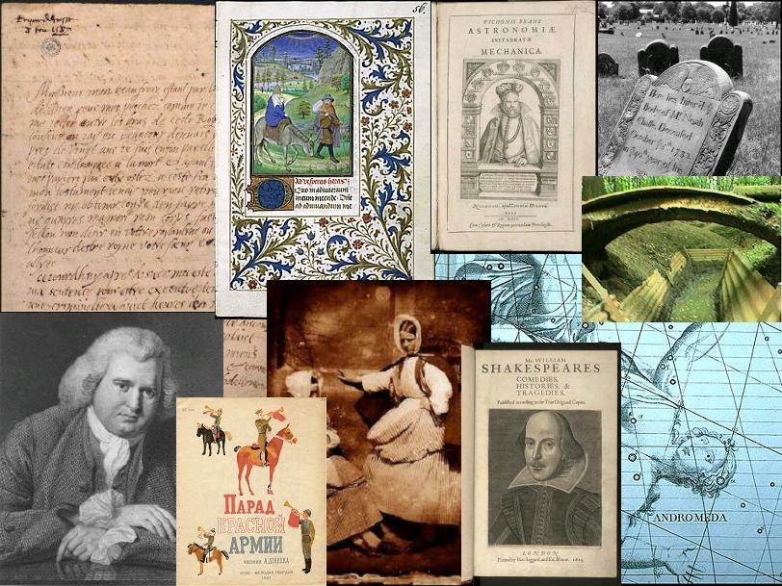
Heterogeneity in Cultural Materials
Notes:
As this slide suggests, there are a variety of subjects, time periods, and sources covered in the resource
celestial maps, rare Shakespeare folios, Scottish calotype photographs, Russian Childrens Books, Medical History photos, gravestones, rare science books, illuminations from the Book of Hours, the Last letter of Mary Queen of Scots, and a poet’s multimedia archive.
The synergy isn’t always obvious! Yet the resource reveals some surprising strengths – and interesting connections.

Slide 13
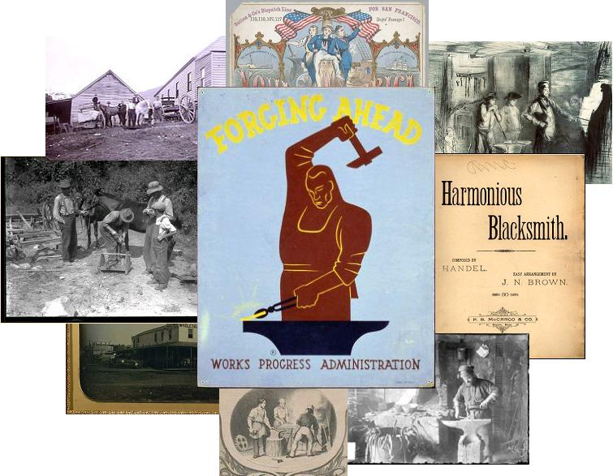
Synergy in Cultural Materials
Notes:
Here is an example of convergence around the subject of blacksmiths -- from a variety of collections from repositories in California, Indiana, North Carolina, and Chicago, as well as from the national libraries of the US, Australia, and Wales.

