Slide 1
Dynamic De-duplication of Bibliographic Data for
User Services
Thorsten Schwander, Herbert Van de Sompel
Los Alamos National Laboratory, Research Library
Digital Library Research & Prototyping Team
DLF Forum
October 26th 2004
Baltimore, MD

Slide 2
Common De-duplication Scenarios
Union Catalogues
FRBR-izing catalogues
MetaSearch engines

Slide 3
LANL De-duplication Problem
LANL Research Library locally hosts a large data collection
  A&I databases: ISI Citation Databases, Inspec, BIOSIS, Engineering Index, …
  Full-text collections: Elsevier, Wiley, APS, IOP, …
Duplicates in LANL data collection:
  amongst bibliographic records
  between bibliographic records and citations
  amongst citations
De-duplication need:
  join records from several databases that describe the same work
  find works that cite a given work

Slide 4
 | Bibliographic Items | Citation Items
Biosis | 13,947,365 | -
Inspec | 7,510,299 | -
Engineering Index | 5,241,479 | -
ISI Science | 25,453,618 | 414,983,407
ISI Arts & Humanities | 3,012,800 | 20,856,114
ISI Social Sciences | 3,738,926 | 53,915,890
Total | 58,904,487 | 489,755,411
Annual Growth | ~ 2,500,000 | ~ 26,000,000

Slide 5
DAVIS BJ ANN NY ACAD SCI 1964 121 404
DAVIS BJ ANN NY ACAD SCI 1964 2 404
DAVIS BJ ANN NY ACAD SCI 1965 121 404
DAVIS BJ ANN NY ACAD SCI 1964 121 407
DAVIS BJ ANN NEY YORK ACAD SC 1964 ___ 2404
DAVIS BJ ANN NY ACAD SCI 1964 2 404
DAVIS BJ ANN NY ACAD SCI 1964 121 2404
CLARK BJ ANN N Y ACAD SCI 1964 121 404
DALLNER BJ ANN NY ACAD SCI 1964 121 404
DAVIES BJ ANNALS NY ACAD SCI 1965 121 404

Slide 6

Current LANL De-duplication Approach
Strategy:
  Batch processing
  Bibliographic key matching
  Complex heuristics
Issues:
  Extensive processing time
  Scalability problem in light of growing data collection
  Revision of heuristics requires reprocessing of collection
Explore alternative:
  On-the-fly de-duplication
  De-duplication approach that is appropriate for citation matching
  Flexibility regarding revision of matching approach

Slide 7
Netrics Software
Netrics in the literature:
  C. Lee Giles Steve Lawrence Kurt D. Bollacker. 1998. CiteSeer: an automatic citation indexing system. International Conference on Digital Libraries. Proceedings of the third ACM conference on Digital libraries Pittsburgh, Pennsylvania. Pages: 89 – 98. DOI 10.1145/276675.276685.
  C. Lee Giles Steve Lawrence Kurt D. Bollacker. 1999. Autonomous Citation Matching. International Conference on Autonomous Agents. Proceedings of the third annual conference on Autonomous Agents, Seattle, Washington. Pages: 392 – 393. DOI 10.1145/301136.301255
  Peter N. Yianilos. 1993. Data structures and algorithms for nearest neighbor search in general metric spaces. Symposium on Discrete Algorithms. Proceedings of the fourth annual ACM-SIAM Symposium on Discrete algorithms, Austin, Texas. Pages: 311 – 321.
  Various papers at http://www.netrics.com/products/prod_papers.shtml

Slide 8
Netrics Software
Netrics elevator pitch:
  Netrics technology is a set of scalable linear-time algorithms that model the human notion of similarity in order to match related information. Netrics algorithms compute optimal weighted bipartite matching of letters and polygraphs. This bipartite matching approach captures a more flexible, more "human" notion of similarity than that provided by traditional approaches to inexact matching, such as string edit-distance, dictionary/speller correction, automaton-based methods, fuzzy search and probabilistic algorithms.

Slide 9

Netrics Software
Demonstration sites:
  First Things [search: epistemolology]
  Prints doc com [search: barnspouse]
  The Swiss Colony [search: hollowene]
  Oscar winning actors database
Notes:
Dan Rumsfield
it was interesting that Dick Chainy didn't change his residense to Woyming
interestingly, Duck Chainy changed his residense to California

Slide 10
Netrics Software
Netrics properties:
  Forgiving with respect to errors in dataset
  Forgiving with respect to errors in query
  Compares strings like humans do
  Response can be optimized for specific datasets: machine-learning module
  Performance scales well with growing dataset
  RAM-based index

Slide 11
LANL Netrics database setup
bibliographic
aulast auinit – stitle – year – volume – issue – spage – epage ||
identifiers of bibliographic records with given key
DAVIS BJ - ANN NY ACAD SCI - 1964 – 121 – A2 – 404 - 412 ||
info:lanl-repo/biosis/PREV12654567
indexed
citation
aulast auinit – stitle – year – volume – spage ||
identifiers of bibliographic records in which citation is found
DAVIS BJ - ANN NY ACAD SCI - 1964 – 121 - 404 ||
info:lanl-repo/isi/A1965221357#10 ; info:lanl-repo/isi/A1977325874#3

Slide 12
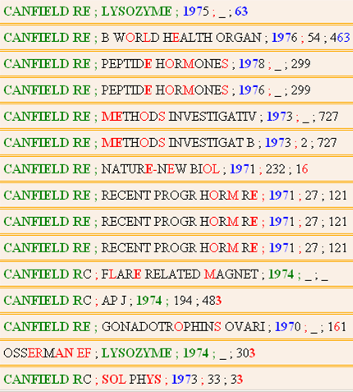

Slide 13
LANL Netrics database setup
bibliographic
Given a bibliographic key, which are the matching bibliographic records
Given a citation key, which are the matching bibliographic records
Given the identifier of a bibliographic record, what is the corrersponding bibliographic key
citation
Given a bibliographic key, which are the citing bibliographic records
Given a citation key, which are the citing bibliographic records

Slide 14

LANL Netrics database loading
ISI 1
OAI-PMH
MPEG-21 DID
XML documents
ISI 2
OAI-PMH
MPEG-21 DID
XML documents
Netrics Harvester
OAI-PMH Federator
BIOSIS
Expose

Slide 15
LANL Netrics database loading
RAM
DISK
extract metadata from DIDL XML documents
bibliographic
bib~
cit~
extract
bibliographic keys,
citation keys,
identifiers
bib~
cit~
bib~
cit~
bib
cit
citation
sort
merge identical keys
Netrics Harvester
bib~
cit~
bib~
cit~

Slide 16
LANL Netrics hardware setup
RAM
Cluster of IBM HS20 blade servers:
  Dual 2.4 Ghz Xeon CPU
  8 Gb RAM
Netrics:
  1 daemon per 2 Gb RAM
  4 daemons per blade server
Bibliographic data:
  36,000,000 biblio keys + identifier
  6,000,000 per daemon
  24,000,000 per blade server
  2 blades for ISI bibliographic keys [12 Gb RAM]
Citation data:
  500,000,000 citation keys + identifier
  136,000,000 unique citation keys + identifiers
  6,500,000 per daemon
  26,000,000 per blade server
  6 blades for ISI citation keys [42 Gb RAM]
IBM HS20 blade server
Dual 2.8 GHz Xeon CPU
8 Gb RAM
bibliographic
IBM HS20 blade server
Dual 2.8 GHz Xeon CPU
8 Gb RAM
IBM HS20 blade server
Dual 2.8 GHz Xeon CPU
8 Gb RAM
IBM HS20 blade server
Dual 2.8 GHz Xeon CPU
8 Gb RAM
IBM HS20 blade server
Dual 2.8 GHz Xeon CPU
8 Gb RAM
citation
IBM HS20 blade server
Dual 2.8 GHz Xeon CPU
8 Gb RAM
IBM HS20 blade server
Dual 2.8 GHz Xeon CPU
8 Gb RAM
IBM HS20 blade server
Dual 2.8 GHz Xeon CPU
8 Gb RAM

Slide 17
LANL Netrics hardware setup
RAM
DISK
Dell 1750
  Broker
  Cache
  Data server
IBM HS20 blade server
Dual 2.4 GHz Xeon CPU
8 Gb RAM
bibliographic
bib~
cit~
IBM HS20 blade server
Dual 2.4 GHz Xeon CPU
8 Gb RAM
IBM HS20 blade server
Dual 2.4 GHz Xeon CPU
8 Gb RAM
bib~
cit~
IBM HS20 blade server
Dual 2.4 GHz Xeon CPU
8 Gb RAM
IBM HS20 blade server
Dual 2.4 GHz Xeon CPU
8 Gb RAM
bib~
cit~
citation
IBM HS20 blade server
Dual 2.4 GHz Xeon CPU
8 Gb RAM
Dell 1750
Dual 3.06 GHz Xeon CPU
4 Gb RAM
client
IBM HS20 blade server
Dual 2.4 GHz Xeon CPU
8 Gb RAM
IBM HS20 blade server
Dual 2.4 GHz Xeon CPU
8 Gb RAM
bib~
cit~

Slide 18
LANL Netrics hardware setup
RAM
DISK
IBM HS20 blade server
Dual 2.8 GHz Xeon CPU
8 Gb RAM
bibliographic
bib~
cit~
Bulk preprocessing: 16 hours
Weekly update processing: 10 minutes
Data reload: 40 minutes
Queries/sec: 17
Queries/sec cache: 25
IBM HS20 blade server
Dual 2.8 GHz Xeon CPU
8 Gb RAM
IBM HS20 blade server
Dual 2.8 GHz Xeon CPU
8 Gb RAM
bib~
cit~
IBM HS20 blade server
Dual 2.8 GHz Xeon CPU
8 Gb RAM
IBM HS20 blade server
Dual 2.8 GHz Xeon CPU
8 Gb RAM
bib~
cit~
citation
IBM HS20 blade server
Dual 2.8 GHz Xeon CPU
8 Gb RAM
Dell 1750
Dual 3.06 GHz Xeon CPU
4 Gb RAM
client
IBM HS20 blade server
Dual 2.8 GHz Xeon CPU
8 Gb RAM
IBM HS20 blade server
Dual 2.8GHz Xeon CPU
8 Gb RAM
bib~
cit~

Slide 19
Netrics LANL queries
Query:
  query key (citation or bib) sent to broker: fielded search
  broker sends requests to all appropriate processes
  thesaurus used for stitle lookups
  broker collects/merges responses
Response:
  list :
  key || likelihood that key is a hit || identifiers of records from which key was extracted
  likelihood ~ Netrics match per field & weight accorded per field
  client application decides on the cut-off point between hit and non-hit

Slide 20
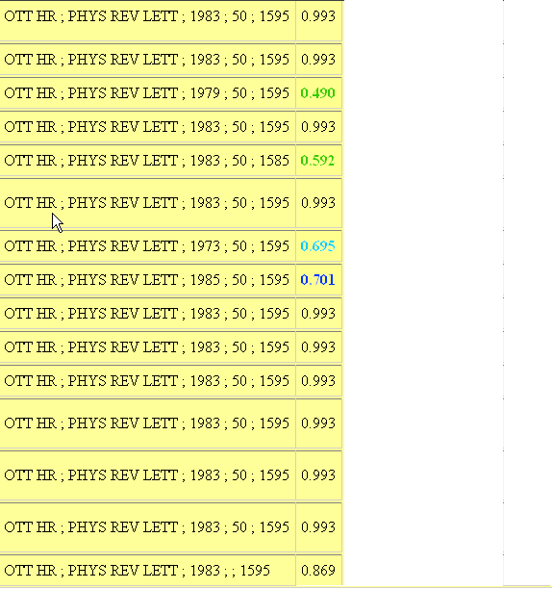
Query: OTT HR – PHYS REV LETT – 1983 – 50 - 1595
Response:
keys
likelihood

Slide 21
Optimizing likelihood
Optimize likelihood scores in function of the dataset
Machine learning: create model that accords weights to fields of the key
Librarians:
  Were presented with a total of 3,000 pairs of keys
  Had to decide whether or not both keys of a pair represented the same work
  Result: clearer cut-off point between matches and non-matches
DAVIS BJ ANN NY ACAD SCI 1964 121 404
DAVIS BJ ANN NY ACAD SCI 1964 2 404
yes
no

Slide 22
local
remote
identifiers
of local
bib records
with same
key
Netrics
bibliographic
ISI
PubMed
OpenURL
biblio
or
citation
k
e
y
local
local
Biosis
Matching to bibliographic records
Inspec

Slide 23
local
remote
identifiers
of
bib records
that
cite
the key
Netrics
citation
ISI
PubMed
OpenURL
biblio
or
citation
k
e
y
local
local
Biosis
Citation matching
Inspec

Slide 24

bibliographic
Nutch Search
XHTML
biblio info
Crawler
citation 1
citation 2
ISI 1
seed list:
identifiers
of
bib records
citation 3
OpenURL
seed list:
(Open)URLs
pointing at
bib records
in
LANL
repository
ISI 2
OpenURL
bib 13
bib 26
Repository crawling

Slide 25
1
XHTML
biblio info
citation 4
citation 6
5
XHTML
citation 7
2
XHTML
biblio info
biblio info
citation 1
citation 1
citation 2
citation 4
citation 3
citation 5
3
XHTML
biblio info
citation 1
citation 2
PageRank
citation 5

Slide 26
Netrics @ LANL : Conclusions
Results look much better than those of batch de-duplication approach ~ Netrics matching + training by librarians
Can ‘de-dup’ external data against local data
No batch processing, but on-the-fly de-duplication
Possibility to retrain the system to optimize responses without data reprocessing: machine learning module
Modularity of solution accommodates growth of dataset
Netrics module can be used by multiple applications, not just one
Positive collaboration with Netrics (machine learning, cache)
Will be plugged into new search environment that is being created
Will be applied to full-content collection

Slide 27
Contact information
LANL:
  Thorsten Schwander <schwander@lanl.gov>
  Herbert Van de Sompel <herbertv@lanl.gov>
Netrics:
  Stefanos Damianakis <snd@netrics.com>
  Anthony Faulise <af@netrics.com>

