Slide 1
The OCLC Metadata Switch Project
Jean Godby, Thomas Hickey,
Diane Vizine-Goetz
OCLC Office of Research
Digital Library Federation
May 14, 2003

Slide 2
Outline of this talk
The changing library collection
Web services for the digital library
A detailed look at three Web services in the OCLC’s Metadata Switch project
Recurring themes

Slide 3

The management of resources in the digital library
Some priorities:
Updated versions of proven solutions
  Metadata
  Knowledge organization
  Authority control
  Automated processing
Interoperability

Slide 4
The “Metadata Switch” project
A research project at OCLC that…
Acknowledges the investment of libraries in metadata.
Leverages the investment by adding value.
Decomposes the functionality of large systems into independent, reusable modules.

Slide 5
Some examples
A module that accepts: …and returns:
A record in one format A record in another format
(Dublin Core) (MARC)
A Web page A class number or
subject heading
A name A set of variant names for
the same entity
A class number An associated subject
heading

Slide 6
A Web service is…
A Web page with functions.
  stock quotes, traffic conditions, calculators, weather
A Web-accessible program that performs a single task…
…using standard Web protocols.
  XML syntax, HTTP packaging
    REST: Representational State Transfer
    SOAP: Simple Object Access Protocol

Slide 7
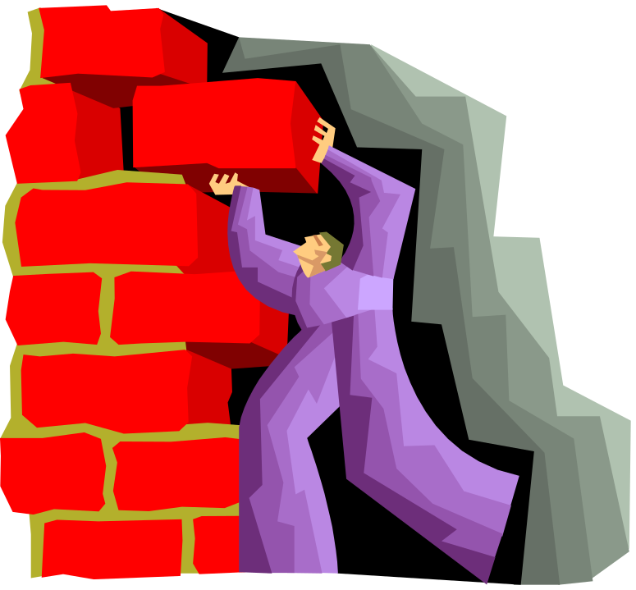
Web services for the digital library
  Register
  Search
  Resolve
  Navigate
  Decompose
  Enhance
  Transform

Slide 8
A closer look at three
Web services

Slide 9

Example 1: The XWork ISBN Web Service
A resolution service
Associates related works using new research results in cataloging theory
  Builds on John Udell’s work on library lookup
  Adds a reference to a FRBRized collection of OCLC’s WorldCat
  Bridges library collections with a bookstore

Slide 10
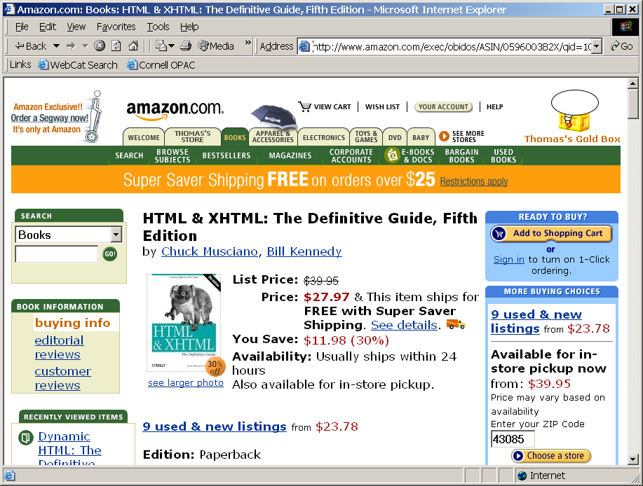
On Amazon

Slide 11
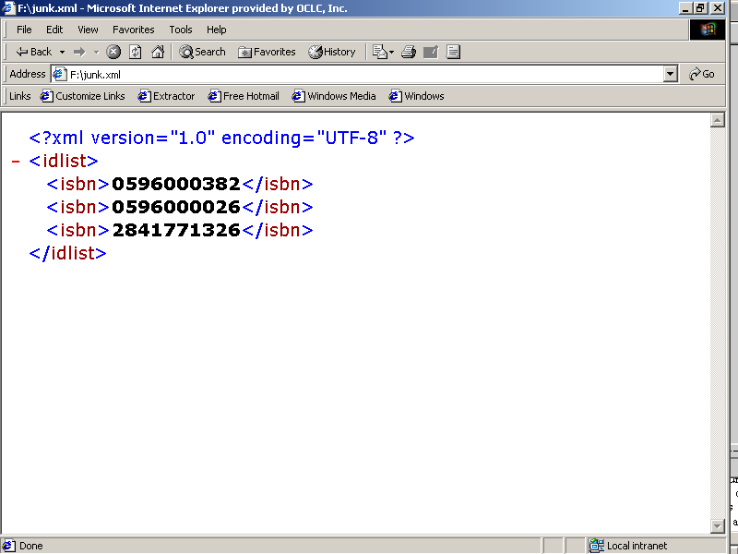

Slide 12
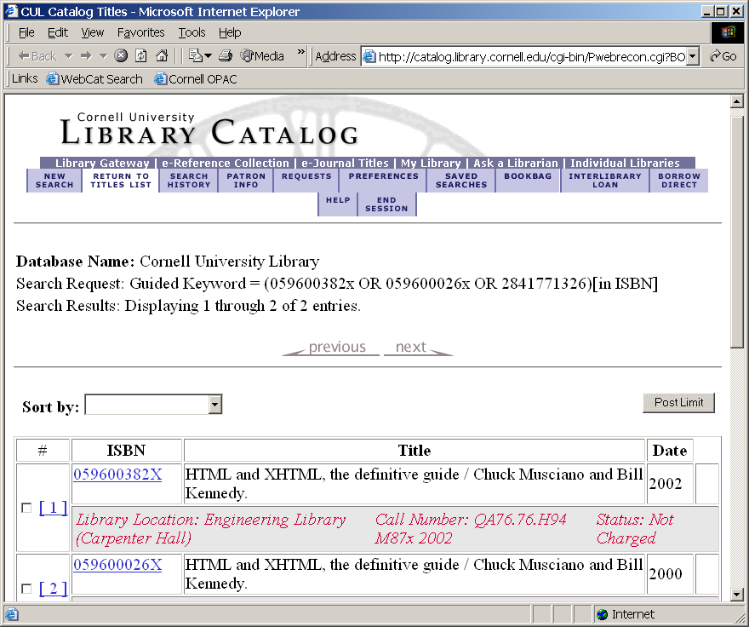
Cornell University

Slide 13
Example 2: A collection of terminology services
Libraries expend significant time and effort creating and managing terminology resources.
The value and usefulness of this work can be extended by…
  Validating a subject heading or class number
  Navigating hierarchies in thesauri or classification schemes
  Enhancing/augmenting metadata descriptions or queries

Slide 14
Levels of services
Basic
  Implement protocol for navigating/querying thesauri
    DDC, ERIC thesaurus, LCSH, MeSH
Enhanced
  Exploit unique resources that do not fit thesaurus model
Experimental
  Most complex, outcomes less certain
  Automated classification/categorization

Slide 15
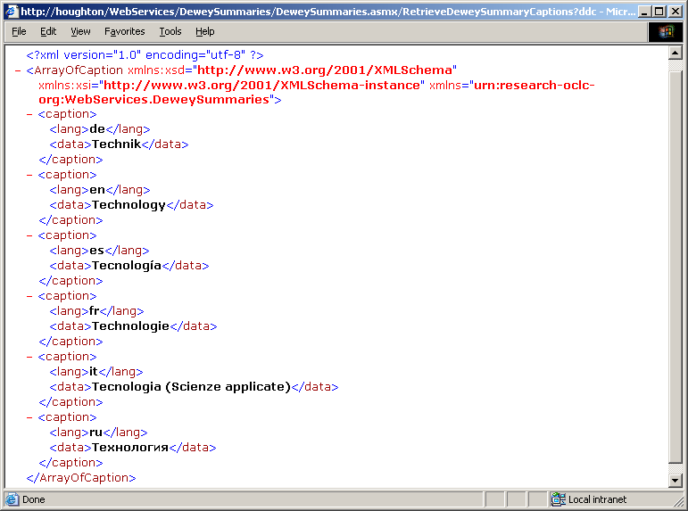
DDC Summaries: Translations

Slide 16
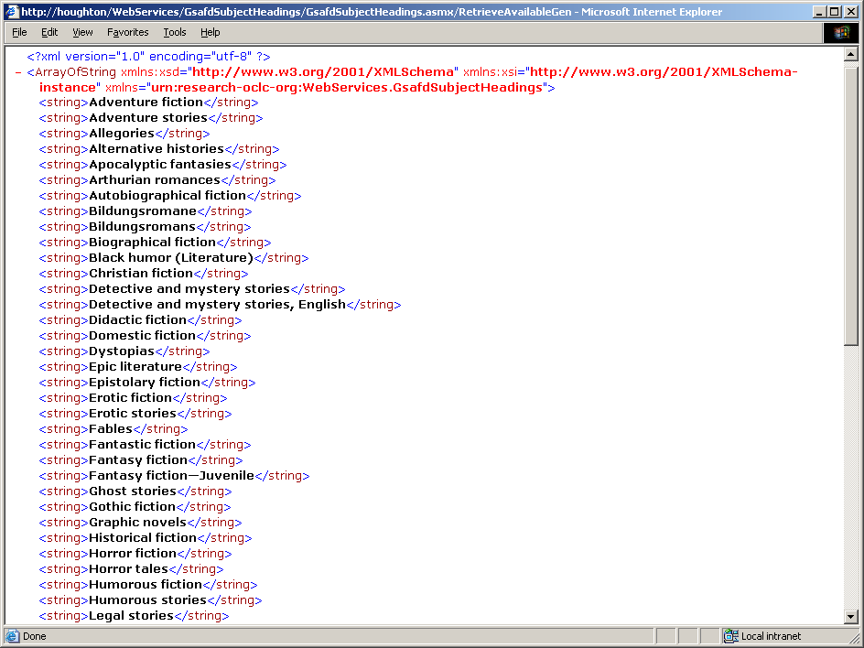
Retrieve genre terms

Slide 17
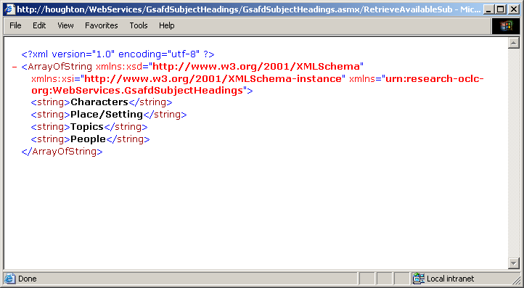
Retrieve subject types

Slide 18
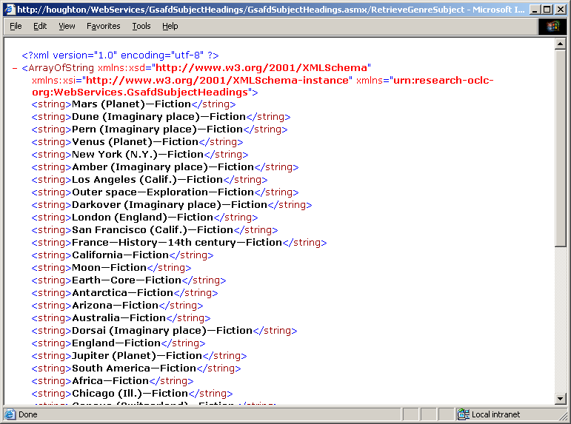
Retrieve place/setting for Science fiction

Slide 19
Example 3:
Metadata translation
The environment:
Multiple formats (MARC, Dublin Core, GEM) and a need for interoperability
Lots of ad-hoc or duplicated effort
Evolving standards and practices

Slide 20
High-level design
Crosswalk
Registry client
A crosswalk
Crosswalk
registry
Transformed record
Record translation
client
Record
transformer
A record to transform

Slide 21
Two pathways to translation
Structural transforms
Simple, lightweight, fully automatic, capitalize on current trends, appropriate when differences are purely structural
But: Hardcoded
Semantic translations
More general, closer to true interoperability
But: Not fully automatic

Slide 22
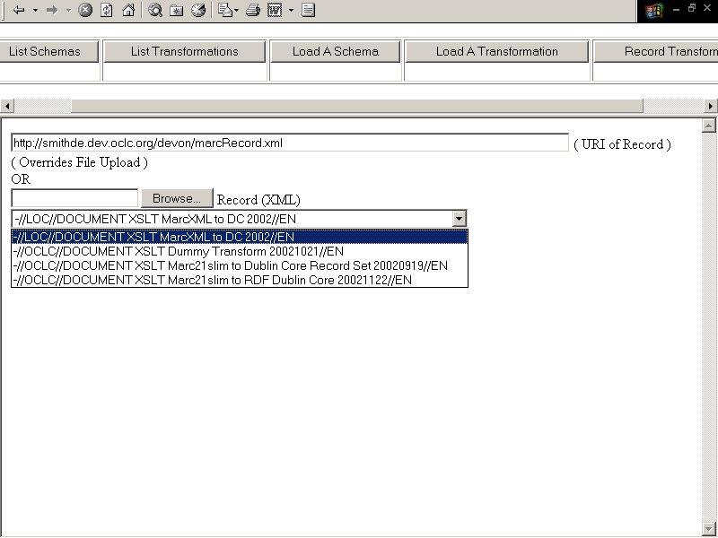
  A working client

Slide 23
Recurring themes in the
Metadata Switch project
Relevance to the management of metadata in the digital library
Appropriateness of the Web services model
Levels of granularity
Research vs. development

Slide 24
For more information
The Metadata Switch Project at OCLC
http://www.oclc.org/research/projects/mswitch/

