Slide 1
metasearching at NC State
Kristin Antelman
DLF April 20, 2004

Slide 2
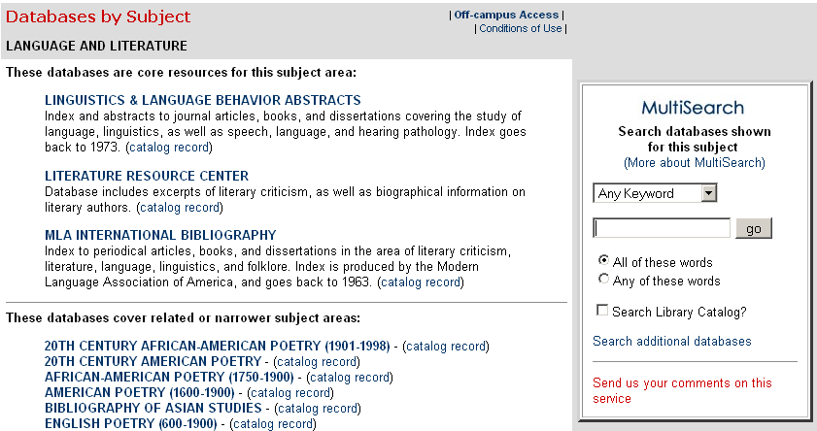
MultiSearch service developed using BlueAngel MetaStar APIs and local JSP/perl scripting
Released August 2002
Two interfaces offered:
detailed subject groupings …
background

Slide 3
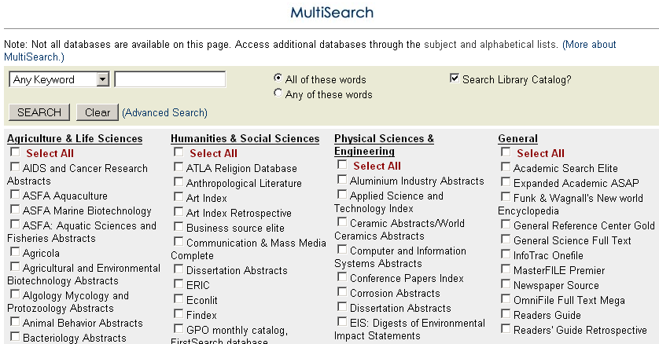
and broad subject groupings w/option
to select across groups
background

Slide 4
the ability to customize and post-process results
-- create OpenURLs for citations
from databases that are not
OpenURL sources
-- embed results in webpages
what we like about it
cross-domain searching
-- support for various metadata schema

Slide 5
Collection:
many core databases are not cross-searchable
Technical:
implementation is expensive
-- poor documentation
-- inconsistent vendor implementations
of Z39.50
Usability:
does the tool meet user needs?
-- are users successful in interacting
with it?
-- does it lead users to relevant
articles?
concerns

Slide 6
-- what information needs are best
met by metasearching?
key questions
-- is cross-searching more databases
better?
-- which is the better place for a user
to start, the smaller or larger result set?

Slide 7
questions :
Is it used?
MultiSearch: ~7000 searches/mo.
Ebsco: ~ 25,000 searches/mo.
log files

Slide 8
questions :
What type of searches do users do?
log files
any keyword
(default): 76%
subject kw: 9%
author kw: 8% title kw: 5%

Slide 9
questions :
What do the searches look like?
networking
log files
european integration
coyote eating habits
appreciation for the earth
Sunday v. Stratton Corporation 390 A.2d 398 (Vt. 1978)
plato
assisted housing discrimination
television news
habituation of birds and human closeness

Slide 10
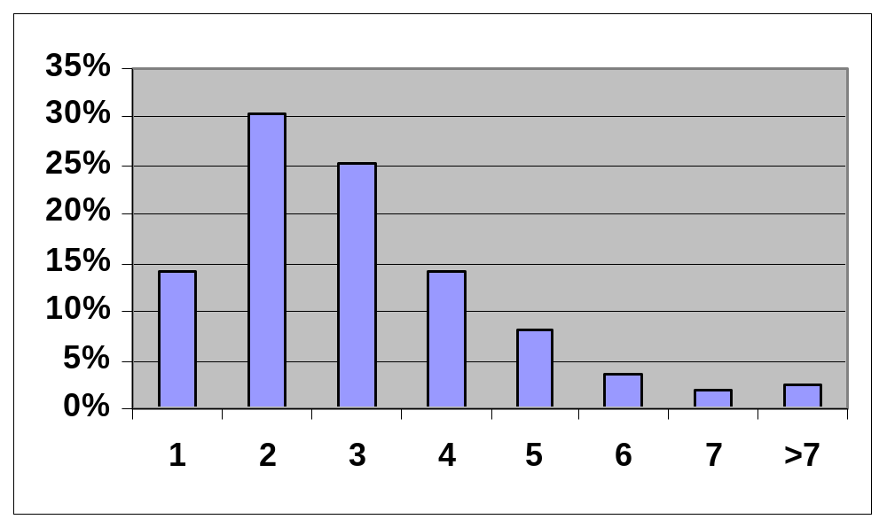
questions :
How many terms do users enter?
log files
mean=3.12; n=4329

Slide 11
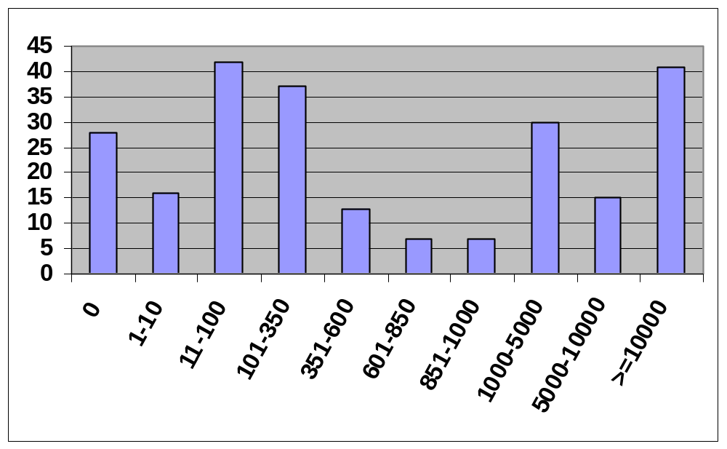
questions :
How many hits are they getting?
log files
n=236; mean > 51,000; stdev > 51,000!

Slide 12
questions :
For large result sets, does it
reduce the set size if the
search is resent as keyword
in subject?
It can.
log files
sets > 10,000 62% fewer (0% nulls)
sets > 350 91% fewer (21% nulls)
sets < 350 81% fewer (49% nulls)
n=39, 72, 95

Slide 13
Tasks:
think of a topic and do a search using
MultiSearch
look at some results and tell us if they
“look good to you”
Ask them:
was it easy or difficult to select the
databases you wanted?
which subject interface do you prefer?
what did you think was happening?
usability testing

Slide 14
questions :
Do they think the results
are useful?
usability testing
Mostly yes.
almost anything “works”
general level of confusion does
not affect satisfaction with results
(also it’s sometimes hard to tell “good”
from “bad” in quickly scanning brief records)

Slide 15
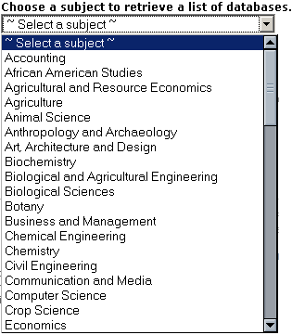
questions :
Which is the better subject grouping?
usability testing
64
OR

Slide 16
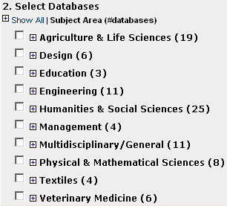
questions :
Which is the better subject grouping?
usability testing
10

Slide 17
questions :
Can users navigate the
interface?
Do they understand what it
is doing (or at least sort of)?
usability testing
Many don’t. They think…
the databases are subjects
the databases search all types
of materials
they are searching the full text
Complex interfaces are intimidating
→ serial failure

Slide 18
1. search for a new metasearch tool
2. improve the current interface
and experiment with ways to lead
searchers to the next step
next steps
for NCSU
3. explore other approaches
to getting users to appropriate
databases
e.g., send searches to local data source,
such as Ingenta tables of contents

