Slide 1

Copyright Permission for Open Access:
Costs, Strategies, & Success Rates
Denise Troll Covey
Principal Librarian for Special Projects – Carnegie Mellon
DLF Forum – April 2004 – New Orleans, LA

Slide 2
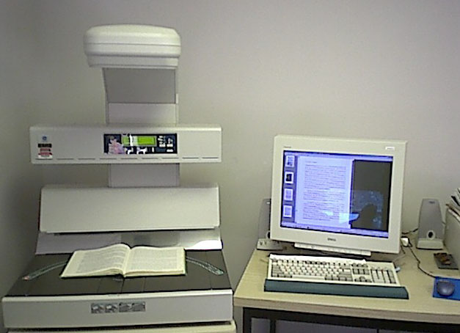
Feasibility Study 1999 – 2001
Random sample of titles in library catalog
Initial request letter – digitize & provide open access
Follow-up request letter
Intermittent labor
Did not track transaction costs

Slide 3
Success of Copyright Permission
 | Books
Total items | 337
1. Copyright protected | 94%
2. Publishers contacted | 88%
3. Publishers responded | 51%
4. Permission granted | 43%
Overall success rate | 22%
Articles | Images
96 | 646
70%
70% | 100%
45% | 36%
90% | 97%
28%
Carnegie
Mellon
1999-2001
Wayne
State
2000
Arizona
State
2001
Notes:
Success per print status – random sample
Of those responding, equally like to get permission to digitize in-print or out-of-print books
More likely not to locate the publisher or get a response with out-of-print books
Success per publisher type (responses)
45% scholarly associations
37% university presses
31% museums, art galleries
12% commercial publishers
Success per print status
Of those responding, equally like to get permission to digitize in-print or out-of-print books
More likely not to locate the publisher or get a response with out-of-print books

Slide 4
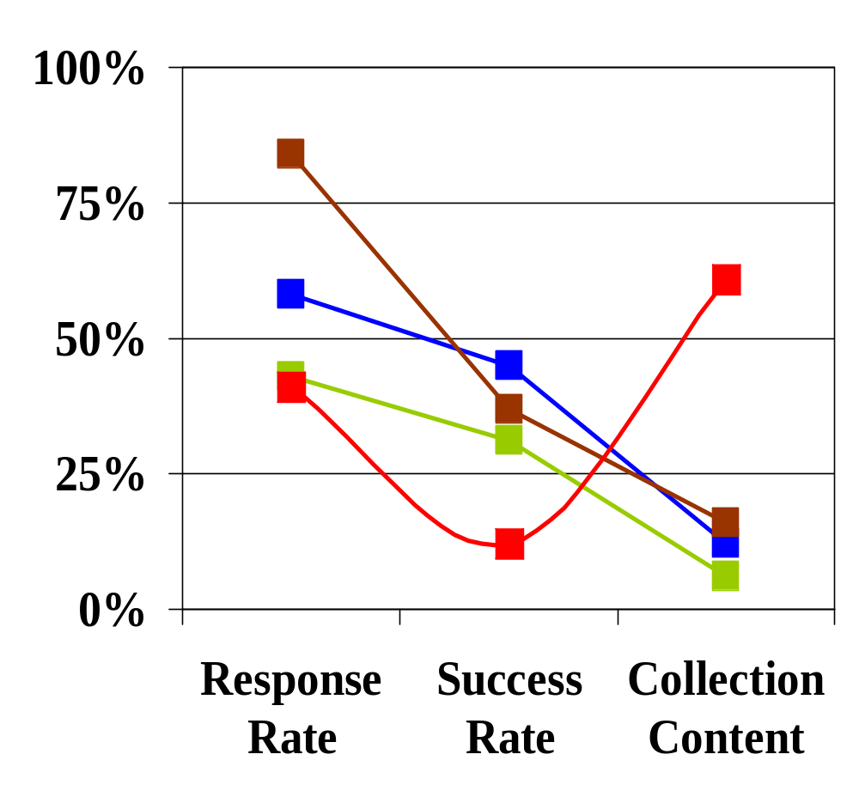
Analysis by Publisher Type
 | Success Rate
Scholarly associations | 45%
University presses | 37%
Museums & galleries | 31%
Commercial publishers | 12%
Based on
Responses
Notes:
Scholarly associations = least likely to respond, but most likely to grant permission if they responded
University presses = most likely to respond, somewhat less likely than scholarly associations to grant permission
Commercial publishers = likely to respond, but unlike to grant permission – most content in the sample

Slide 5
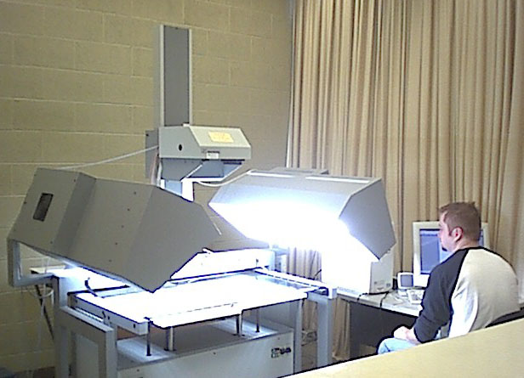
Fine & Rare Books Study 2003
Posner Collection – titles
Initial request letter
Follow up phone call or email
Dedicated labor May thru Oct 2003
Tracked transaction costs

Slide 6
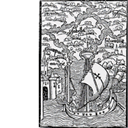
Problems Seeking Permission
Identifying & locating copyright holders
Publishers
  Don’t know what they published
  Don’t know what rights they have
  Afraid of open access & lost revenue
Learning copyright laws
  Abandoned foreign works
Notes:
Don’t know their rights
Don’t know what they published

Slide 7
Success of Copyright Permission
 | Posner Copyright Owners
Total | 107
1. Copyright protected
2. Owners contacted | 65%
3. Owners responded | 76%
4. Permission granted | 70%
Overall success rate | 53%
Sample Copyright Owners
337
94%
88%
51%
43%
22%
Posner Books
1106
302
66%
48%
  10% access restriction
  6% time duration restriction
Notes:
302 copyrighted titles / 1106 = 27% of collection
[OLD data = 53/326 = 16% foreign titles]
[Contacted owners of 218 titles 218/326]
144 permission granted / 302 = 48% titles overall permission granted
144 permission granted / 218 = 66% titles overall permission granted
39 / 114 copyright holders = 34% granted permission
70 copyright holders contacted / 107 total copyright holders = 65%
10% access restriction (14 books, 11 publishers)
6% time duration restriction (9 books, 1 publisher)

Slide 8
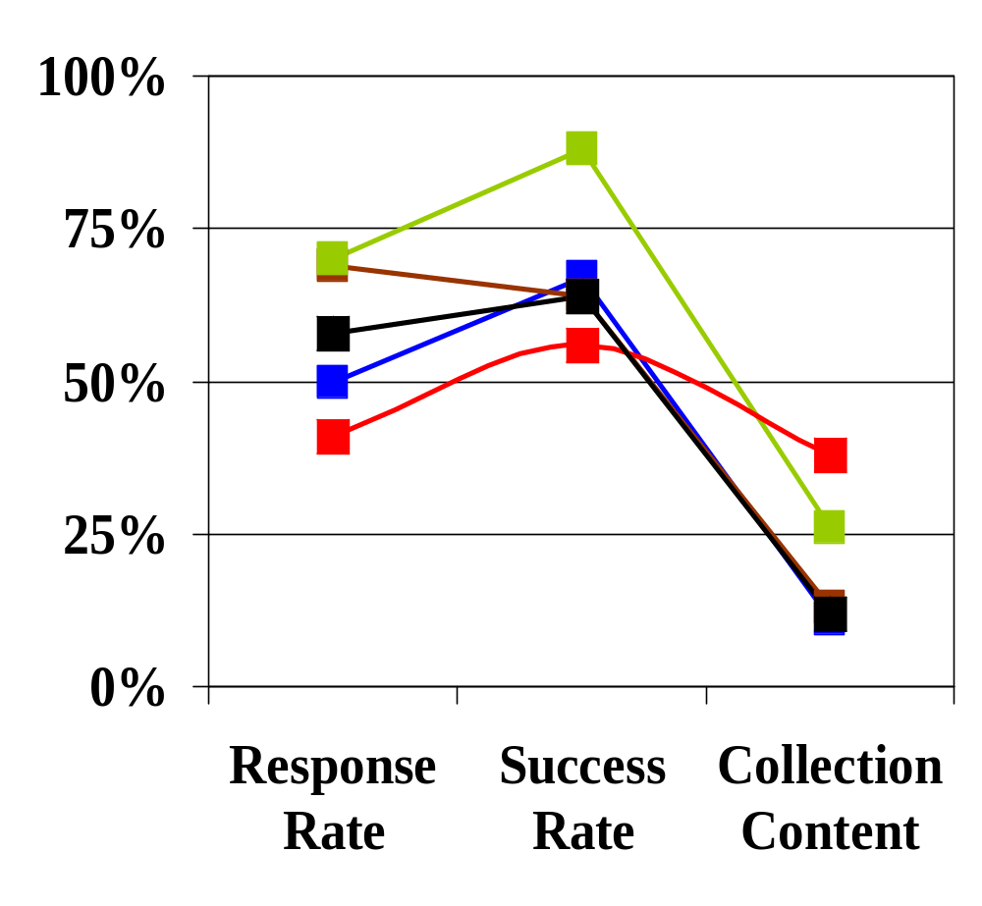
Analysis by Copyright Holder Type
 | Success Rate
Scholarly associations | 67%
University presses | 64%
Commercial publishers | 56%
Estates | 64%
Other | 88%
Based on
Responses
Notes:
Contacted 17 estates
6 granted permission = 35%
5 denied permission = 29%
3 didn’t respond = 18% -- 82% response rate
45% of content – of titles published by copyright holders contacted

Slide 9
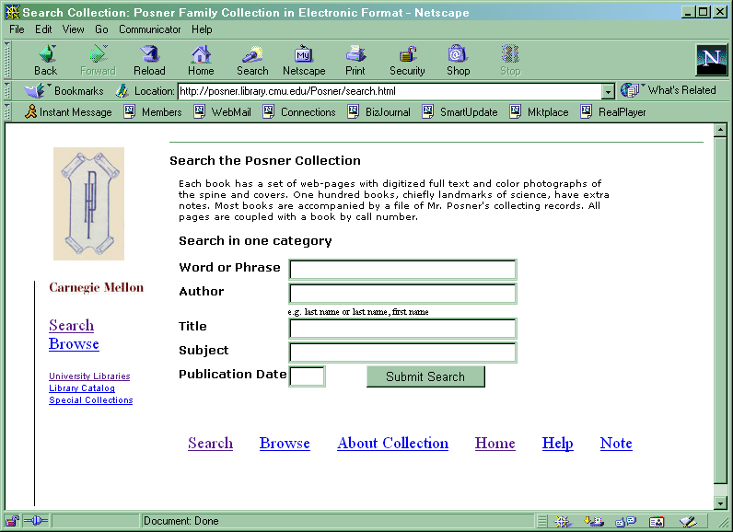
Transaction Costs
$78 per book/volume
$ 10,808 | FTE labor
$ 379 | Phone calls
$ 100 | Paper & postage
$ 11,287 | TOTAL
May 2003 – October 2003
Does not include legal fees,
administrator time, or cost of Internet
connectivity or database creation.
  170 letters & 159 follow-up calls or email

Slide 10
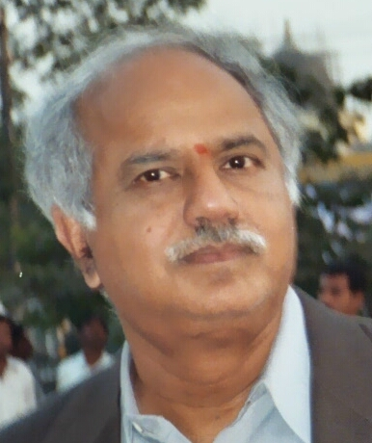
Million Book Project 2002 – 2007
Collection of collections
Initial request letter – titles ➔ publishers ➔ titles
  Works cited in Books for College Libraries
Follow up phone call or email
Dedicated labor beginning Nov 2003
Tracking transaction costs

Slide 11
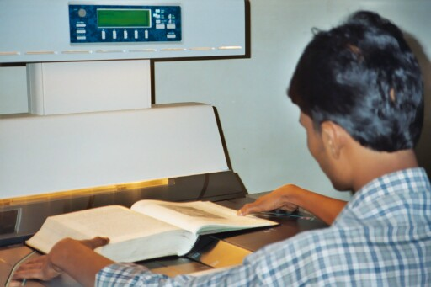
Request Letter
Educate
  Users want to find information online, but use print
  Online access increases use, even use of older works
  Open access does not decrease & can increase sales
  Currently no revenue from out-of-print books
Notes:
Increases use of older works

Slide 12
Request & Incentive
Ask for non-exclusive permission to digitize
  All out of print, in copyright titles
  All titles published prior to a date of their choosing
  All titles published # or more years ago
  List of titles they provide
Assure
  Following preservation standards & copyright law
  Print & save only one page at a time
Give – images, metadata, & OCR ➔ $$$$

Slide 13
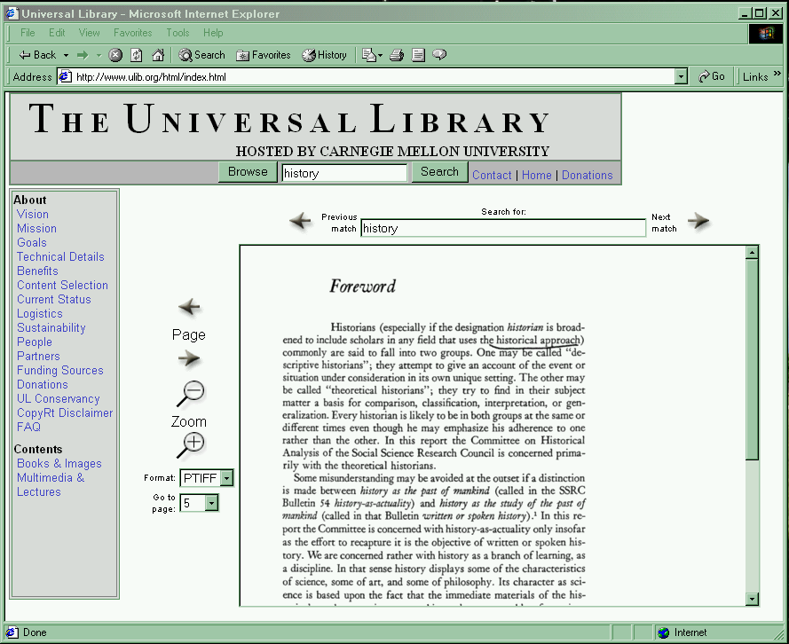
Estimated Transaction Costs
 $1.48 per book
$ 6,400 | Labor
$ 10 | Follow up
$ 93 | Paper & postage
$ 6,503 | TOTAL
Jun 2002 – Aug 2003
Does not include legal fees,
administrator time, or cost of Internet
Connectivity or database creation.
  207 letters & 57 follow up calls or email
Notes:
423 = 20% per month x 15 months = 6345
25,400 per year salary & benefits
184 letters = 68.00 postage (U.S.)
$15 paper/printing

Slide 14
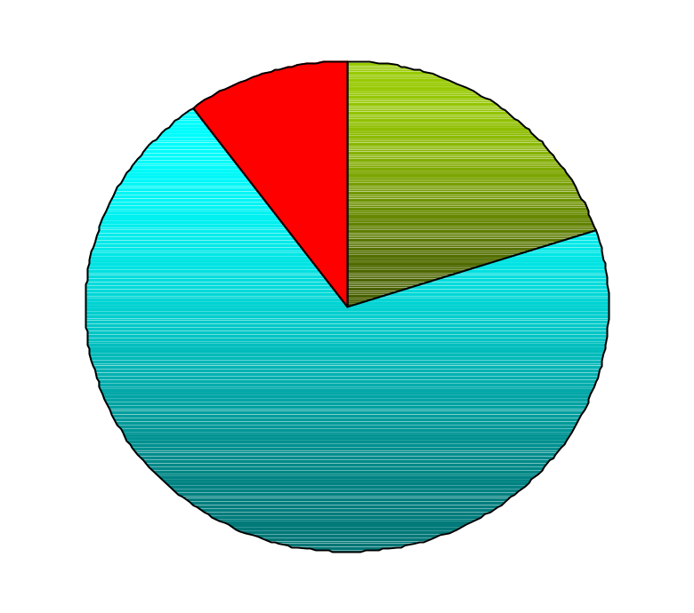
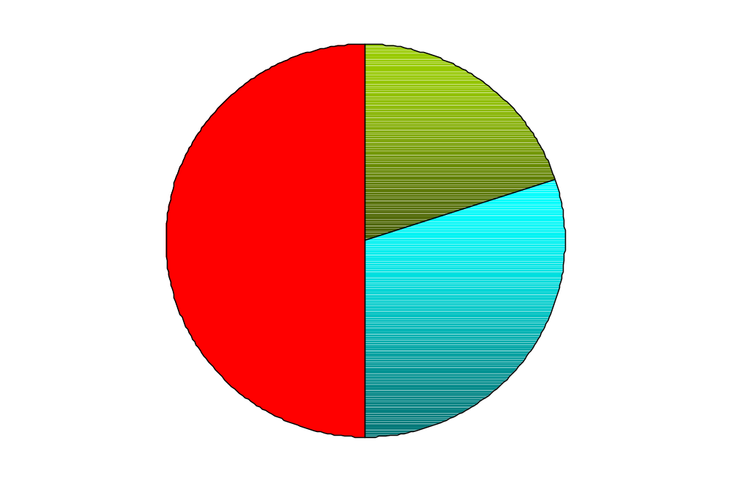
“More Bang for the Buck”
Initial
Current
Requires 6% success rate
with BCL publishers
& 1500 books each
In Copyright
Public Domain
Indigenous Materials

Slide 15
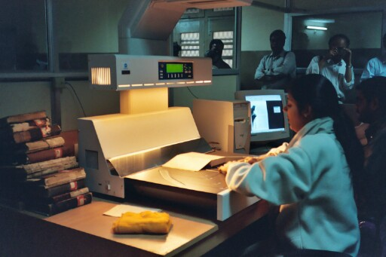
Snags with University Presses
Copyright often reverts to the author when books go out of print
More recent books will never go out of print because of print-on-demand contracts
Third-party copyright ownership issues
Will consider specific titles that WE select
Notes:
Concerns about third-party copyright ownership
More recent books will never be declared out of print because of print-on-demand contracts

Slide 16
Publisher Initial broad request letter
• If agree (grant permission), create & submit list of titles for approval
• If don’t agree, offer to create & submit
list of titles for consideration
(Books for College Libraries)
If copyright reverted, contact Author
If author deceased, contact Estate
• Request all or designated titles
(Books for College Libraries)
• If grant all, they provide list of titles

Slide 17
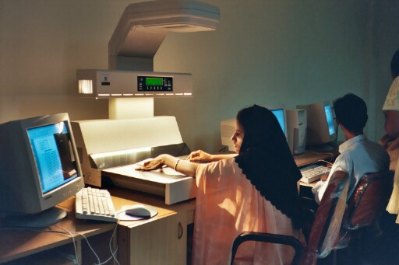
Experiment: Office of Copyright
Publisher
Expedite identifying & locating copyright holder
  Asked to identify & locate copyright holders of 7 titles
  Charged $150 fee – 3 days after request
  Estimated 4 to 6 weeks
  Nudged at 8 weeks
  Took 15 weeks to respond
  Confirmed one citation

Slide 18
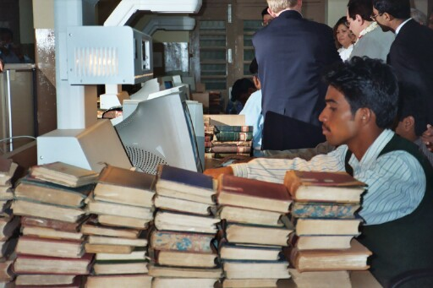
Experiment: Authors Registry
Author
Estate
Expedite locating copyright holder
  Asked to locate 25 authors or estates
  Charged $2.50 fee per author/estate found
  Same day response
  Found 52%
  92% accuracy rate
Notes:
Found 13 of the 25 authors/estates

Slide 19
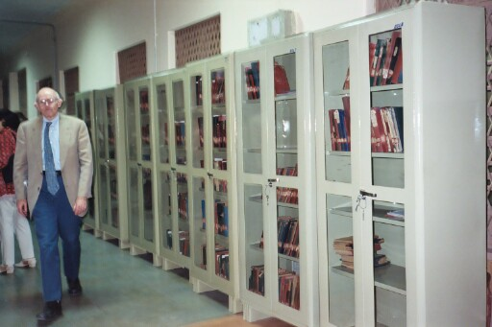
Experiment: Workflow Time Trials
List of Titles
Expedite generating lists of titles
  Verify citation – 30% improvement using digital BCL over WorldCat
  Verify copyright status – improvement using enhanced copyright renewal records database
  Verify print status – not cost effective
  Reduced from 9 to 6 minutes per title
Notes:
Found 13 of the 25 authors/estates

Slide 20
Success of Copyright Permission
 | Million Book Copyright Owners
Total | 206
1. Copyright protected
2. Owners contacted | 100%
3. Owners responded | 24%
4. Permission granted | 57%
Overall success rate | 14%
Posner Copyright Owners
107
65%
76% **
70%
53%
314 letters sent to locate 206 copyright owners
136 follow-up calls or email

Slide 21
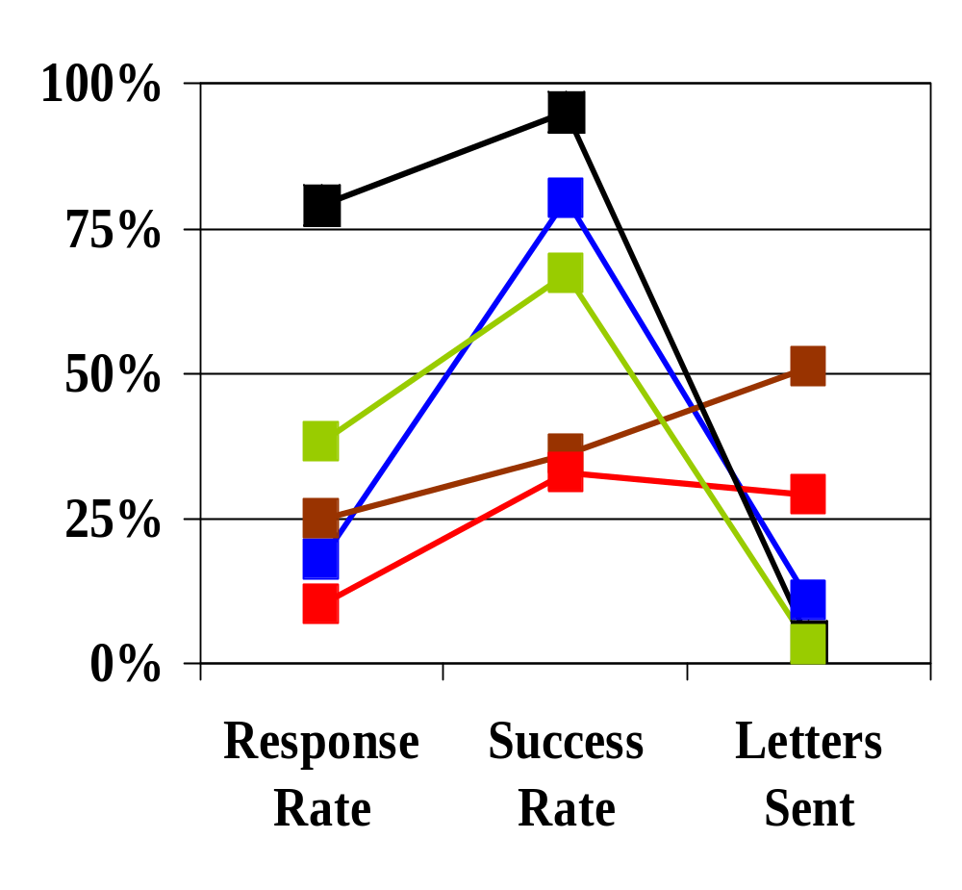
Analysis by Copyright Holder Type
Based on
Responses
 | Success Rate
Scholarly associations | 80%
University presses | 36%
Commercial publishers | 33%
Authors/Estates | 94%
Other | 67%
Don’t know number of books

Slide 22
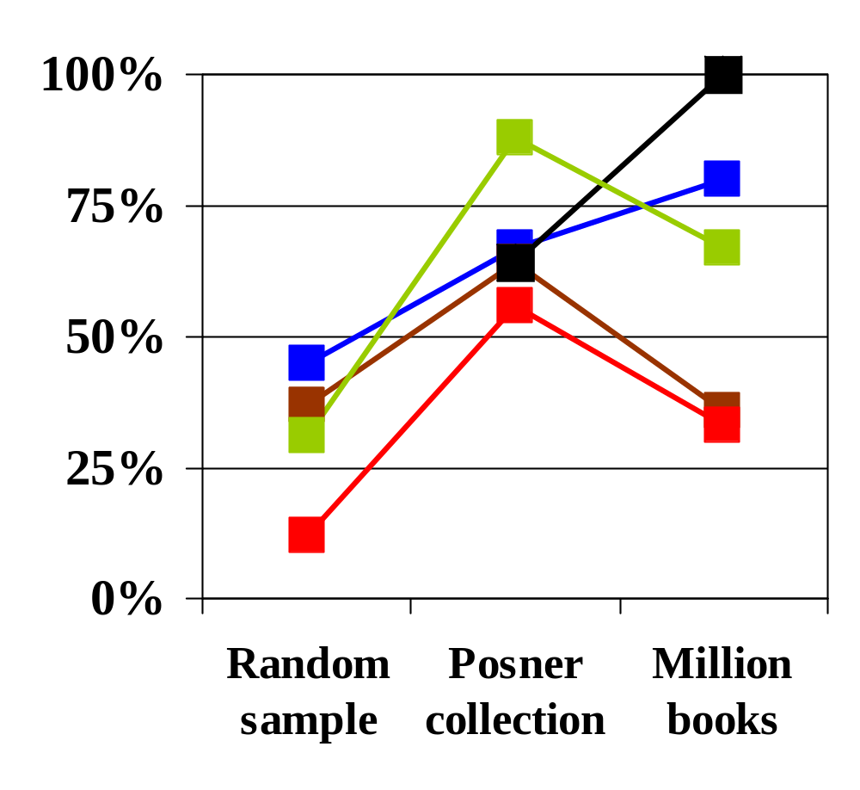
Success Rate Comparison
Scholarly associations
University presses
Commercial publishers
Authors/Estates
Other

Slide 23
Next Steps
Copyright assessments 2006
  Analyses of success rates, transaction costs, # of books
  Survey of participating publishers
Best practices & shared database
Partner with U.S. Office of Copyright
  Study impact of CTEA on accessibility of out of print books & costs of acquiring large scale permission
  Develop IT to help reduce costs & increase success
Notes:
Satisfaction with quality of copies
What they did or plan to do with the copies
Impact on revenue & view of open access
Use & impact on users –what they did with the books & why, what difference the books made, assessment of the quality of the Collection & the delivery system, and their estimation of the significance of the project.

Slide 24
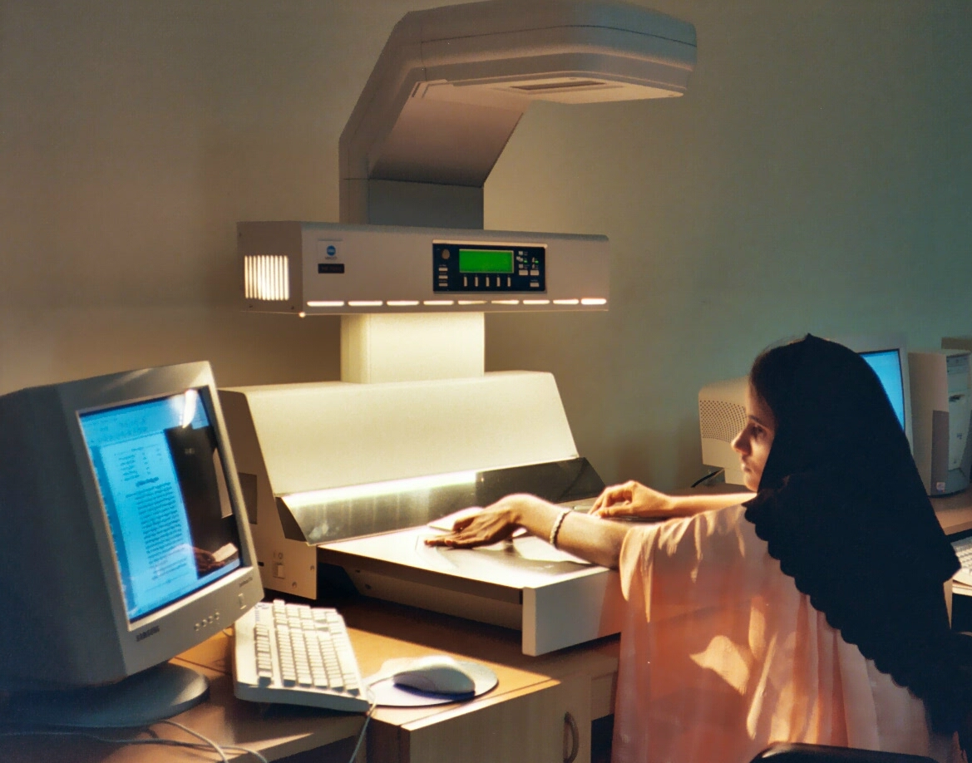
Thank you!
Denise Troll Covey – troll@andrew.cmu.edu

