Slide 1
Toward a User-Centered Digital Library
Virtual Collections at UCLA
Curtis Fornadley, Digital Library Architect
Howard Batchelor, Project Coordinator
curtisf@library.ucla.edu
howardb@library.ucla.edu
“Simply displaying collection objects, considered useful for informal learning in some way or another online, will no longer do.”
Digicult 4: October 2003

Slide 2
Interactive Digital Library Outline
Introduction: Digital Library interactivity concepts (5 minutes, HB).
< 1 >
Technical concepts and demonstration of Virtual Collections. A bridge to learning systems: (15 mins, CAF)
Save
Share
Transfer
< 2 >
< 3 >
Production and design implications for teaching collections and virtual communities. (10 mins, HB)

Slide 3
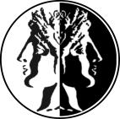
Digital Libraries In a Time of Transition
USABLE
DIGITAL
COLLECTIONS
DIGITAL
COLLECTIONS
DISCOVERING
FORAGING
LEARNING
TEACHING
CMS INTEGRATION
CUSTODIAN-
SELECTED
COLLECTIONS
USER-
SELECTED
COLLECTIONS

Slide 4
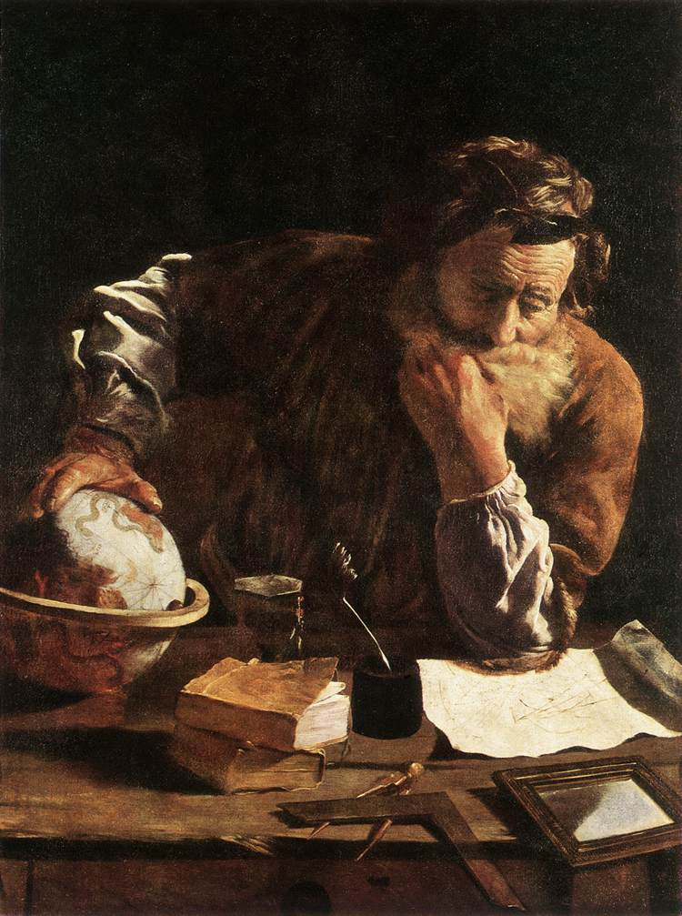
Reclaiming a Role for Libraries
The web has changed the relationship between learning and libraries.
How can digital libraries use the Web to add value to the experience of using library resources?

Slide 5
Ensuring the Survival of New Scholarship
Expectations for digital libraries
Experimental
Open-ended
Interactive
Software-intensive
< new, evolving, untested with users >
< objects have life-cycles >
< user experience is enriched >
< cost of tools and back-end support >
Executive Summary of New-Model Scholarship: How Will It Survive?
Abby Smith, CLIR publication, March 2003

Slide 6
Beyond the Shopping Cart:
The Experience of Ownership
Virtual Collections Resemble Commercial Web Services
http://www.expedia.com/
http://eat.epicurious.com
http://www.ebay.com

Slide 7

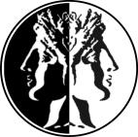
Virtual
Collections
Digital Libraries will be distinguished by the Services they provide.
Virtual Collections Is a Service.

Slide 8
















What Are Virtual Collections?
My Virtual Collection (1)
Digital Flag Collection
My Virtual Collection (2)

Slide 9
What are Virtual Collections?
My Virtual Collection 1
Digital Flag Collection
My Virtual Collection 2
Database

Slide 10
Users Create Virtual Collections
Virtual Collection Types
Registered User
Signed On
Ownership
View/Edit/Delete
Private
Protected-Locked
Protected-Unlocked
Anonymous User
Not Signed On
No Ownership
View/Edit
Public

Slide 11


Virtual Collection - User Access Model
Collection State | View | Edit
Private | No | No
Protected Locked | Requires Password 1 | Requires Password 2
Protected Unlocked | Requires Password 1 | Requires Password 1
Public | Yes | Yes
Note: The Owner of a Virtual Collection has full View/Edit/Delete Rights

Slide 12
Virtual Collection Architecture
VC Table
Unique ID
Title
Owner
Owner ID
Date Stamp
Access Level
Access Code
Lock (Y/N)
Admin Code
CLOB text
<?xml version="1.0" encoding="UTF-8"?>
<records>
<record>
<recordID>56334</recordID>
<note>A very long note</note>
</record>
<record>
<recordID>59360</recordID>
<note />
</record>
<record>
<recordID>61526</recordID>
<note>A very short note</note>
</record>
</records>

Slide 13
Using Virtual Collections in Context
The Sheet Music Consortium
http://digital.library.ucla.edu/sheetmusic
Rat Spinal Cord Image Archive
http://digidev.library.ucla.edu/ratscia

Slide 14


Current Architecture
Digital Library
Application
My VC
DB of
Virtual Collections
My VC

Slide 15
Future Architecture
DL App
DL App
DL App
DL App
My Digital Library
My VC
My VC
Virtual Collections

Slide 16

Connecting Users to Collections
Virtual
Collections
Formal Communities
Usable
Collections
Virtual Communities

Slide 17
Virtual Collections as a Bridging Technology: Implications for Digital Collection-Building
Change criteria for acquisition and selection: Projects respond to user needs and preferences. User-driven, not provider-driven.
Find the most appropriate subject matter to leverage features and benefits of Virtual Collections.
Form new alliances with CMS users (faculty and students) who need organized collections.
Attract virtual communities of scholars and researchers.

Slide 18
Challenges for User-Driven Digital Libraries
(1)
Managing user expectations.
Matching standard features to user needs.
Usability and User Expectations
(2)
Producing Collections for Targeted Audiences
(1)
Learners and teachers as primary VC users?
Or focus on research agendas?
(2)

Slide 19
Teaching Collections:
Criteria for Testing Relevance and Longevity
Plan to use in class (will teachers use the web?).
Critical mass (# of objects = 100 >?).
Permanent collection – of value beyond this class.
Is the material unique (not available on the web already).
Can departments create digitized material and metadata, or will library staff have to do it for them?
Do department staff buy into standards for metadata and digitization?
Can the department provide a project manager?
Will teachers accept a standard interface and viewer?

Slide 20
Virtual Collections - Virtual Communities:
The Search for Contextual Mass
Heritage institutions might benefit from fostering virtual communities….
Digicult 2004
Writing on archival materials
Virtual
Collections

Slide 21
References
“Simply displaying collection objects, considered useful for informal learning in some way or another online, will no longer do.”
Digicult: Thematic Issue 4 (October 2003)
“Academic libraries support and promote research, learning, and cultural engagement. In carrying out this role, they are inherently Janus-faced. Their gaze in one direction is focused on assembling, curating, and supporting the use of scholarly information; in another, it is fixed on tracking what information faculty, students, and lifelong learners actually need and on how and where they prefer to discover, locate, and use it.”
Dan Greenstein in Brockman, William S. et al. Scholarly Work in the Humanities and the Evolving Information Environment, CLIR 2001: (pub. 104) http://www.clir.org/pubs/reports/pub104/contents.html
Executive Summary of New-Model Scholarship: How Will It Survive?
Abby Smith, CLIR Symposium on Learning and Libraries (April 13, 2004): http://www.clir.org/registration/symp2004.html
Martha L. Brogan, A Survey of Digital Library Aggregation Services, Digital Library Federation, Council on Library and Information Resources, 2003.
http://www.diglib.org/pubs/brogan/
Borgman, Christine L:
  Challenges in Building Digital Libraries for the 21st Century, in Digital Libraries: People, Knowledge, and Technology (5th International Conference on Asian Digital Libraries, ICADL 2002). Singapore, Springer
  The Interaction of Community and Individual Practices in the Design of a Digital Library, in Sugimoto, S. (ed). Proceedings of the International Symposium on Digital Libraries and Knowledge Communities in Networked Information Society, March 2004, University of Tsukuba. http://www.kc.tsukuba.ac.jp/dlkc/
Digicult Thematic Issue 5: Virtual Communities and Collaboration in the Heritage Sector. http://www.digicult.info/

Slide 22
References
Problems of reconciling digital library environments with learning object standards are discussed in two working papers: Clifford Lynch and Neil McLean, “Interoperability between Information and Learning Environments—Bridging the Gaps,” A Joint White paper on behalf of the IMS Global Learning Consortium and the Coalition for Networked Information. Draft version of June 28, 2003: 13p.; at http://www.imsglobal.org/DLims_white_paper_publicdraft_1.pdf ;
and by Raymond Yee, “Enhancing Interoperability between Digital Libraries and Educational Technology via XML
Crosswalks.” http://www.cni.org/tfms/2003a.spring/abstracts/PB-Enhancing-Yee.html

