Slide 1
A Repository of Metadata Crosswalks
Jean Godby, Devon Smith, Eric Childress, Jeffrey A. Young
OCLC Online Computer Library Center
Office of Research
DLF-2004 Spring Forum
April 21, 2004

Slide 2
Outline of this talk
Crosswalks and metadata translation
Solution 1: A collection of XSLT scripts
Solution 2: Pathfinders for crosswalks
Solution 3: A crosswalk repository
Open issues
Project status

Slide 3
Our research project goals
A robust design for metadata translation
  A clean separation of:
    document data model
    schema translations
    machinery
  Support for current practice and foreseeable innovation
A metadata translation system/toolkit
  An ‘unplugged’ service for metadata translation
  A place for human input (intellectual mappings) in an automated system

Slide 4
Our system design
Crosswalk
repository
client
A metadata crosswalk
Record translation
client
A record
Metadata Translator
A transformed record

Slide 5
The problem
Reusing metadata often requires translation
Available translation options typically:
  Support single use cases
  Produce low-fidelity translations
  Are cumbersome to maintain
100 ‡a Shakespeare,
William, ‡d 1564-1616.ℙ
245 ‡a Hamlet.ℙ
260 ‡a New York :
‡b Penguin Books,
‡c c2003.ℙ
100 ‡a Shakespeare,
William, ‡d 1564-1616.ℙ
245 ‡a Hamlet.ℙ
260 ‡a New York :
‡b Penguin Books,
‡c c2003.ℙ
<dc:creator>Shakespeare,
William,1564-1616</>
<dc:title>Hamlet</>
<dc:publisher>Penguin Books</>
<dc:date>2003</>

Slide 6
What is a crosswalk?
“Crosswalks are used to ‘translate’ between different metadata element sets. The elements (or fields) in one metadata set are correlated with the elements of another metadata set that have the same or similar meanings. This is also sometimes called ‘semantic mapping.’”
Source: Canadian Heritage Information Network (http://www.chin.gc.ca/English/)

Slide 7
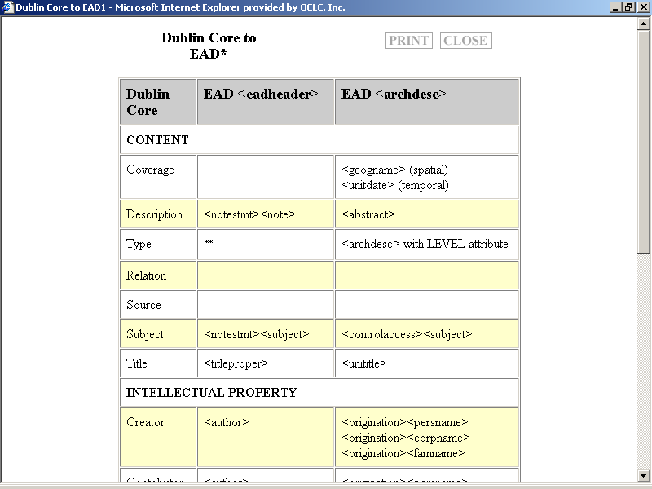
An example: Dublin Core to Encoded Archival Description (EAD)

Slide 8
Why use XSLT for crosswalks?
It capitalizes on current trends that model structured text in XML.
It is a reasonable solution for lightweight processes and simple semantic mappings.
So, an XSLT repository would:
Reduce duplication of effort.
Promote the use of standards.

Slide 9
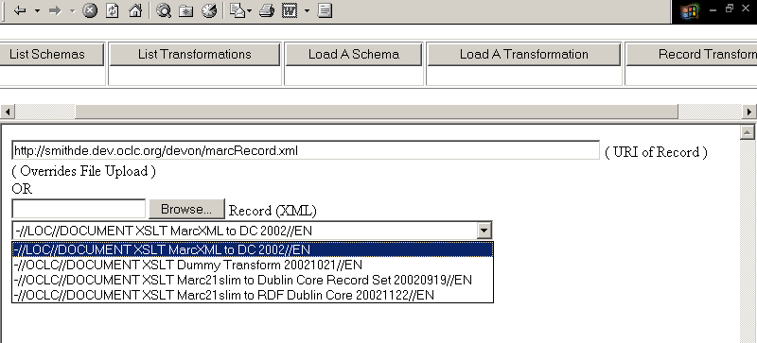


A test client
Which crosswalks have XML schemas that match my data?
Which crosswalks are equivalent?
If they’re not equivalent, how do they differ?

Slide 10
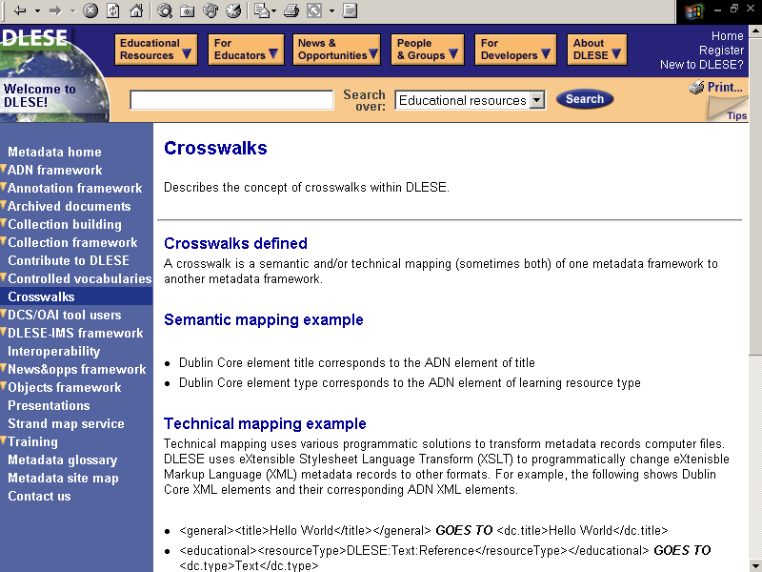
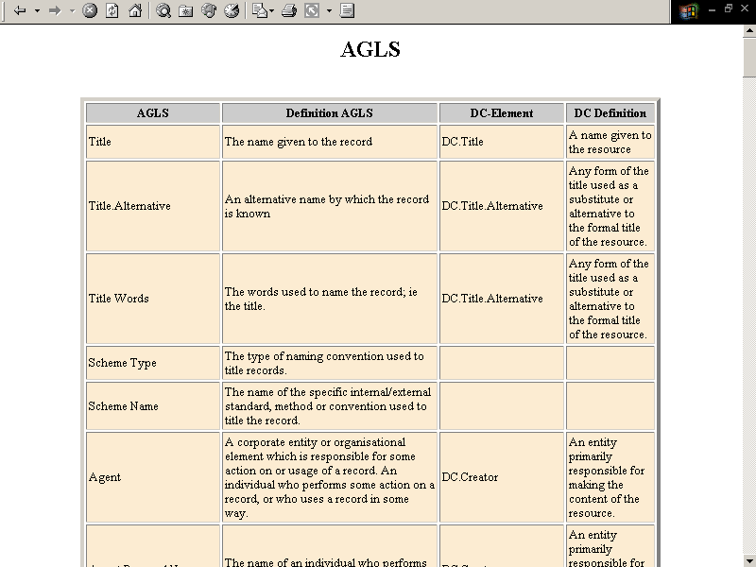
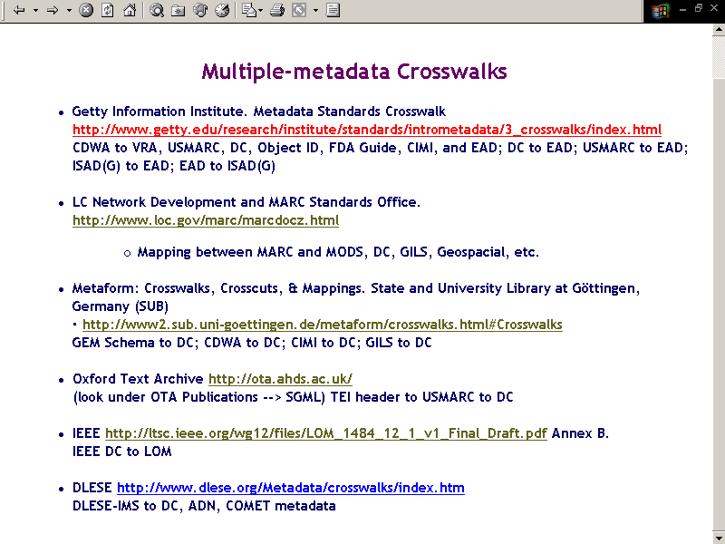
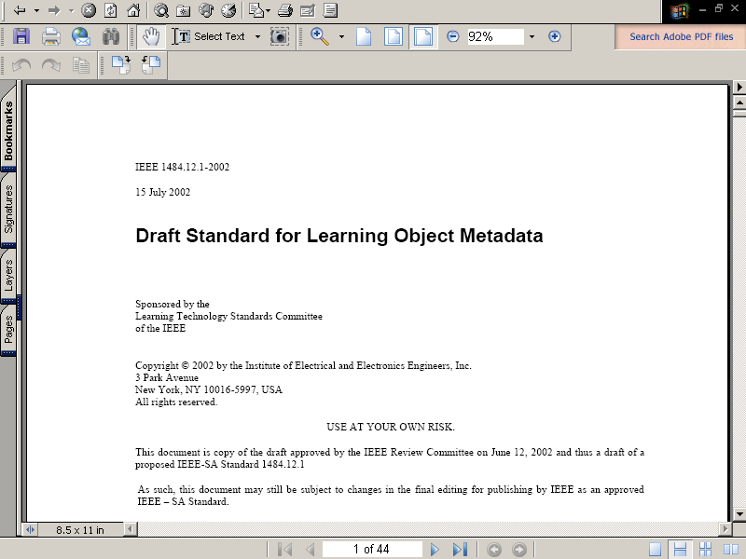
A crosswalk pathfinder

Slide 11
Some problems
In the XSLT collection
  Information needed for executing the scripts is missing.
  Undocumented XSLT scripts aren’t crosswalks, as we have defined them.
  Syntax and semantics have been dissociated.
  The collection can’t be mined.
In the pathfinder page
  The documents vary in scope and granularity.
  Executable code is often difficult to locate.
  Pathfinders aren’t designed for browsing and searching.

Slide 12
The crosswalk repository (3.0)
Components of our solution:
Model the crosswalk as a complex object using the Library of Congress Metadata Encoding and Transmission (METS) standard.
Assemble the records into a searchable repository built on Open Archives Initiative (OAI) standards.

Slide 13
A crosswalk as a METS record
Describe the crosswalk object in the METS header.
Assemble and identify six objects in the METS structural map:
  The source metadata schema
  The target metadata schema
  The crosswalk
  Human-readable and executable versions of each
Associate metadata for each file in the METS Descriptive Metadata Section.

Slide 14
OCLC’s OAI repository
“The Open Archives Initiative develops and promotes interoperability standards to facilitate the efficient dissemination of content. Primary among these is the Open Archives Initiative Protocol for Metadata Harvesting (OAI-PMH).” Source:oclc.org/research
Collects publicly accessible XML-encoded metadata on a range of research projects into a searchable collection, including thesauri and Electronic Theses and Dissertations.
Includes XML tools required to manage the data, such as XSLT scripts.
Serves as a testbed for research on information registries, URL maintenance, and searching.

Slide 15
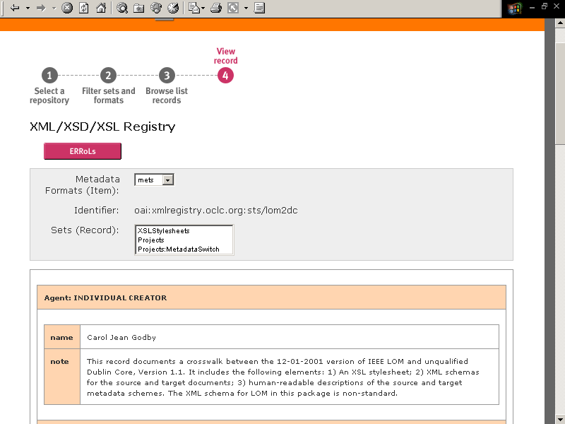
A crosswalk METS record
in the OAI repository

Slide 16
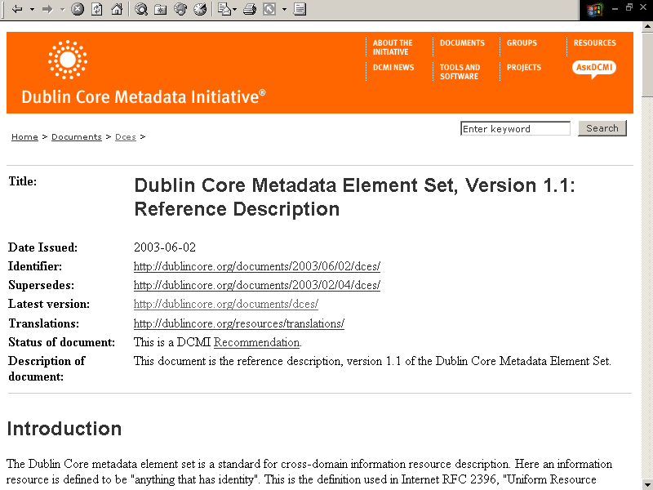
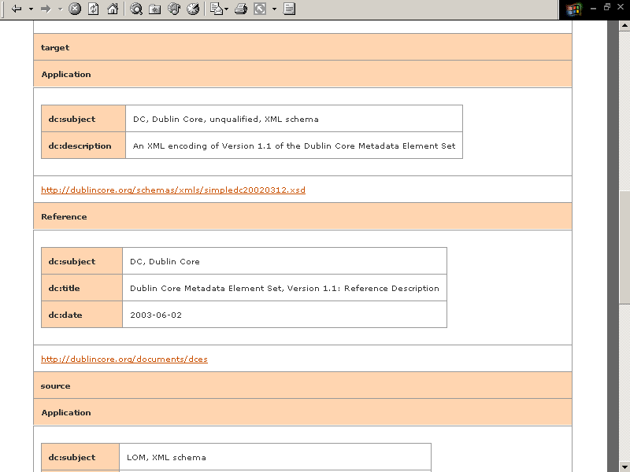
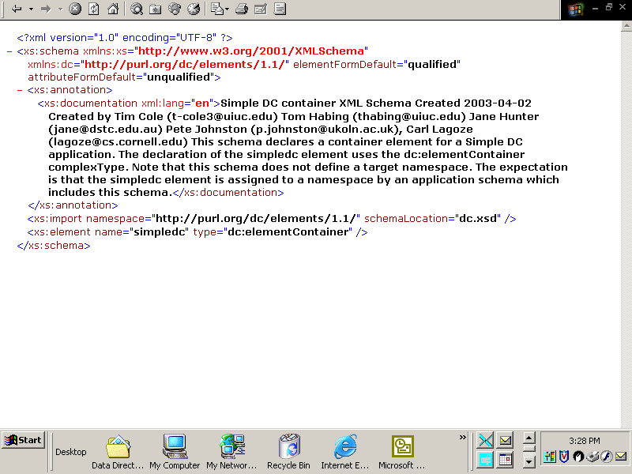

Slide 17
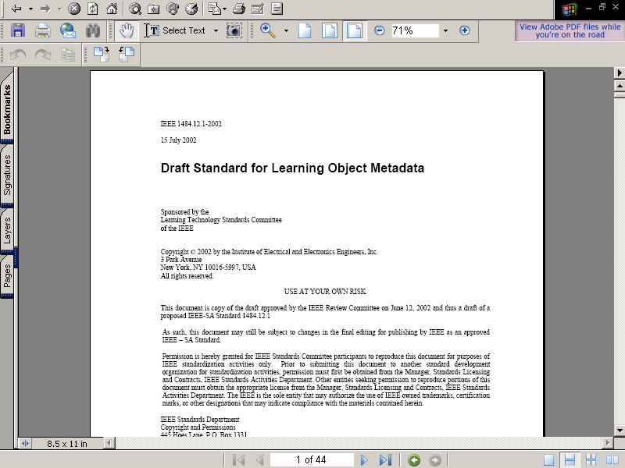
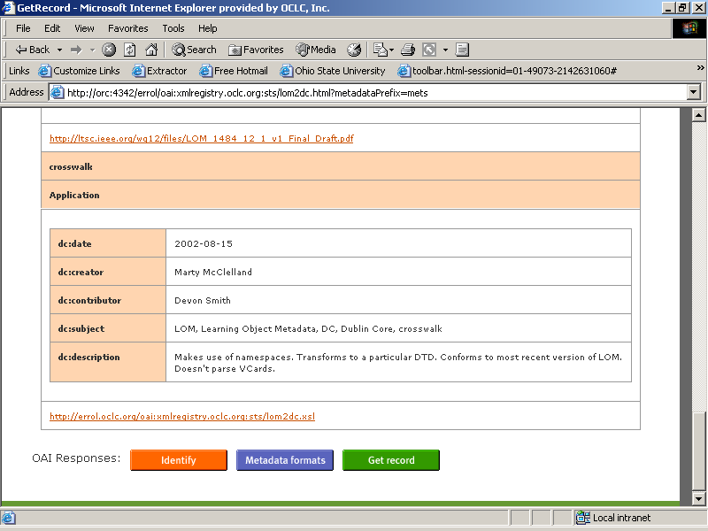
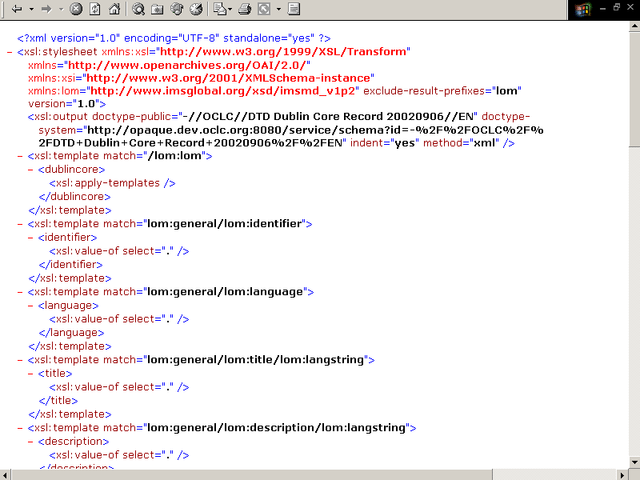

Slide 18
What the METS encoding solves
The semantic and syntactic information required for interpreting and executing a crosswalk is collected into a single object.
The repository is searchable by humans and automated processes.
Services can be built on top of it.
It encourages the development and standardization of crosswalks.
These outcomes are possible because every component in the system is a standard.

Slide 19
Some possible services
Translations
Queries
  Which encodings have been done for a given metadata schema or namespace?
Interactions with data
  Given the XML schema and namespace referenced in my data, does this repository have any XSLT scripts that process it?
Documentation
  The METS crosswalk object can be associated with a given set of records to document which standards/versions/scripts were used to convert it.

Slide 20
Open issue 1
Are crosswalks a potential standard? Or just a local solution for the management of heterogeneous data?
“The crosswalk is a preliminary one aimed at transforming relatively simple METS documents…” Source: Yee and Beaubien, 2003
“Crosswalks that extend interoperability are essential so that the digital library collections can be accessible through a variety of portals and search interfaces. As more organizations share what they have learned…the development of crosswalks will be better understood and more easily accomplished.” Source: Lightle and Ridgway 2003

Slide 21
Open issue 2:
Is XSLT the best tool for metadata translation?
XSLT is cumbersome when there is a need for high-fidelity translations.
More precise associations between syntax and semantics may be necessary.
The supporting documentation required for verifiable translation is daunting.
Metadata Schema X (versions * encodings) *
Metadata Schema Y (versions * encodings)

Slide 22
Project status
The OCLC OAI repository is accessible at:
http://errol.oclc.org/xmlregistry.oclc.org.html
Advanced searching using the SRW (Search/Retrieve Web service) protocol is currently being implemented.
The registry is being populated with crosswalk records.
We welcome your comments and participation!
Notes:
\

Slide 23
For further information
Metadata Schema Transformation Services
http://oclc.org/research/projects/mswitch/1_schematrans.htm
The Open Archives Initiative Project
http://oclc.org/research/projects/oai/default.htm
“Two Paths to Interoperable Metadata”
http://oclc.org/research/publications/archive/2003/godby-dc2003.pdf

Slide 24
References
Raymond Yee and Rick Beaubien. 2003. “A Preliminary Crosswalk from METS to IMS Content Packaging.” Library Hi Tech.
Kimberly Lightle and Judith S. Ridgway. 2003. “Generation of XML Records across Multiple Metadata Standards.” DLIB http://dlib.org/dlib/september03/lightle/09lightle.html

