Slide 1
OAI Registry at UIUC http://gita.grainger.uiuc.edu/registry
Presented by: Thomas Habing
Grainger Engineering Library Information Center
University of Illinois at Urbana-Champaign
thabing@uiuc.edu

Slide 2
Reason
Difficulty finding relevant OAI repositories to harvest, especially in selecting individual sets within a repository
Other questions:
  Which repositories are aggregating other repositories?
  How big are individual repositories?
  How to find new repositories as they come online?
  What is the state of the OAI world?
Enable other meta services

Slide 3
Sources
Various other registries:
  http://celestial.eprints.org/cgi-bin/ListFriends.pl
  http://oaisrv.nsdl.cornell.edu/Register/ListFriends.pl
  http://www.language-archives.org/register/archive_list.php4
  http://www.mds.rmit.edu.au/~ajk/oai/interop/targets.xml
  http://www.openarchives.org/OAI/RejectedSites
  http://www.openarchives.org/Register/ListFriends.pl
Google (allinurl:verb=Identify)
friends
provenance

Slide 4
Features
Search (Identify, ListSets, sample records)
Harvestable via OAI
RSS
Many ways to customize repository lists
Many misc. reports and lists
Harvest Bag (still needs much work)

Slide 5
New Features
Classify repositories (GEM?)
Automate repository maintenance
Better record counts for each repository
Identify which repositories are aggregators
Open for suggestions…

Slide 6
Tech Details
Windows 2000 Server
Active Server Pages (ASP) running under the IIS web server
SQL Server database w/ fulltext search
Custom harvesting programs written in VB and VBScript

Slide 7
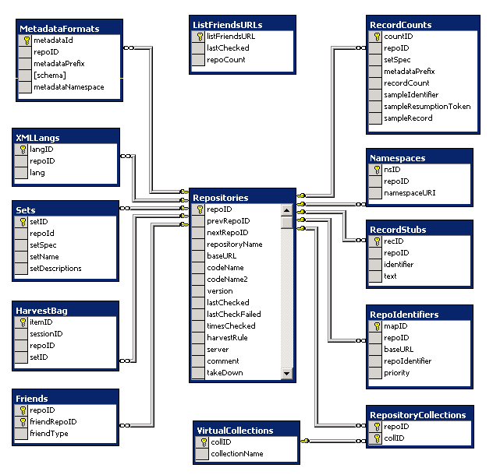
Database

