Slide 1

The 3 M’s: MINERVA, MODS, and METS
Allene Hayes (LC)
Rebecca Guenther (LC)
Leslie Myrick (NYU)
DLF -- New Orleans April 20, 2004
Notes:
Conversion = Scanning or reproducing in digital form something that was originally in analog (American Memory historical collections). Digital version usually for access, sometimes for preservation
Born digital = never had an analog equivalent – Digital is it.

Slide 2
Topics of Discussion
MINERVA http://www.loc.gov/MINERVA/
MODS http://www.loc.gov/standards/mods/
METS http://www.loc.gov/standards/mets/
Notes:
Allene : provide basic over view of the MINERVA Project and introduce our cataloging issues.
Rebecca: provide information about the use of MODS for MINERVA and introduce our use of METS.
Leslie: will discuss the development of METS application profile for a Web site object.

Slide 3
Mission Statement
MINERVA collects and preserves Web sites and Web pages for the Library
Goal is to preserve primary source materials for future generations

Slide 4
Why Archive Web sites?
"The Internet is as important as the print media for documenting these events.”
"Why? Because the Internet is immediate, far-reaching, and reaches a variety of audiences. You have everything from self-styled experts to known experts commenting and giving their viewpoint."
Notes:
Comments of Diane Kresh, Director of Library Services,
Library of Congress

Slide 5
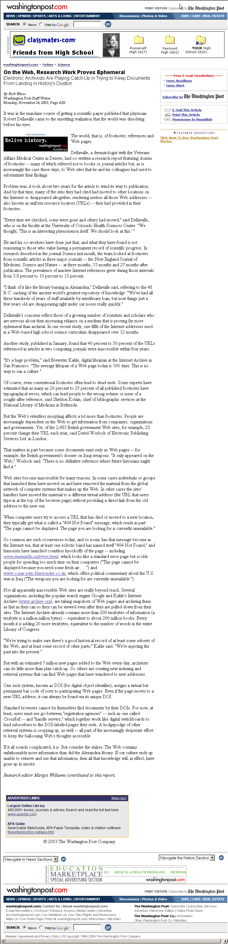

Slide 6
Our Core Team
Project Manager
2 Reference Specialists
2 Digital Conversion Specialists
Cataloging Specialist
Network Development and MARC Standards Office representative
and soon, we hope, a digital rights specialist…

Slide 7
Partners
Internet Archive
Alexa Internet
WebArchivist.org
  University of Washington, Center for Communications and Civic Engagement
  State University of New York, Institute of Technology (SUNY-IT)
Notes:
The prototype, which I’ll talk about in a moment, was developed entirely in-house by Library of Congress staff.
Since then, partnerships and collaborations have been crucial to the creation of the Library’s web archives. Internet Archive, a 501(c)(3) public nonprofit has been a major partner since 2000. Internet Archive brought advanced technologies and expertise to the project. This archive was our first practical test case for a large-scale, event-based collection. Founded in 1996, the Internet Archive has used technology available to them under partnership with Alexa Internet to harvest, manage, and provide access to the Library’s web archive data. Currently, three collections (Election 2000 and September 11, and Election 2002) are temporarily hosted by the Internet Archive while the Library works to process, catalog, and make them available directly from the Library’s servers.
For the Election 2000 collection, the Internet Archive worked with Compaq Computer to undertake the major task of collecting and archiving sites. Alexa Internet collected and archived Web sites for the Olympics and September 11th Collections and has also worked with the Library on its three most recent projects.
The Library has also formed a partnership with WebArchivist.org, a research group co-directed by professors at the State University of New York Institute of Technology and the University of Washington. This group develops systems for identifying, collecting, cataloguing and analyzing large-scale archives of web objects, and the Library has contracted with them to perform a variety of web archiving tasks, including the development and testing of new methods of identification, cataloging, and access.

Slide 8
Collections
FY00
LC Prototype: sampling of sites
Election 2000: 767 sites
FY01
September 11th: 30,000+ sites
Notes:
With each project, we’ve become more advanced and experienced. The team has grown from a small part-time pilot group to full-time, dedicated staff and a variety of participants from around the library helping with the effort.
We’ve gained specific experiences during the pilot and beyond, and have worked to build better structured, better cataloged, and with better access as we’ve moved through the last years.

Slide 9
FY02
2002 Winter Olympics: 70 sites
9/11 Remembrance: 1,800 sites
Election 2002: 3,000+ sites
FY03-04
107th Congress: 588 sites
War on Iraq: 288 sites
Election 2004: 134 sites & growing

Slide 10
The Prototype
Initial test Mid 2000
LC crawled about 30 sites using a desktop Web crawler (HTTrack)
Provided an initial investigation into the processes involved in Web capture
Sites were cataloged
Access is on campus only

Slide 11
The MINERVA
Process
Collection
Planning
Legal Review
Access
Selection
Interface
Development
Notification/
Permissions
Cataloging
Technical
Review
Crawl & QA
Notes:
Our work is evolving, and we’re learning and improving with each project. Our current process includes the following general steps:
First, we develop a collection plan and strategy for collecting sites related to a particular event (such as the War on Iraq). We identify breadth, depth, and frequencies for the collection.
Recommending officers at the Library select sites to be included, and a technical review is performed to ensure that we can capture the relevant content.
Site owners are contacted prior to crawling to notify and seek permissions.
URLs are then submitted to our harvesting contractor through an XML-based “SEED FILE”, which includes specifications about what frequency to crawl.
The contractor and the Library perform quality assurance tests on the archive.
Cataloging, Interface, and Access decisions are made, and if all goes well, we have an archive!

Slide 12
The Process is Evolving
Collection
Planning
Notification/
Permissions
Legal Review
Legal
Authority
Access
Non-Event
based collecting
Templates &
Tools
Cataloging
In-house
expertise
Interface
Development
Selection
Select + create
metadata up front
International
Internet Preservation
Consortium
Technical
Review
Automation
& Tools?
Crawl & QA
Alternate
Crawl
Contractors
Preservation?
OSI
Notes:
Our work is evolving, and we’re learning and improving with each project. Our current process includes the following general steps:
First, we develop a collection plan and strategy for collecting sites related to a particular event (such as the War on Iraq). We identify breadth, depth, and frequencies for the collection.
Recommending officers at the Library select sites to be included, and a technical review is performed to ensure that we can capture the relevant content.
Site owners are contacted prior to crawling to notify and seek permissions.
URLs are then submitted to our harvesting contractor through an XML-based “SEED FILE”, which includes specifications about what frequency to crawl.
The contractor and the Library perform quality assurance tests on the archive.
Cataloging, Interface, and Access decisions are made, and if all goes well, we have an archive!

Slide 13
Collection planning
Identify the “event” (thematic)
Secure the funding
Develop task order
  Scope of collection
  Acquisition parameters
    Size of collection
    Collection period (start and end dates)
    Web site URLs – define categories for selection
    Frequency, depth, breadth

Slide 14
Legal Review
Bibliographic Services Agreement
Task Orders
Notifications and permissions
  Fair use argument for event-based collecting
    Notice of crawl; Permission to display offsite
    Permission to crawl and display: foreign and “creative” sites
  Modification of 407 mandatory deposit regulation

Slide 15
Selection
MINERVA reference specialists work with Recommending Officers to:
Develop collection policy statement for event-based collections
Identify specific Web sites to collect
Identify contact information of site owner/producer
Enter into database using nomination form

Slide 16
Notification/Permissions
Tasks currently shared by all members of the team:
Email appropriate notification and permissions
Respond to phone & email queries
Find alt addresses and resend if no response
Track responses in database
Provide access condition statements for catalog record, inform ITS of restrictions

Slide 17
Technical Analysis
Identify potential technical challenges:
  Macromedia FlashTM introductions
  Log-ins, either free or pay sites
  Dynamically-generated Web pages
  Dynamic menu
  Databases
Determine best point of entry (eg. start URL)

Slide 18
Crawl and QC
Access to crawl 24 hrs after completed
Quality assurance using status and error reports
Troubleshoot problems with crawl
Modifying the crawl to be more focused, refined, specific

Slide 19
CATALOGING
Prototype
  MARC records in ILS
Collection Level
  MARC records in ILS
MODS Item Level
  MODS records on MINERVA site, but created with import to ILS in mind

Slide 20
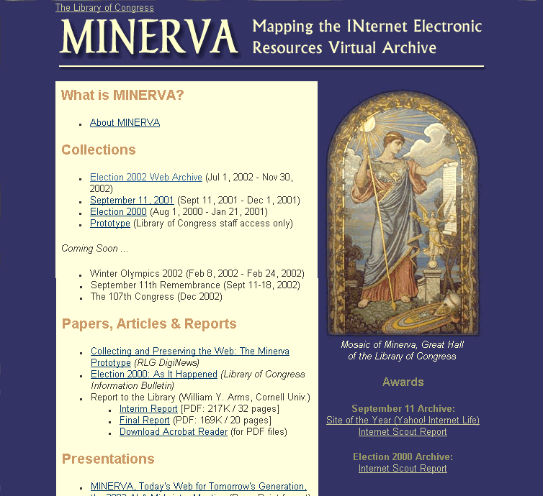

Slide 21
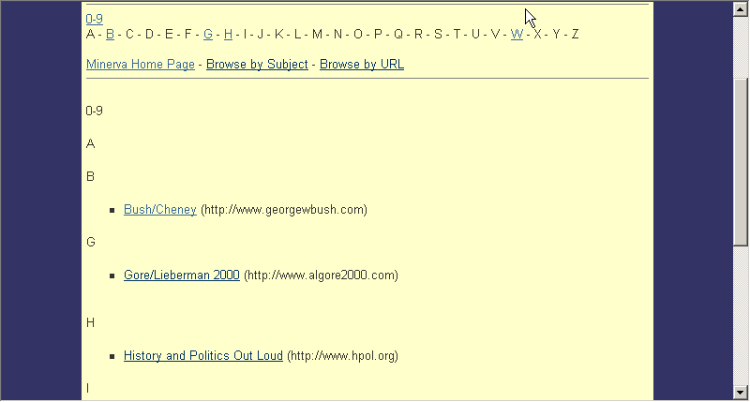
Notes:
From the prototype page you can access the individual site. From here you can access the Title resource page which lists all the iterations of the site that had been captured on the day of harvest.
If we click on Bush/Cheney. We are taken..

Slide 22
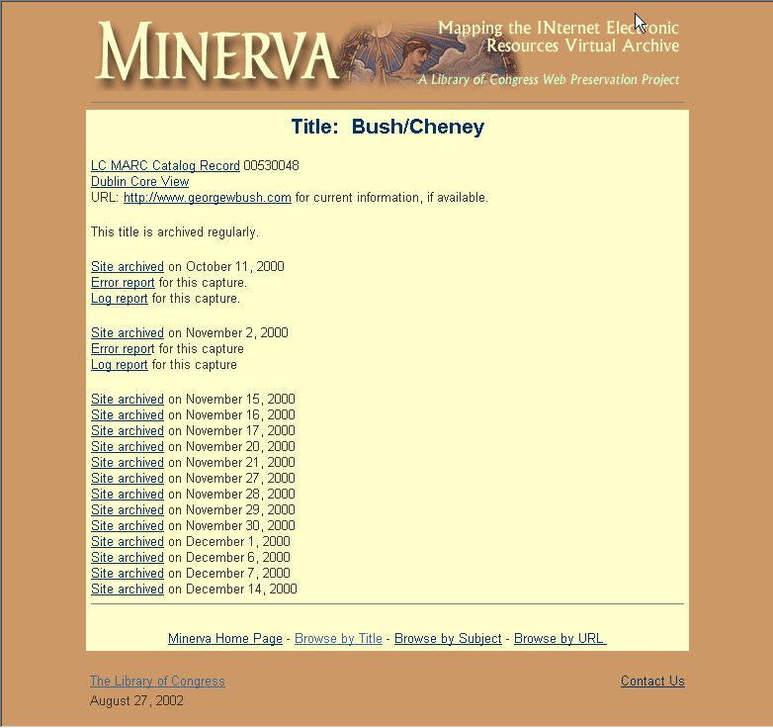
Notes:
To the Bush/Cheney Title Resource page with lists each iteration of the site and the day of harvest (if you will). From here you can access the archived site, the live site if still available and the record in our ILS.

Slide 23
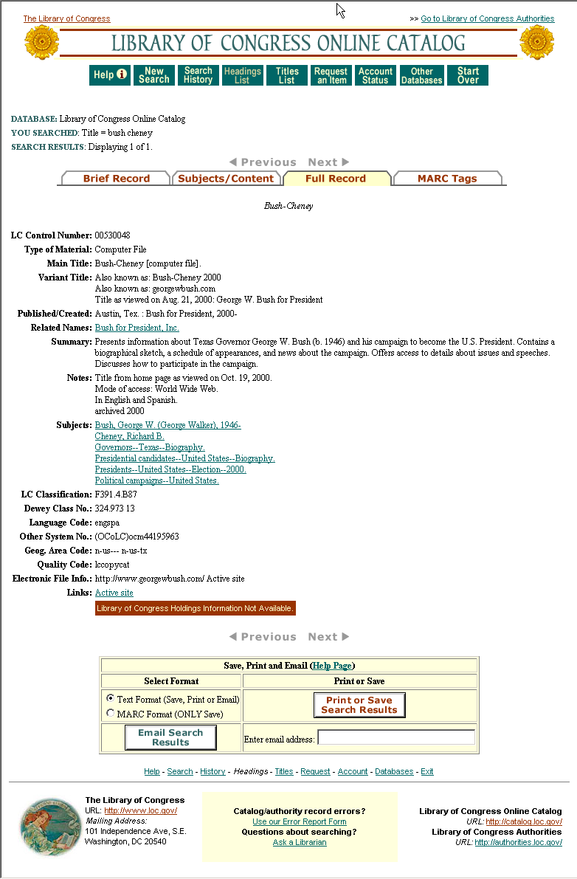

Slide 24
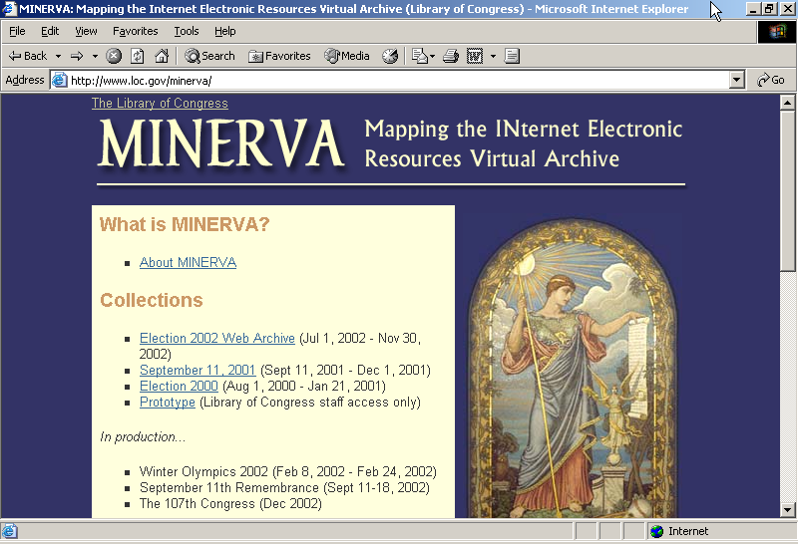
Notes:
If you’re interested in learning more about the Web Preservation Project Team
Or MINERVA’s pilot project. You can visit the MINERVA Team page and just click on prototype.

Slide 25
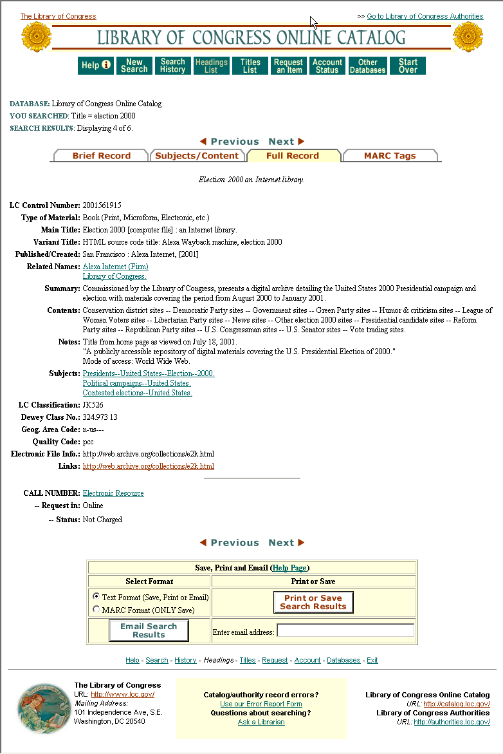

Slide 26
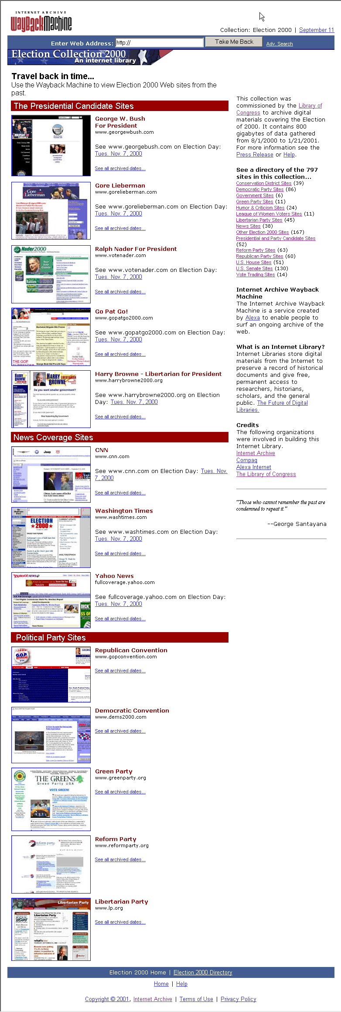

Slide 27
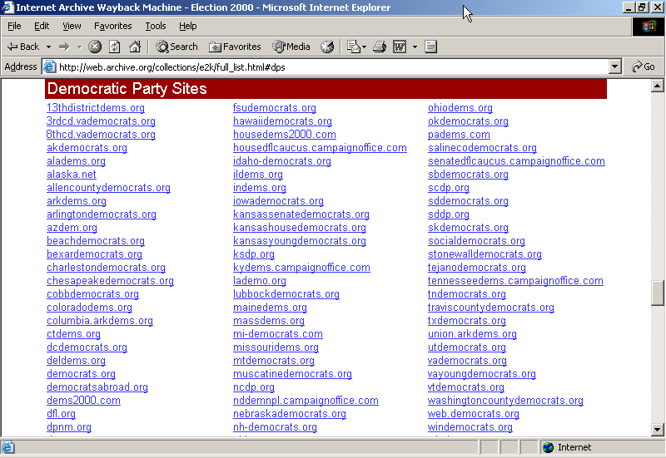

Slide 28
Lesson Learned
Some type of cataloging/descriptive metadata needs to be done to be able to search through the collection

Slide 29
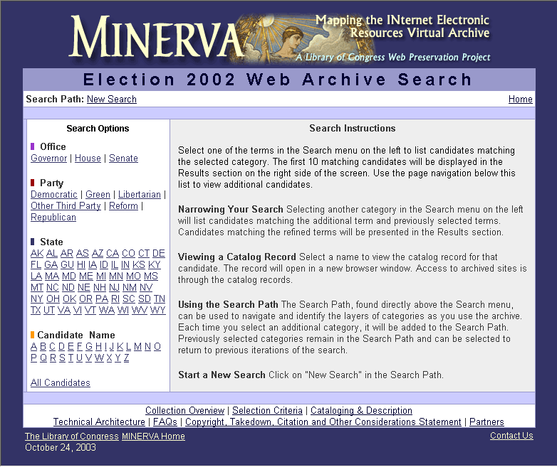

Slide 30
MODS
Metadata Object Description Schema
Descriptive metadata standard
Uses XML Schema
A derivative of MARC using language-based tags but MARC semantics
Element set is compatible with existing descriptions in large library databases
Particularly applicable to digital objects
Hierarchy allows for rich description, especially of complex digital objects

Slide 31
Why MODS
Rich but not too rich descriptive metadata format; richer/more hierarchical than Dublin Core and simpler than MARC 21/MARCXML
Alternative for emerging initiatives
  Z39.50 Next Generation specified format
  extension schema to METS
  to represent metadata for harvesting (OAI)
  As an interoperable format for convergence between MARC and non-MARC XML descriptions

Slide 32
Status of MODS
Open listserv collaboration of self-selected possible implementors, LC coordinated (1st half 2002)
First comment and use period: June – December 2002
Version 2.0 Feb. 2003-Dec. 2003
MODS version 3.0 now available
Registration submitted to NISO and going through approval process

Slide 33
Fields Used in Election 2002
Title
Name (structured form)
Abstract
Date captured
Genre (value always “Web site”)
Physical description (file formats)
Identifier (base URL)
Language
Access conditions/rights management
Subject (keyword or LCSH if possible)

Slide 34
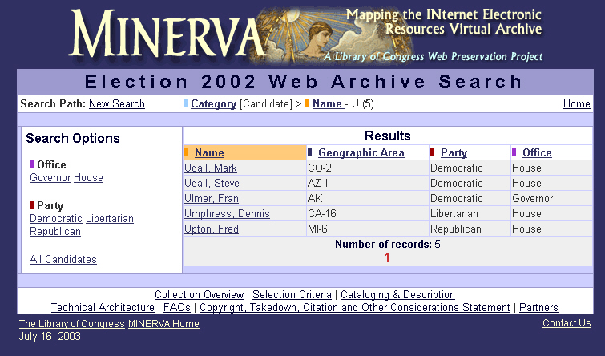

Slide 35
Sample MODS record for Election 2002 Web site
Fran Ulmer Web site record (XML)

Slide 36
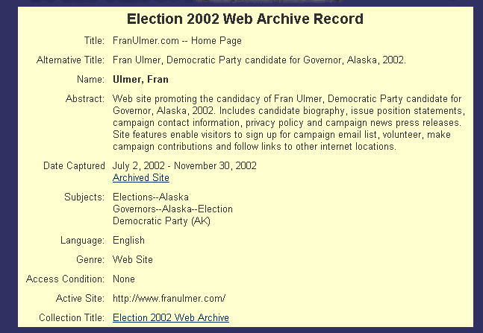

Slide 37
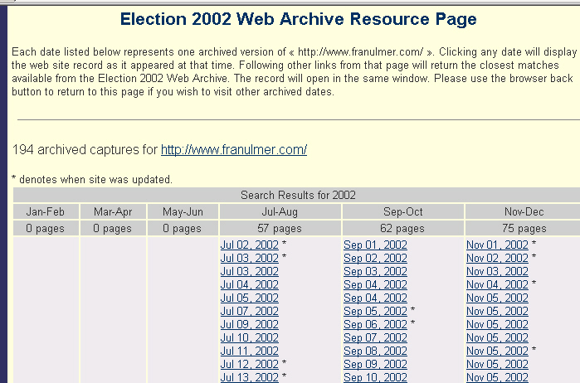

Slide 38
107th Congress
Enhanced descriptive metadata (MODS) created at LC
Include authoritative forms of names, subject headings, and classification numbers
Registered handles for archived sites
Plan to use LC created tools for METS creation, record input and search/browse
  Example: http://www.loc.gov/ihas

Slide 39
MODS record
Joint Economic Committee XML record

Slide 40
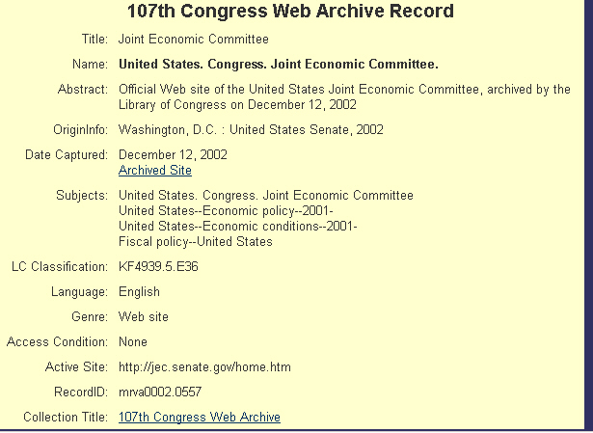

Slide 41
Lessons learned (cataloging)
More accurate, usable cataloging if we do in-house
  We understand the way the data will be used
Good metadata results in good searching
Simple records can be created in minimal time using MODS
Flexibility of XML allows for options in display

Slide 42
Interface & Access
IA & WebArchivist.org interfaces: Election 2000, September 11, Election 2002
LC moving to refine, improve, develop interfaces in-house
Access to available collections through MINERVA home page and through ILS collection level records
Transferring access to archive to on-site

Slide 43
METS/MODS for Minerva
Experiment with METS objects for Web sites
MODS for descriptive metadata
  Hierarchy in relatedItem powerful for multiple captures and linked pages
  Works well with METS structMap
  relatedItem type=“host” link to aggregated resource
  relatedItem type=“constituent” for linked pages
  Allows for descriptive metadata at lower level and facilitates display of object
Developing tools for capture of some technical metadata
Developing METS profile for Web sites

