Slide 1
Implementing OAIS Reference Model at OCLC
Leah Houser
Andreas Stanescu
Notes:
Welcome
Introductions - name, title, organization
Leah…
… and I am Andreas Stanescu, software architect of the Digital Archive. Since joining OCLC, in addition to building archive software, I have spent the best part of the past 2 years studying digital preservation, reading many of the articles and presentations posted on the subject. Also, I participated in the Global Digital Format Registry meetings and contributed our views on what its use cases should be.
The presentation you are about to witness is based on a paper written by our colleague Pam Kircher, which will be presented at the IS&T (Society for Imaging Science and Technology) conference and some of the results of my work in the preservation tools arena.

Slide 2
Outline
OCLC Digital Archive overview
Influences on development decisions
Preservation planning
Notes:
The OCLC Digital Archive was implemented in phases over three years, from 2000-2002, and is currently in production. Our goal was to build a general-purpose archive for digital objects based on the draft ISO standard Reference Model for an Open Archival Information System (OAIS). In the course of that we would implement workflows for capturing and managing digital objects and we would implement a metadata set for the archived objects.
Throughout the development process we were aware of the influences on our decision from sources other than the OAIS. We think those influences will come to bear on every OAIS implementation and will be specific to a repository. In this presentation I will discuss the influences on development decisions, and which decisions were affected.

Slide 3
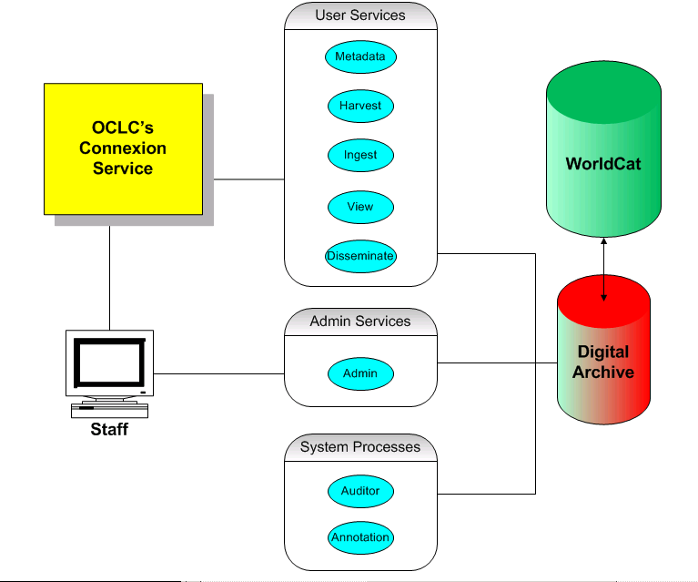
OCLC Web Archiving Services
Notes:
This brief overview of the Service will provide you with background for understanding the OCLC development decisions.
The OCLC Digital Archive is a third-party service that provides (1) tools for the capture of individual online resources and offline collections; (2) a repository in which those resources and collections can be stored for preservation purposes; and (3) an administration module, which allows depositors to manage their archived resources after submission.
The archive is modeled from OAIS. It supports the 6 functional areas defined in OAIS: ingest, archival storage, data management, administration, preservation planning, and access.
This diagram is of the web archiving service, which uses OCLC Connexion, a browser-based metadata creation tool, as the front end of the process. Connection is the platform from which metadata creation, harvesting and ingest take place.
The Digital Archive component stores content files and structural and preservation metadata and rights and access policies for digital objects.
A web-based administration module provides functions for depositors to manage their resources after ingest. The Admin Module allows users to organize objects into Content Groups, and create and assign Rights and Access Groups to objects.
System Processes are internal to the Archive and include an Auditor which runs periodically to check on the integrity of objects in the archive. We are currently working on an Annotator, a technical metadata creator, which extracts technical metadata from images.

Slide 4
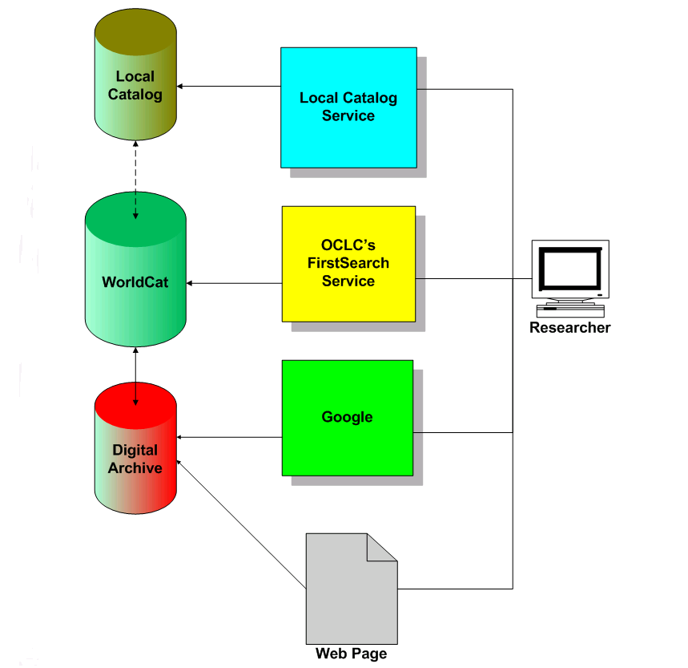
Discovery Services
Notes:
Once ingested into the archive, assets can be viewed by clicking on a Digital Archive URL, a unique identifier. This URL may be made available in numerous places, e.g., in a bibliographic record in WorldCat (through FirstSearch or Connexion), in a bibliographic record that has been exported from WorldCat to an OPAC or created in an OPAC, or from a portal or other web page.

Slide 5
Influences on Development Decisions
Institution developing the archive
Local depositor community
Global digital archiving community
Notes:
The decision to build an OAIS archive immediately gave rise to the need for many additional decisions—about hardware and software, database architecture and indexing, and so on—the kinds of decisions required by many systems development projects.
This part of the presentation focuses on a different set of decisions—those needed to implement the functions of a digital archive within a specific depositor community—and how those decisions were influenced by three factors.
These three factors continue to shape the ongoing development of the OCLC Digital Archive.
The factors are
the nature of the institution developing the archive,
the local depositor community,
the activities and emerging standards of the global digital archiving community.

Slide 6
Influence: Archive & Depositors
OCLC
  International member cooperative
  Members were pilot depositors
  Corporate commitment
Local depository community
  Guided requirements
  Confirmed following OAIS model
  Emphasis on pre- and post-ingest processes
  Influenced preliminary content object formats and types
Notes:
OCLC is an international membership cooperative. Our goal was to develop an archive that could be used by OCLC’s entire membership, which encompasses a variety of libraries and other cultural heritage institutions who hold diverse digital collections.
When it decided to build the archive, OCLC committed sufficient staff and financial resources to enable its development to be sustained over time. Yet we also needed to build understanding and commitment throughout the organization. We undertook a campaign to gain overall institutional education, support and acceptance. At least 12 different work units were involved in the implementation of this service from Legal to Computer Operations.
From the beginning of the project, we were assisted by a small group of OCLC members designated as pilot depositors to the system. They constituted our local depositor community. All of the institutions wanted to capture web objects; most had legal mandates for preservation.
This local depositor community guided our development requirements and assisted in usability assessments. We talked extensively with them about workflow, the metadata element set, staffing, types of materials, reports, and other details.
From the outset, the pilot institutions and OCLC agreed that the OAIS was the model to follow for the archival functions. However, we soon realized that our project scope went beyond the OAIS requirements. In particular, pre-ingest and post-ingest management of objects is of great importance to our depositors.
All of the institutions wanted to capture web objects. The basic requirements for selection, acquisition, cataloging, and preservation were common to all, but at the same time the institutions were distinct enough that the processes they used to accomplish these tasks differed, which meant that the tools we developed had to accommodate a variety of workflows.

Slide 7
Influence: Global Digital Archiving Community
Provided inspiration and practical experience
Source of evolving standards
Opportunity for hands-on involvement with peers around the world
  PREMIS
  Task Force on Certification
Ongoing access to an international knowledge-base
Notes:
Throughout our development process, the global digital archiving community provided a source of inspiration, practical experience, and evolving standards from which to draw.
In addition to our reliance on the OAIS model, we utilized information from projects such as CEDARS, NEDLIB, and PANDORA. We read about research in publications, followed conference proceedings and ongoing research projects at academic institutions such as Harvard, University of California at Berkeley, and MIT.
The activities of the global digital archiving community continue to exert a strong influence on the development of our archive. Since implementation, we’ve begun to incorporate the emerging Metadata Encoding and Transmission Standard (METS), an XML schema for encoding metadata with a digital object, into our Digital Archive processes.
We’re also involved in two new international working groups formed in 2003. OCLC and RLG sponsor PREMIS (Preservation Metadata: Implementation Strategies), the goal of which is to create a practical, implementable preservation metadata set. We participate on the Task Force on Digital Repository Certification to produce certification requirements for establishing and selecting reliable digital information repositories.
The results from these working groups will impact future Digital Archive development.
Those are the 3 influences. Now let’s look at what decisions were affected by those influences.

Slide 8
Decisions Influenced
Object types and formats
Access
Preservation metadata
Rights management capabilities
Preservation planning
Notes:
Among the decisions influenced by the three factors discussed above are the formats and object types accepted into the archive, access methods, preservation metadata created by depositors and our system, types of tools developed, rights management capabilities, and preservation policies.
These decisions were inter-related. For example the formats and object types decisions in turn influenced decisions on preservation metadata, rights, and access methods

Slide 9
Decision: Object Types & Formats
Initial formats
  Text and still image
  PDF, HTML, TXT, TIFF, GIF, JPEG, BMP
Initial object types
  Born-digital documents
Notes:
Early in the development cycle the local community reached consensus on the object formats to start with: text and still image. They knew from their previous work with web documents that these predominated—for now.
We currently accept the following: PDF, HTML and associated java script and cascading style sheets, TXT, TIFF, GIF, JPEG, and BMP. This list of formats is a union of both (1) our assessment of the likelihood that we would eventually be able to offer full preservation of content in these formats and (2) of our depositors’ immediate needs. OCLC plans to expand the list of accepted formats based on depositor request and preservation potential.
These decisions about object types and formats clearly affected the tools we built, such as the harvester; the first method of access, a browser; and the amount of rights information preserved with each object.

Slide 10
Decision: Access
Notes:
This is the same slide from earlier.
The access decisions illustrate how the nature of the developing institution and the depositor community influenced our development.
We made use of existing OCLC infrastructure such as WorldCat and FirstSearch by using the WorldCat record for the end-user’s discovery and access mechanism. That bibliographic record might be in a library’s catalog, or in a reference service like OCLC FirstSearch. This approach makes sense given the amount of use WorldCat and other catalogs receive each day, the sophistication of searching capabilities in WorldCat and local library systems, and that, for our local community, the archiving workflow is associated with a cataloging workflow.
We chose to control access through existing OCLC cataloging and FirstSearch authorizations. We also included an IP recognition option based on the capability already available in FirstSearch. Although these are by no means ultimate solutions, they work well for now because most of the objects deposited (government documents) are in the public domain. These access controls work if the object’s metadata is posted on a web page or is in Google.

Slide 11
Decision: Preservation Metadata
Built from what existed at the time
Considered metadata in context
  Types of objects archived
  Element scope and purpose
  Availability of the metadata at ingest
  Function of the metadata in archive
Notes:
Our metadata elements are still evolving.
At the time that our archive went into production, the OCLC/RLG Working Group on Preservation Metadata had not released its report. So OCLC and the pilot participants began by looking at the elements proposed by other projects from the global community such as CEDARS, NEDLIB, and National Library of Australia.
As we considered elements proposed by other projects, and ones we proposed ourselves, we considered the elements in context. For each element we asked ourselves
was the element needed for the types of objects we were archiving;
did we understand the proposed element’s purpose and scope;
when would the information contained in the element be available for capture, extraction, or creation
would the information be available to the local community, to the archive, could it be inferred
and for what functions would the depositor or the system need the metadata?
Examples :
Object type: government documents in the public domain require less rights metadata than other objects.
Availability of metadata: The web objects that our local community are responsible for preserving were not created by them. They may not know or be able to obtain some preservation metadata elements such as object origin information, object composition, or the relationships among the files. As a result, our system does not require the depositor to supply much metadata at ingest: simply the title of the object, the language of the object and the metadata, and a bibliographic record number. The system then creates or extracts other required metadata, such as the object composition, fixity, and the URL map, which records the relationships of files to each other in a web object.
Functions of the metadata: Our local community wants to integrate workflows: to select, capture, catalog, and archive in a streamlined fashion. They need the process to be straightforward, so that staff of all levels of technical ability and experience can ingest objects into the archive and still obtain the necessary preservation metadata. Building our metadata creation tool on the OCLC Connexion interface allowed us to integrate cataloging with archiving in a single interface.

Slide 12
Decision: Tools
Notes:
This is the same diagram from earlier, but I want to talk about tools that we created to assist with the pre-ingest and post-ingest functions of the archive.
The tools derived from the workflows established by the local community, which in turn derived from the object types and formats. Development of the tools was further affected by the metadata decisions. Development of each was influenced by issues of complexity versus ease of use, performance, and usability, among others.
As mentioned, we built the metadata creation tool into Connexion, OCLC’s browser-based metadata creation tool. This was a good decision in terms of ease of use and workflow flexibility and compatibility; it provides a level of commonality among cataloging and archiving tasks, and offers a familiar interface in which to do new tasks.
The harvester bridges Connexion and the archive, adding additional complexity to the development process. The harvester communicates with both systems, and must return status messages to Connexion without delaying Connexion processes. The harvester provides substantial information about the web object’s composition prior to the actual harvest, allowing the depositor to determine the boundaries of the object to be harvested. The amount of information returned, the display of the information, as well as explanations of the harvester’s actions (such as inclusion and exclusion of files) has been the subject of continual examination and enhancements.
We built an administration module to allow the depositor to set access permissions on an object, to manage collections via content groups, to create and apply rights statements, to view reports, and to view objects for quality assurance.
We also built a dissemination manager tools to create METS-encoded packages of metadata and objects. Technical metadata about each file is included in the DIP (Dissemination Information Package) in either the MIX or textMD formats.

Slide 13
Decision: Rights Management
Local community
  Long experience working with them
  Assume right to harvest and preserve
  Knowledgeable about copyright
Types of objects archived
  Preserve government publications
  Provide access now and in future
Notes:
Our decisions about rights management capabilities were driven by the local community and the types of objects they most needed to archive.
As mentioned, the local community needed to preserve government publications to allow public access over time. Copyright is not an issue with these publications. Further, we rely on the depositor to ingest objects for which they have legal responsibility and explicitly state in our submission agreement that the depositor has that responsibility to comply with copyright. Therefore we created a mechanism to associate a simple rights statement with each object. Additional mechanisms allow the depositors to restrict access if needed.
It is clear that our archive must eventually accommodate more complex rights needs, but because our initial development made provisions for basic rights statements and access controls, we are able to wait while the global community makes progress on digital rights metadata via various projects.

Slide 14
Decision: Preservation Planning
Local depositor community
  Use of objects long-term
  Significant properties
  Review of policy
Global digital archiving community
  Format registry
  Review of policy
Notes:
Currently we offer bit preservation services for all objects in the archive. We have a preservation policy in progress and are prototyping preservation action plans. As we undertake this planning, both the local depositors and the global communities influenced our work.
For the local depositor community, our preservation plans are considering how we will identify, document and support the significant properties they want preserved and the level of access to those objects.
By reading the literature, attending conferences, and various collaborative working groups, we’re incorporating information from the global digital community in our preservation planning process. An example is the Global Digital Format Registry initiative from the Digital Library Federation.
Both of these communities will be able to review and comment on our preservation planning process and outcomes. The policy will be available to the public on our web site in the future.

Slide 15
Preservation Policy
Provides a general outline of OCLC’s approach to digital preservation
Specifies the list of digital formats currently accepted and how that list can change over time
Specifies the preservation service levels
Specifies what services are implemented to ensure uninterrupted access
Defines technology watch service
Defines how the policy itself changes
Defines roles and responsibilities of participants
Notes:
Read 1.
Currently accepted formats are: PDF, HTML and associated cascading style sheets (.css) and javascript (.js), TXT, TIF, JPEG, GIF, and BMP.
It also specifies how this limitation will be lifted or changed: specifically, other formats will be accepted in the OCLC DA in the near future.
At this time, we are offering only “bit” preservation. However, the preservation planning work I will discuss later is intended to elevate most or all of the accepted formats to “full” preservation. We will probably expand the list of accepted formats as soon as we've validated the process for developing preservation plans and have created plans for materials already archived.
We have implemented on-going activities to ensure “bit”-preserved content remains viable. For example, periodic verification of data integrity and absence of viruses is performed; also, on-site and off-site backups are maintained as well as a recovery process in case of a disaster.
Read 5-6
The policy defines oversight groups, advisory groups and other collaborators to ensure transparency into the operation of the Archive. It also specifies how changes to the policy and preservation actions are communicated to the members.

Slide 16
Preservation Planning
Designed a strategy behind digital preservation processes
How to identify the digital object formats best suited for preservation
How to determine what computing platform offers the longest life-span expectancy
How to measure preservation decisions
What classes of metadata are necessary
How to determine preservation actions
Notes:
To support the preservation policy, I designed a methodology that objectively identifies and measures preservation solutions.
The premise behind the methodology I proposed is that each digital format is potentially a candidate for preservation. This way, we can use this method to
compare formats,
understand what is gained and what is lost if migrating from one to another,
define preservation goals in terms of which significant properties can be preserved, and
end up with is the ability to judge the most cost effective way to achieve known preservation goals.
With that in mind, this methodology defines:
- A way to identify the digital object formats best suited for long-term preservation, (best suited in terms of preservation goals)
- A way to determine what computing platform offers the longest life-span expectancy
- A objective method to measure preservation decisions
- The classes of metadata necessary to describe all preservation aspects
And lastly,
- How to determine what preservation actions should be taken and at one point in time
The roadmap assumes that technical metadata schemas will be developed in cooperation with standards organizations and research institutions. Existing efforts in this area will be incorporated: the OCLC-RLG PREMIS working group, METS, textMD and MIX. As format experts develop new mappings, they will be used as well.
The roadmap does not address questions of rights and copyrights. These points are addressed in the policy and the contracts signed with the member institutions.

Slide 17
Preservation Planning Tools
Designed a set of metrics necessary to assess the viability of any solution
Designed the set of viable preservation actions
Designed formal models to specify and document the computing platform necessary to render digital objects
Designed processes to assess and prove authenticity of the digital objects
Notes:
To accomplish those goals, we have designed a number of tools.
One is a metrics system used to assess the viability of a candidate solution.
Another is a set of viable preservation actions.
Yet another is a set of models capable of categorizing the components that make up a rendering machine.
And lastly, I am working on processes that assess and prove the authenticity of the digital objects.
I spent long hours reviewing these tools with my colleagues, the development staff and the product managers of the Digital Archive. Once they appeared polished enough, we circulated the proposals with our own Office of Research and also with Nancy McGovern, Cornell University’s Digital Preservation Officer. DON”T READ: Assistant Director Research Department
Once their feedback was crystallized and incorporated into the roadmap, I have started to test this methodology using GIF images and PDF documents already in our custody.

Slide 18
Preservation Planning Tools
Designed a risk-based assessment methodology
It is designed to look at all facets of the digital format specification itself and its dependencies
Considered environment dependencies such as other specifications, software and hardware
Considered associated organizations such as vendors, standard organizations, content owners, beneficiaries
Notes:
Essentially, the methodology is based on recognizing and assessing risks.
One way to look at preservation planning is that it is simply a response to known and unknown risks posed by the promise to provide access over time to digital objects.
This method asks a number of reviewers, all of whom are experts in their domain, to rank a number of previously identified risks. Then, I developed a method to collect and summarize their responses into a result format that allows us to compare preservations actions and formats.
Risk-based assessment methods are widely used in software project management, security threat analysis and business planning. I developed these tools by using my expertise in security threat analysis models and a number of project management risk-based methods. I also incorporated ideas developed by Cornell University’s Prism project and information presented by Anne Kenney in the paper called “Preservation Risk Management for Web Resources”.
DON”T READ but KEEP AS REFERENCE: Anne Kenney is the associate director of the department of preservation and conservation and codirector of the Cornell Institute for Digital Collections.
Read points 2-3
For example, GIF uses the LZW compression algorithm. HTML allows executable extensions in the form of scripts and cascading style sheets. Windows Media formats use proprietary DRM & encryption algorithms and hardware devices.
Read point 4.

Slide 19
Preservation Planning Tools
Adopted the risk exposure calculation scales developed by Gregory Lawrence (Cornell Univ.)
Identified several classes of potential reviewers, including computer scientists, format experts, librarians, preservation specialists, hardware vendors, lawyers, digital archive developers
Developed a methodology to collect, analyze and compare the assessments
Developed methods to relate assessment results to preservation actions
Notes:
Instead of developing new risk-ranking scales, I adopted those suggested by Gregory Lawrence in the paper called “A file format investigation”, which was published in 2000 by CLIR (Council on Library and Information Resources).
DON”T READ but KEEP AS REFERENCE: Gregory Lawrence is government information librarian at Cornell University's Albert R. Mann Library.
Read points 2-4.
As I mentioned earlier, this methodology is currently being tested against GIF images and PDF documents currently held in the OCLC Digital Archive. The results of this test will be fed back into the methodology and the results will be shared with the digital preservation community later this year.

Slide 20
Preservation Actions
The proposed strategy is to identify preservation actions by monitoring and reducing risk
Chose open source, open license and open specification software, hardware and formats
Identify and test alternative open source software tools and computing environments
Specify and test one current era commercial alternative, respecting the investment in technology already made by beneficiaries
Migrate to new formats when risk is too great
Notes:
Read point 1-3.
The choice of open source/license/specification is based on the belief that they will last for as long as its users consider it useful. This timeframe is considerably longer than that of commercial interests. Commercial products last as long as they are financially viable and marketable, and are often changed and replaced not because they become obsolete but because the vendors need new ways to generate revenues.
This isn’t to say that commercial products won’t be used: they will, for a variety of reasons, including the market exposure of proprietary but widely deployed formats. Windows Media, Real and Office formats come to mind.
With that in mind, … read point 4.
Lastly, … read point 5 … and restart the preservation process, using the new format as its target. We will also consider lossy derivatives or emulation for the short-term until migration plans are finalized. Note, however, that the original bytestream will always be kept, as well as any migrated versions used as copy of record. The authenticity trail maintained by the metadata as well as the bytestream themselves is critical to trustworthy preservation plans.
Preservation planning will be an ongoing process. As technology changes, our plans also have to change, but the underlying process remains constant: we will review the assessments periodically and make any adjustments as necessary. If needed, we’ll redefine the computing environments and test them accordingly. If needed, we will develop new authenticity rules, test and deploy them accordingly.
Our commitment to our members is that we will fully test computing configurations and clearly document any loss of characteristics, significant properties or functionality. It is this step that can fully use the collaboration between institutions and preservation archives.
DONE!
If you have any questions,…

Slide 21
In Conclusion
Questions and Comments
Contact:
Andreas_Stanescu@oclc.org
Leah_Houser@oclc.org
Pam_Kircher@oclc.org

