Slide 1
From Creation to Dissemination
A Case Study in the Library of Congress’s use Open Source Software
DLF Spring Forum
Corey Keith
ckeith@loc.gov

Slide 2

Introduction
What is OSS
Why OSS
OSS used at LC
XML is a favorite tool

Slide 3
Purpose
Share information on available tools
  Especially those outside the library community
Promote using OSS
Promote developing OSS

Slide 4
Open Source Initiative
Open source promotes software reliability and quality by supporting independent peer review and rapid evolution of source code.

Slide 5
What is OSS?
Software with source code attached
Access to underlying code
Derivative works
  Add functionality
  Enhance functionality
  Remove functionality
Redistribution (Gotcha)

Slide 6
Why OSS?
Low experimentation cost
  Technologies
    Rapid evolution
    Move to commercial solution if needed
Not profit driven community

Slide 7
What types of OSS?
Low Level
  Programming Libraries
  Databases
  Languages
  Operating Systems
  Servers
  Internet Infrastructure
High Level

Slide 8
Selecting OSS for use
Size
  Active developers
Alive/Dead projects
Reliable Support
Sponsored Projects
  Apache Foundation
Licenses

Slide 9
Benefits of OSS
Peer reviewed
Less defects
  “Many eyes makes all bugs shallow”
Increased security

Slide 10
Standards
Promote standards through software development
Collaboration by development

Slide 11
Benefits for Software Producers
Development speed
  Interesting projects attract developers
  Less likely to switch once started
Lower overhead
Smaller institutions can handle larger projects
If you release OSS, hire from OSS community

Slide 12
Benefits for Software Consumers
No vendor lock in
License maintenance
Own vs rent

Slide 13
Costs for Producers
Supporting the project
  Goal: Self sustaining
Preparing for open source distribution

Slide 14
Costs for Consumers
Finding technical support
Services
  Free software
  $$$ Services
Possible increased outsourcing costs

Slide 15
LC Case Study
I Hear America Singing
Digital Production
  METS Making
Dissemination
  METS Transformation
Project Management

Slide 16
Philosophies
Get data to XML as early as possible
Flexible manipulation of XML with XSLT
Aggregation of XML from variety of sources
Pipelined XSLT

Slide 17
Digital Production
Aggregate from different sources
  MySQL DB Descriptive Data
  Filesystem for Structure
Apache Cocoon

Slide 18
Apache Cocoon
XML Glue
XML Pipeline
XML Publishing Framework
Separation of content and style

Slide 19
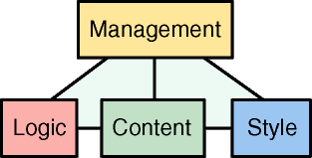
Cocoon Pipeline
Generate XML
  From files (or URLS)
  From databases
  From code (XSP, JSP, PHP)
  From MARC21 records
Transform XML
  XSLT
Serialize
  XML, HTML, PDF, SVG, JPEG
Caching, Logging
Pass parameters to XSLT’s
Maps URL to Generate/Transform/Serialize
Command line interface

Slide 20
Filesystem
MySQL
ESQL
XSP Generator
Directory
Generator
DB to MODS
XSLT
Digital Production
Aggregator
METS Making
XSLT
METS

Slide 21
Dissemination
Apache – Web Server
Tomcat – Application Server
Cocoon – XML Transformation
Lucene – Searching/Indexing

Slide 22
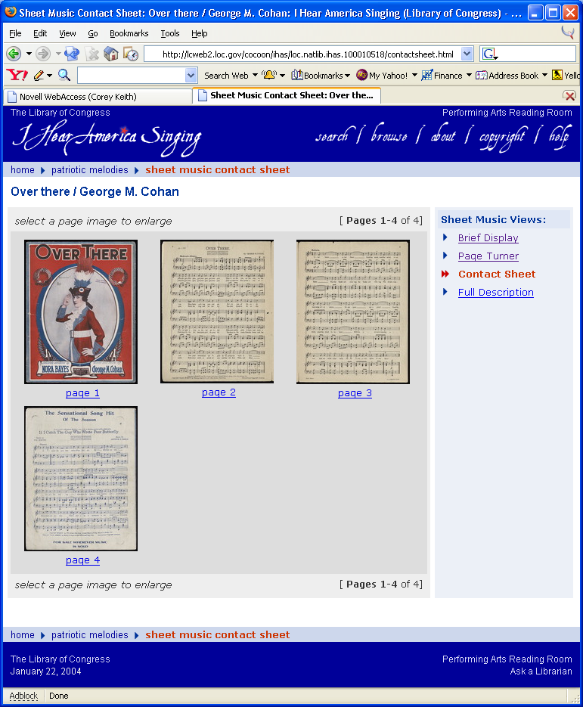
METS
Header.xhtml
Footer.xhtml
File
Generator
File
Generator
File
Generator
Dissemination
Behavior XSLT
(contactSheet.xsl)
Aggregator
Render IHAS Page
XSLT

Slide 23
Apache Lucene
Text Indexing API
Flexible
Fast
Hierarchical
Cross-collection
Depends how you build indexes

Slide 24
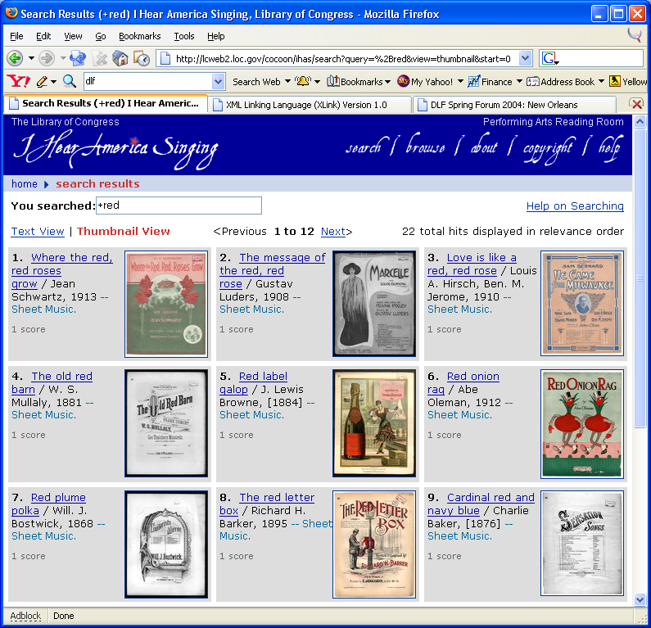
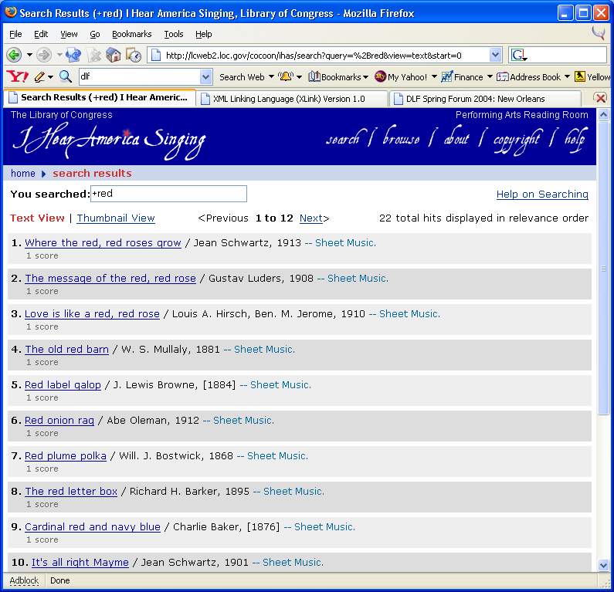
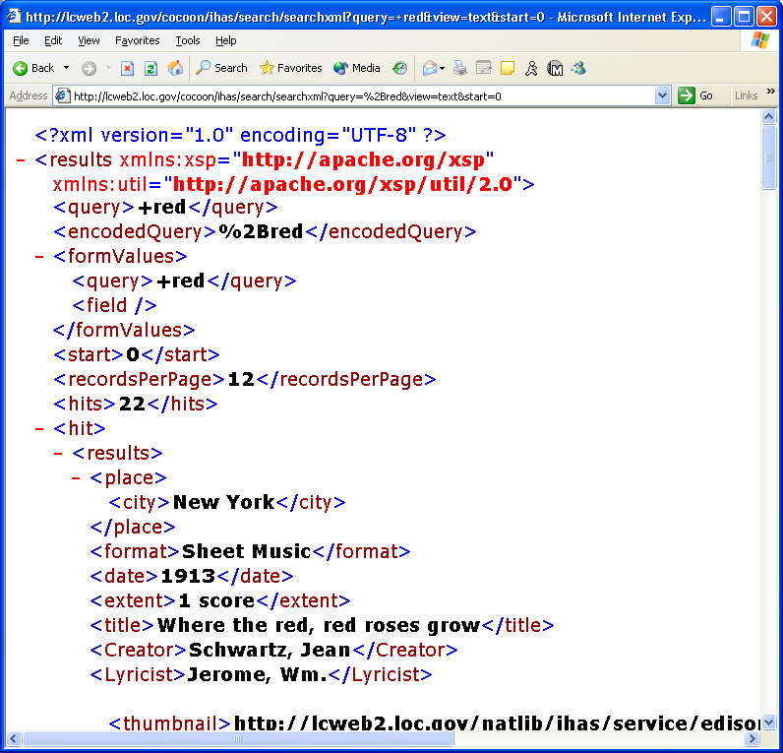
METS
File
Generator
Render Search
XSLT
METS to Index
XSLT
XSP Generator
Searches Lucene
Index XML
Index
Builder
(Java)
Lucene
Index
Cocoon CLI
Cocoon

Slide 25
Project Management
CVS
Bugzilla
Ant

Slide 26
CVS
Version Control
Manage multiple document versions
  Schemas
  Documentation
  Code
  Libraries
Multiple developer projects

Slide 27
Bugzilla
Web-based defect tracking
Avoids flurry of emails
Products – Components
Accountability
Reporting

Slide 28
Ant
Automated build tool
Packaging
Deployment

Slide 29
What you can do to support OSS
Demand (well documented) source code when outsourcing
  Release this code
Release code your internal projects

Slide 30
Why this is hard
Clean-up code
  Embarrassing
Documentation
Preparing for release
Fears of supporting the code
Hosting
Marketing
Generalizing for others use

Slide 31
Summary
OSS Software
  Benefits
  Costs
Uses at LC
  I Hear America Singing
Questions

