Slide 1

Implementing “Find Articles”:
A low-altitude view of metasearching
Marty Kurth
University Library
DLF 2004 Spring Forum, New Orleans, LA
Notes:
Introduce self
Members of cross-functional team to bring ENC based services into production
Mainstreaming as of this month
Will have time for questions. Please ask questions to clarify during the presentation and hold others till the end. We’re happy to discuss any aspects of the project you’re interested in.

Slide 2
Implementation decision points 1
Positioning the metasearch service to promote its use
Configuring the interface and retrieval-set limits to optimize performance
Establishing Z39.50 connections to enable similar searches
Configuring the search-results screen to normalize heterogeneous data

Slide 3
Implementation decision points 2
Configuring the single-record screen to feature reference linking
Parsing A&I-vendor metadata to maximize OpenURL connections
Interpreting user transactions to improve performance

Slide 4
History of CUL gateways
Mann Library Gateway (1991)
Cornell University Library Gateway (1998)
E-Reference Collection (2001)
Find Articles/Find Databases/Find e-Journals (2003- )
Notes:
Positioning the metasearch service to promote its use
History of services that have highlighted provided access to networked resources and proxied remote users. All were databases of metadata about licensed and free networked resources. The metadata in the e-Reference Collection enabled users to discover, then connect to the resources in its collection.
Though the scope and audience changed over the years, the makeup of the database stayed the same.
This system was a popular one. In calendar year 2001, the average monthly connections to e-Reference resources was well over 55,000 connections per month.

Slide 5
Service enhancements
Existing functions
Search gateway metadata
Go to database from search results
Browse by subject
Navigate to other CUL resources
Authenticate users for restricted resources
Added features
Search at article level
Simultaneous search across multiple databases
Reference linking
Search for all e-journal titles
Notes:
To these existing functions we wanted to add metasearching and a searchable and browsable e-journal database. The metasearching functions are the ones in yellow.

Slide 6
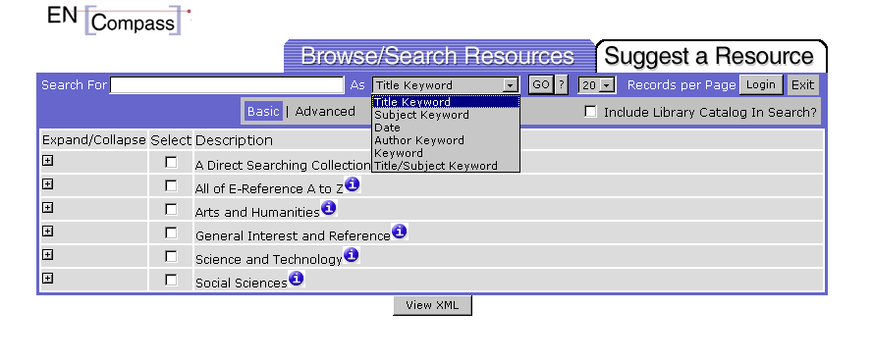
We tried to put metasearching in a single interface with existing database-metadata search and browse functions
Notes:
We started with the out-of-the-box interface and added a metasearching module to an interface that included the existing capabilities of searching the local repository of metadata about networked resources

Slide 7
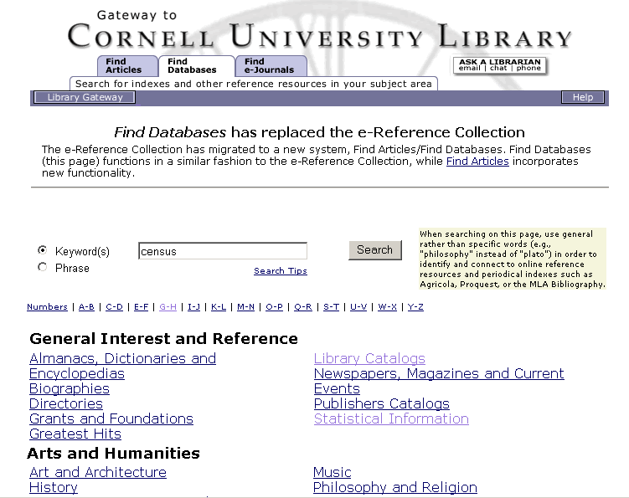
We settled on a 3-tab, 3-service structure
Notes:
We arrived at a 3-tab, 3-service structure

Slide 8
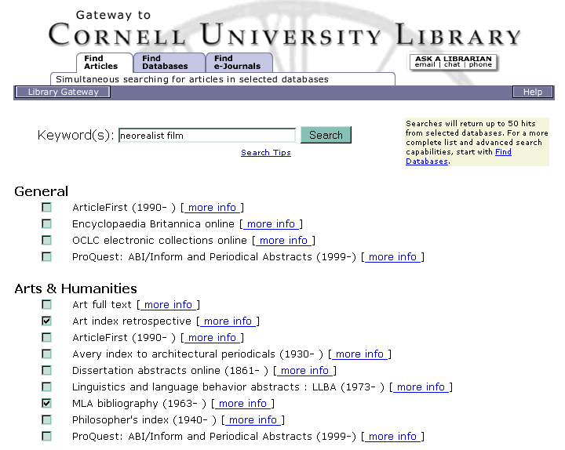
“Find Articles” became the metasearch service
Notes:
Configuring the interface and retrieval-set limits to optimize performance
simultaneous searching interface
users select up to 8 databases (java script prevents more)
started with most-used databases, also included those we could connect
license agreements impact database selection, little used db got lots of use: biol and ag index
interface design went through lots of variations: alpha list, subject list on two screens, then one very briefly, then no alpha list, subject only with individual databases repeated
Best luck with Z39.50 connections
had difficulty with http connections
One XML gateway, later dropped
Limited search results to 50 per database for reasons of response time and manageability of results sets

Slide 9
Z39.50 connection parameters
“Keyword” use attributes varied: 1016 (OCLC, ProQuest, RLG, WebSPIRS); 1017 (RLG); 1035 (EBSCO, Wilson); 4 (EBO—title only)
Structure attributes were tricky: phrase (Wilson); unspecified (EBSCO, PQ); word list (EBO, OCLC, RLG, WebSPIRS)
Notes:
Establishing Z39.50 connections to enable similar searches
Search parameters and therefore results are not consistent database to database, even though the interface looks uniform to users
though Wilson is set up as “phrase” it searches as Boolean OR
problematic to explain to public services staff how different databases perform

Slide 10
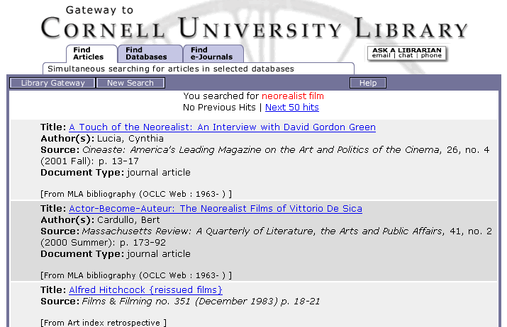
We normalized heterogeneous search results
Notes:
Merged search results screen
no deduping
lot of xsl work to get search results to display consistently
variations required database by database
three potential sources of display problems:
in XML, but not in XSL
not in search display config (DC)
not mapped from A&I MARC to DC

Slide 11
Search results XML 1
<B1>A Touch of the Neorealist: An Interview with David Gordon Green</B1>
<B2>Lucia, Cynthia</B2>
<B5>0009-7004(200123)26:4&lt;13:ATOTNA&gt;2.0.TX;2-V</B5>
<B5>2001360916</B5>
<B5>26</B5>
<B5>0009-7004</B5>
<B5>4</B5>
<B5>13</B5>
<B5>20010998</B5>
<B5>13-17</B5>
<B5>Cineaste</B5>
<B6>Cineaste: America's Leading Magazine on the Art and Politics of the Cinema</B6>
<B6>26, no. 4 (2001 Fall): p. 13-17</B6>
<B8>journal article</B8>
<DBC>MLABIB</DBC>
<DBN>MLA Bibliography</DBN>

Slide 12
Search results XML 2
<B1>A touch of the neorealist: an interview with David Gordon Green</B1>
<B2>Lucia, Cynthia</B2>
<B4>George Washington is the first feature film by David Gordon Green. Green claims to be influenced by American filmmakers of the 1970s, but his film has much in common with Italian Neorealist and contemporary Iranian filmmakers, in terms of such elements as its . . . . </B4>
<B5>0009-7004</B5>
<B5>Cineaste$bCineaste$c26$d4$fFall$gFall$h23$j2001$k13$l17</B5>
<B6>Cineaste v. 26 no. 4 (Fall 2001) p. 13-17</B6>
<DBC>ARTFULL</DBC>
<DBN>Art Full Text</DBN>

Slide 13
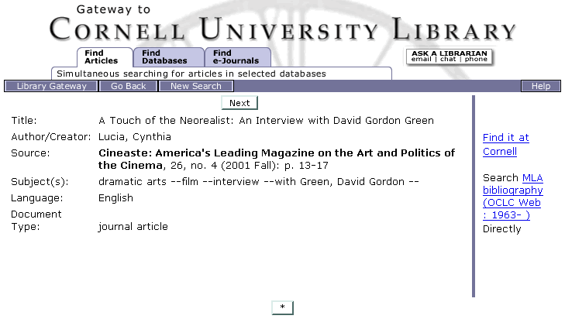
Single-record display with OpenURL link
Notes:
Object record for one index entry retrieved in the search
custom xsl work to get database name in remote launch link to native interface; had been generic previously
find-it-at-cornell: picked a name for local service; had been vendor brand
Clicking on Find it at Cornell takes you to this screen . . .

Slide 14
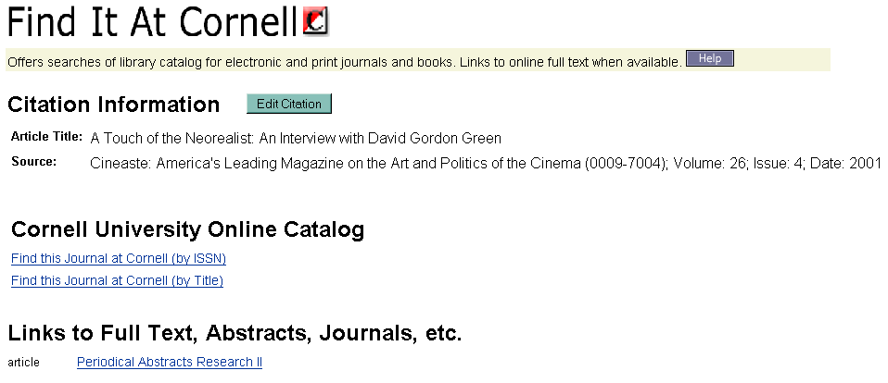
“Find It At Cornell” display
Notes:
gives link to full text if available and extended services to do catalog searches; other searches were optional but we stuck with catalog only; ILL was one option, but it had service implications so we tabled it and will come back to it

Slide 15
Z39.50 citation metadata used to build the OpenURL
<MR773t>Cineaste: America's Leading Magazine on the Art and Politics of the Cinema</MR773t>
<MR773p>Cineaste</MR773p>
<MR773g>26, no. 4 (2001 Fall): p. 13-17</MR773g>
<MR773x>0009-7004</MR773x>
<MR949a>26</MR949a>
<MR949b>4</MR949b>
<MR949c>13-17</MR949c>
<MR949e>2001 Fall</MR949e>
<MR949f>13</MR949f>
<MR949g>20010998</MR949g>
Notes:
Part of the XML encoded metadata underlying the object record screen we looked at
These elements parsed and mapped in ENC to build the Open URL passed from ENC to LFP
Note granularity in bottom set

Slide 16
Common OpenURL elements
aulast -- first author's last name
issn -- ISSN number
title -- title of a bundle (journal)
atitle -- title of an individual item (article)
volume -- volume of a bundle
issue -- issue of a bundle
spage -- start page of an item in a bundle
date -- publication date of the item or bundle
Notes:
These are the elements we typically mapped

Slide 17
Resulting OpenURL
http://128.84.158.87:8888/lfp/LinkFinderPlus/Display?&aulast=Lucia&atitle=A+Touch+of+the+Neorealist%3A+An+Interview+with+David+Gordon+Green&title=Cineaste%3A+America%27s+Leading+Magazine+on+the+Art+and+Politics+of+the+Cinema&volume=26&issn=0009-7004&issue=4&spage=13&date=2001&pages=13-17&stitle=Cineaste
Notes:
From the metadata passed from the A&I vendor ENC constructed this OpenURL and passed it to LFP
The elements we saw results in the one highlighted in white

Slide 18
Compare this citation metadata to the previous
<MR773t>Journal-of-the-Acoustical-Society-of-America; 1995, 97, 4, Apr, 2511-2524.</MR773t>
<MR773t>Cadernos-de-Lingua; 2001, 1(23), 53-67.</MR773t>
Notes:
both are from same a&i database Linguistics and Language Behavior Abstracts
both are only source of volume, issue, date, and start page
both show lack of clear caption indicators to identify which elements are volume, issue, etc.

Slide 19
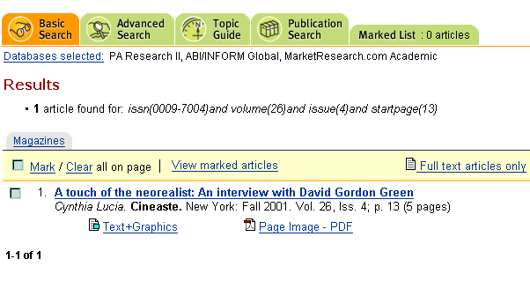
Another variable: OpenURL requirements of target site
Notes:
ProQuest appears to be looking for ISSN, volume no., issue no., and start page.

Slide 20
Sources of OpenURL connection failures
Lack of granularity in A&I vendor metadata
Ambiguous captioning in citations
Variation in citation practice over time
Journal-by-journal variation in citation elements
Mismatch between citation metadata and target site requirements
Notes:
Summarizes the points where the OpenURL connection linkage can break down

Slide 21
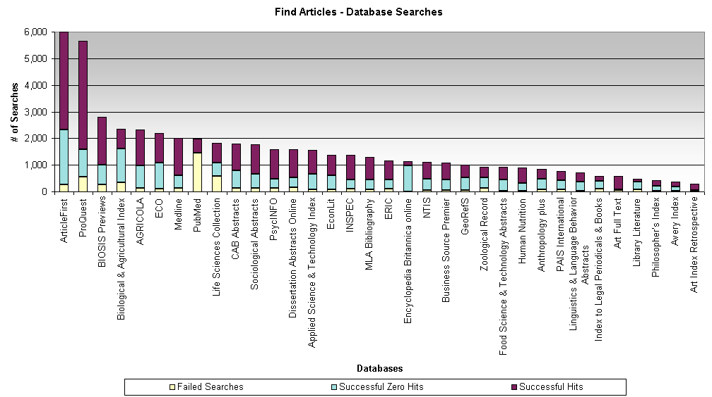
Find Articles search activity, including connection failures
Notes:
source of connection failures:
too many users
remote server down
our server down
license/subscription interruption

Slide 22
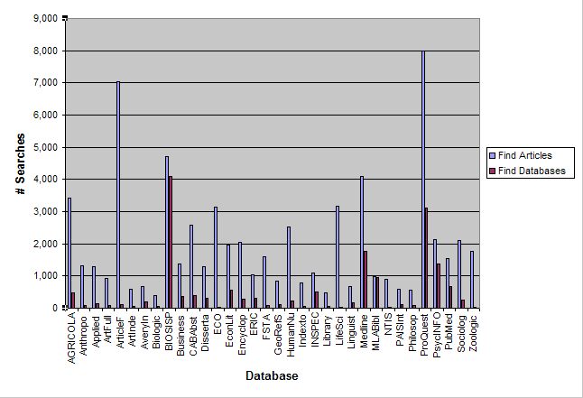
Databases searched via Find Articles versus Find Databases
Notes:
You might wonder how users are connecting to databases now that we have two points of access – Find Articles and Find Databases….Here is a look at the month of October. Connections through Find Articles are in the bars to the left, in light blue, and connections to Find Databases are in the bars to the right, in purple.
At first glance, it looks like many more users are searching databases through Find Articles. However, there is a big caveat here: whenever a user clicks on a database from Find Databases and then connects, we have no record of how many times he or she then runs searches in that database. That is information that only the vendor has at the present time. In contrast, since we have access to the data for how many times a user connects to a remote repository in Find Articles, via our ENCompass tables, we can determine how many actual searches were run per database. As a result, the number of searches by database in Find Databases should be much higher than what you see here – we are only able to represent the first search each user runs.
Therefore, what you are looking at is not an accurate comparison. For example, after a user connects to Find Databases, we do not know how many searches were run. In order to run a true comparison, we would need to obtain vendor information on individual number of searches for Cornell users, by database.
Because the Find Databases numbers you see are artificially low, we know that users are accessing certain databases (ProQuest and BIOSIS, for example) through the native interface more often than through the Find Articles page. (If we were looking at a one-to-one search comparison, the purple bars would be much higher.) In contrast, take a look at ArticleFirst and Zoological Abstracts. A relatively small number of users searched those through the native interface, while a significant number of those users searched them through Find Articles.
We can infer from this that these resources were under-utilized until we made them available through the Find Articles interface.

Slide 23
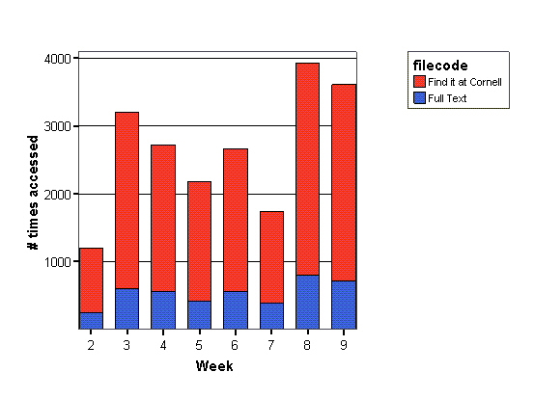
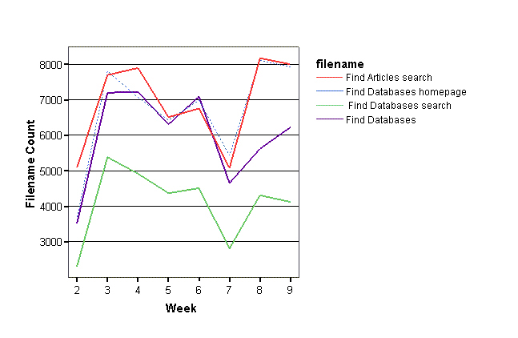
Find it at Cornell usage
Notes:
And what about Find it at Cornell? We are very interested in how many users are clicking on the Find it at Cornell link from a find articles object record, and further, how many are then clicking on the full text when that option is available for a given article. Since reference linking is a service that users highly value and expect more and more, we anticipated that full text access would be high.
The chart on the left shows you the breakdown between simply clicking on the Find it at Cornell screen and clicking on the full text link for an article. The red represents how many times users clicked on Find it at Cornell, and the blue represents how many times they went to the full text. Given the assumption that users want to go to the full text and would click on a link if it were present, the numbers you see here surprised us.
I added the chart on the right for a point of comparison – take a look at the top line, which represents the number of times Find Articles was accessed, week by week. For example, if we look at week 2 for this chart and compare it to week 2 of the chart on the left, we can surmise that out of about 5,000 sessions where users searched Find Articles, the Find it at Cornell screen was accessed about 1,200 times. From there, users clicked on roughly 250 full text articles. Again, it appears users are connecting to full text via Find Articles and Find it at Cornell a surprisingly small percentage of the time. At this point, we have only about 35 remote repository connections in Find Articles, whereas Find Databases connects to over 1,000 resources. Although it is true that not all of the 35 remote repository connections in Find Articles link to full text articles, it is also true that reference linking should allow for a much higher rate of full text access. Currently, the number of electronic journals in our “knowledge base” in LinkFinder Plus covers about 90% of our total Cornell subscriptions.
These results leave us with some important questions:
Are users selecting and searching more non-full-text rather than resources through Find Articles? If they are searching full text resources, are they having difficulty recognizing how to connect to the full text? Currently, we have the full text link showing up at the bottom of the Find it at Cornell page, below our Catalog search options, as is the default display setting in LinkFinder Plus. We are in the process of moving the link up above the catalog search options so it will be interesting to see if that display order increases the number of connections to full text. Beyond that, we need to do some user observation to determine how users are navigating Find it At Cornell and whether or not they are missing the links.

Slide 24
Next steps
Another round of connection testing and implementation
Additional services on “Find It At Cornell” page
User studies to learn more about reference linking use
Notes:
before: people wanted to search for articles but couldn’t; they thought they were, but they weren’t; find e-journals did not include all titles
during: we met with users during the development process; we were able to make radical changes as a result: tab structure; our assumption about what e-reference meant to users was wrong
after: transaction logs have already given us insights into use of the system and problems with certain parts of it; they will drive near future usability studies

