Slide 1

METS and MODS / MINERVA
PART 3
METS Profiles for Web Sites
Leslie D. Myrick, NYU
DLF Forum, Spring 2004

Slide 2

Today’s Topics
Background: challenges of web archiving
How METS can resolve some of the challenges
Why METS Profiles are necessary
Announcement of imminent posting of profiles for web sites by LC and PCWA
“Superclass” / “subclass” modeling of those profiles vis a vis each other

Slide 3
Political Web Communications Archiving Project
Under auspices of CRL and Mellon
Participants: Cornell University, Stanford University, UT Austin, NYU
Focus: SE Asia, Sub-Saharan Africa, Latin America, Western Europe
Content: Internet Archive
Mentoring: LC MINERVA / NDMSO

Slide 4
Web Archiving Challenges: I
Definition of the object “web site” and its boundaries
  what to do with external links? near files?
Complex nature of web site structure
Complex nature of a web page itself
  HTML wrapper around embedded files
  perhaps dynamically generated

Slide 5
Web Archiving Challenges: 2
Version Control-related storage and access issues
Creator-driven changes: successive harvests and versions
Repository-driven changes: refreshing, migration, other changes

Slide 6
Web Archiving Challenges 3
Lack of influence over the production of the content we’re archiving
Bad metadata from producers of web pages
  Programmatically extracted metadata as possible source for MODS and MIX bits in METS instances for websites
  Descriptive MD from <title>, <meta> tags ??
  Technical MD from embedded file information

Slide 7
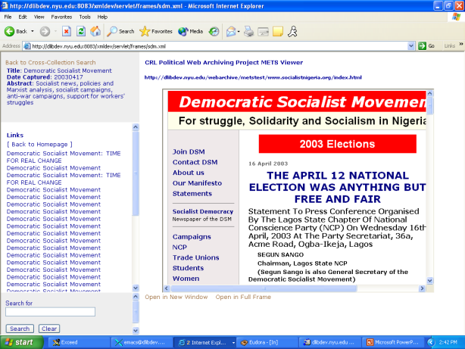

Slide 8
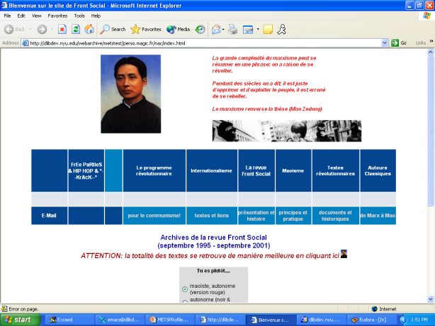
The Case of the Purloined Metadata

Slide 9
The Case of the Purloined Metadata, continued
<snip>
<HTML>
<!-- saved from url=(0041)http://www.sport.de/spart/sk1/ski006.php3 -->
<HEAD>
<TITLE>Bienvenue sur le site de Front Social</TITLE>
<META CONTENT="text/html; charset=windows-1252" HTTP-EQUIV="Content-Type">
<META CONTENT="Sport sports Baseball Basketball Beach-Volleyball Bob Boxen Bundesliga Bundesligavereine Championsleague DEL DFB DFB-Pokal Eishockey Ergebnisse Europameisterschaft Europapokal Fernsehen Football Formel1 Formel3 Fußball Golf Hallenmasters Handball Hockey Inline-Skating Leichtathletik Motorbike Motorrad Motorsport Nationalmannschaft NBA NFL NHL Reiten Rodeln Schwimmen Skifahren Skispringen Snowboard Sportarten Sportnachrichten Surfen Tennis Tischtennis Turniere Uefa-Cup US Open Vereine Volleyball Wassersport WBA WBC WBO Weltmeisterschaft Weltrangliste Wimbledon Fußball Motorsport Radsport Volleyball Sport Eishockey Skisport Boxen Handball Leichtathletik Pferdesport Schwimmen" NAME="keywords">
<META CONTENT="Sport Sportnachrichten Sportvereine Ergebnisse Tabellen Ranglisten Bundesliga DEL Formel 1 Tennis" NAME="description">
<META CONTENT="thu, 30 mar 2000 12:00:00 GMT" HTTP-EQUIV="date">
<SCRIPT language="JavaScript" SRC="sport_fichiers/sidiscript.js">
<SCRIPT language="JavaScript">
<!--
var on = "/ima/pfeil_weiss2.gif";
var off = "/ima/pfeil_weiss.gif";
</snip>

Slide 10
Whence Web Archive Metadata?
No dearth of metadata provided by crawlers as humble as wget or as sophisticated as Alexa
Management of it all: a perfect job for METS
Typical Alexa / IA SIP = .arc and .dat files along with byte offset .ndx files
  IA .arc = 100 MB gz archive file packed with archived files from web crawl along with server’s http response headers for each file.

Slide 11
Typical IA .arc snippet
<snip>
[ crawler’s file header]
http://www.apgawomen.org:80/calender.htm 63.241.136.203 20030417223125 text/html 2570
[http headers]
HTTP/1.1 200 OK
Date: Thu, 17 Apr 2003 21:35:43 GMT
Server: Apache/1.3.27 (Unix) FrontPage/5.0.2.2510
Last-Modified: Sun, 26 Jan 2003 04:05:37 GMT
ETag: "3b01d2-8fb-3e335e91"
Accept-Ranges: bytes
Content-Length: 2299
Connection: close
Content-Type: text/html
[file itself]
<html>
<head>
<title>calender</title>
<meta http-equiv="Content-Type" content="text/html; charset=iso-8859-1">
</head>
<body bgcolor="#FFFFFF">
</snip>

Slide 12
Technical Metadata Sources
Crawler frontier application
Host Server (HTTP response headers)
Captured Files
  Some info from accompanying HTTP headers
  Some from post-processing with ImageMagick and its ilk for other multimedia

Slide 13
Technical Metadata Desiderata
Host Server
  IP Address, operating system, webserver configuration
Capture Transaction
  Timestamp, software, HTTP response headers, errors
All Captured Files
  File format, file name, file size, last modified date, creating software, creating hardware, generated checksum
HTML Pages
  Charset, language, encoding, links broken down by type, embedded scripting, <meta> tags.

Slide 14
Image Files
(After post-processing with ImageMagick)
format
bit depth
compression
resolution
imageWidth and imageLength
file size
identifier

Slide 15
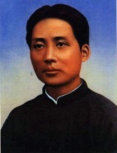
Image Magick dump for Mao1925.jpg
Image: Mao1925.jpg
Format: JPEG (Joint Photographic Experts Group JFIF format)
Geometry: 142x185
Class: DirectClass
Type: true color
Depth: 8 bits-per-pixel component
Colors: 11423
Resolution: 300x300 pixels
Filesize: 8115b
Interlace: Plane
Background Color: grey100
Border Color: #DFDFDF
Matte Color: grey74
Iterations: 0
Compression: JPEG
signature:
8c173bd33c3e5667d27e51aee539afcd58ccbc8d4a11ab76b127408905f598fd
Tainted: False

Slide 16
<mix:mix>
<mix:BasicImageParameters>
<mix:Format>
<mix:MIMEType>image/jpeg</mix:MIMEType>
<mix:ByteOrder>little-endian</mix:ByteOrder>
<mix:Compression>
<mix:CompressionScheme>1</mix:CompressionScheme>
<mix:CompressionLevel>0</mix:CompressionLevel>
</mix:Compression>
<mix:PhotometricInterpretation>
<mix:ColorSpace/>
</mix:PhotometricInterpretation>
</mix:Format>
<mix:File>
<mix:ImageIdentifier>www.aniagolu.org/images/people_dallas.jpg</mix:ImageIdentifier>
<mix:FileSize>189010</mix:FileSize>
</mix:File>
<mix:PreferredPresentation/>
</mix:BasicImageParameters>
<mix:ImageCreation/>
<mix:ImagingPerformanceAssessment>
<mix:SpatialMetrics>
<mix:ImageWidth>1020</mix:ImageWidth>
<mix:ImageLength>767</mix:ImageLength>
</mix:SpatialMetrics>
<mix:Energetics>
<mix:BitsPerSample>8,8,8</mix:BitsPerSample>
</mix:Energetics>
</mix:ImagingPerformanceAssessment>
<mix:ChangeHistory/>
</mix:mix>

Slide 17
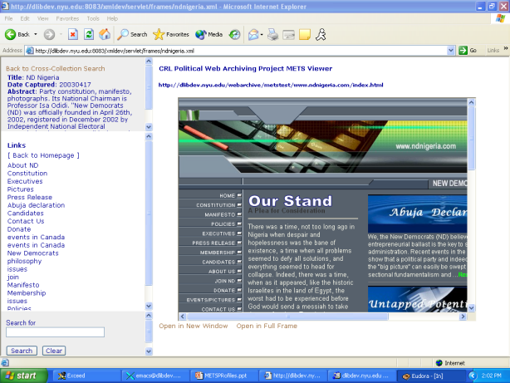
METS Website Viewer

Slide 18
Why METS Profiles?
As a transfer, archiving or functional syntax METS is a paradigm of flexibility.
But METS’ very flexibility is at once its strength and its onus.
How can we constrain METS instance production to facilitate interoperability?
Enter METS Profiles

Slide 19
Profiles as Blueprints for Classes of Objects
METS XML Schema and Profile Schema expressly written in WXS to take advantage of O-O modeling
Profiles, by specifying constraints beyond those of the METS schema proper, create classes of objects whose properties are predictable

Slide 20
XML Schema Constraints
Structural validation of the document and its elements’ content model
  does it have a structMap?
Referential and identity integrity
  Do the IDs and IDREFs match up? Are IDs unique?
Data type validity
  Is the string value kb or b not appended to your mix:fileSize?

Slide 21
Profile Constraints Go Further
May specify particular extension schema, rules of description, or controlled vocabs
May specify arrangement and use of METS elements and attributes
May specify technical characteristics of data files within a METS object
May prescribe particular tools or applications to be used with a METS object

Slide 22
Modeling Web Site Object(s) in a continuous archive
One possibility for PWCA:
Root level node (web site in the abstract) with <mptr>s to
Intermediary node (web site harvested on April 17, 2003) with <mptr>s to
Leaf node (single web page in web site harvested on April 17, 2003)

Slide 23
APGA Women Websites
April 17, 2003
December 12, 2003
February 2, 2004

Slide 24
LC Profile / Model
Describing Internet Libraries e.g. MINERVA with different configurations of aggregation of content
Profile and model to serve as “superclass” for other web site profiles e.g. PCWA

Slide 25
Aggregator and Single Captures Model
Profile for top level aggregation that uses <mptr>s to point to either another intermediary aggregator or to more than one captured version of a web site.
Profile for single standalone captured site, whether part of successive harvests or a one-off capture.

Slide 26
Aggregator Profile
Contains single MODS description describing the aggregation as an intellectual object
  e.g. Election 2004; JohnKerry.com (Nov 1-10)
Contains no amdSec, fileSec or structLink.
Contains a root <div> for the aggregation nesting <div>s with <mptr>s to each subsidiary aggregation or captured version.

Slide 27
MINERVA Election 2004
November 1, 2004
November 3, 2004
November 2, 2004
Kerry
Kerry
Nader
Nader
Kerry
Nader
Bush
Bush
Bush

Slide 28
MINERVA Election 2004
Kerry
Bush
Nader
Nov 1
Nov 1
Nov 2
Nov 1
Nov 2
Nov 3
Nov 2
Nov 3
Nov 3

Slide 29
Single Capture Profile
Top-level MODS description describes the web site as it existed when it was captured.
MODS record for each HTML page.
amdSec uses textMD, MIX, A/V prototype
fileSec
structMap
structLink

Slide 30
Modeling web site structure(s)
Flattened logical tree hierarchy in structMap
  entry page as root <div> nesting all other pages (LC)
  optionally further nesting pages’ hyperlinked pages (PWCA)
is cross-referenced to hyperlink structure in structLink <smLink> element
  either from page to page (LC) or
  from link to page (PWCA)

Slide 31
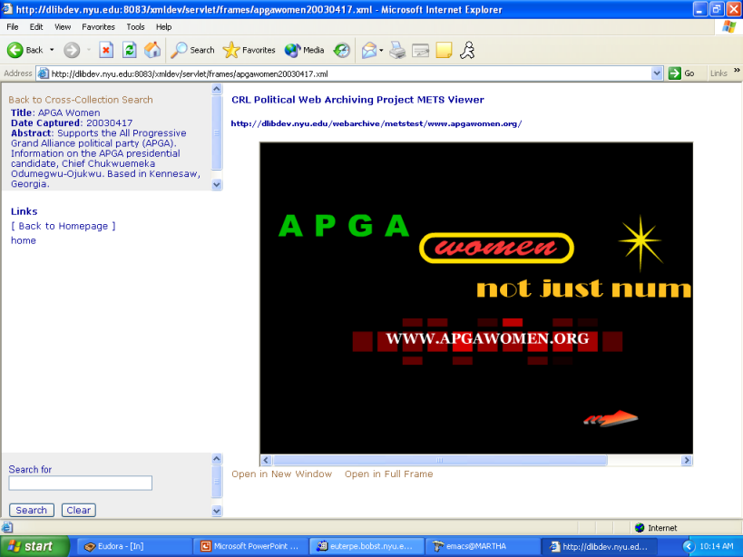

Slide 32
LC structure
<METS:div DMDID="DM01" TYPE="wc:website" ID="page18" LABEL="http://dlibdev.nyu.edu/webarchive/metstest/www.apgawomen.org/">
<METS:fptr>
<METS:par>
<METS:area FILEID="FID18"/>
<METS:area FILEID="FID1036"/>
<METS:area FILEID="FID1043"/>
<METS:area FILEID="FID1075"/>
</METS:par>
</METS:fptr>
<METS:structLink>
<METS:smLink from="page18" to="page1059"/>
…
<METS:smLink from="page1059" to="page154"/>

Slide 33
_x0013_
<METS:structMap>
<METS:div DMDID="DM01" TYPE="web site" ID="page18"
LABEL="http://dlibdev.nyu.edu/webarchive/metstest/www.apgawomen.org/" ORDER="01">
<METS:fptr>
<METS:par>
<METS:area FILEID="FID18"/>
<METS:area FILEID="FID1036"/>
<METS:area FILEID="FID1043"/>
<METS:area FILEID="FID1075"/>
</METS:par>
</METS:fptr>
<METS:div ID="LINK1" LABEL="home" ORDER="2">
<METS:fptr>
<METS:area BEGIN="000" BETYPE="BYTE" END="111" FILEID="FID18"/>
</METS:fptr>
</METS:div>
<METS:structLink>
<METS:smLink from="LINK1" to="page1059"/>
…
<METS:smLink from="LINK2" to="page113"/>
<METS:smLink from="LINK3" to="page120"/>

Slide 35
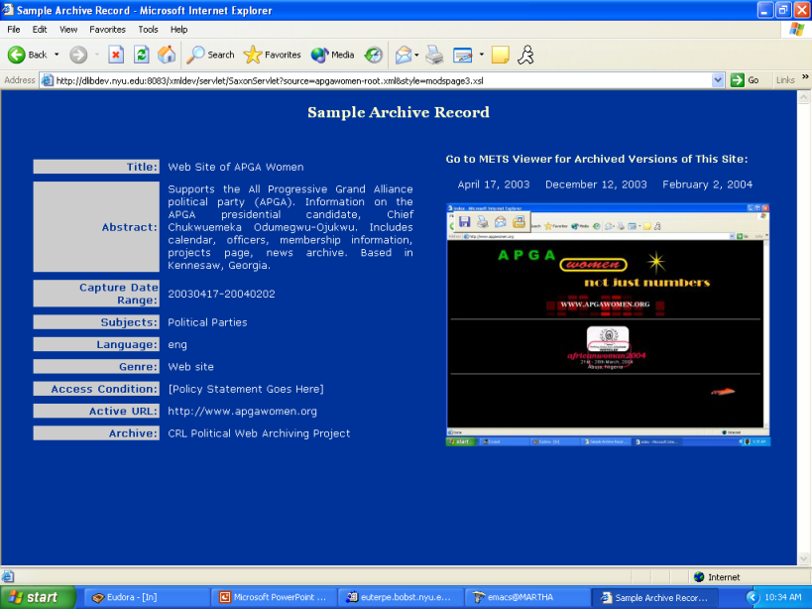
_x0013_

Slide 36
_x0013_

