Slide 1
Building a robust knowledge base for digital formats
John Mark Ockerbloom
DLF Spring Forum
April 21, 2004

Slide 2
Why this talk?
Figure out how to build such a knowledge base
  Raise a lot of questions about how to do it
  I’ll propose some answers in this talk, but I’d like you to be thinking about the questions
Show a prototype designed to help answer some of these questions
  Fred (Format REgistry Demonstration)
Invite you to participate in the process
(And thank sponsors of this effort, in particular the DLF and the Mellon Foundation)

Slide 3
Why a format registry?
  Detailed format knowledge needed for many digital repository and preservation activities
  But the knowledge is now being assembled
    Piecemeal (no one place to look, or even start looking)
    Incompletely (much format information not public)
    Redundantly (lots of projects need the same info)
  Some registries already exist…
    IANA’s MIMEregistry is the most widely used
    Some organizations (PRO, Dspace, Apple) have registries for their own constituency or software
  …but have insufficient breadth, depth, or participation for the needs of preservation

Slide 4
Some challenges for a global format registry
  What information does it really need to manage?
  How is this information going to be accumulated, mantained, used?
  How can it get both high quantity and good quality of information?
  How will it interact with other people, systems?
  Practical issues: How will it be governed, supported?

Slide 5
Why a format registry prototype?
“The best is the enemy of the good”
  Get rid of the paralysis induced by having to get it right the first time
  For now, forget the idea that a single registry has to do everything
Provide a more concrete basis for discussion and planning of global digital format registry system
Test ideas about data model, service model
  Starting with a data model prepared by Stephen Abrams based on previous GDFR meetings
  Starting with a simple interactive Web site for viewing and entering information. (Other interfaces to follow.)
Get some experience collecting, managing format description data
Plan for a persistent, sustained, more authoritative registry system

Slide 6
What should a registry do?
  Name formats
    Give them unambiguous, ubiquitous names
      Analogy: naming authority databases
    and/or provide a mechanism to assign such names
      Analogy: DNS
    Ideally, the naming should have global reach, comprehensiveness
  Document formats, their identification, and their use:
    Describe: Document format characteristics, specs, risks
    Identify: Assist in the determination, validation of object formats
    Use: Point to tools and methods to render, characterize,extract information from, and convert objects in that format
  Registry can contain original information, or pointers

Slide 7
How are formats described?
Syntactically: What the bytes look like
  E.g. BSDL, grammars
  Verification: Signatures and other “magic number” checking
Structurally: What data structures are present
  E.g. DIDL, ASN.1 declarations, many specification documents
  May assume particular underlying syntax (e..g XML Schemas), or abstract away from it (e.g. Dublin Core and OAIS definitions)
Functionally: What can be done with the format
  E.g. TOM: Object-oriented approach (attributes, methods…)
  E.g. PRONOM: Programs that use, maintain, produce the format
Practically: Effective use and sustainability of format
  Support, quality, IP restrictions, etc.
  (Many issues covered in LC talk from Fall 2003 Forum)
We care about all of these
  But might not be able to address them all perfectly
  They also matter for abstract “formats”: Scope creep?

Slide 8
Where does the information come from?
  From the designers of the formats
    You need to find them
    They need the time to provide the documentation
    They need to trust you
    They might not be the most objective about utility
  From the researches of the registry maintainers
    They need the time and expertise to seek it out and record it
  From third parties (developers, researchers, the public)
    They need to be able and willing to contribute
    There needs to be some way to evaluate the validity and quality of the information provided
      Either to admit it, or to rate it
  A comprehensive system needs all of these sources

Slide 9
What can we learn from MIME?
Simple naming conventions, registration procedure can be widely used
  Sponsorship by IANA also helps
Less information than we’d like
  Many more specialized formats not covered
  Many listed formats not covered adequately
    Maybe because of limitations on who can register
    Specialized format variants not well covered; maybe format relations need to be better supported
Naming needed some work
  “Experimental” tree got messy
  “Vendor” tree helped enlarge repertoire, still incomplete

Slide 10
What can we learn from Wikipedia?
Over time, you can pick up a lot from a large, interested user community
  And even slowly progress towards more reliable information
  And develop useful structures, conventions over time
Trustworthiness still a concern
  Attribution, histories, discussion, all help evaluate and maintain trustworthiness
  Can also interact with more formal peer review
    Not used much in Wikipedia (in part because there are other peer-reviewed encyclopedias)
    Used elsewhere for monographs, open source software
Interlinking (within, into, and out of) a key strength
Note: A format registry system would have a smaller user base
  (though ßprobably more expert and motivated on average)

Slide 11
How have we designed Fred to work as a testbed?
  Make it easy to evolve
    Start with a basic data model based on GDFR discussions
    Represent in XML, render using generic, data-driven display and editing modules (also to be used with TOM)
    Makes for easy export, import, remapping
  Make it accommodate a continuum of control, structure
    Core in structured form with strict access control
      But: format authors can open up permissions if desired
    Each format also has unstructured Wiki discussion
  Promiscuously link with related information resources
    Aliases link to other “registry” systems (e.g. TOM, MIME)
    Within registry system, format relations and repository-specific namespaces may encourage network growth
  Make it highly reflective and participatory
    Linked Wikis let users comment on, improve, information
    Full editing , discussion, review history maintained

Slide 12
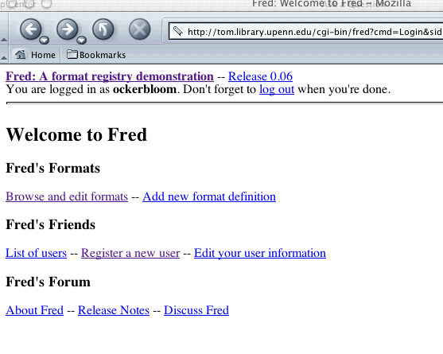
Quick tour

Slide 13
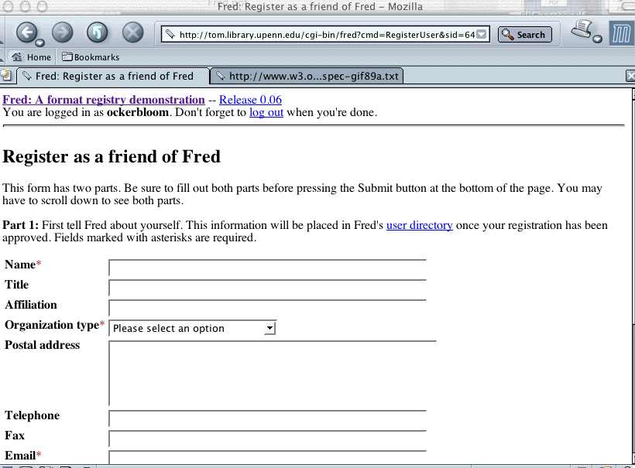
Quick tour

Slide 14
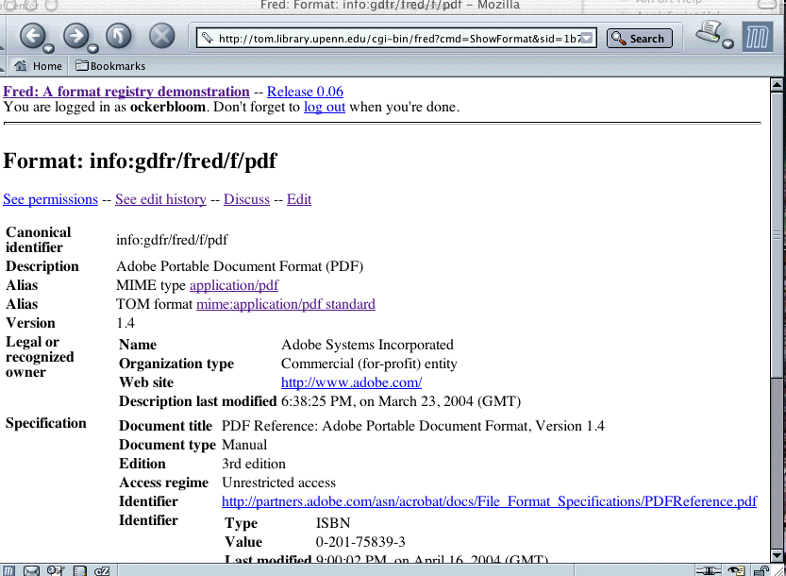
Quick tour

Slide 15
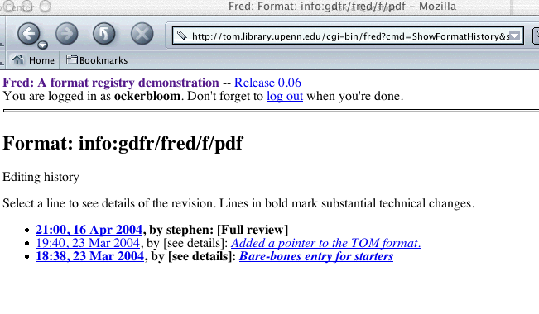
Quick tour

Slide 16
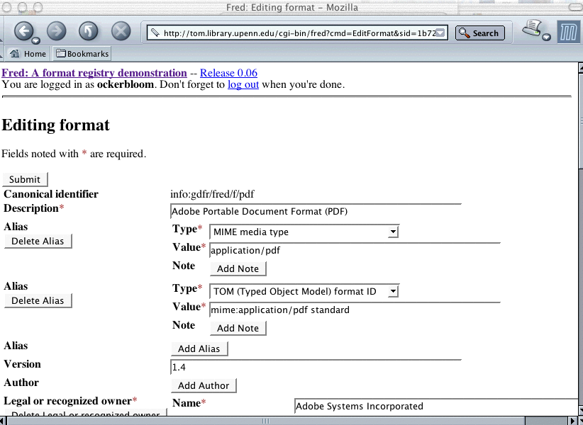
Quick tour

Slide 17
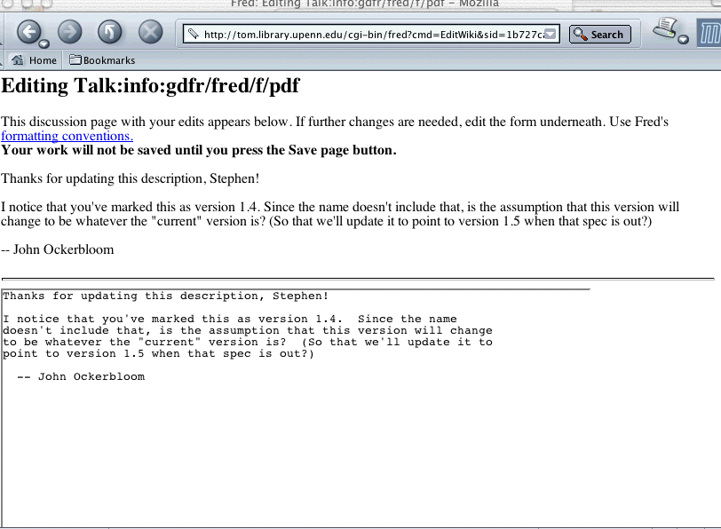
Quick tour

Slide 18
What’s next for Fred?
Build a larger repertoire, community
Elaborate on, discuss and evaluate data model details
  Add support for classification systems, peer registries
  How should classifications be designed and maintained?
  Does data model need revision for reuse of agent and service information, peer exchange of information?
Improve user interface, add machine interfaces
Plan relationships between Fred and other registries
  Including a successor GDFR system
Explore synergies between Fred and TOM
  TOM can bring in more sophistication about format relationships and abstraction, pointers to conversion services
  Fred can bring better support for documentation, links to related description systems, support for version control and reflection
Release code as open source

Slide 19
What can you do to help?
See Fred’s website: http://tom.library.upenn.edu/fred/
Register there to add and edit format information, participate in discussions
Tell us what information, features are helpful to you, what changes you’d find useful
  Practical, specific experience and applications especially helpful

