Slide 1


Opportunities for Collaboration:
The HEARTH Project
Joy Paulson and Nathan Rupp
Cornell University
Digital Library Federation
Spring Forum
New Orleans, Louisiana
April 2004

Slide 2
Outline
Introduction
Metadata
Tying metadata together
Notes:
Welcome…thanks for coming. I’m Nathan Rupp and this is Joy Paulson. We’re from Cornell University and today we’ll talk about the HEARTH digital library project and how we’ve pulled together metadata from a number of different sources and units within Mann Library to support the project. We will discuss what HEARTH is and then talk about the different kinds of metadata used in the project, including vendor-supplied metadata, descriptive metadata, preservation metadata, and structural metadata. Lastly, We’ll discuss how these different types of metadata are tied together.

Slide 3
The HEARTH Project
Home Economics Archive: Research, Tradition, History
Subjects covered
Bibliography development
Reformatting
Technical details
Funding
Notes:
The HEARTH—or Home Economics Archive: Research, Tradition, History—project serves up via the Web essential and influential books and journals in home economics that were published in the United States before 1950. The collection includes materials in applied arts and design; child care, human development and family studies; clothing and textiles; food and nutrition; home management; housekeeping and etiquette; housing, furnishing, and home equipment; hygiene; institutional management; retail and consumer studies; and teaching and communication.
For this project, librarians at Cornell developed bibliographies in each of the subject areas; these bibliographies were then reviewed by scholars in the field who ranked the materials in the bibliographies in respect to their importance. This method is based on the one used in the Core Historical Literature of Agriculture (CHLA).
Once we had determined what titles should be in the collection, we began reformatting titles published before 1925. From the ranked list of titles, project staff first identified titles in the Cornell University Library collection and later worked with librarians at other research institutions to locate materials not in the Cornell collection. The approach for conversion taken by this project built on the increasingly popular methods articulated by Anne Kenney and others that were used in the Making of America projects at the University of Michigan and Cornell and the Core Historical Literature of Agriculture project at Cornell. The procedures used by this project affirmed guidelines and best practices that are well established in the preservation community.
Pages were scanned as 600 dpi bitonal images and in some cases as 400 dpi gray-scale images. All images are TIFF 6.0 and compressed using ITU Group 4. Page image files were processed to generate OCR and XML that enable searching and navigation. Full-text searching is provided via the OCR'd text. The present access system, DLXS, was first built for the Making of America project by the University of Michigan's Digital Library Production Service. The system and its user interface have been modified somewhat for the HEARTH materials.
The development and bibliographic work was supported by a three-year Hatch Fund grant (Federal appropriations for research distributed by the Cooperative State Research, Education, and Extension Service) and phase one of the reformatting project was funded by a two-year grant from the Institute of Museum and Library Services.
Today, as we have said, we’re going to talk about the various kinds of metadata that go into supporting HEARTH and how that metadata creation is dispersed throughout the library staff. We’ll discuss the metadata we receive from the vendor, descriptive metadata for the actual digital objects, preservation metadata, structural metadata, and how we tie all of it together to create a workable system.

Slide 4
Vendor Metadata
TIFF headers contain:
Bibliographic information
Descriptive information
Date and time of scan
Source description
Image description
Notes:
The metadata we receive from the vendor is contained in a TIFF header associated with each image. These TIFF headers contain:
1. Basic bibliographic (author, title, publisher, place of publication, series notes, and subject headings) and descriptive information (total number of pages expected to be scanned and any anomalies, such as missing pages). This data was noted at Cornell and sent to the service vendor with the volumes to be converted.
2. Date and time of scan and source description, noted by the vendor.
3. Image description, provided by the vendor.

Slide 5
Image Description
Monographs and serials
  Shipment number
  ID number
  Image sequence number (padded to 8 digits)
  Technical description information
Serials only
  Volume and issue number
Notes:
The image description contains several pieces of information, recorded by the vendor, including—for monographs and serials—the shipment number, ID number, image sequence number (padded to eight digits), and technical description information. For serials, the vendor also records the volume and issue number.
When this project began three years ago, it wasn’t clear what level of technical metadata needed to be recorded. Today we’d require the vendor to record further information such as the type of scanner or digital camera used, the name of the operator, input format, output format, etc.

Slide 6
Image Description
Image width Resolution unit
Image length Bits per sample
X resolution Compression
X position Orientation
Y resolution
Y position
Notes:
Information included in the technical description of the image, which, again, is provided by the vendor, includes: image width, image length, x resolution, x position, y resolution, y position, resolution unit, bits per sample, compression, and orientation.

Slide 7
Descriptive Metadata:
Traditional Cataloging
All titles included in OPAC
  Titles available at Cornell
  Titles from other libraries supporting home economics
MARC 856 field
Notes:
There are over twelve hundred volumes in HEARTH, including 934 monograph titles and 8 serial titles. Some of these are digital reproductions of items held by Cornell libraries; others are digital reproductions of items loaned to Mann Library from other libraries supporting home economics programs. It is Cornell’s policy to make all titles included in digital library systems available via the library’s catalog. For HEARTH, we had catalog records for the titles we owned; we created original records by copying the catalog records for the print titles we already owned and made changes to them to reflect the titles’ digital status. For the titles we borrowed from other libraries, we created original records based on records for print titles in the OCLC database. Each of these catalog records utilized a URL in the MARC 856 field to point to the title in the HEARTH system.

Slide 8
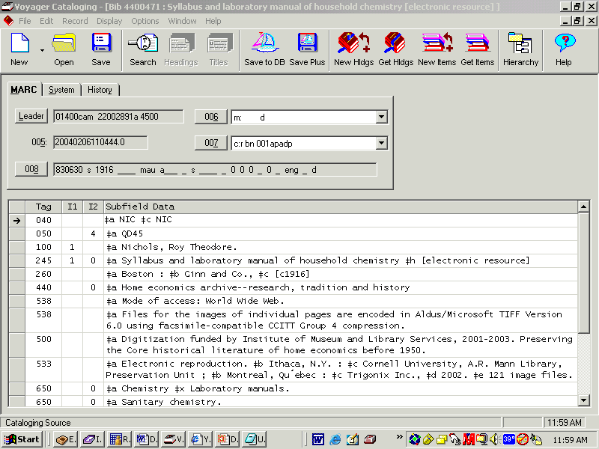
Notes:
Here’s an image of a MARC record with the 856 URL that points directly to the HEARTH database. You’ll notice that we’ve also created a persistent URL (PURL) for the record.

Slide 9
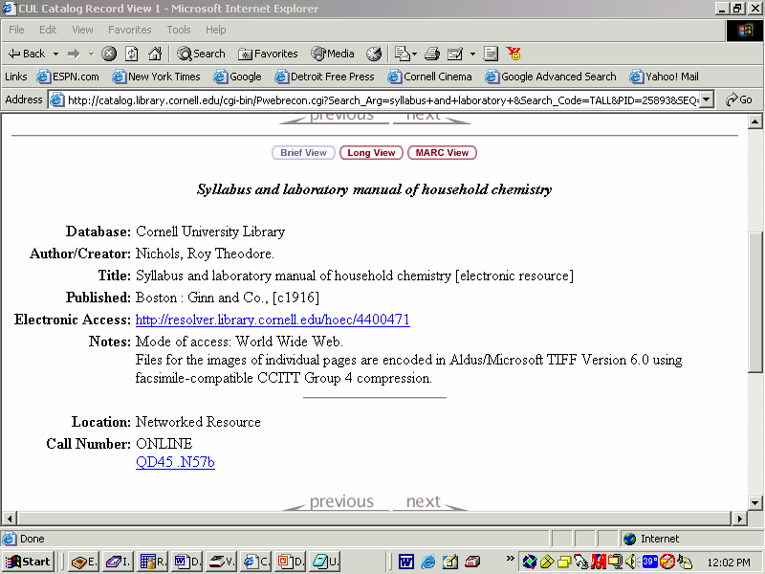
Notes:
Here’s a screen shot of the same record from the public catalog (OPAC) view.

Slide 10
Descriptive Metadata: Repurposing MARC
Descriptive metadata from MARC records
MARC to TEI Lite conversion scheme
  100ad → Author 300a → Pagination
  245ab → Title 6XX → Keywords
  260abc → Publication
Problems
  Dates
  Edition statements
Notes:
After creating bibliographic metadata records (MARC) for all the titles in HEARTH we really didn’t want to have to re-enter all that metadata again into the HEARTH system, but we still wanted people to be able to search HEARTH itself and get full text to the titles within the system as well as through the online catalog. To eliminate this duplicate work, we repurposed the bibliographic metadata from the MARC records into a metadata form that could be used and searched in HEARTH.
We used a MARC to TEI-lite conversion process that had been used at Cornell in other digital library projects, like the Core Historical Literature of Agriculture. Much of this work was straight forward—authors were mapped from the MARC 1XX a and d subfields (our programmer doesn’t currently pull additional authors from the MARC 7XX fields, but has plans to do that in the future); titles were mapped from the 245 a and b subfields; publication information was mapped from the 260 a, b and c subfields; the pagination was mapped from the 300 a subfield; and keywords were taken from the 6XX fields.
In doing this, we encountered a couple of small difficulties or problems:
One, there are two dates in a MARC record, one in the 260c field and another in the fixed field. The date in the 260c field is used for display purposes in a public access catalog and the date in the fixed field is used by the computer systems to sort the records by date. We extracted both these dates from the MARC records for HEARTH and used them for the same purposes: the 260c date is for display purposes and the fixed field date is used to sort the records by date.
Two, the cataloging for the records we were using was all over the map according to what version of AACR the item had originally cataloged with. This resulted in, for example, edition statements being recorded in some cases in the 250a field and in others in a 500 note field. After consultation with catalog librarians, the project programmer wrote a program that would pull the edition statement from the 250a field if it was present, and if not, the program would search the 5XX fields until it found an edition statement. If no edition statement was found either place, it would not be included in the HEARTH record. The only other 5XX notes fields extracted for use in HEARTH were notes about the digitization process.

Slide 11
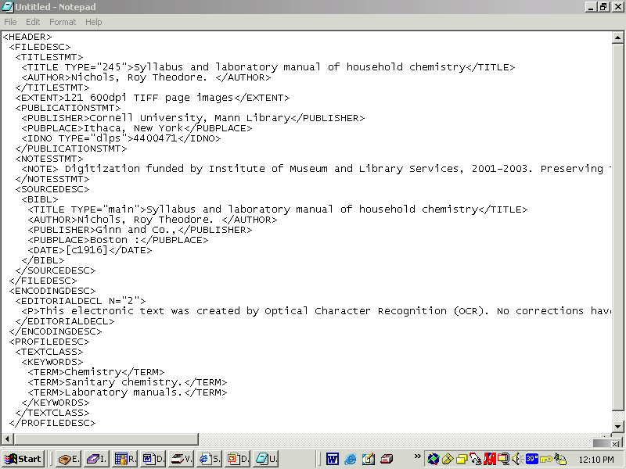
Notes:
Here’s the header from the TEI mark up for the record in question. You can see where we have put the author, title, publisher information, digitization note and keywords from the subject headings. We also have used the bibliographic identification number as an identification number in the mark up.

Slide 12
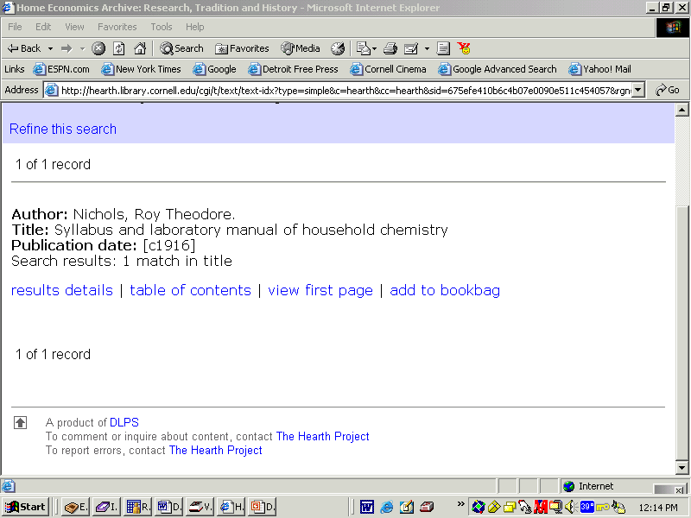
Notes:
Here’s a shot of what this title looks like within the HEARTH system itself.

Slide 13
Structural Metadata
Document Structuring Tool
Designed in house
Provides project management
Manages copyright information
Structures the document
Performs quality control of images
Notes:
For the HEARTH Project, our project programmer designed a system to manage the images from the time of return from the vendor. The major functions of the system are project management—it allows us to control who can access the system and who is working on what at any given time, management of copyright information, structuring of the document, and quality control of the images.

Slide 14
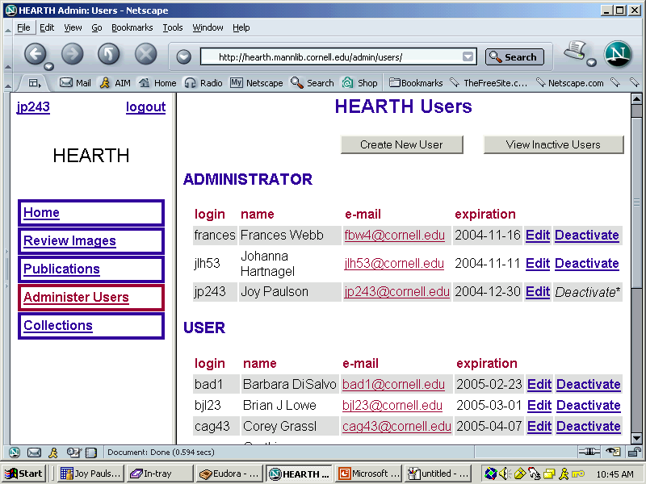
Administrative System (1)
Notes:
Here’s a shot of the screen that allows us to control levels of access to the system. Some project team members without the need to work in the system have read only access. Students have access only during their terms of employment and only to materials assigned to them in the system. Only a few staff members have the authority to all areas of the system and the ability to create access for others

Slide 15
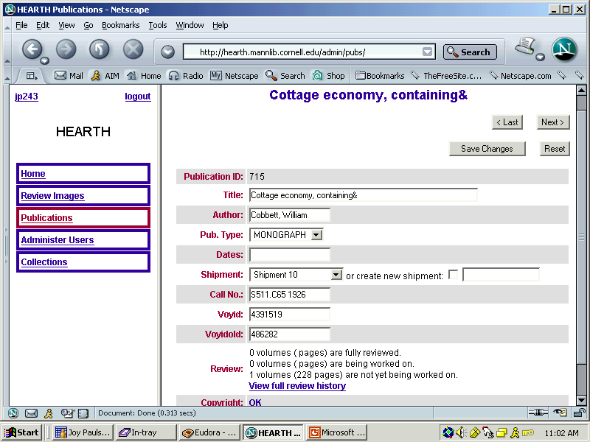
Administrative System (2)
Notes:
This screen allows us to see if a title has been fully reviewed, is currently being worked on, or if the title has not yet been structured.

Slide 16
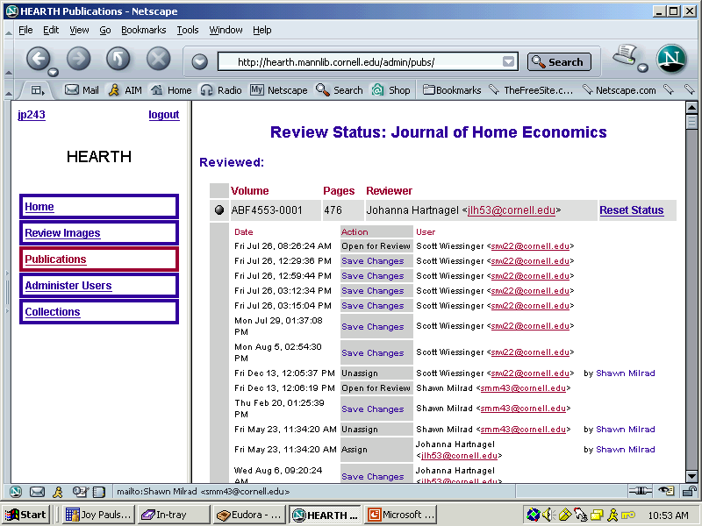
Administrative System (3)
Notes:
We can view the entire history of work on the title. We know exactly who has worked on which volume and when. For long serial runs this is very helpful. When multiple people structure a serial run, we do have one person run a final review of the entire title to ensure consistency.

Slide 17
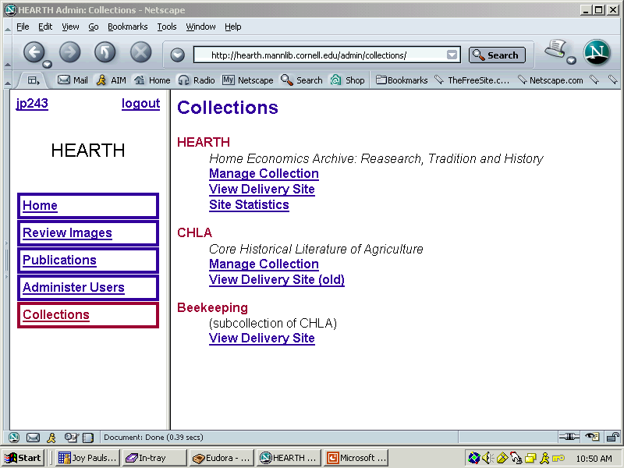
Administrative System (4)
Notes:
The system is designed in a way that allows us to work on multiple collections while keeping the images and metadata for the different collections separated.

Slide 18
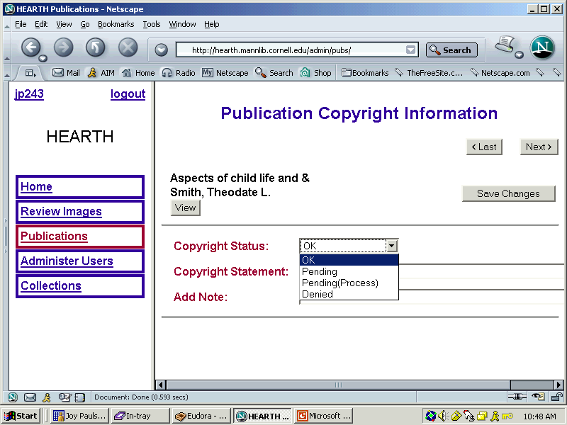
Copyright Management
Notes:
Here’s a shot of the screen that allows us to manage copyright information, including requests for specific copyright statements by publishers who have grated permission to use copyright protected material.

Slide 19
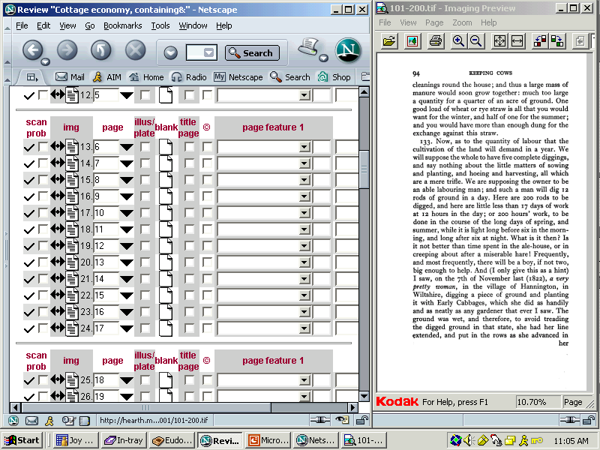
Structuring Documents (1)
Notes:
The image of each page can be viewed and evaluated at the same time that any important structures it contains are noted. We use check boxes and drop down boxes to reduce the need for inputting and to reduce errors. Scanning problems can be described in a notes field at the bottom of the page. Matching of image sequence numbers to page numbers is not done on a page by page basis— and can generate a sequence of page numbers by clicking and dragging.
We have successfully trained student staff to undertake this work. On average we can inspect and structure 4 monographs per hour. Volumes with many illustrations and structures do take longer.

Slide 20
Structuring Documents (2)
Quality control of images
Match page numbers to image sequence
Highlight important structures:
Title pages
Table of contetnts
Other tables
Front matter
Notes
Indexes
Illustrations
Bibliographies
Back matter
Errata
Notes:
When the scanned images for both monographs and serials are returned from the vendor on CD-ROM, they are inspected to evaluate quality—whether they were complete, legible, and correctly placed.
We match page numbers to the image sequence and highlight important structures in the document to aid in navigation.

Slide 21
Providing Access
Article level
  Browse by author
  Search for author or title
Volume level
  Structuring Process
Notes:
By indexing to the article level we can allow the user to browse by the name of the author of a specific article or to search using the articles author or title. Users can also browse volumes. This is a much more time consuming process. We usually have project staff rather than student staff work on structuring serial material, although occasionally we have students who have a substantial amount of experience structuring monographs also work on serials. It takes 1 to 4 hours to structure a volume depending on the complexity of the physical layout of the pages, length, number of articles, number of illustrations, etc.

Slide 22
Other Functionalities
Insert blank pages
Insert pages missing note
Reorder pages out of sequence
Mark pages with scanning problems—description placed in notes field
Notes:
The system allows us to insert blank pages when blank pages are included in the pagination without the cost of scanning a blank page. This reduces patron confusion. We can also add a missing pages note that may be temporary or permanent.
We can reorder pages that have been scanned out of sequence.
We can also mark pages with scanning problems, describing the specific problem in the notes field.

Slide 23
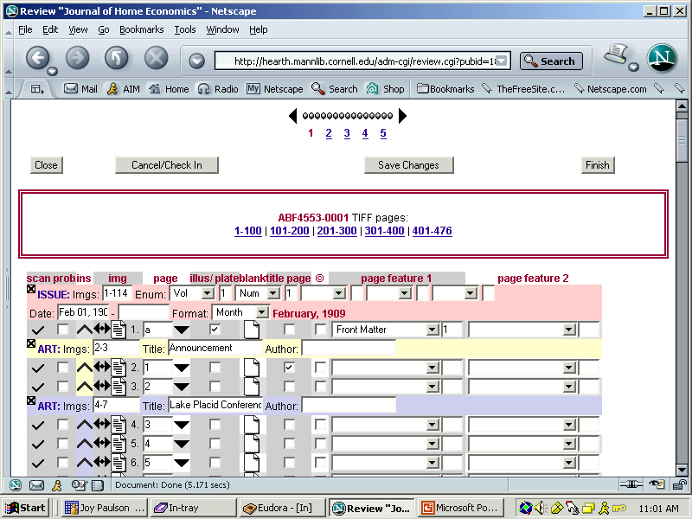
Notes:
Author names, article titles, and page ranges must be keyed in for each article. This requires strict attention to detail and does mean that errors can occur. We have begun delaying this process until OCR of the volume is complete. We can than cut and paste from the OCR’d text and simply make any corrections to the OCR so that spelling is correct. This seems to be more efficient and accurate. Different colors are used for each article to make it easier for the staff member to see where they are in the process.

Slide 24
Tying It All Together
Vendor-supplied metadata
Descriptive (MARC) metadata
Preservation metadata
Structural metadata
MARC record information
OCR
Images on server
Notes:
This system not only allows all these functionalities—provides administrative control over who has access to the system, allows for structuring of complex documents, and manages copyright, but it also serves as a way to pull together the vendor-supplied, descriptive, preservation, structural metadata, OCR text, and images on the server and transfer all of this into DLXS. The resulting file is not fully TEI Lite, but it is TEI Lite-like. The project programmer designed this data structure so that it could be migrated to a number of different systems; the only thing that we would have to change in a different system would be the way the different pieces of data are tied together.

Slide 25
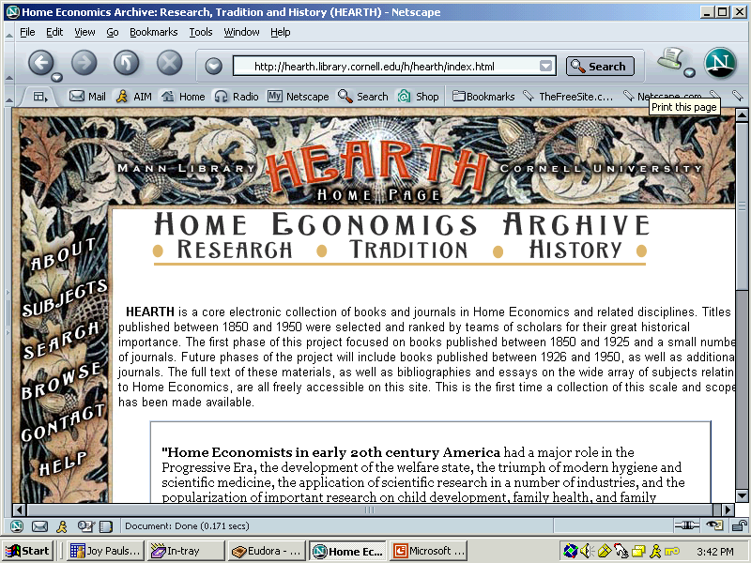
HEARTH

Slide 26
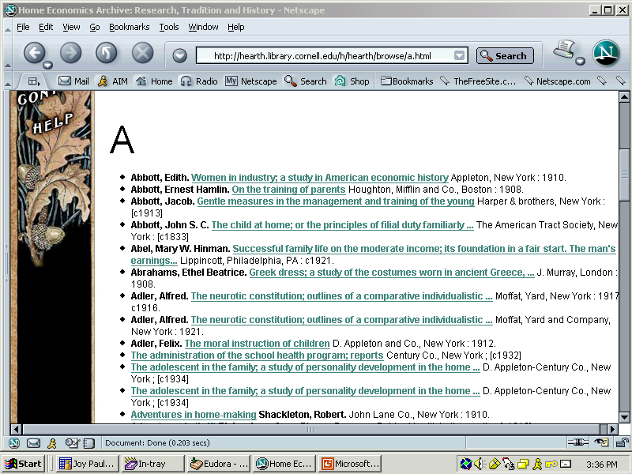
Browse by Author or Title
Notes:
The system allows users to browse author or title.

Slide 27
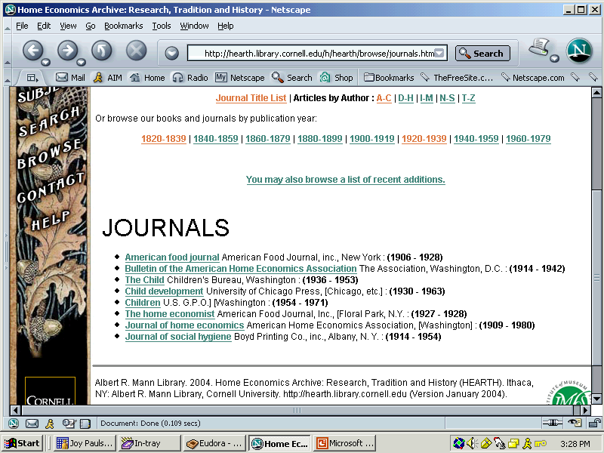
Browse Journals Page
Notes:
The HEARTH site allows journal titles to be browsed. Currently the list is short, but we expect the list to grow as more materials are added to the site.

Slide 28
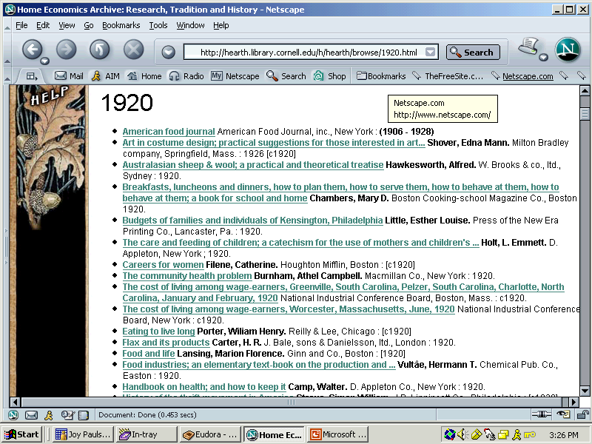
Journals and Monographs by Year
Notes:
It is also possible to browse journal articles and monographic titles by year. We had many requests for access either by year or year ranges.

Slide 29
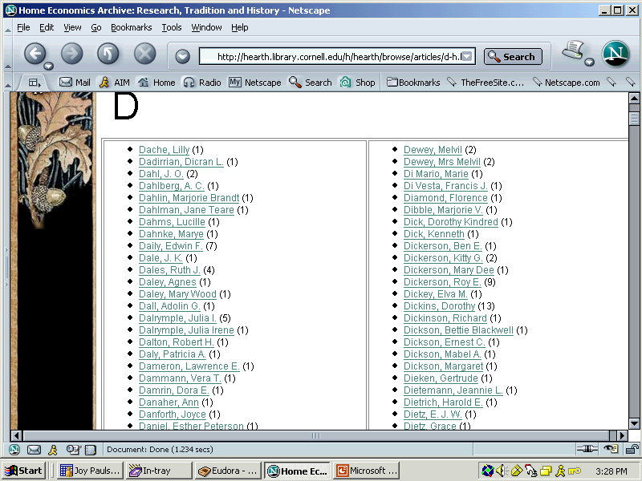
Article Author Browse Page (1)
Notes:
It is also possible to browse by journals by the author of an article.

Slide 30
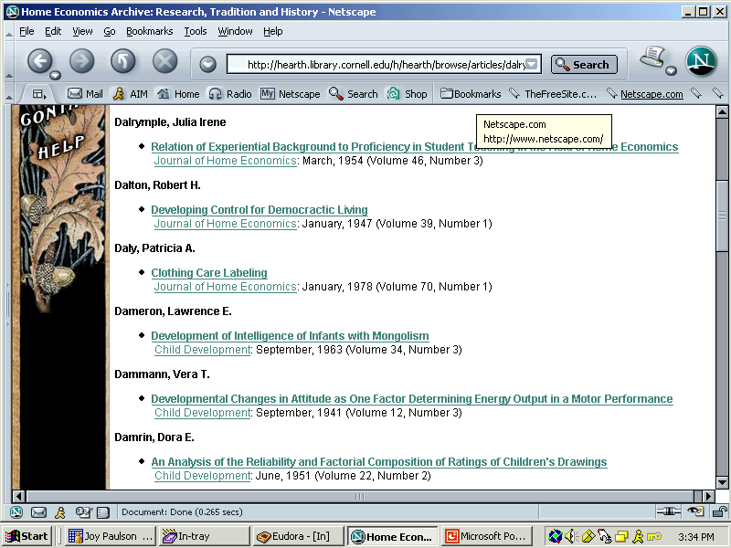
Article Author Browse Page (2)
Notes:
Clicking on a name brings the user to a list of articles by the author. Clicking on the specific title will take you directly to the article.

Slide 31
Questions?
Joy Paulson
(607) 255-7950
jp243@cornell.edu
Nathan Rupp
(607) 255-7943
nar25@cornell.edu

