Slide 1
XML Schema for
E-Resource Licenses
Nathan Robertson
Johns Hopkins University
Tim Jewell
University of Washington
DLF Spring Forum
New Orleans
April 21, 2004

Slide 2
Talk Outline
Background: the DLF E-Resource Management Initiative
XML and License Information
Issues and Next Steps
Questions and Comments

Slide 3
1. The DLF Electronic Resource Management Initiative

Slide 4
ERMI Goals
Describe architectures needed to manage large collections of licensed e-resources
Establish lists of elements and definitions
Write and publish XML Schemas/DTD’s
Promote best practices and standards for data interchange
http://www.diglib.org/standards/dlf-erm02.htm

Slide 5
ERMI Project “Deliverables”
(google “web hub”) or http://www.library.cornell.edu/cts/elicensestudy/home.html
Problem Definition/Road Map
Functional Specifications
Workflow Diagram
Entity Relationship Diagram
Data Elements and Definitions
XML Schema

Slide 6
Recent ERMI Developments
ILS Vendor Responses
  Innovative (“III”): beta testing begun
  ExLibris: Development plan: Dec. ’04
  VTLS: Development plan, product name
  Dynix: Draft “white paper”
Consortial support issue
CONSER Summit
  Publisher interest in standard description of “public” versions of licenses
  “Test bed” for shared resource/license records?

Slide 7
2. XML and License Information

Slide 8
XML Investigation Sub-group
Adam Chandler (Cornell, Chair)
Miriam Blake (Los Alamos National Laboratory)
Sharon Farb (UCLA)
Nancy Hoebelheinrich (Stanford)
Angela Riggio (UCLA)
Nathan Robertson (Johns Hopkins)
Simon St. Laurent (O’Reilly & Associates)
Robin Wendler (Harvard)
special thanks to:
Renato Iannella (developer of ODRL)
Susanne Guth (Wirtschaftsuniversität Wien)

Slide 9
Why License Focus?
Originally considered a schema for the entire data dictionary, but . . .
  Significant overlap with existing and emerging schemas.
  Limited functionality.
Why licensing?
  Area of considerable concern and current interest.
  Significant commercial activity in defining and schematizing.
  Limited library activity in defining and schematizing.

Slide 10
Uses for License Data Exchange
Licensing elements actionable in an ERM system
  Convey appropriate license restrictions.
  Show or hide resources depending on availability to certain groups.
  Prompt staff for action
Exchange with consortial partners
License feeds from vendors

Slide 11
ERMI Standards Comparison
ID/
Descrip.
Acq
License/
Rights
Access/
Trouble
Usage
Stats
Preser-vation
Authent-ication
Open
ERMI Focus
Dublin Core
A-Core
ONIX
ONIX for Serials
<indecs>
METS
COUNTER
Shibboleth
ODRL
XrML

Slide 12
Existing License/Rights Efforts
ONIX for Serials
<indecs>
METS
ODRL
XrML
  Rights are part of scope, but planned for later
  development.
  “metadata framework.” Insufficiently precise.
  Has developed a draft “simple rights schema”
  while more comprehensive RELs (XrML,
  ODRL) are being developed and debated.

Slide 13
ODRL vs. XrML
ODRL
“does not determine . . . requirements of any trusted services . . . that utilize its language.”
“does not enforce or mandate any policies for DRM.”
“has no license requirements and is available in the spirit of ‘open source’ software.”
XrML
“licenses can be interpreted and enforced by the consumption application.”
“How will the industry benefit from XrML? Enables the creation of new revenue streams based on the ability to control the use and access of digital content and services”
“a portfolio of patented technologies. . . . if you use XrML in a context covered by the ContentGuard patents, then there may be a fee.”

Slide 14
“License/Rights”
License (ERMI): “Information from the legal document, a contractual agreement, that defines the relationship between the grantor and the licensee and the terms and conditions of use for the product.”
Rights (ODRL): “Rights include Permissions, which can then contain Constraints, Requirements, and Conditions. Permissions are the actual usages or activities allowed…. Constraints are limits to these permissions…. Requirements are the obligations needed to exercise the Permission…. Conditions specify exceptions….”

Slide 15
ERMI License Terms
Fair Use Clause Indicator Citation Requirement Details Display Digitally Copy Print Copy Scholarly Sharing Distance Education ILL Print or Fax ILL Secure Electronic Transmission ILL Electronic | Course Reserve Print Course Reserve Electronic / Cached Copy Electronic Link Permission Course Pack Print Course Pack Electronic Remote Access Walk-in Users Authorized User Groups Authorized Locations

Slide 16
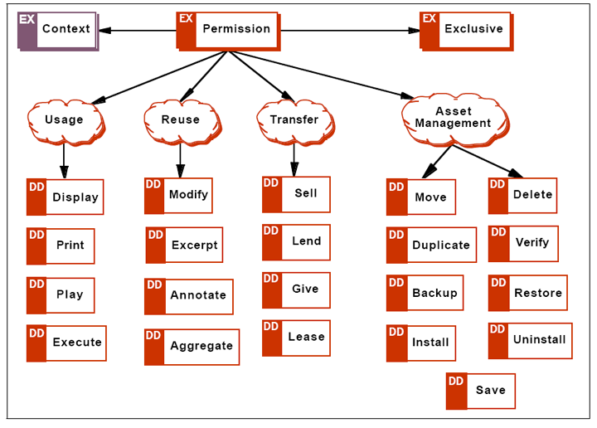
ODRL Permissions Model

Slide 17
ERMI License ≠ ODRL Rights Expression
Many similarities in function & specifics
ODRL is extensible, non-proscriptive
ERMI licensing needs more generic rights statements
ERMI needs more specific rights statements
ODRL requires explicit permission assertions (silence=prohibition)
“ODRL pictures the contracts which define the relationships
as a series of checkboxes rather than a complex legal
document written in somewhat creative English.”

Slide 18
ERMI Permission Values
via “out of the box” ODRL
Permitted (explicit)
Permitted (interpreted)
Prohibited (explicit)
Prohibited (interpreted)
Silent (uninterpreted)
Not Applicable

Slide 19
ODRL
<o-ex:agreement>
<o-ex:asset>
<!--Title information, etc.-->
<!--description outside ODRL scope-->
</o-ex:asset>
<o-ex:context>
<!--Information about the agreement-->
</o-ex:context>
<o-ex:permission>
<o-dd:display />
<o-dd:print />
<o-dd:lend>
<o-ex:constraint>
<o-dd:count>5</o-dd:count>
</o-ex:constraint>
</o-dd:lend>
</o-ex:permission>
</o-ex:agreement>

Slide 20
ERMI Extensions to ODRL
<o-ex:agreement>
<o-ex:permission>
<!--explicit permissions-->
<ermi:illprintorfax />
<ermi:pcoursepack />
</o-ex:permission>
<ermi:assumed-permission>
<o-dd:print />
<o-dd:display />
<ermi:scholarlysharing />
</ermi:assumed-permission>
</o-ex:agreement>

Slide 21
What do we lose?
Inability to distinguish prohibitions from silence leads to loss of much useful data
“silence=denial” means extra work to identify and explicitly state all assumed permissions
Our “assumed permissions” extensions don’t mesh with ODRL processing model
Extensions increase validation demands
Concern that ERMI usage may be incorrectly used to limit users' activities

Slide 22
What do we gain?
Uses existing rights expression language
Avoids creation of library-specific metadata standard
Helps build momentum for open ODRL
Helps bridge human license reading into actionable computing values
Builds a crosswalk between ERM systems and DRM applications

Slide 23
3. Issues and Next Steps

Slide 24
Next Steps: XML Investigation
Find, extend, or create a genuine licensing metadata exchange scheme
  Creative Commons license via RDF
    "Unlike Digital Rights Management (DRM) technology, which tries to restrict use of digital works, Creative Commons is providing ways to encourage permitted sharing and reuse of works."
Make our other selections from the metadata salad bar. . . .

Slide 25
Next Steps: ERMI Project & ERM Development
Write and publish final report (release under Creative Commons “Attribution” license?)
Form “Interest Groups?” (LITA, ALCTS?)
Vendor development
Renew “standards discussion” process?
  Should there be a (or multiple) standard?
  What maintenance agency?
  Develop “Resource Record” exchange testbed?

Slide 26
Questions and Comments
http://www.diglib.org/standards/dlf-erm02.htm
http://www.library.cornell.edu/cts/elicensestudy/
tjewell@u.washington.edu
nate@jhu.edu

