Slide 1

SRW and CQL; Open Source at LC
Overview:
Motivations
Explain Operation
SearchRetrieve Operation
Scan Operation
CQL
Implementations
NISO Metasearch Initiative
Rob Sanderson (azaroth@liv.ac.uk)

Slide 2
SRW/U: Introduction
SRW is an Information Retrieval web service based protocol.
Motivations:
Create an easy to implement protocol with the power of Z39.50
Need for a generic IR web service
Use existing off the shelf solutions where possible
Re-evaluate Z39.50 “a good idea at the time” baggage
Avoid library-centric preconception
Information:
http://www.loc.gov/srw/
http://www.loc.gov/cql/
http://explain.z3950.org/
Rob Sanderson (azaroth@liv.ac.uk)

Slide 3
SRW/U: Protocol Overview
SRW is the SOAP binding. (POST of XML request and response)
SRU is the REST binding. (GET parameters for XML response)
Current Version: 1.1
Related Specifications:
CQL (Common Query Language)
ZeeRex (Z39.50 Explain Explained and Re-Engineered in XML)
Three Operations Available:
Explain
SearchRetrieve
Scan

Slide 4
SRW/U: Explain Operation
Purpose: Retrieve Service Description
Request Parameters:
Version '1.1'
RecordPacking 'string' or 'xml'
Stylesheet URI
ExtraRequestData Namespaced XML
Response Parameters:
Version '1.1'
Record Record (ZeeRex schema)
Diagnostics Sequence of Diagnostic
ExtraResponseData Namespaced XML
EchoedExplainRequest Request

Slide 5
SRW/U: New Parameters in 1.1
Version (all messages):
Request: version of the request and that the client wants the response to be less than, or preferably equal to, that version.
Response: version of the response.
Stylesheet (all requests):
URL of xml stylesheet for the response, for SRU thin clients.
Extra{Request|Response}Data (all messages):
Space for extensions. Extensions must be requested, and requests may be silently ignored. Carried as embedded, namespaced XML in SRW, or on the URL with an 'x-' prefix for SRU requests.
Echoed*Request (all responses):
Thin clients may not even know what they just asked for.

Slide 6
SRW/U: Explain Record
ZeeRex Service Description Schema
Six sections to a record:
ServerInfo: Host, port, database path
DatabaseInfo: Title, description, access rights, etc.
MetaInfo: Updates, aggregation
IndexInfo: CQL contextSets and indexes
SchemaInfo: Available record schemas
ConfigInfo: Settings, supports and defaults
Can be (and is already) used to automatically configure a client, in the way that Z39.50's Explain service was supposed to work. Even simple XSLT transformations can be used to generate a usable HTML interface.
Website: http://explain.z3950.org/

Slide 7
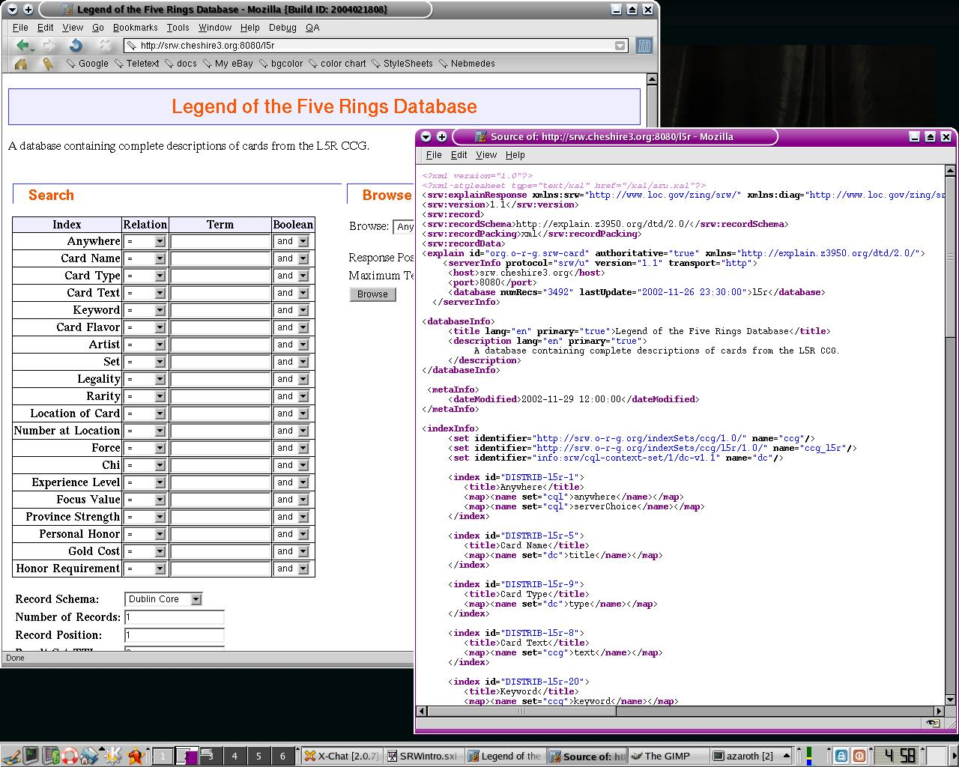
SRW/U: XSLT Thin Client
ZeeRex Service Description Record

Slide 8
SRW/U: SearchRetrieve Request
Purpose: Find, Sort and Display Records
Request Parameters:
Version '1.1'
Query CQL Query (string)
RecordSchema URI Schema Identifier or alias
RecordPacking 'string' or 'xml'
RecordXPath XPath Expression (string)
StartRecord Positive Integer
MaximumRecords Non Negative Integer
ResultSetTTL Non Negative Integer
SortKeys Sort Expression (string)
Stylesheet URI
ExtraRequestData Namespaced XML data

Slide 9
SRW/U: New Parameters in 1.1
RecordPacking:
Either embed the record or return as an encoded string. Raw XML is good for thin clients, but can be problematic in SOAP
RecordXPath:
An XPath expression to select nodes from the record to return. Useful for paging through long records (EAD, X3D, SVG), or selecting a known section (title/author display). Returned in an XML encoded form.
ResultSetTTL:
Servers need to know if the client wants a result set to be maintained or not. This parameter allows the client to request the set be maintained for a certain time.

Slide 10
SRW/U: Result Sets and State
State:
Z39.50 has session state due to a persistent connection.
HTTP does not have a persistent connection between requests.
State is optional in SRW as it is only necessary for persistent result sets. These result sets might persist between connections in Z39.50 as well. Not every SRW service will require persistent result sets, eg an SRW interface to Google.
Result Sets:
A result set is an ordered list of records. Each result set has a unique id and a time to live. It is named by the server and cannot change once created. For example, if a result set is sorted, it will receive a new identifier.

Slide 11
SRW/U: Sorting
SortKeys:
One or more keys by which to sort the result set.
Each key has the following structure:
Path XPath expression
Schema URI Identifier for a record schema
Ascending Boolean, sort upwards or downwards
CaseSensitive Boolean, treat case separately
MissingValue Action to take if the path is not present
Some schemas might include 'utility' paths which do not resolve to a particular element, but instead allow sorting by a dynamic feature such as relevance score.

Slide 12
SRW/U: SearchRetrieve Response
Purpose: Find and Display Records
Response Parameters:
Version '1.1'
NumberOfRecords Non Negative Integer
ResultSetId String
ResultSetIdleTime Non Negative Integer
Records Sequence of Record
NextRecordPosition Non Negative Integer
Diagnostics Sequence of Diagnostic
ExtraResponseData Namespaced XML
EchoedSearchRetrieveRequest Request + XQuery

Slide 13
SRW/U: Records
Records are transferred in SRW in a simple structure:
RecordSchema URI identifier for the schema
RecordPacking 'string' or 'xml'
RecordData The actual record
RecordPosition Record's position in the resultSet
ExtraRecordData Space for further metadata
Like Z39.50, SRW does not assume a record structure in the database, but all records must be transferred in an XML format, either raw or string encoded. A list of registered schema identifiers is available, but any may be used.

Slide 14
SRW/U: URI Identifiers
We need to know which XML schema to use for the response.
Can't use namespace or schema location.
Identified by a unique URI, some of which are from 'info'.
'info' was developed in the OAI/OpenURL world.
SRW info URIs have the form:
info:srw/<type>/<owner>/<identifier>
eg: info:srw/cql-context-set/1/cql-v1.1
Identifiers used for record schemas, context sets, diagnostics, extensions and profiles. Can be info, but many are also regular http URIs.
eg: http://srw.cheshire3.org/contextSets/ccg/1.1/
(Yes a URI Identifier is kind of like an ATM Machine)

Slide 15
SRW/U: Scan Operation
Purpose: Retrieve Ordered List of Searchable Terms
Request Parameters:
Version '1.1'
ScanClause CQL Search Clause (string)
ResponsePosition Non Negative Integer
MaximumTerms Non Negative Integer
Stylesheet URI
ExtraRequestData Namespaced XML
Response Parameters:
Version '1.1'
Terms Sequence of Term
Diagnostics Sequence of Diagnostic
ExtraResponseData Namespaced XML
EchoedScanRequest Request

Slide 16
SRW/U: Terms
Scan Term Structure:
Value String
NumberOfRecords Non Negative Integer
DisplayTerm String
WhereInList 'first', 'last', 'only' or 'inner'
ExtraTermData Namespaced XML
Scan in SRW is almost identical to the same operation in Z39.50
Even ScanClause is similar, although other options were discussed for carrying this information to determine the index and position.

Slide 17
SRW/U: Diagnostics
Sometimes things go wrong.
Diagnostic Structure:
Uri URI diagnostic code
Details Machine readable or debugging string
Message Human readable string
Both fatal and non-fatal, surrogate and non-surrogate.
URI is new in 1.1, and allows user communities to define their own profiled diagnostics.
Mappings available both to and from Z39.50's diagnostics.

Slide 18
CQL: Common Query Language
Goals: Simple and Intuitive, also Powerful and Expressive
Primary CQL Components:
Term “fish”
Index dc.title
Relation =
Boolean and
Extended CQL Components:
Relation Modifiers cql.word
Boolean Modifiers distance>3
Context Sets dc.
Prefixes >dc=“info:srw/cql-context-set/...”

Slide 19
CQL: CQL Examples
Nothing explains a query language like a few examples:
“duck”
title = “duck”
title = “duck” and author = “sanderson”
dc.title any “duck fish”
cql.resultSetId=“a8fljqqq” or cql.resultSetId=“889flkcc”
dc.date within/cql.isoDate “2004-04-06 2004-04-23”
title any/relevant/rel.algorithm=CORI and/rel.mergeSum ...
(a or b) and (c or d)
cat prox/distance<5/unit=word/ordered hat
dc.title any “^cat ^dog hat*”
bib1.1003 =/bib1.2=3/bib1.3=6/bib1.5=100 “fish”
prox and/or <dc:title>and or</dc:title> and or

Slide 20
SRW/CQL: Extensability
CQL Context Sets:
Indexes
Relations
Relation/Boolean Modifiers
Operations:
ExtraRequestData/ExtraResponseData
SOAP/HTTP Headers
New Operations
Individual Entries:
ExtraRecordData/ExtraTermData
Diagnostics
Record Schemas

Slide 21
SRW/CQL: Administration
Standards Body: NISO (Or ISO as profile of Z39.50)
Maintenance Agency: Library of Congress
Proposed Editorial Board:
Managing Editor: Ray Denenberg
Senior Editor: Rob Sanderson
Technical Editor: Matthew Dovey
Plus about 8 others from Australia, US and Europe.
All additions for future versions will first require implementation as extensions to prevent creeping bloat.
Extensions to SRW and CQL do NOT have to be registered.

Slide 22
SRW/CQL: Implementations
Cheshire:
Python based gateway to Z server
Native CQL/SRW in Cheshire3
IndexData:
Native SRW/CQL support in YAZ 2.0
Gateway to the Library of Congress bibliographic database
OCLC:
Axis based gateway to Z servers
DSpace/SRW implementation
Others:
British Library and TEL
Ex-Libris Metalib
BibSys
...

Slide 23
SRW/CQL: LC Implementation
IndexData:
Gateway to the Library of Congress bibliographic database
Open Source (next version of YAZ toolkit)
Provides Z39.50 to Z39.50 and SRW to Z39.50
Load balancing, timeouts and bandwidth throttling
Improved session management
Protection from 'aggressive' clients
These features in web servers already
Provides additional record transformations from MARC
These issues are all important in a MetaSearch environment as well, where many clients will be cross-searching the database.

Slide 24
SRW/CQL: NISO MetaSearch
NISO MetaSearch Initiative:
NISO organising 3 task groups:
Access Management
Collection Description
Search and Retrieve
Content and gateway providers
First face to face meeting follows DLF
SRW specifically named as search protocol to investigate
All but one requirement met by SRW
Not filled: multiple resource access by single request
Less of an issue than for Z39.50

Slide 25
SRW/CQL: Summary
What To Take Away With You:
SRW is an IR web service similar to Z39.50
Easy enough to implement with off the shelf/OSS tools
Multiple open source implementations
Very customizable without losing focus
Three operations, either SOAP or URL form
NISO MetaSearch group looking at SRW
http://www.loc.gov/srw/
azaroth@liv.ac.uk

