Slide 1
A Digital Library Architecture
For UVA
DLF Spring Forum
April 19,2004

Slide 2
Digital Library Assumptions:
All media, all content types integrated into one collection
A network that is built to be a part of a global network
The global network will be built by corporations, governments and libraries
Searching and browsing are equally important

Slide 3
Digital Library Assumptions (cont.):
We will provide to tools to make sophisticated use of our collections
Any given resource can be presented in any number of contexts
Increasingly, we will be faced with born-digital materials
This is going to take a very long time …

Slide 4
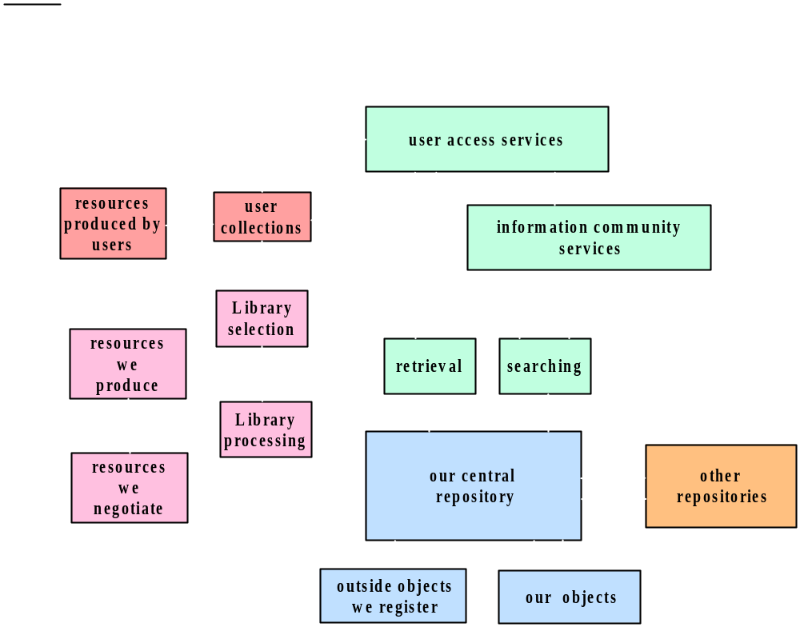
The Big Picture

Slide 5
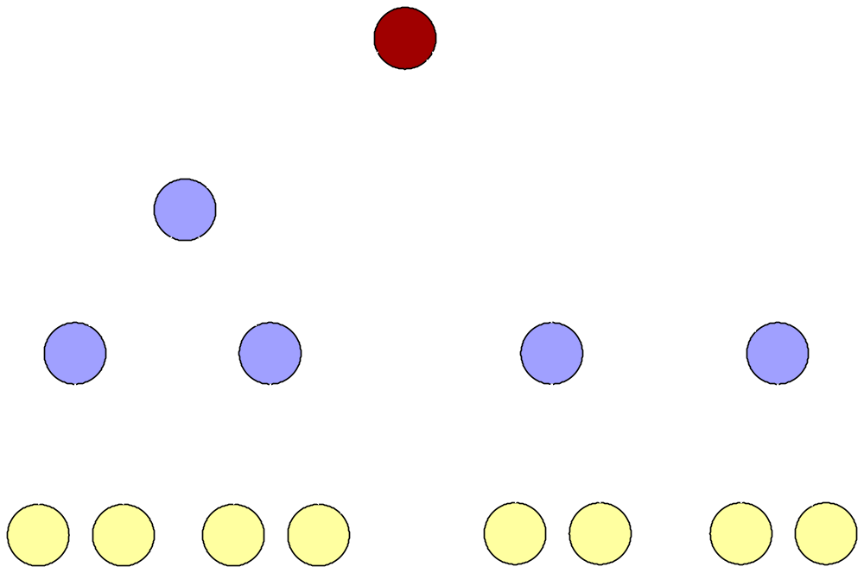
The digital library as a network

Slide 6
A data object is one unit of content.
Persistent ID (
PID
)
Digital object identifier
Default Disseminator
methods for disseminating “views” of content
Your Extension
Your Extension
Datastream (item)
set of content or metadata items
Datastream (item)
Datastream (item)
metadata about history and policies
System
Metadata

Slide 7
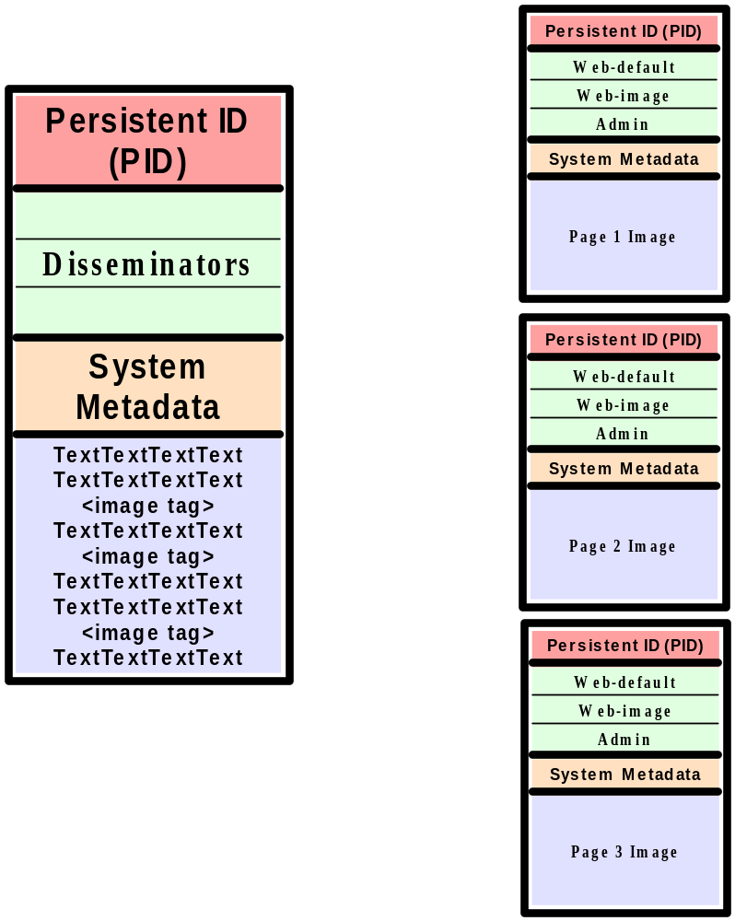
Explicit Relationships

Slide 8
Implicit Relationships
Defined by rules, i.e XPATH statements
The PID of the parent is in the child’s metadata
Child objects are assembled at dissemination time
Child objects can respond to more than one parent

Slide 9
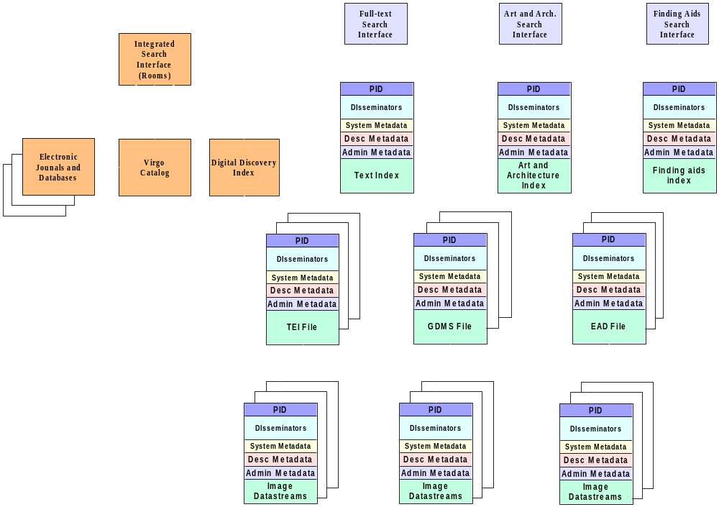

Slide 10
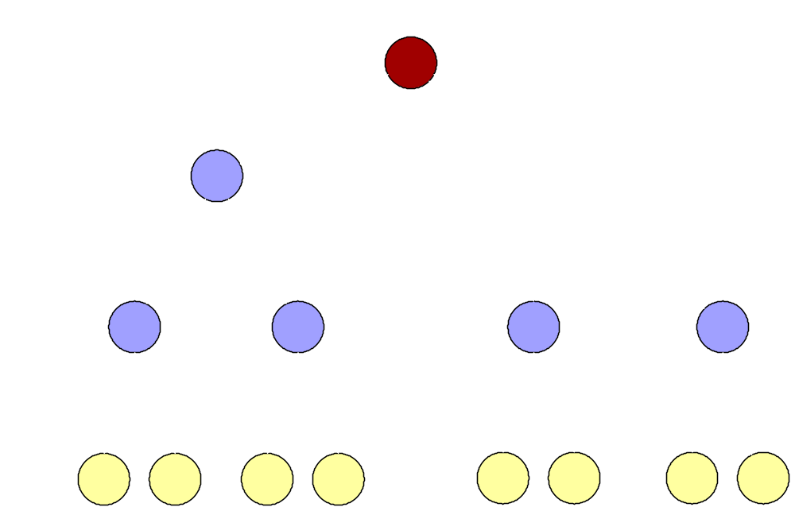
Explicit Data Modeling

Slide 11
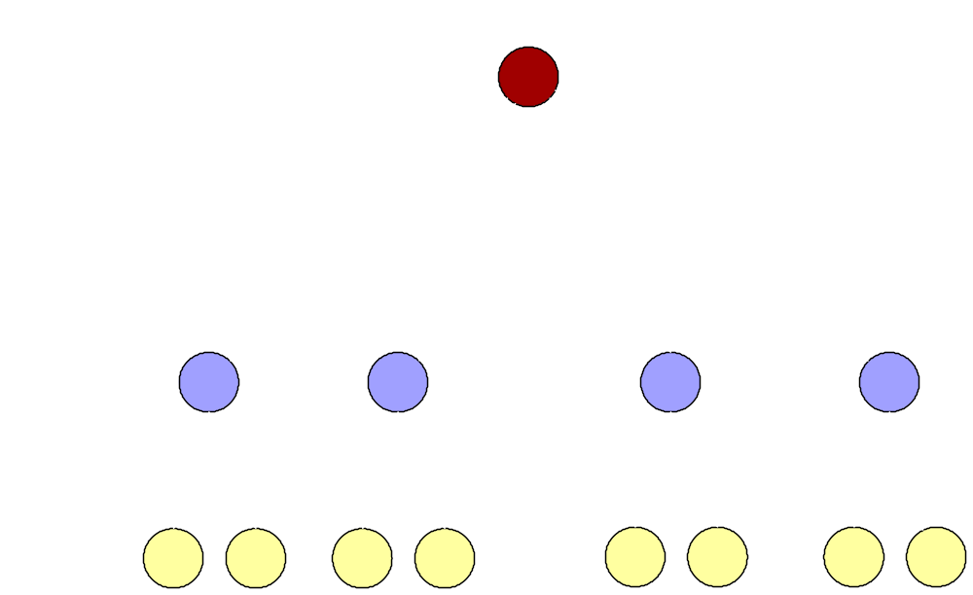
Quantitative Data Collections

Slide 12
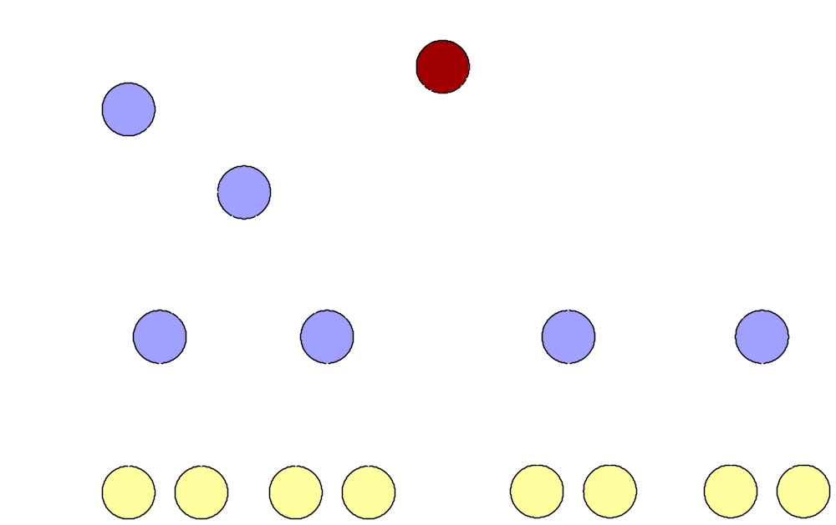
Collecting Scholarly Projects

