Slide 1


From Theory to Practice
Bielefeld Academic Search Engine
Friedrich Summann
Bielefeld UL

Slide 2
Presentation Overview
Part 1:
General introduction to the BASE Digital Collections
objectives, content, potential
Part 2:
Technical report about the BASE Digital Collections
backend: harvesting and preprocessing, processing and indexing
frontend: search interface, search and result presentation

Slide 3
Academic Online Information: the Reality
web pages
publishers‘
ejournals
library
catalogues
subject
databases
institutional
document
servers
search engine
digital libraries
commercial providers
portals
search

Slide 4
Starting Point:
Digital Library North-Rhine Westphalia (1998-2001)
Problems:
Users want search engine look and feel
Search functionality too slow
No integration of fulltext resources
No integration of web pages

Slide 5
Academic Online Information: the Vision
web pages
publishers‘
ejournals
library
catalogues
subject
databases
institutional
document
servers
search engine for academic online information

Slide 6
Evaluation of Search Technology
(02/2002 – 08/2002)
Convera
Google
mnoGo
FAST
Lucene (2003)

Slide 7
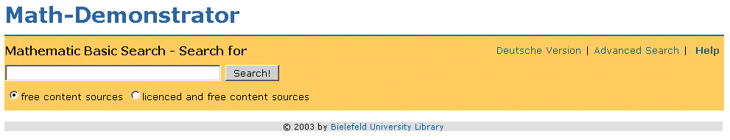
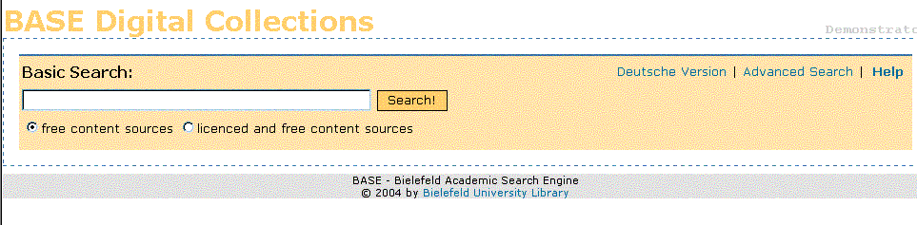
From Theory to Practice (1)
Proof of concept with FAST Data Search (Math Demonstrator)
Extension: Bielefeld Academic Search Engine: search service for digital collections

Slide 8
From Theory to Practice (2)
The concept of BASE:
collecting and making accessible in a single index a representative and heterogeneous set of academic online content
  different document types
  different data formats
  fulltext and/or metadata
  content from the “visible” and “invisible” web

Slide 9
From Theory to Practice (3)
Objectives of the BASE Search Engine:
Real-life testing and implementation of FAST Data Search
working with interoperability standards (OAI, XML)
developing prototypes of intelligent and flexible user interfaces

Slide 10
From Theory to Practice (4)
Some general information:
work on BASE in progress at Bielefeld UL since summer 2003
team of 2 software developers
software: FAST Data Search 3.2
pilot project for national proposal “Using Search Engine Technology in Digital Libraries and Scientific Information Portals” by Bielefeld UL and North Rhine-Westphalian Service Centre for Academic Libraries (part of VDS in vascoda)

Slide 11
The Content (1)
about 600,000 documents indexed up to now in 15 collections:
a)Metadata
Project Euclid (6,516 articles):
  harvested using OAI-protocol
Bielefeld UL: Journals of the German Enlightenment
(57,690 articles)
  database output

Slide 12
The Content (2)
b)Fulltext without metadata /
web content
Documenta Mathematica (e-journal)
preprint servers at Bielefeld University
  (together 18,301 documents)
TIL/UL Hannover: project reports of BMBF (64 documents)

Slide 13
The Content (3)
c)Fulltext with metadata
Springer journals (224,387 articles):
  metadata indexed, fulltext in preparation
Bochum UL: electronic dissertations of Ruhr-University Bochum (1908 documents):
  harvested using OAI-protocol
Bielefeld UL: Online publications (369 documents)
  harvested using OAI-protocol, metadata indexed, fulltext in preparation
Oxford Internet Library of Early Journals (104,516 pages)
  SGML export

Slide 14
The Content (4)
c)Fulltext with metadata (cont.)
University of Michigan Historical Math Collection (772 documents)
Cornell University Library Historical Math Monographs (630 documents)
  metadata harvested using OAI-protocol, metadata and fulltext indexed separately
SUB Göttingen/GDZ: Mathematica (427 documents)
  harvested using OAI-protocol, up to now only metadata indexed

Slide 15
The Potential
making accessible different kinds of content sources in one index: web content and databases/catalogues
indexing metadata and fulltext with or without metadata
enhancing fulltext data by metadata extraction
flexible and customizable frontend
transferring performance and scalability of search engine technology to digital library world

Slide 16
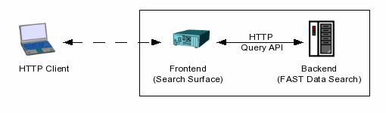
System Components
separate frontend and backend server
currently one frontend server
can be easily enhanced with more servers
currently one backend server (single node)
can be enhanced to multi node system

Slide 17
Dispatching
Frontend:
search interface (basic, advanced) (PHP)
result processing and result presentation
Backend:
harvesting (Perl OAI harvester)
preprocessing and conversion from BRS,
OAI-DC and other DB formats with Perl
filetraverser, crawler
document processing and indexing of data
query and result processing

Slide 18
The Frontend
Siemens Primergy, 2 x 800MHz CPU
1.28 GB RAM
RAID1, Adaptec SCSI, 36GB
SuSE Linux 9.0, Kernel 2.4.21-smp
Apache web server with PHP 4
Bielefeld University Library web server

Slide 19
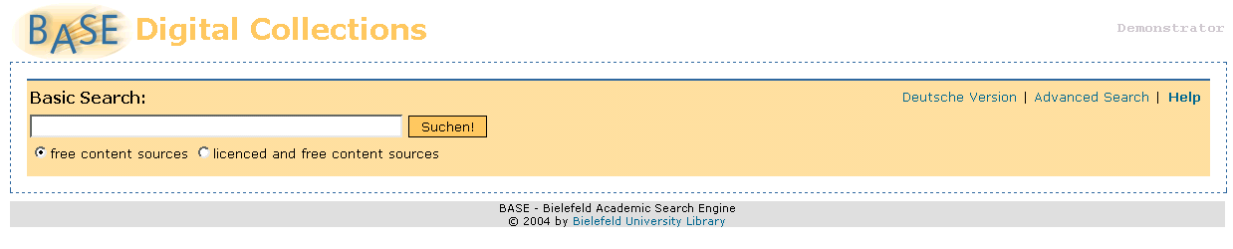
Search Interface (1)
Basic Search
single search field
advanced search
content source
language

Slide 20
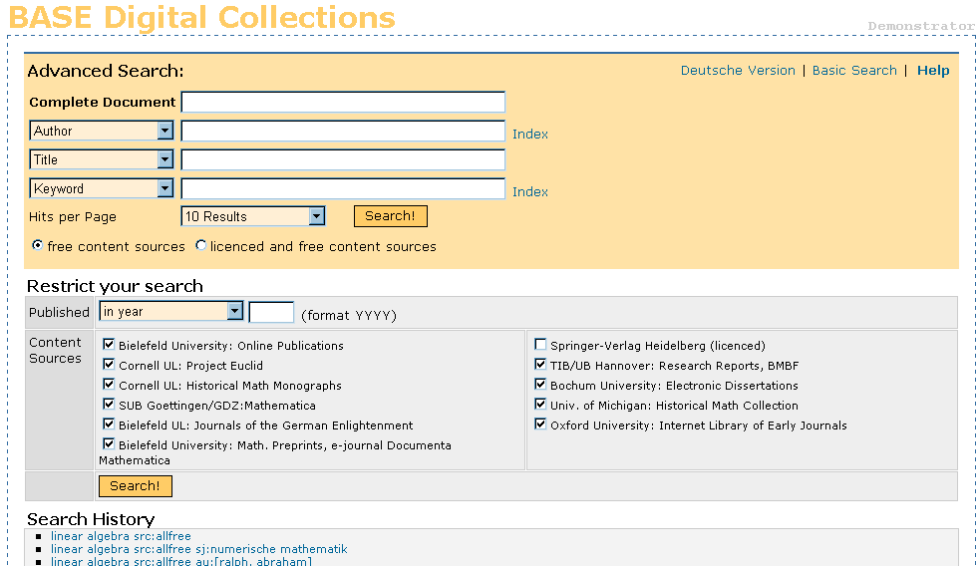
Search Interface (2)
Advanced Search
search field selection
year limit
source selection
Search history

Slide 21
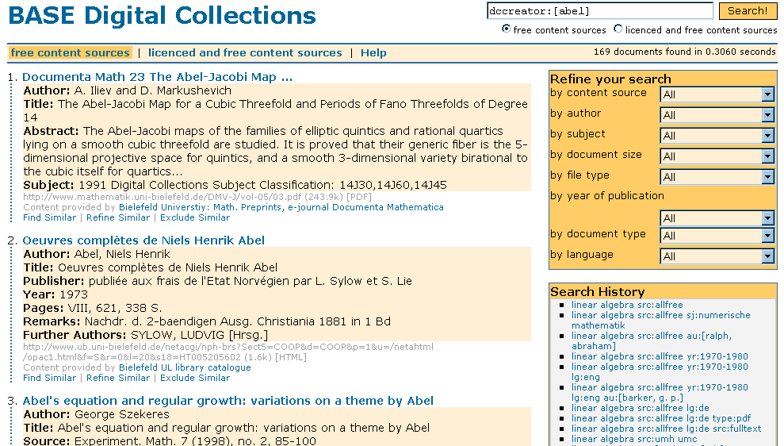
Result Presentation (1)
drill down
result change
search history
metadata display

Slide 22
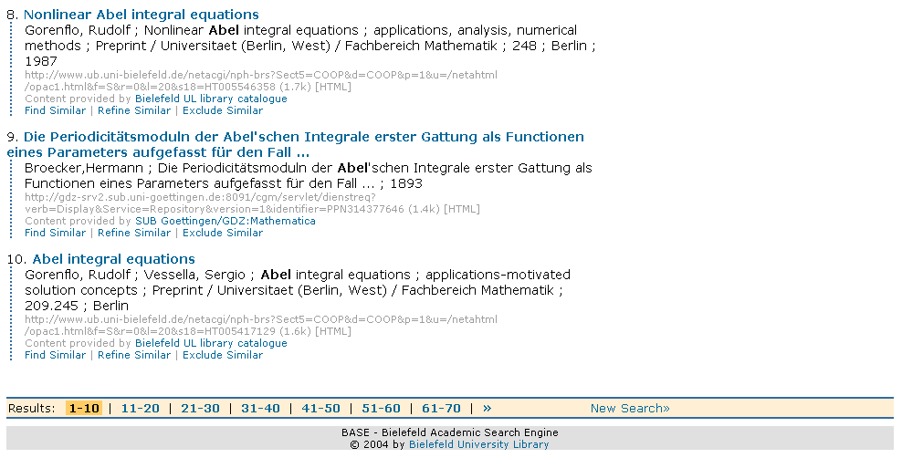
Result Presentation (2)
fulltext

Slide 23
The Backend
Live-System:
Intel PC Dual Pentium, 2 x 2.8 GHz CPU, 2GB RAM
RAID5 + Hotspare 290 GB
Suse Linux 9.0
System report: 344.8GB total, 24.8GB used, 320GB free
  15 Collections, > 600000 documents
  FAST Search 3.2 (PHP 4, Python 2.2)
Test-System
(provided by FAST Search & Transfer):
Dell PowerEdge, 1 x PIII 730 MHz CPU, 1.2 GB RAM
RAID5, Adaptec SCSI, 66GB
RedHat Linux 7.3, Kernel 2.4.22-pre5

Slide 24
Our current routines:
Integrating resources in a „Metasearch environment“
Analyzing database interface (HTTP, Z39.50)
Implementing search database calls
Scanning results and preparing internal display format

Slide 25
BASE data workflow
Samples
OAI -Data
Database
records
Web Pages
Harvesting
Pre-Processing
Federated
Search
(XML search
query)
Processing
Internal Index (FAST)
User interface (PHP)

Slide 26
BASE data workflow tools
 | FAST | Additional developments
Data Loading | Crawler, File Traverser, DB Connector | OAI Harvester DB export
Pre-processing |  | Perl, XSLT crosswalks
Processing | Standard stages | Python stages
Indexing | Indexer
Access, Navigation | Search API | PHP scripts

Slide 27
Bielefeld Development Environment
OAI Harvester tool (harvesting metadata)
  (open source)
Perl, XSLT (Preprocessing)
Python (Processing)
PHP (frontend programming)
Apache
Linux

Slide 28
Harvesting
harvested OAI-DC data
assumed:
<date>1991</date>
reality:
<date>-set=math&amp;until=2003-11-03&amp;metadataPrefix=oai_dc-</date>
<date>1903;1903-09-02</date>
<date>[c1911] </date>
<date>1906-1928 [v.1, &apos;28] </date>
<date>[192-?] </date>
<date>C. Gerolds sohn,</date>
<date>28 cm.</date>

Slide 29
Preprocessing (1)
in:
<date>[c1915]</date>
out:
<element name="dcdate"><value>[c1915]</value></element>
<element name="dcyear"><value>1915</value></element>
in:
<language>ENG</language>
out:
<element name="dclanguage"><value>eng</value></element>
<element name="language"><value>en</value></element>

Slide 30
Preprocessing (2)
in (binary data from CDROM database):
... Japanese. Esperanto summary ...
out:
<element name="dclanguage"><value>Japanese. Esperanto summary</value></element>
<element name="language"><value>jp</value></element>
<element name=„secondarylanguage"><value>eo</value>
</element>

Slide 31
Preprocessing (3)
Summary
language code (text and ISO 639-2 to ISO 639-1)
  ISO 639-1 (de,fr)
  ISO 639-2/B (ger,fre), ISO 639-2/T (deu,fra)
date filtering
XML encoding and conversion
generating unique document id (doi, document number, ...)
general filtering and error correction
building of body content (author, title, description, ...)
fulltext link extraction

Slide 32
Processing (1)
Filetraverser sources
loading of preprocessed content with filetraverser
processing with self created pipelines
  language detection from title and description
  setting of mime type
  generate teaser based on description, meta data or body
  tokenize selected fields
  lemmatize (run, runs, running, ran) and synonyms
  (security, safety) → dictionary based
  vectorizer (for analyzing similarities between docs)

Slide 33
Processing (2)
Crawler sources
crawling of selected web sites according to rules
crawling of fulltext link lists
system processing with stages (partly self developed)
  deleting format (mime type)
  format detection
  uncompressing (zip, gzip, tar, ...) and setting of new format
  set content type (metadata, fulltext, mixed, unknown)
  Postscript conversion (Ghostscript)
  PDF conversion (XPDF)
  SearchMLConverter (FAST)
  language and encoding detection (FAST)

Slide 34
Indexing
Current indexstructure
enhanced by 15 DC fields
additonal 5 index fields
  dcisbn (ISBN, ISSN)
  dcdoi (DOI or similar identifier)
  dcyear (filtered year as integer)
  dcstype (metadata, fulltext, ...)
  rights (name of source)

Slide 35
Further Development (1)
Frontend
Templating (customised views)
search interface (search API)
combining metadata record and corresponding fulltext in result display
truncation

Slide 36
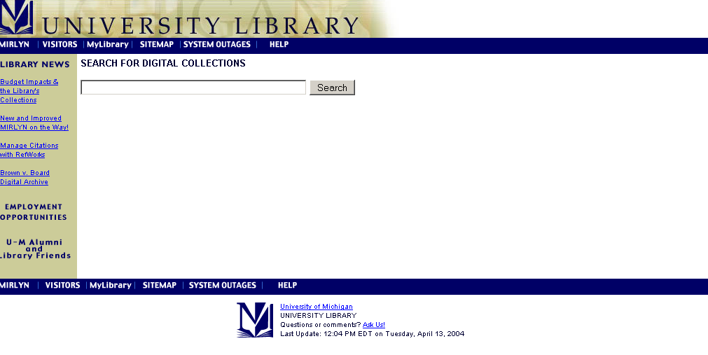
Customised views

Slide 37
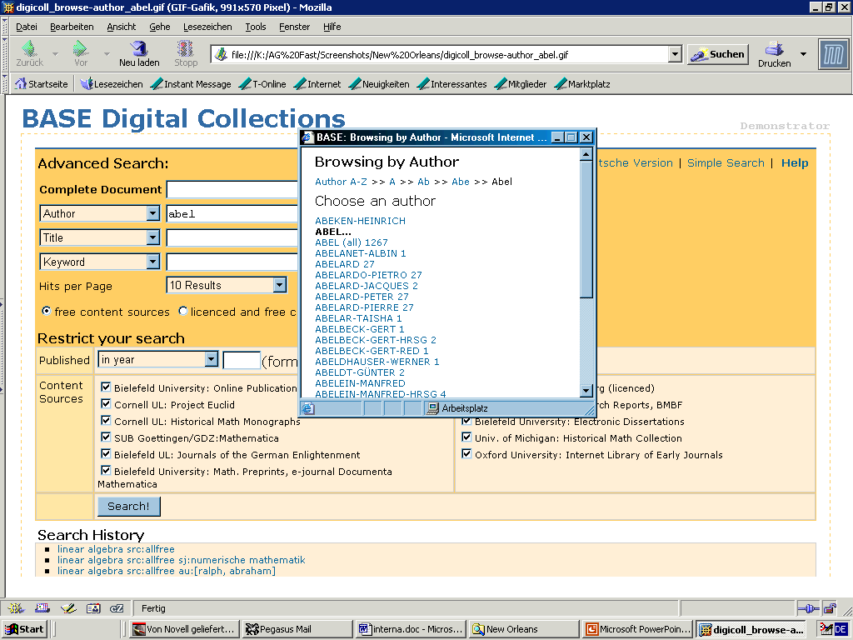
Author Index Browsing

Slide 38
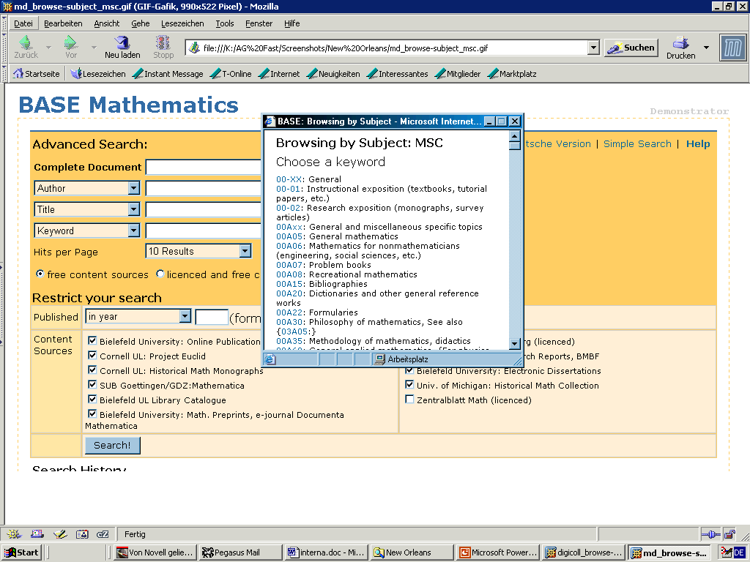
Subject Index Browsing

Slide 39
Further Development (2)
Backend
automation of harvesting and content preprocessing
Federated search, linking with external indexes
search result improvement (ranking, boosting, linguistics)
performance optimisation
support of standard protocols (Z39.50, OAI, SOAP) as a target system

Slide 40
Further Visions
Anchor analysis
Link topology analysis
Citations analysis
Automatic linguistic analysis of anchor texts
Push services
Personalized ranking
Cross-language information retrieval

Slide 41
Thank you!

Slide 43
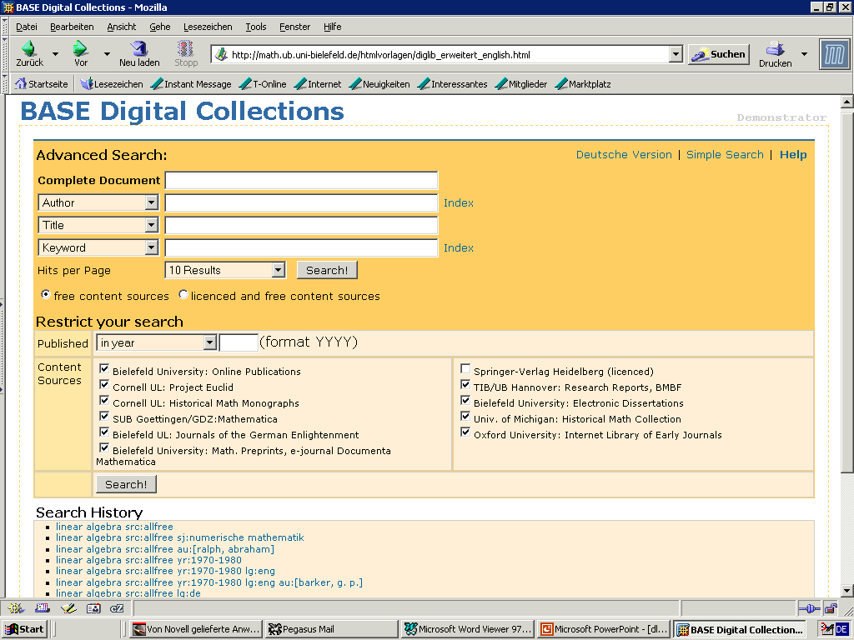

Slide 44
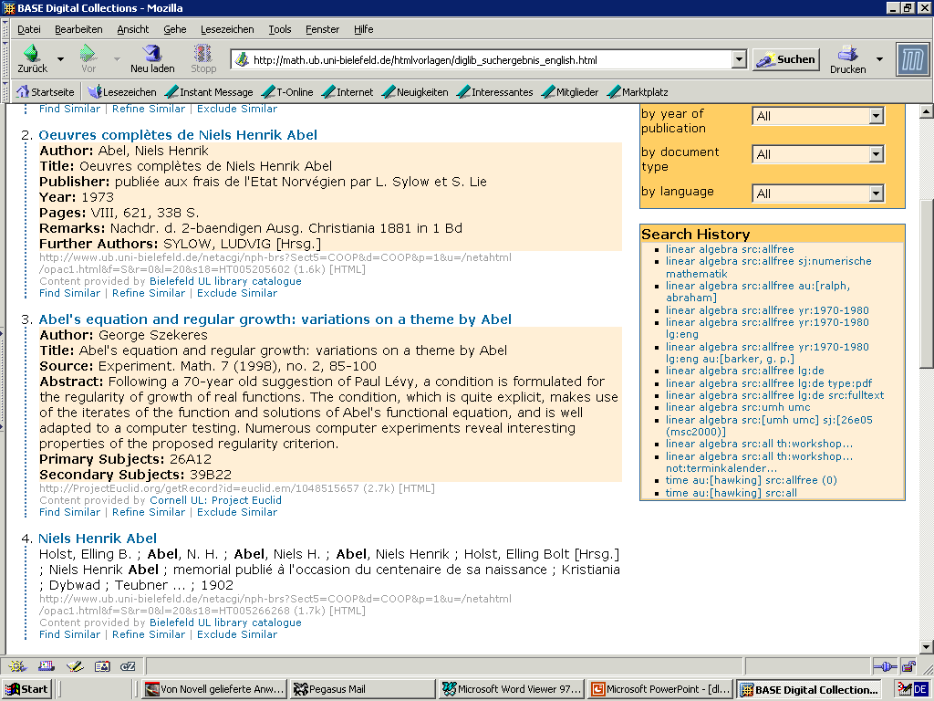

Slide 45
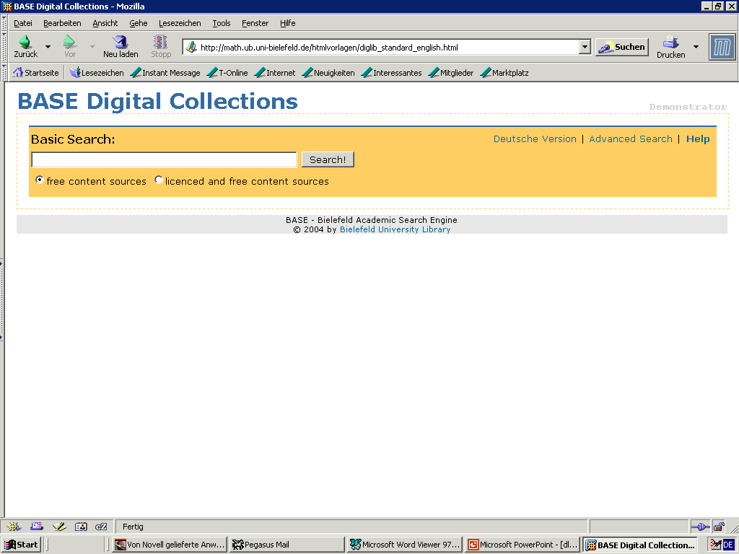

Slide 46
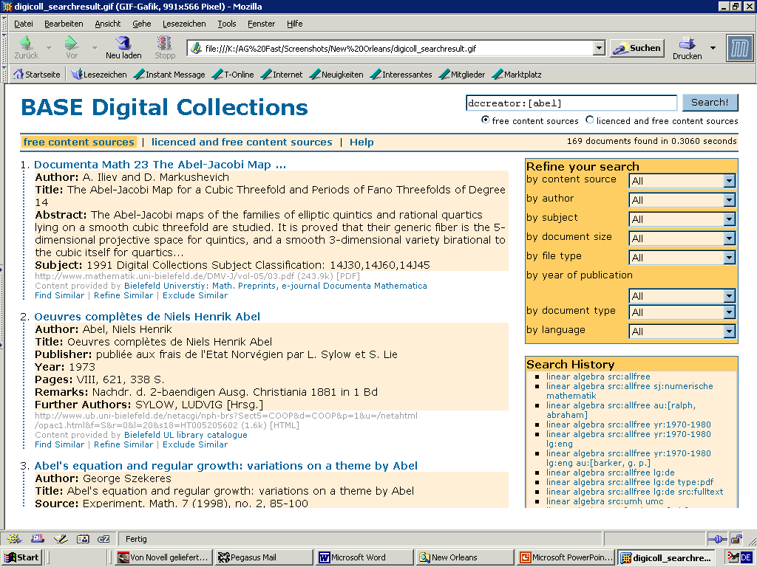

Slide 47
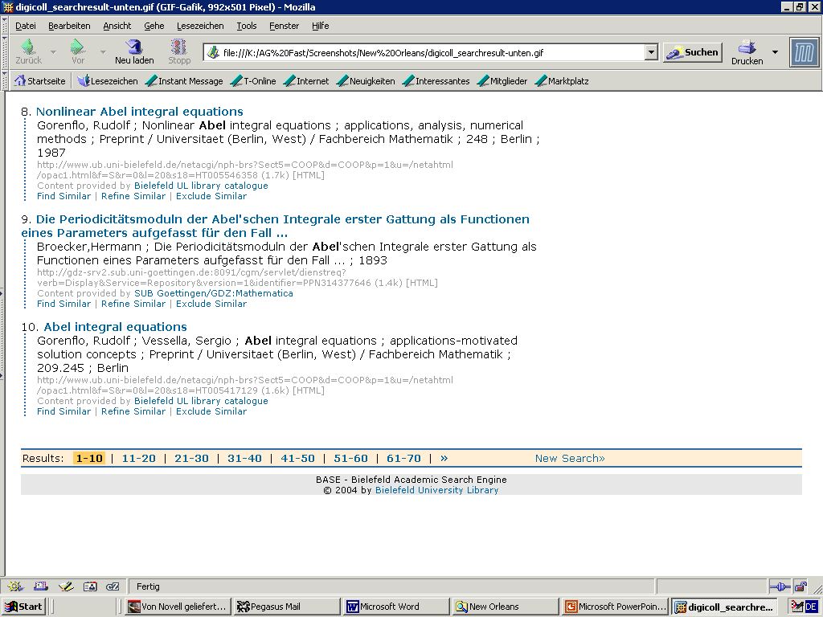

Slide 48
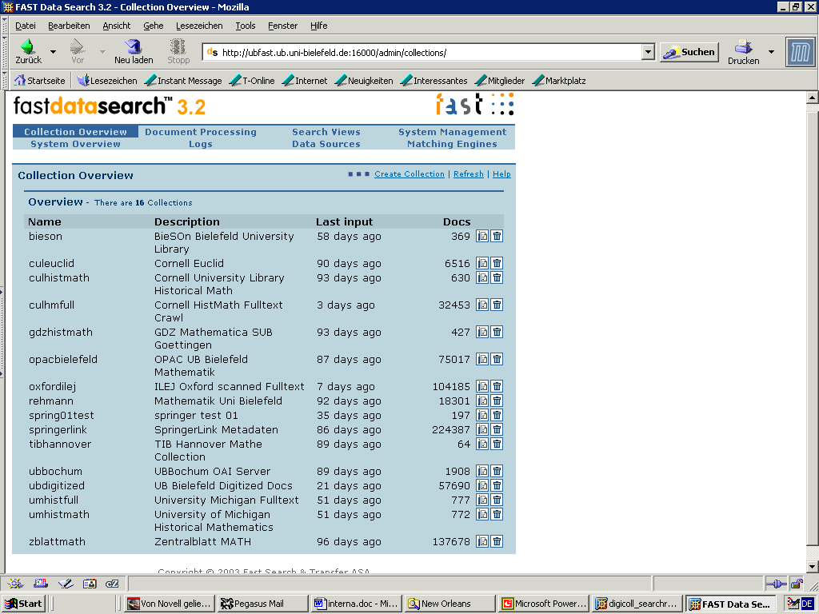

Slide 50
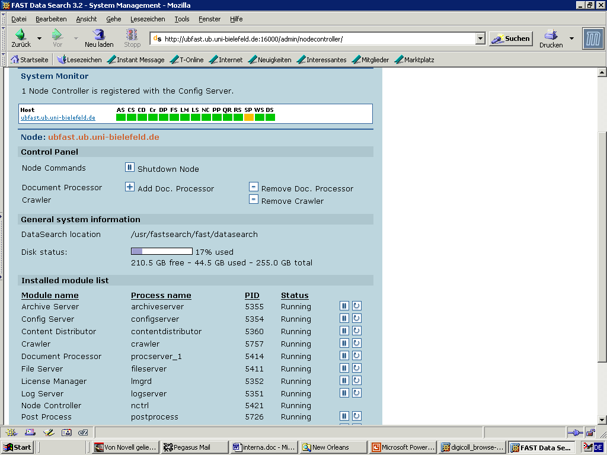

Slide 51
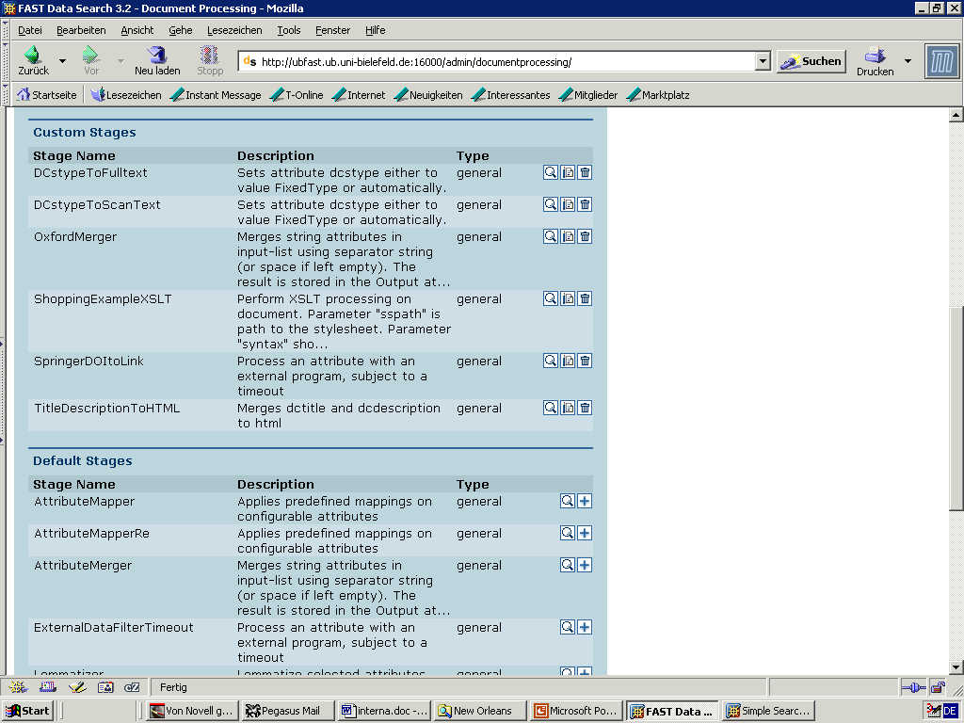

Slide 52
