Slide 1

Metasearching Lessons from the California Digital Library
Roy Tennant
California Digital Library

Slide 2
Metasearching at CDL: A Brief History
1997, UC San Diego creates Database Advisor
1999, CDL decides to create a metasearch tool based on DBA, to be called SearchLight
2000, SearchLight is launched

Slide 3
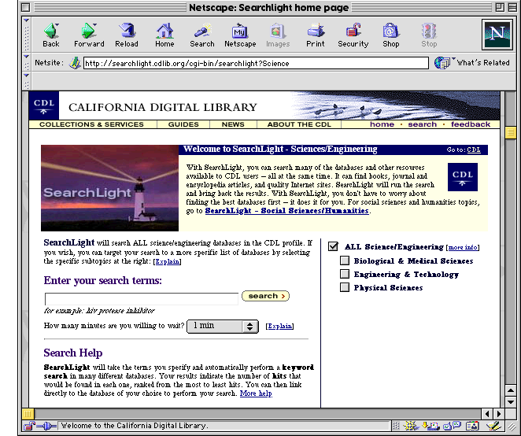
http://searchlight.cdlib.org/cgi-bin/searchlight

Slide 4
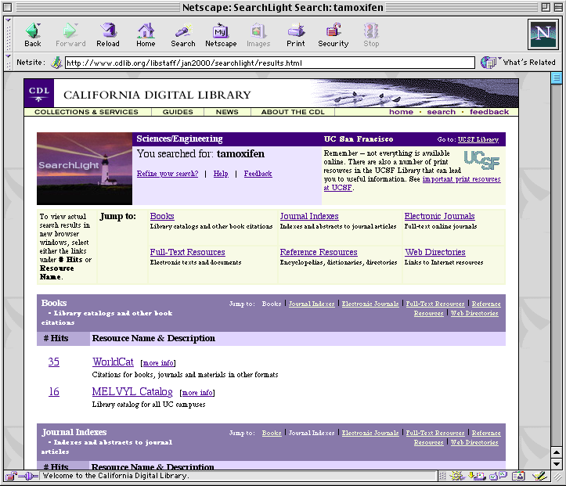

Slide 5
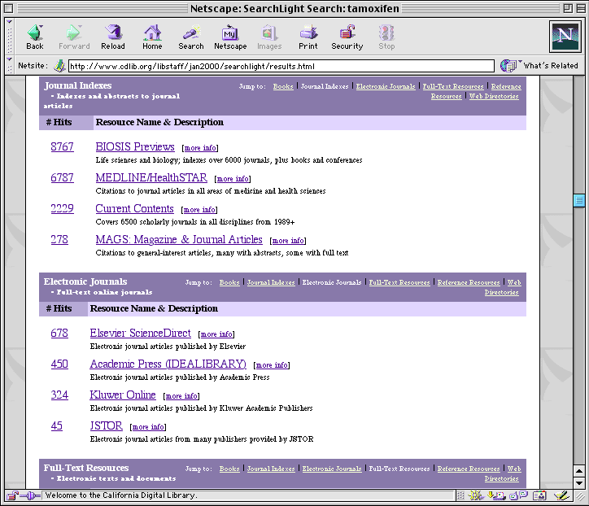

Slide 6
Metasearching at CDL: A Brief History
2001-3, CDL looks beyond the limitations of the SearchLight service
2002-3, Commercial products become viable
2003, CDL Metasearch Infrastructure Project formally launched

Slide 7
Lessons from SearchLight
Metasearching is worth doing (it’s what many users want)
For a large research library, metasearching is best focused on particular needs or subject areas (the “drinking from a firehose” problem)
Not all databases are created equal (e.g., we need a way to focus on core databases, or have results from core databases ranked higher than others)
Focusing on specific audiences or needs provides an opportunity to expand service beyond simple searching

Slide 8
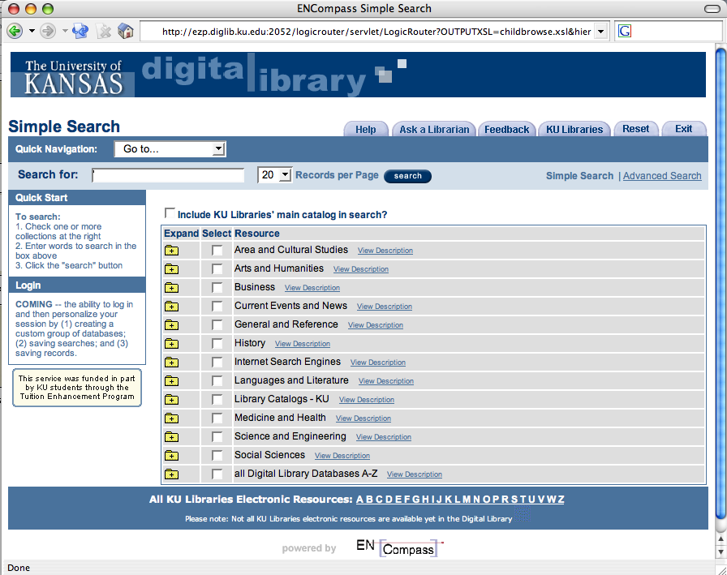

Slide 9
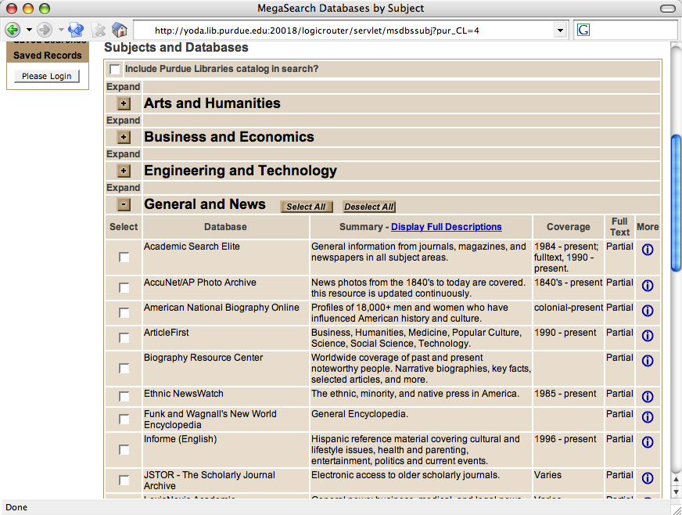

Slide 10

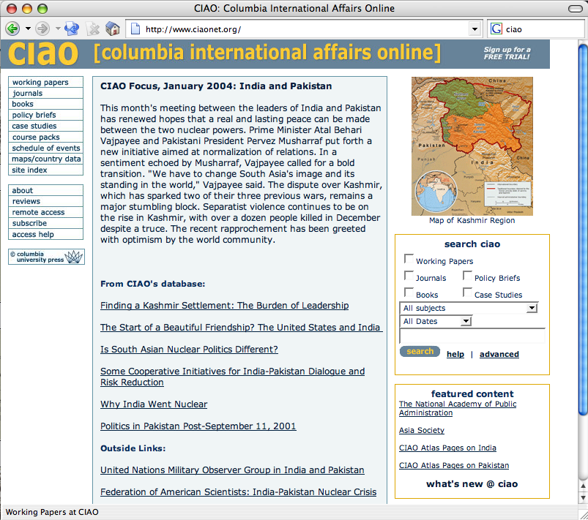

Slide 11
Principles
Metesearching is a tool that is appropriate for some tasks, but not for others
Only librarians like to search, everyone else likes to find
All things being equal, one place to search is better than two or more
“Good enough” is often just that

Slide 12
Principles
The size of the result set isn’t as important as how the results are displayed (the Google lesson)
Our ability to create effective one-stop searching is dependent on our ability to appropriately target user needs
Services should be placed as close to the user as possible

Slide 13
Building a Metasearch Infrastructure
Goal: to build a reference implementation that allows us to “eat our own dog food” while providing:
  An implementation for campuses that don’t want to mess with it
  An easy-to-modify set of templates for those who do
Requirements: shared resource descriptions, templates, implementation guidelines, etc.

Slide 14
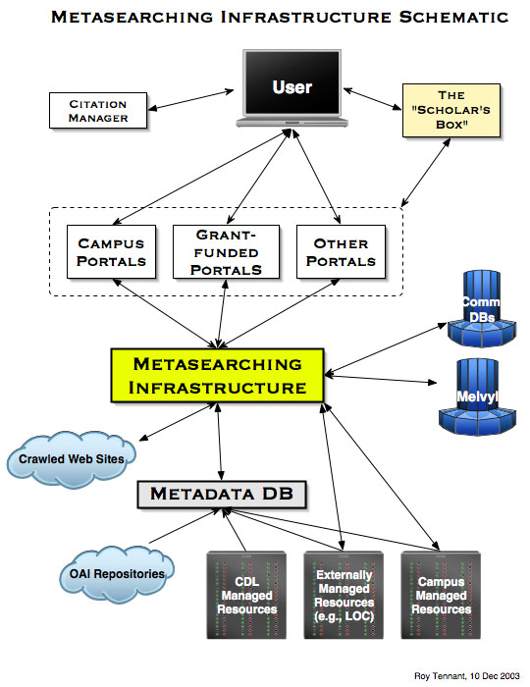

Slide 15
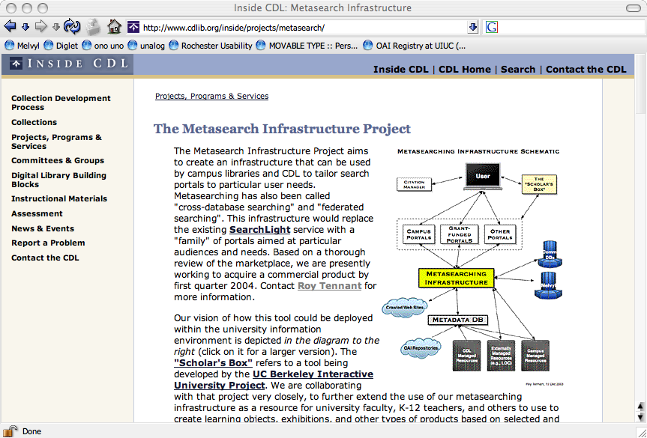
CDL Metasearch Infrastructure Project
Web site
www.cdlib.org/inside/projects/metasearch/

Slide 16

| | |
Home
Library Info
Services
Research
EZArticleFinder
Search less, find more...
Best bets for finding articles related to giant squid
* BIOSIS Previews
* Expanded Academic ASAP
* Lexis-Nexis
More search options | Search tips
Giant squid
Search
Search for giant squid found 60 results. 1-50 of 60 records retrieved.
No. Author Title Year Source
1. Watson JD; Molecular structure of nucleic 1953 Nature [via Medline Plus] View abstract
Crick, FH acids. A structure for
deoxyribose nucleic acid.
2. Miller GA The magical number seven plus 1956 Psychol Rev [via Medline Plus] View abstract
or minus two: some limits on our
capacity for processing information.
3. Bush, Vannevar As we may think 1945 The Atlantic [via Google] View abstract
4. Lovins, Amory Soft energy paths 1976 Foreign Affairs [via Google] View abstract
5. Rettig, Marc Prototyping for tiny fingers 1994 Communications of the ACM View abstract
[via Web of Science]
50. Snyder, Carolyn Paper protoyping 2001 IBM developerWorks [via View abstract
Google]
Next Results Page
Ask a Librarian for help with research or using EZArticleFinder.
EZArticleFinder is a service of the UC Libraries, powered by the CDL.
UCSC home

Slide 17

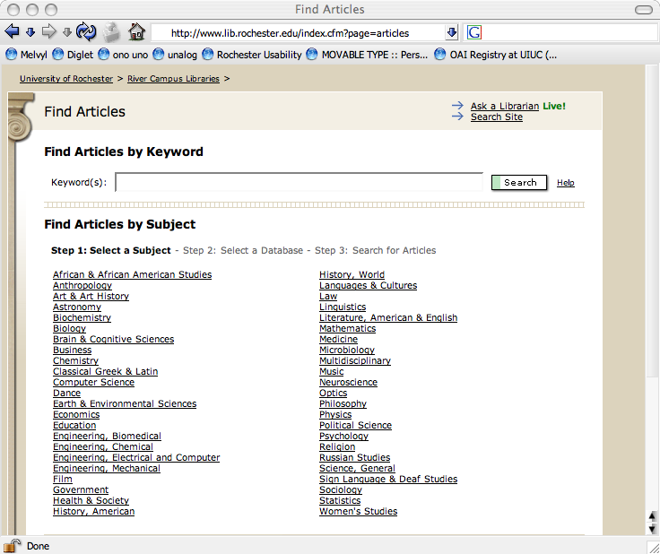
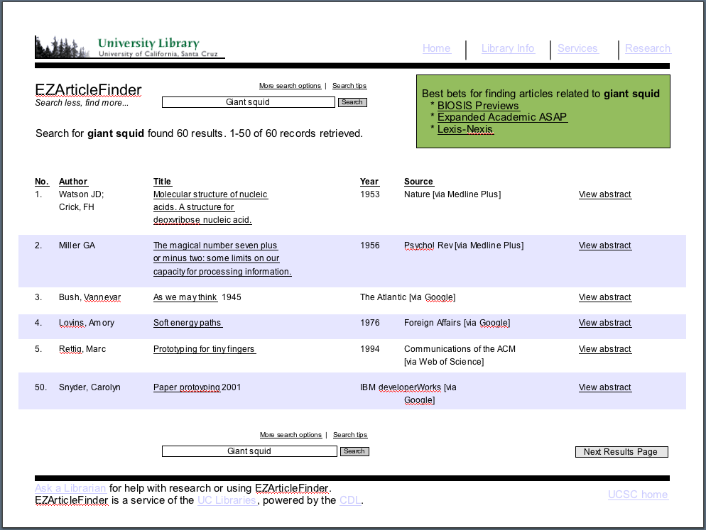
Database Advisor Service
Interface
software
User
Initiates search
Sends search to
Metasearch
Software
Sends mergeddisplay to
Sends search to
Performs search, identifies top 2-3 DBs, writes out file referenced by results page
Launches multiple
searches
Database
Advisor Tool
Merges, dedupes
results
Builds
display
Receives
results

Slide 18
Plenty of Problems to Go Around
Database Vendor Issues
Software Provider Issues
Library Issues
User Issues

Slide 19
Database Provider Issues (the short list)
Access control (robust authentication and authorization)
Load
Inappropriate searches (searching databases that don’t apply)
Branding and “unfair” deduping

Slide 20
Software Provider Issues (the short list)
Access management
Search mapping
Unreliability of targets
Systems that don’t support an API (that must be screen-scraped)
Inadequate result data for good:
  Deduping
  Ranking

Slide 21
Library Issues (the short list)
Selecting the right system
Cost (both upfront and ongoing)
System design and implementation
System maintenance
  Ability to add new resources/targets
  Ease of interface changes and upgrades
System inadequacies (e.g., ranking)

Slide 22
User Issues (the short list)
What must I go through before hitting the search button?
How difficult is it to review results?
Are results ranked by relevance? (that will be my assumption)
Will I get buried? (too many sources, too many results?)
Do I have methods to easily focus in on what I want?
Once I find what I want, can I get to the full-text with a click?
Can I copy a citation and put it in my paper?

Slide 23
Challenges
Software still needs improvement (understatement)
Some databases are still not searchable
How do we create an infrastructure that is easy to deploy for a variety of purposes and/or audiences?
We can learn from other systems (e.g., redlightgreen)?
Standards are on the way (e.g., NISO), but many of us have deployed systems that could use solutions now

Slide 24
Metasearching Today & Tomorrow
Today:
  One-stop shopping
  Broad subject categories with many databases each
  Not integrated with any other system (e.g., course management systems)
Tomorrow:
  Tailored portals for specific user needs or topic areas
  Targets created by libraries for specific purposes (e.g., focused crawling of web sites, harvesting of repositories)
  Dynamic selection of sources based on user query

