Slide 1
The Social Aspects of Interoperability
John P. Wilkin
University of Michigan

Slide 2
Introduction
We hate silos
We shun sharing
We define “federation” as “interoperation”
Creating “A Distributed Digital Library of Mathematical Monographs”

Slide 3
“Why does [Interop] got to be so sad”
Hard problem because a complex problem
Cf. Z39.50
In full text systems …
  Common metadata?
  Common results format?
  Needle in the haystack
  “transport”
    sending and receiving a search
    sending and receiving information about results
    sending and receiving the actual content

Slide 4
Distributed Search vs. Interoperable Search
“Distributed” difficult?
  Single institution distributed
  Multi-institution distributed
  Interoperability
Challenges of “agreement” in interoperability

Slide 5
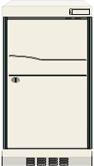

DLXS: port-based inter-machine communication with architecture-specific language and mediation

Slide 6
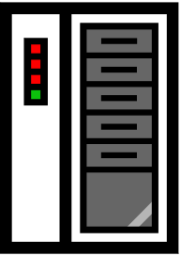
Pittsburgh
Indiana
Michigan
DLXS: port- and database-based inter-institution communication with architecture-specific language and mediation

Slide 7
CGM: protocol-based inter-service communication
Repository A
Query mediating service
Repository B
Repository C

Slide 8
Isn’t “Boolean” Easy?
Documents with (pages including (X and Y))
  Document includes one page with both X and Y
  Document includes one page with X and another page with Y

Slide 9
What We Accomplished
It works [next slide]

Slide 10
Cornell QM service
Cornell Repository
Northeast user
Göttingen Repository
Michigan QM service
Midwest user
Michigan Repository

Slide 11
What Remains to be Done
Tapping the potential of structured queries
Implement the DISSEMINATE verb fully
Improve the production-worthiness of CGM
  The affect of network latency.
  … process large numbers of results from multiple institutions.
  Accommodating different models for ranking or sorting
  Determining and taking into account outages and partial outages at remote sites.
  Introducing mechanisms such as scaffolding into search strategies

Slide 12
Conclusion
http://www.library.cornell.edu/mathbooks/
Why is interoperability important?
Not a problem of SOAP, WSDL, SRW or other technologies, but rather the social factors, and CGM is a great foundation
Contacts:
  jpwilkin@umich.edu,
  cgm-feedback@umich.edu

