Slide 1
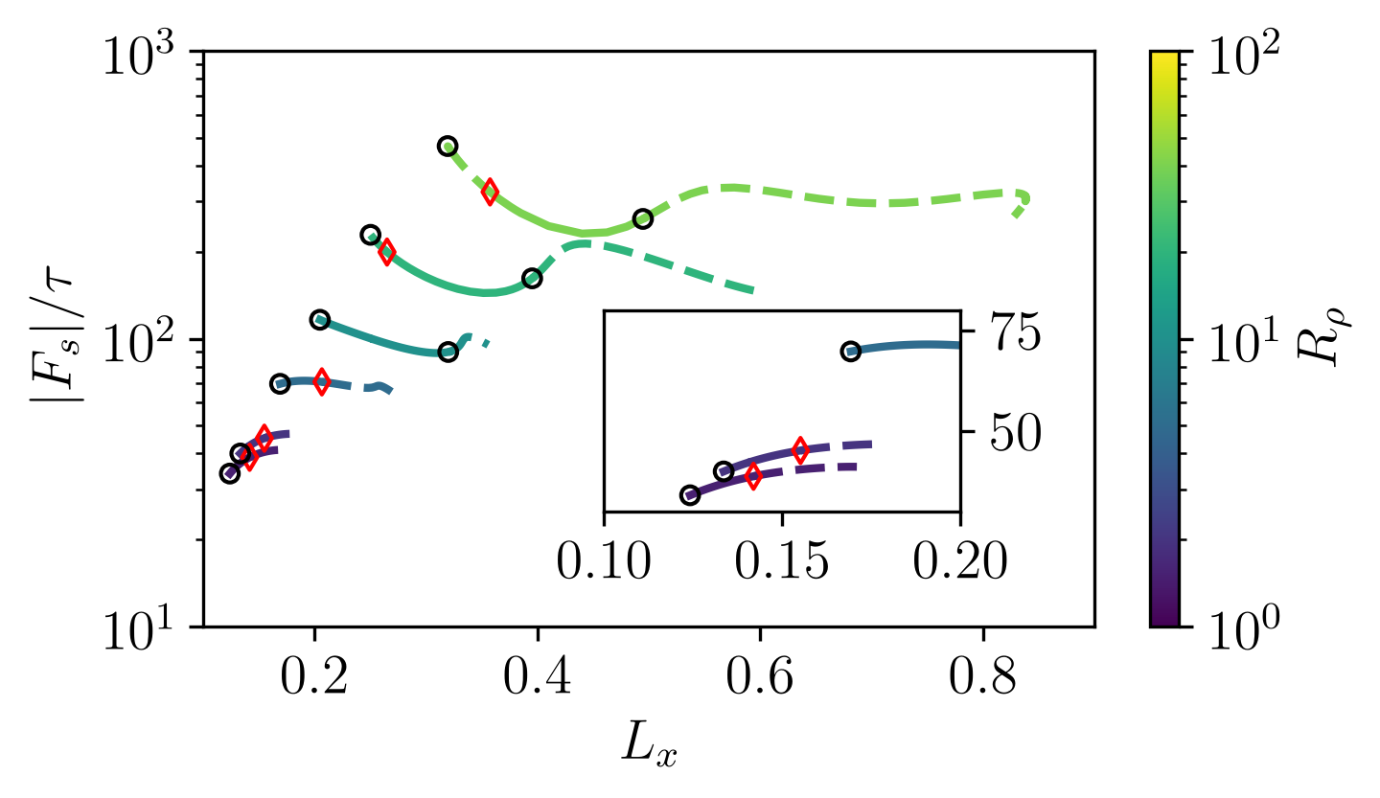
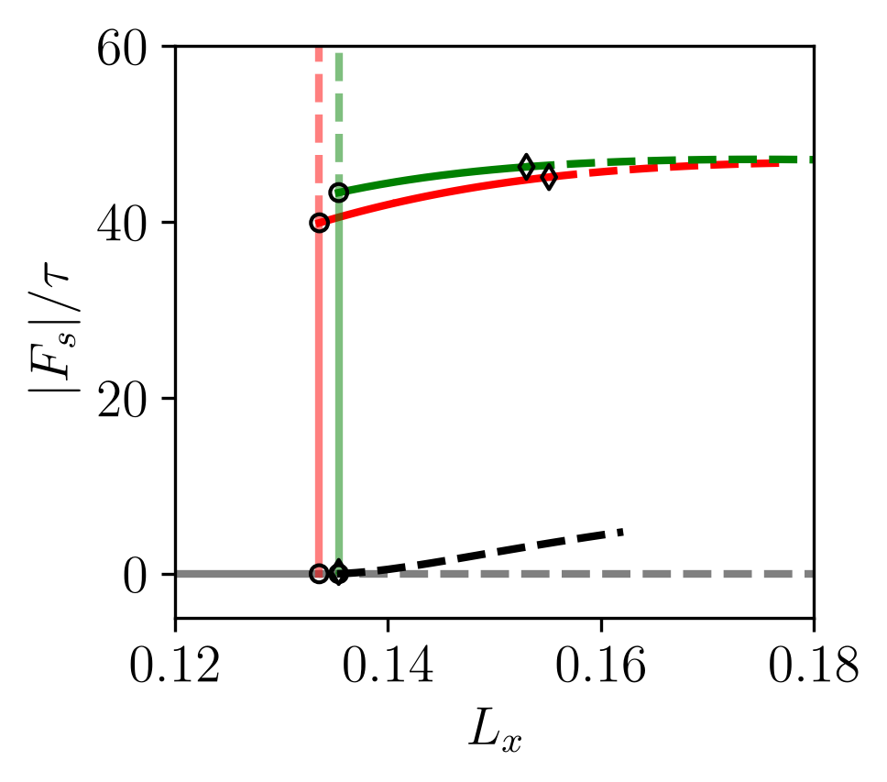
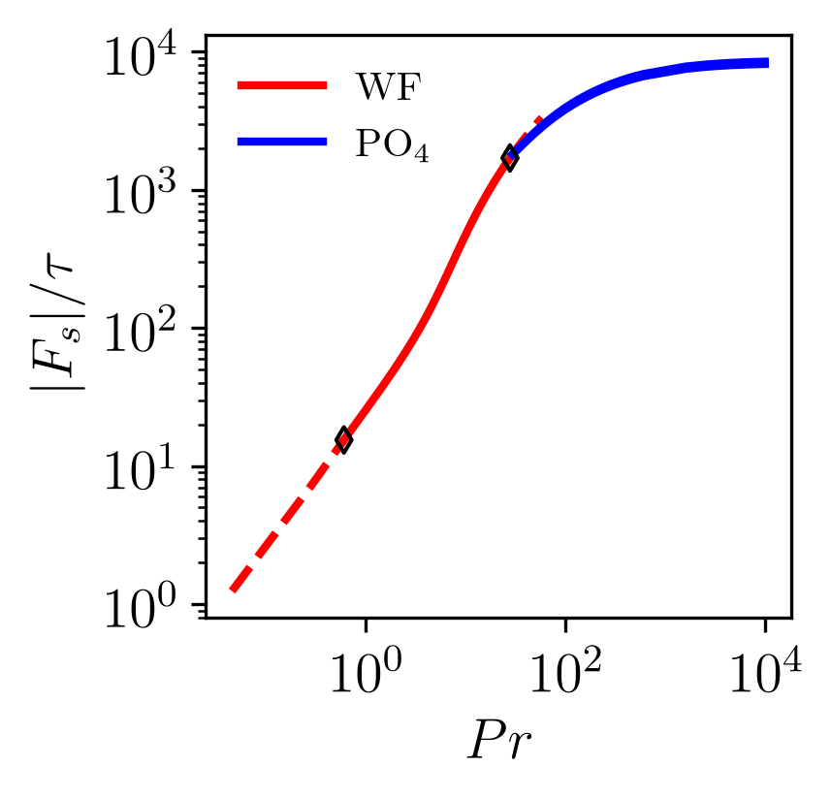





(a)
(b)
(c)
40
20
10
5
5
2
2
1.5
1.5
WF
IWF

