Slide 1
Lesseps
Evaluation framework
NOVEMBER 2025

Slide 2
Overview | Framework for evaluating EIW automation priorities
Preliminary
Key objectives of framework
Two inputs to support prioritization of automation across processes
Surface priority processes with the greatest remaining potential for automation
Aid in reporting progress toward L3, L2 and L1-level automation achieved (versus max potential)
Automation potential
1. Level of automation potential
The highest degree of automation possible for each process
Based on manual review, with directional flagging of degree of automation achievable
Current level automation
2. Current level of automation
Based on 2 inputs for each automation initiative:
Coverage - share of workflow touched by automation initiatives to-date
Impact - level of efficiency achieved to-date by automation initiatives
Indented for high-level progress tracking, based on initiative overviews shared by owning teams¹
Coverage
Impact
1. Applicable to a range of automation initiatives (e.g., RPA, GenAI, Agentic AI)
Notes:
¹

Slide 3
Automation Index | Sample walkthrough of framework to identify whitespace opportunity for a given process
Preliminary
Units: L3 Equivalent = unit of activity equivalent to one L3 workflow
Automation potential
Current level of EIW automation based on ongoing initiatives
(Coverage * Impact)
Automation index
Defines highest potential degree of automation based on the nature of each EIW L3
(max expected coverage with 100% impact)
Coverage
Impact
Calculates current gap remaining to full automation potential
Assesses current % of EIW L3 workflow covered by ongoing automation initiatives
Evaluates degree of transformation within each EIW L3 that is enabled by ongoing automation initiatives
H/M/L scale
H/M/L scale
(% weighting for automation index)
0-4 Impact scale
(% weighting for automation index)
0-1 L3 EQs scale
Score
0 = full automation potential realized
HIGH (100%)
Fully automatable
HIGH (100%)
Full workflow coverage
No
realized Impact
0
1
2
3
4
Fully realized impact
Scoring method
MED (66%)
Some human input
MED (66%)
Moderate coverage
0%
25%
50%
75%
100%
LOW (33%)
Heavy human input
LOW (33%)
Minimal coverage
Low adoption/ efficiency gains
Moderate adoption/ efficiency gains
High adoption/ efficiency gains
1 = no automation potential realized
NONE (0%)
Not automatable
NONE (0%)
No coverage
Illustrative example: EIW 3.1.3 - Create service/solution design
0.66
0.66
0.5
.33 L3 EQs
Example
MED (66%)
Coverage score*: MED (66%)
Impact score*: 2 (50%)
Automation Index
Workflow has strong automation potential but requires human review and input
Ongoing initiative, Interstellar ELA Assistant for SW Complex Pricing, covers major portion of workflow
AI assistant proof of concept deployed in March; further testing and refinement ongoing
Current index of
automation for EIW 3.1.3
* Directional estimates based on description of AI initiative (provided by owner)
Source: Q2C initiative overviews, shared October 2025

Slide 4
Detail | Evaluation form to share with initiative owners
Preliminary
Initiative Name
Name of the AI automation initiative
Initiative Description
Describe what your solution does and how it impacts the relevant process(es). Include intended users, deployment scope (teams/regions), and expected benefits or outcomes:
Brief description of initiative, deployment timeline, and expected impact
Section 1: Coverage within the L3 Process(es)
Section 2: What level of impact has the initiative realized today?
Briefly describe the specific workflow or activities your initiative targets.
What level of adoption or efficiency improvement has your initiative achieved so far? Select one:
e.g., Source prospective talent, screen candidates, conduct outreach, set up interviews
4 –
3 –
2 –
1 –
0 –
Broadly adopted and delivering full expected efficiencies across users and regions
Adopted across multiple regions/functions with measurable improvements
Early adoption with partial efficiency realized
Pilot or limited use, early indications of benefits
Not yet in use/delivering measurable impact
Briefly describe the broader workflow or process within which your initiative sits.
e.g., Talent acquisition
Within the broader workflow, estimate the portion of total time (%) dedicated to your specific workflow within a given month. Select one:
HIGH (~70-100%) -
Most or all of total time spent on broader workflow activities covered by specific workflow
Please provide a brief justification for your selected coverage level
Please provide a brief justification for your selected impact level
MED (~30-70%) -
A significant portion of total time spent on broader workflow activities covered by specific workflow
LOW (~1-30%) -
A limited amount of time spent on broader workflow activities covered by specific workflow

Slide 5
Detail | Evaluation form to share with initiative owners
Preliminary
Sample answers based on illustrative example
Initiative Name
Talent Acquisition Agent
Initiative Description
This automation solution addresses the early stages of recruiting process by sourcing prospective candidates, screening them, and conducting initial outreach with the ability to set up interviews. Cover 50 FAs, with expected ~10-15x ROI. Expected timeline: US launch, January 2026.
Section 1: Coverage within the L3 Process(es)
Section 2: What level of impact has the initiative realized today?
Briefly describe the specific workflow or activities your initiative targets.
What level of adoption or efficiency improvement has your initiative achieved so far? Select one:
Sourcing prospective talent, screening candidates, conducting outreach, and setting up interviews once approved
4 –
3 –
2 –
1 –
0 –
Broadly adopted and delivering full expected efficiencies across users and regions
Adopted across multiple regions/functions with measurable improvements
Early adoption with partial efficiency realized
Pilot or limited use, early indications of benefits
Not yet in use/delivering measurable impact
Briefly describe the broader workflow or process within which your initiative sits.
Talent acquisition
Within the broader workflow, estimate the portion of total time (%) dedicated to your specific workflow within a given month. Select one:
HIGH (~70-100%) -
Most or all of total time spent on broader workflow activities covered by specific workflow
Covers a meaningful portion of time spent on early-stage talent acquisition activities; additional time required to confirm candidate fit (e.g., live interviews)
Talent acquisition agent in development. Pilot to roll out in January 2026 for the US only. Expected to expand to other regions once the efficacy of the tool is proven.
MED (~30-70%) -
A significant portion of total time spent on broader workflow activities covered by specific workflow
LOW (~1-30%) -
A limited amount of time spent on broader workflow activities covered by specific workflow

Slide 6
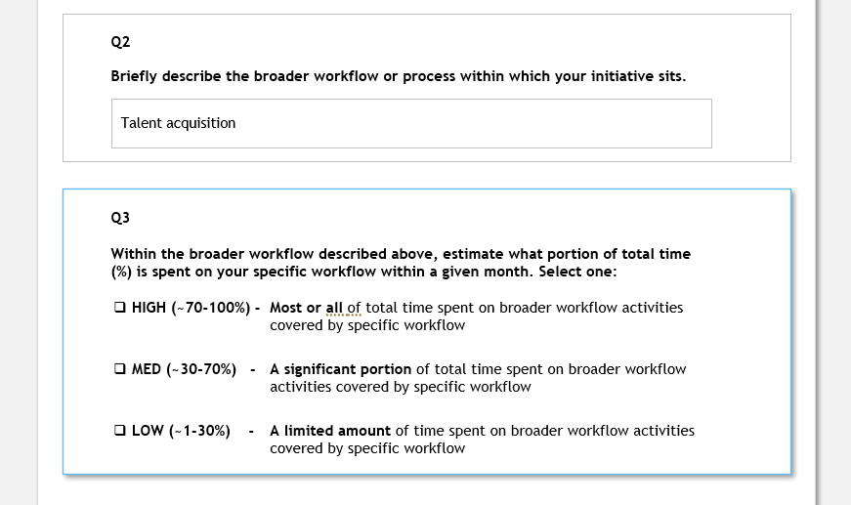
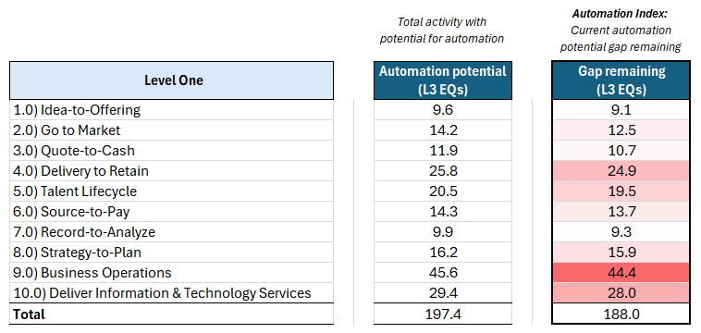
Detail | Key steps to operationalize evaluation framework
Preliminary
Evaluation process to be conducted yearly to refresh scores of existing initiatives; new initiatives to be scored as they are created
Step 1: Solicit input/descriptions from initiative owners
Step 2: Score each initiative based on provided context
Step 3: Roll up results for socialization
Sent out survey to initiative owners via email with link to survey tools
Initiative owners fill out survey
Download the survey results from the survey tool
Copy the data into the scoring model excel
Map each initiative to the most relevant L3
Selects/adjust coverage and impact score based on the provided survey answers
Automation index scores are calculated by the templatized excel/dashboard
Socialize rolled up Automation Index scores from excel dashboard with relevant stakeholders, at desired level of granularity
(L1, L2 or L3)
1a
2a
2b
1b
Illustrative survey
2c
Illustrative rollup output
2d
Next steps: Set up survey for distribution to initiative owners – BCG can support here if helpful

Slide 7
Detail | Automation potential scoring methodology
Preliminary
Automation potential
Step 1: Read through L3 and APQC process descriptions
Step 2: Assess automation potential based on qualitative workflow characteristics
Step 3: Assign an automation score and provide rationale
Defines highest potential degree of automation based on the nature of each EIW L3
(maximum expected coverage with 100% impact)
Two main inputs used for manual review of each L3:
Individual L3 process descriptions
APQC long-form definitions
Qualitative characteristics used for scoring determination:
Strategic importance
People to people involvement
Transactional process
etc.
Automation potential score assigned to each L3 (High, Medium, Low or None)
Short description providing rationale for scoring determination included
Scoring method:
H/M/L scale
Non-exhaustive
HIGH
(70-100%)
Fully automatable across most or all relevant L3 workflows activities
Example
Example
Example
MED
(30-70%)
Partial automation across workflow steps; moderate human input required
L3 description: "5.2.3) Screen and select candidates"
APQC definition: "Evaluating and selecting potential employees through interviews, tests, etc."
Screening has high automation potential along a defined set of parameters/criteria; final selection process requires people to people involvement
Automation potential: MED (66%)
Rationale: "AI orchestrates workflows and prepares recommendations; human sets priorities and approves actions"
LOW
(1-30%)
Minimal automation across workflow steps; heavy human input required
NONE (0%)
Not automatable
Preliminary review of L3 automation potential to be refined with stakeholder input

Slide 8
Detail | Scoring descriptions for coverage and impact evaluation
Preliminary
Standardized scoring descriptions
Coverage
Impact
Evaluates the number of activities automatable by your initiative out of the entire set of activities to be automated within the relevant EIW L3(s)
Assesses current efficiency gains by considering level of adoption across functions and regions as well as time saved through automation
Level | Description | Score
High | Covers most or all of the relevant workflows or process steps within the L3 process | 1.0
Medium | Covers several key workflows or a moderate portion of the L3 process | 0.66
Low | Covers a limited set of workflows or point activities within the L3 process | 0.33
None | Does not currently cover any part of the L3 process | 0
Level | Description | Score
4 | Broadly adopted and delivering full expected efficiencies across users and regions | 100%
3 | Adopted across multiple regions/functions with measurable improvements | 75%
2 | Early adoption with partial efficiency realized | 50%
1 | Pilot or limited use, early indications of benefits | 25%
0 | Not yet in use/delivering measurable impact | 0%
User selects the appropriate coverage and impact level for each initiative based on initiative context/description

