Slide 1
How We Prioritized
The method behind the MCC AI initiative roadmap
Methodology share · MCC AI Transformation

Slide 2
CONTEXT
What this was, and how we built it
An eight-week IBMC strategy engagement to define MCC's AI initiative roadmap.
Built from about 17 domain-lead interviews and 8 cross-domain workshops, on top of the IX team's 321 detailed process maps.
Run with MCC domain leads, and with the CIO for the feasibility assessment.
Output: 41 initiatives, scored on Value and Feasibility and grouped into core marketing capabilities, with 10 selected for Wave 3.
The top tier was fully prioritized for Wave 3; the rest stay in the backlog and are re-scored each wave.
This deck is the repeatable method, so the backlog can be re-scored as new waves and new ideas arrive.
How We Prioritized | MCC AI Transformation
2

Slide 3
THE PROCESS
Five steps, from raw asks to a sequenced roadmap
1
Capture Pulled every initiative we heard across the discovery interviews into one backlog.
2
Refine Filtered and consolidated duplicates into standardized, comparable initiative blueprints.
3
Score Rated each on two dimensions: Value and Feasibility, using simple 1 to 3 sub-metrics.
4
Place Plotted every initiative on a Value by Feasibility matrix to see relative priority at a glance.
5
Sequence Grouped the placed initiatives into capability clusters so the roadmap builds in a reinforcing order.
Steps 3 and 4 are objective and identical for every workflow. Step 5 is where MCC judgment shapes the sequence.
How We Prioritized | MCC AI Transformation
3

Slide 4
HOW WE SCORED, THE TWO DIMENSIONS
Value, crossed with feasibility
Value
Feasibility
Direct value over current approaches: efficiency, effectiveness, speed.
Sized first by relative efficiency impact, how many resources the process consumes today. The heaviest factor, about 50%.
Then productivity, the share of that effort AI can remove, plus alignment to MCC strategy.
Time to value.
Business priority is the top-line lens: the KPIs each initiative moves (revenue or pipeline), T-shirt sized high, medium, or low.
A joint CIO and delivery-team assessment.
Data availability and quality (sensitivity, semantic readiness, security).
Dependency on and maturity of existing platforms.
Level of effort and implementation complexity (agent outcome, identity, organizational).
Both dimensions consider AI capabilities from across the martech ecosystem, not just one vendor. Efficiency is quantified; top-line impact is kept directional, captured through business priority.
How We Prioritized | MCC AI Transformation
4

Slide 5
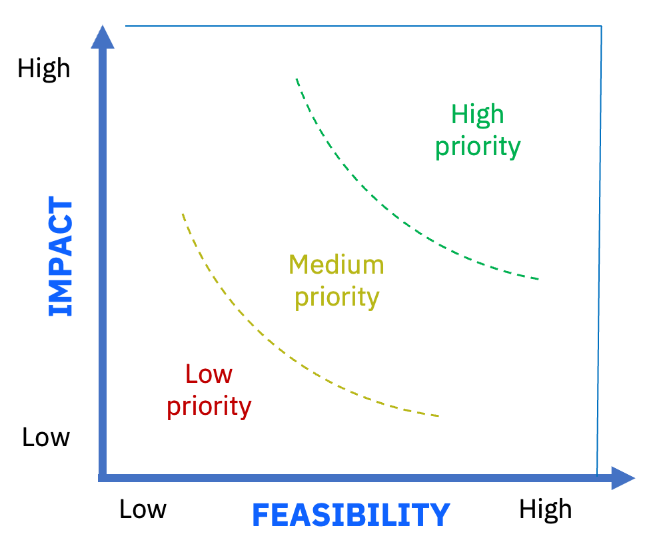






Prioritization Approach Across Workflows
Value
Direct value over current approaches (incl. efficiency, effectiveness, speed)
Alignment to MCC strategy and agentic vision
Time to value
Feasibility*
Data availability and quality (data sensitivity, semantic readiness, security)
Dependency and Maturity of CIO existing platforms
Implementation complexity (agent outcome, identity management, and organizational)
*The above feasibility assessment was a joint exercise between the CIO and IBMC
Considering AI capabilities from across the martech ecosystem
5
5

Slide 6
HOW WE SCORED, THE MECHANICS
Six inputs, scored, then combined
Each input is rated High, Medium, or Low, then combined into a Value score and a Feasibility score, each 1 to 5. Efficiency impact carries the most weight in Value.
Input
High
Medium
Low
Feeds
Relative efficiency impact
High
Medium
Low
Value (50%)
Business priority
High
Medium
Low
Value (25%)
Productivity (efficiency gain)
75 to 100%
50%
25%
Value (25%)
Feasibility
High
Medium
Low
Feasibility (33%)
Complexity (inverted)
Low complexity
Medium
High complexity
Feasibility (33%)
Data readiness
High
Medium
Low
Feasibility (33%)
Efficiency impact (size of the effort) and productivity (the share AI removes) are distinct; their product is the savings. Efficiency impact was estimated from workflow information and validated with LT members.
How the composites are built
Value (1 to 5) = relative efficiency impact as the primary driver, with business priority and productivity Feasibility (1 to 5) = feasibility, complexity (inverted), and data readiness Composite ranking = Value x Feasibility
How We Prioritized | MCC AI Transformation
5

Slide 7
DATA SOURCES AND METHOD
Where each input came from, and how we scored it
Metric | Data source | From data to score
Relative efficiency impact (Value, ~50%) | Org and role data (headcount by role) plus the 41 initiative definitions. AI first pass, validated with LT members. | AI estimated headcount touched, share of their time on the activity, and efficiency gain per initiative; ranked relative across the 41, then bucketed High / Med / Low. A detailed efficiency workbook sits behind it.
Business priority | Domain-lead interviews, leadership mandates, and the KPIs mapped to each initiative. | Identified the KPIs each initiative moves (identification, efficiency, and revenue or business impact); T-shirt sized the strength and any leadership mandate to High / Med / Low. This is where top-line enters.
Productivity (efficiency gain) | Domain workshops and interviews, plus the same AI model used for efficiency. | Estimated the share of in-scope time AI can remove: about 25% Low, 50% Medium, 75 to 100% High.
Feasibility | Joint CIO and IBMC delivery-team workshops. | Judged whether the data and capability exist to build it now; rated overall buildability High / Med / Low.
Complexity (inverted) | CIO and delivery workshops. | Scored implementation complexity (agent outcome, identity, organizational change), then inverted so low complexity raises feasibility.
Data readiness | CIO workshops and data / CDP audits. | Assessed data availability and quality (sensitivity, semantic readiness, security); rated High / Med / Low.
Inputs were scored High, Medium or Low, then combined: Value (efficiency-impact weighted) and Feasibility each 1 to 5, Composite = Value x Feasibility. Sources were interviews, the IX process maps, AI modeling on org and role data, CIO and delivery workshops, and LT validation. EBM was not used as a scoring input.
How We Prioritized | MCC AI Transformation
6

Slide 8
A WORKED EXAMPLE
Content Creation: the evidence behind each score
Category | Rating | What we collected to size it
Relative efficiency impact | High | The single largest time sink in MCC: resources across content creation, localization and QA in every domain. Tops the relative scale (5 / 5).
Business priority | Medium | A broad enabler behind many campaigns rather than a single headline KPI, so rated medium.
Productivity | High | Much of the work is repeatable generation, adaptation and first-pass QA that AI can take on.
Feasibility | High | Builds on the established GenStudio content workflow from Wave 2; a proven pattern.
Complexity (inverted) | High | Spans every domain, channel and locale, with brand and legal governance at scale. High complexity tempers feasibility.
Data readiness | High | Content, brand and localization assets are largely available across the domains.
RESULT
Value
5 / 5
Feasibility (complexity-tempered)
3.5 / 5
Composite (V x F)
17.4
Highest in the portfolio
Efficiency impact is the heaviest input, about 50%. Content Creation tops the efficiency scale, which carries Value to 5 even with business priority only medium. High complexity then tempers feasibility to 3.5, and the two combine to the highest composite in the set.
How We Prioritized | MCC AI Transformation
7

Slide 9
HOW PLACEMENT MAPS TO PRIORITY
Value and feasibility scored independently; composite is their product
Highest composite scorers (Value x Feasibility)
High
Aspirational
Build now
• Strategic Planning & SoT • Content & Forms QA • Audience, Content & Journey Orch • AdHoc Reporting • Workflow Auto: TL to Marketo • Client Engagement Insights • Trigger-Based Activation • Client Engagement Playbook • Response Optimization
• Content Creation (incl Loc.) • End-to-End Gap ID & NBA • Growth Cohort & Buying-Group • Event Strategy & Workflow Orch • Demand Intelligence & Planning • Spend & Performance Data Fdn • Content Expansion (NEW)
• GenStudio Creative Expansion • Content & Speaker Narrative • AI Taxonomy Tagging & Meta Gen
Initiative
V
F
V×F
Content Creation
5
3.5
17.4
GenStudio Creative
4
4.0
16.0
End-to-End Gap ID & NBA
5
3.2
15.8
Content & Speaker Narrative
4
3.9
15.6
Med
VALUE
• Anomaly Investigation & DQ
• Unified Agent (Innovation Studio) • Event Briefer (v2+) • Grant Lifecycle Orchestrator • Ad Ops & Content Trafficking • Thought Leadership Engine • Partner Performance Intelligence • Co-Marketing Process Automation • Tech Capability Intake • RFI Ninja • Scenario Planning
• Resource & Capacity Planning • Budgeting and Planning • Foundation for PMM Research
Client Engagement Playbook
4
3.8
15.2
Resource & Capacity Planning
3
4.9
14.6
Growth Cohort & Buying-Group
4
3.4
13.5
AdHoc Reporting
5
2.5
12.3
Low
Reconsider
V = value (business impact, 1 to 5). F = feasibility (1 to 5). Composite = V x F, used only for ranking.
• Press Release Orchestration • HC Optimization & Workforce
• Buying Group Contact Accuracy • Media Monitoring & Activation • Executive & Account Leader Briefer
• Exec Narrative Intelligence • Social Media Advocacy • CEO Office Hours Reporting • Chatbot Expansion
Highest value is not the same as highest priority. Crossing it with feasibility is what surfaces the build-now set.
Feasibility
Low
Med
High
How We Prioritized | MCC AI Transformation
8

Slide 10
HOW THE CAPABILITY LENS SHAPED THE PORTFOLIO
Grouping Initiatives Against Core Marketing Capabilities
We grouped the placed initiatives into four capability clusters. We did not use them as a 1-2-3 build order. We used the lens to make sure the portfolio was balanced and reinforcing.
Foundations
Insights
Content
Activation
Clean, unified data and measurement everything else relies on
+
Intelligence on who to reach and where the gaps are
+
Create and govern assets at scale
+
Orchestrate the right content to the right audience
What the lens did for selection
Foundations first. We front-loaded the first wave with Foundations, since the most downstream work depends on them.
One from every pillar. We deliberately advanced at least one initiative in each of the four pillars. They are the enduring core of marketing, regardless of how workflows change in the future.
Gap-spotting. Where a pillar had no strong candidate, that is where net-new initiatives were added.
Living portfolio. Lower-scoring items are revisited through governance and quarterly reassessment, not dropped.
How We Prioritized | MCC AI Transformation
9

Slide 11
AI FOUNDATIONS
WORKFLOW ALIGNMENT
FULL TRANSFORMATION
MCC AI Transformation - Initiative Portfolio
Phased rollout of initiatives aligned to foundational capabilities. Each initiative is assigned to the wave in which delivery begins. Waves accelerate as foundations are established.
Data + Measurement
Foundations
Insights
Content
Activation
Individual
Contributors
#1
W3
#10
W3
#9
W3
#8
W3
#14
#35
W6
Spend & Performance Data Fdn
Client Engagement Playbook
GenStudio Content & Creative
Audience, Content & Journey Orch
Resource & Capacity Planning
Social Media Advocacy
#2
W3
#16
W3
#7
W3
#13
#21
#36
AI Taxonomy Tagging & Meta Gen
Demand Intelligence & Planning
Strategic Planning & SoT
Event Strategy & Workflow Orch
Event Briefer (v2+)
Scenario Planning
#4
W3
#12
W4
#3
W3
#22
#24
#28
Data Fdn for Research
End-to-End Gap ID, RCA & NBA
Ad Ops / Adobe POC Scaling
Trigger-Based Activation
Budgeting and Planning
Exec & Account Leader Briefer
#5
W3
#15
#6
#32
#19
#37
Buying Group Contact (CDO)
AdHoc Reporting & Data Interrog
Content Creation incl Localisation
Workflow Auto: TL to Marketo
RFI Ninja
Tech Capability Intake
#27
#17
W5
#11
#38
W7
#23
#39
Data Anomaly & DQ (CDO)
Partner Performance Intel
Content & Speaker Narrative v2
Response Optimization
CEO Office Hours Reporting
Press Release Orch
#18
#29
W5
#26
W4
#20
#40
Client Engagement Insights
Content Expansion (NEW)
Co-Marketing Process Auto
Unified Agent (Inn. Stu.)
Chatbot Expansion
#25
#30
#33
#41
Growth Cohort & Buying-Group
TL Creation Engine
Exec Narrative Intel
HC Optimization & Workforce
#31
#34
Content & Forms Creation QA
Media Monitoring
Phasing of initiative drops
W3
Sept 1 '26
W4
Jan 1 ‘27
W5
April 1 '27
W6
July 1 '27
W7
Aug 1 '27
Living roadmap with quarterly reassessment. Backlog items may be team-driven, self-service, or deferred per governance review.
IBM Confidential
DRAFT

Slide 12
TAKEAWAYS
What carries over to any prioritization
Standardize the input
Be honest about precision
One blueprint per initiative, so every option is compared on the same basis.
Score on two simple dimensions. Quantify what you can (efficiency); keep top-line directional to avoid false precision.
The matrix is a tool, not gospel
Treat it as a living backlog
Layer judgment for sequencing: foundations first, quick wins, and cross-domain end-to-end combinations.
Re-score each wave through governance, rather than locking a one-time rank.
The method is portable: the same five steps and two dimensions work on any AI transformation backlog.
How We Prioritized | MCC AI Transformation
14

Slide 13
Prioritization Approach Across Workflows
★ = prioritized
9
Aspirational Bets
6
3
High Impact / High Feasibility / Aspirational
★ Strategic Planning & SoT
★ Content & Forms Creation QA
★ Audience Content & Journey Orch
★ AdHoc Reporting & Data Interrogation
★ Workflow Auto: TL to Marketo
★ Client Engagement Insights
★ Trigger-Based Activation
★ Client Engagement Playbook
Response Optimization across Channels
★ Content Creation (incl Localization)
★ End-to-End Gap ID & NBA
★ Growth Cohort & Buying-Group
★ Event Strategy & Workflow Orch
★ Demand Intelligence & Planning
★ Spend & Performance Data Foundation
Content Expansion - NEW
★ GenStudio Creative Expansion
★ Content & Speaker Narrative
★ AI Taxonomy Tagging & Meta Gen
High
1
9
3
Anomaly Investigation & DQ
★ Unified Agent (Innovation Studio)
★ Event Briefer (v2+)
Grant Lifecycle Orchestrator
Ad Ops & Creative/Content Trafficking
Thought Leadership Creation Engine
Partner Performance Intelligence
Co-Marketing Process Automation
Tech Capability Intake
RFI Ninja
Scenario Planning
★ Resource & Capacity Planning
★ Budgeting and Planning
★ Foundation for PMM Research
BUSINESS IMPACT
Medium
3
Reconsider
3
3
Low Impact / High Feasibility
Press Release Orchestration
HC Optimization & Workforce Planning
★ Buying Group Contact Accuracy
Media Monitoring & Activation
Executive & Account Leader Briefer
Exec Narrative Intelligence
Social Media Advocacy
CEO Office Hours Reporting
Chatbot Expansion
Low
Low
Medium
High
FEASIBILITY →

Slide 14
A WORKED EXAMPLE
GenStudio: the evidence behind each score
Category | Rating | What we collected to size it
Relative efficiency impact | High | Large creative and content team; about 46 efficiencys of time on asset production, resizing, QA and localization.
Business priority | High | Creative velocity and brand and legal compliance called out as leadership priorities; moves throughput and CTR/ROAS.
Productivity | High | Modeled near 65% of the in-scope time is repetitive resize, reformat, first-pass QA and translation that AI takes on.
Feasibility | High | Extends a proven GenStudio proof of concept on the Adobe stack already in place.
Complexity | Medium | The build is straightforward; activation depends on the Adobe control-plane and agency plumbing.
Data readiness | Medium | Needs brand guidelines, legal rules, translation memory and channel specs assembled; partly in place today.
RESULT
Value
4 / 5
Feasibility
4 / 5
Composite (V x F)
16
Build-now corner
Each rating is a High, Medium or Low call backed by the evidence shown. Value and feasibility both land at 4, which puts GenStudio in the build-now corner.
How We Prioritized | MCC AI Transformation
7

Slide 15
AI FOUNDATIONS
WORKFLOW ALIGNMENT
FULL TRANSFORMATION
No Regrets, Foundational Capabilities As We Start Pivoting
The initiatives are not separate projects. They map to a logical value chain anchored on four core capabilities impacting all MCC domains
Data + Measurement
Foundations
Insights
Content
Activation
WHAT IT IS
WHAT IT IS
WHAT IT IS
WHAT IT IS
Unified data layers that feed every agent, every workflow, every domain. Built once, used everywhere.
Collecting, enriching, and synthesizing intelligence to know who to reach, what they need, and where the gaps are.
Generating, localizing, and governing text, media, and creative assets at scale across every channel and domain.
Orchestrating execution and activation across all types of marketing tactics and channels.
WHY IT MATTERS
WHY IT MATTERS
WHY IT MATTERS
WHY IT MATTERS
Every downstream initiative depends on clean, structured, accessible data. Without a unified taxonomy, reliable spend data, and accurate buying group contacts, AI agents have nothing to work with. These are the non-negotiable building blocks.
MCC teams spend enormous time manually pulling data, explaining anomalies, and building reports for stakeholders. Every domain cited this as a top time sink. AI can eliminate analyst bottlenecks and put intelligence directly in the hands of decision-makers.
Content creation, localization, and governance is the single largest time commitment across MCC. Every domain produces content. The same creation and QA patterns repeat across Named, Select, PMM, Brand, and Corp Comms. Build the engine once, apply it everywhere.
Getting the right content and communications to the right audience at the right time is where marketing impact is realized. Today this is manual, slow, and reactive. Trigger-based activation and journey orchestration turn weeks into minutes and shift MCC from push to pull.
WHO IT IMPACTS
WHO IT IMPACTS
WHO IT IMPACTS
WHO IT IMPACTS
Select, Named, PMM, T&O, MMAPI, Events, and CSR
Named, Select, PMM, MMAPI, and T&O. Includes partner and ecosystem signal intelligence for Select.
Named, Select, PMM, C&C, Corp Comms, Brand, and Events
Named, Select, PMM, and Events. Includes partner ecosystem orchestration for Select
5 initiatives
7 initiatives
8 initiatives
6 initiatives
These are not new frameworks. They are the no-regret groupings for execution, regardless of org structure or future workflow design. Remaining initiatives land on the roadmap through governance and quarterly reassessment.
IBM Confidential

