Slide 1
ICIS 2018, 截止日期：5.2
文章思路/结构：1. 展示可视化分析结果 2. 针对可视化发现的关系建立模型(model) 3. 展开统计分析，寻找影响要素(impact factors) 4. 推测因果关系(causality analysis)
任务一：以“国际合作对处理事件(incident/product)的影响为核心”，串联目前发现的现象(pattern)，将目前的成果绘制成思维导图(Mind map)
任务二：寻找并尝试结合外源资料，例如年报(annual report)，对现阶段的发现做验证及解释，例如各地分公司的盈利情况(revenue)及业务性质和“国际效率”的关系，地图炮也可以考虑

Slide 2
附件一：思源老师推荐参考的文章
https://misq.org/catalog/product/view/id/1669
https://misq.org/catalog/product/view/id/1734
https://papers.ssrn.com/sol3/papers.cfm?abstract_id=2685902
https://papers.ssrn.com/sol3/papers.cfm?abstract_id=2619922
https://papers.ssrn.com/sol3/papers.cfm?abstract_id=3057722
里面的分析套路和模型比较符合ICIS(会议)的口味

Slide 3
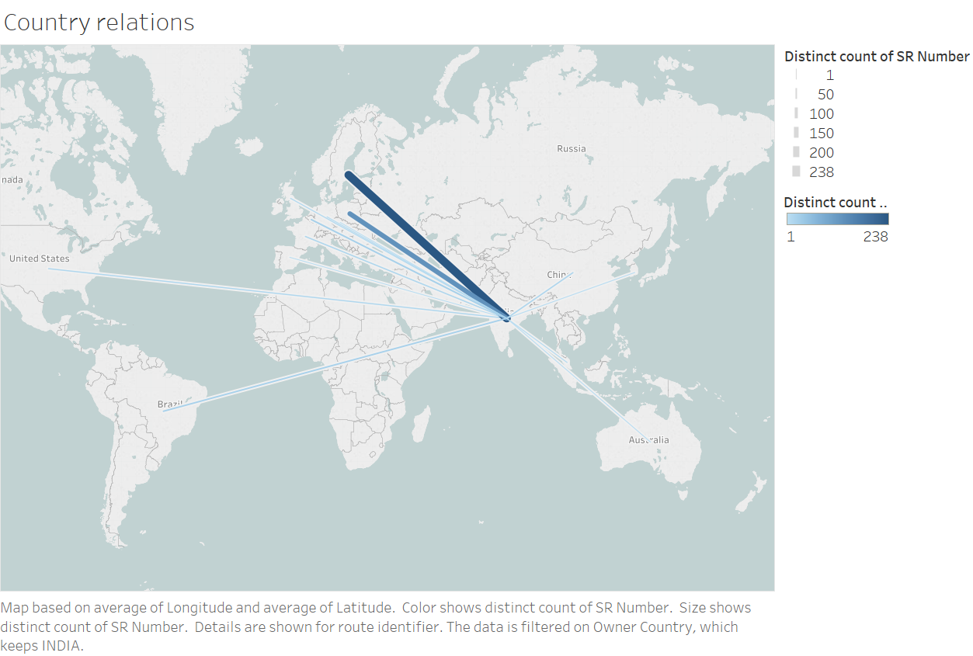
附件二：关系型图(node link)
Tableau系统构建图，可以选择一个或多个国家来看事件(incident)的转手情况

Slide 4
附件三：a quick summary
Rough timeline
How to make stories
How deep should the statistic test go
Method to find impact factors

Slide 5
Report on 1226, 0114, 0208
For each country, the number of incidents (SR_numbers) is proportional to the number of products she dealt with. (1226)
For each country, EXCEPT Poland, the number of employees (action owners) is proportional to the number of incidents. (1226)
The distribution of logs is uneven: the turbulence is extreme in May, 2012. (will be explained in 0220, found on 0114)
The demography of employees appeared in the dataset is similar to the claim in annual report. (0114)
Go deep in analysis on countries, and make stories. (0208)

Slide 6
Report on 0220
All incidents in the dataset are ended between 04/30/2012 and 05/22/2012, which is approx. 3 wks.
Ignore Function Div, supported ST, Org line, which lack explanation in original dataset. Also, these are more related internal organization of Volvo (Belgium).
Several statistics have not been proven useful yet.
Co-relation matrix between incident origin countries and nationality of action owners reveals the internationalization in the first place. (This finding can be verified by viz on 0320).

Slide 7
Report on 0220
Other graphs might be useful: spectrum, and viz in individuals (action owners).

Slide 8
Report on 0311
Focus on new “definitions”:
Domestic handling
Working efficiency
Difficulty level of incidents
International cooperate on incidents/products
International cooperation with consideration of incident impact
Other graphs might be useful

Slide 9
Node link viz on 0320

