Slide 1
Efficiency analysis
A Volvo case

Slide 2
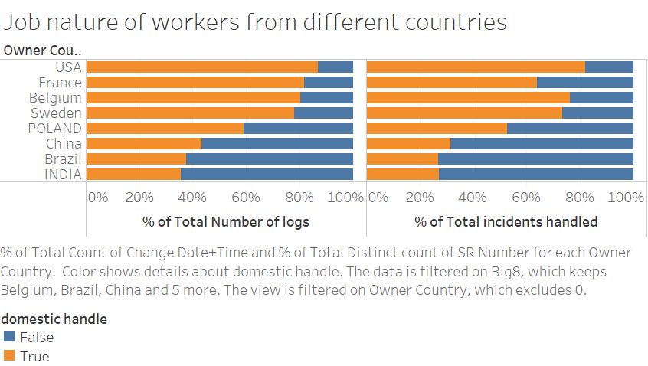

Slide 3
Logs, incidents handling, domestically or not?
In this graph, “domestic” is defined as the owner handles the incident which the origin is the same as his or her nationality.
In this graph, there are two approaches: with the count of logs and with unique count of incidents (count of SR numbers).
The eight countries selected in this graph will be known as the “big-8” throughout this report. They are the top 8 countries in terms of number of Volvo action owners.
We can see that India and Brazil usually handle oversee issues, while USA generally handle the issue within the country.

Slide 4
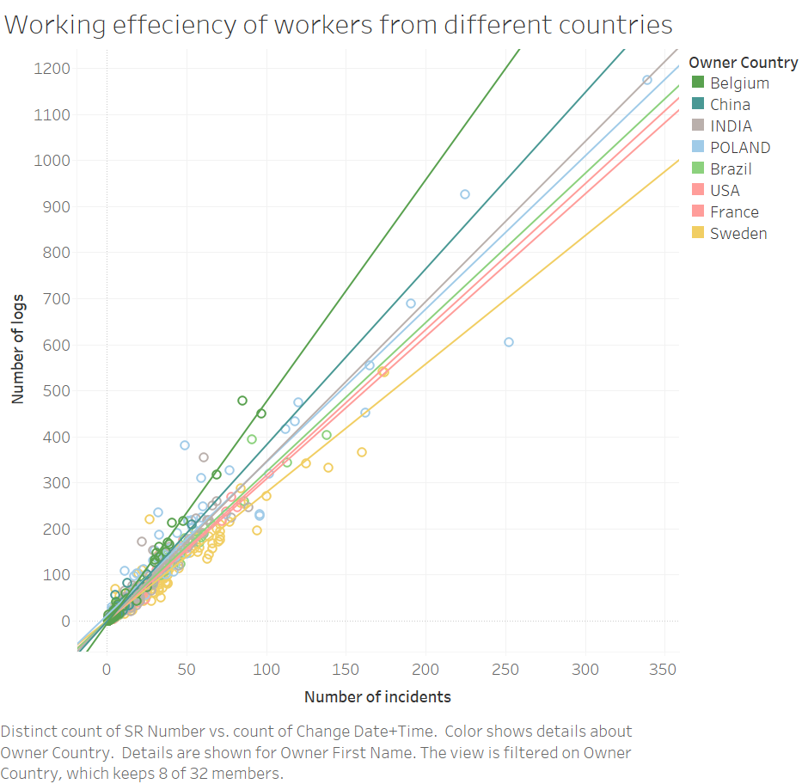

Slide 5
Workers’ efficiency, classified by countries
In this graph, efficiency is defined as number of logs generated per incident: the more generated logs for an incident, the lower the efficiency is.
Each dot on the graph is representing an action owner, while the x-axis is the incidents he or she handled and y-axis is the total number of logs he or she generated.
Classified by countries, we can see that, by definition, large slope is an indicator of low efficiency; this also determines legend sequence.
We apply liner trend line to this model.

Slide 6
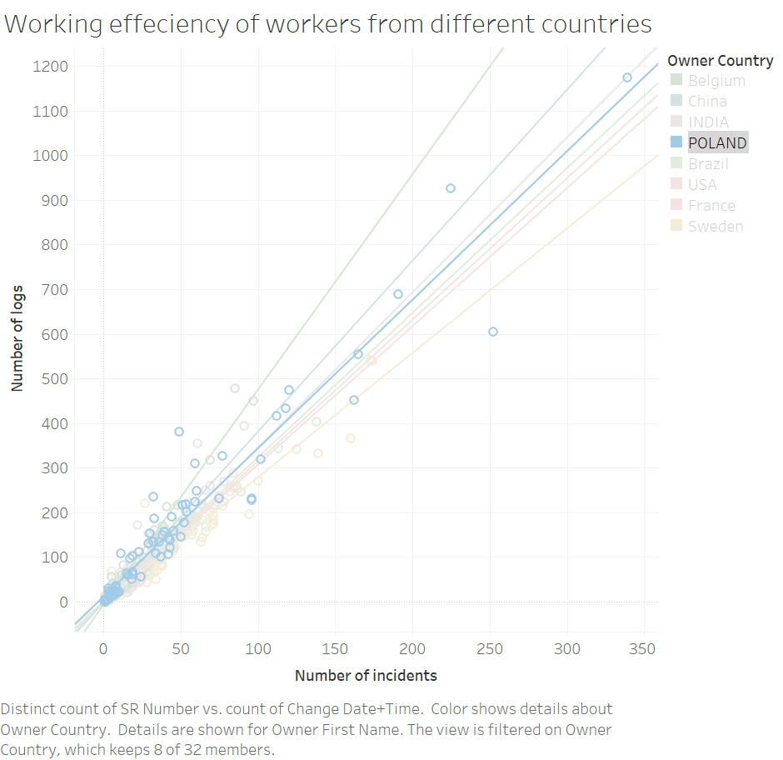

Slide 7
Example of Poland, and general remarks
Trend line parameters:
P-value < 0.0001
Equation: y = 3.32369*x + 11.4063
R-squared = 0.937
t-value = 32.7288
All R-squares of eight trends are within (0.8, 0.9), which indicates and liner relationship between number logs generated and incidents handled.

Slide 8
Conclusion 1 (from slide 2-7)
Except Belgium, all eight country owners tend to be more efficient in handling domestic affairs.
Slopes of China, India, Poland and Brazil are all large than that of France, USA and Sweden.
Potential explanation for large slope of Belgium: the data is originated from Volvo Belgium, so it could miss out some data.
Flaws of this theory: the international cooperation may have some routine logs of handling over tasks between different countries, while domestic handling may require less bureaucratic procedures.

Slide 9
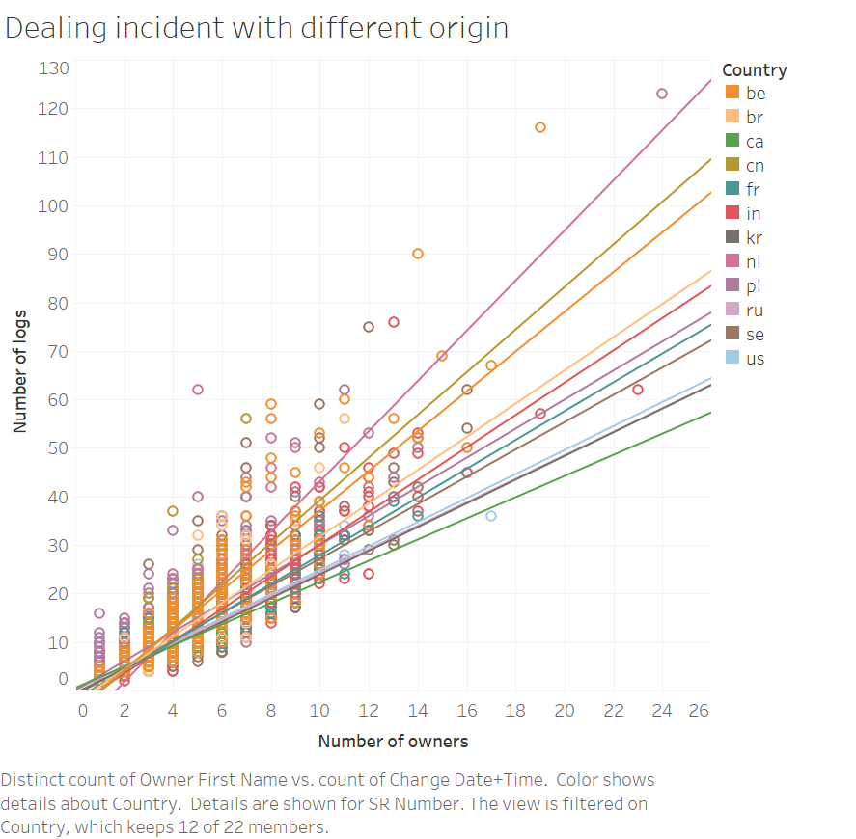

Slide 10
Difficulty of incidents with different origins
In this graph, I would like to see the difficulty level with incidents from different countries.
Difficulty of an incident is defined as the number of logs generated per action owners in dealing with this incident.
In the graph, each dot is an incident (SR Number), while classified by countries, their origin countries.
Slopes of each trend lines can be interpreted as difficulty levels.
We apply liner trend line to this model.

Slide 11
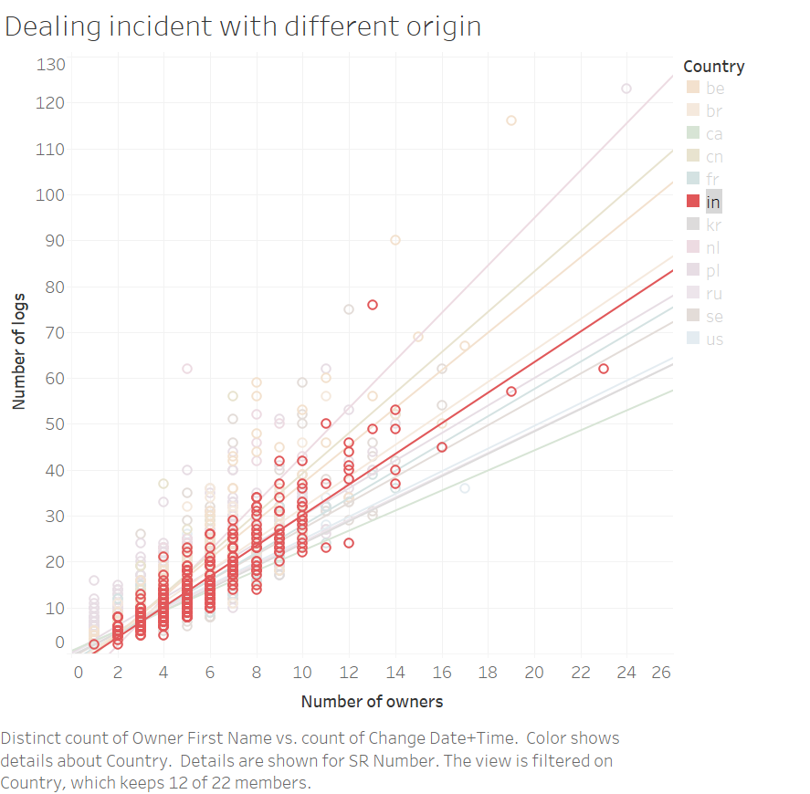

Slide 12
Example of India, and general remarks
Trend line parameters:
P-value < 0.0001
Equation: y = 3.33072*x -3.17965
R-squared = 0.832
t-value = 49.2119
Most of R-squareds are around 0.8, except a few falls below 0.5

Slide 13
Conclusion 2 (from slide 2 to 12)
The difficulty level of incidents from different countries vary a lot. For the finding at this part, I have not yet come up with much way to find the correlation with other information.
This is several idea that I have been considering:
Find information on annual report, to see if Volvo at one country has specialized work to do
To see if the higher the difficulty level is, the lower rate of domestic handling would become
Find use of correlation matrix of owner country and incident country

Slide 14
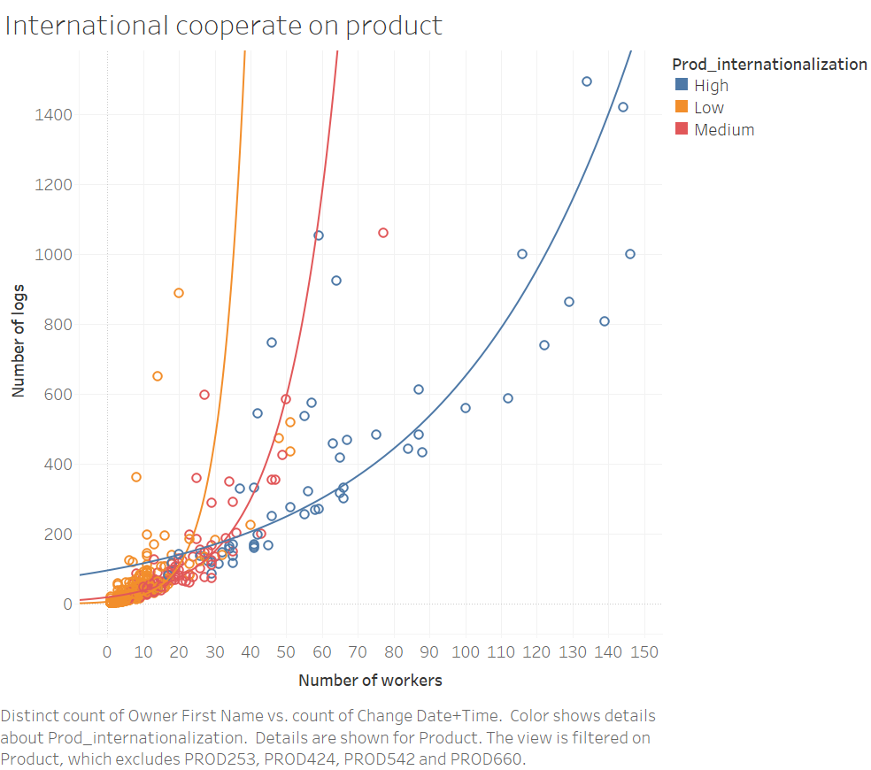

Slide 15
Products’ level of internationalization
Each dot is a product, with number of logs and number of workers involved in this. However, to show the overall trend, I remove a few products for clarity.
If the product involved with workers from more than seven countries, then this product is denoted as “High” international cooperation.
If the product involved with workers from more than four countries and less than eight countries, it will be denoted as “Medium”.
Others will be ascribe as “Low”.
Exponential model is applied on this model.

Slide 16
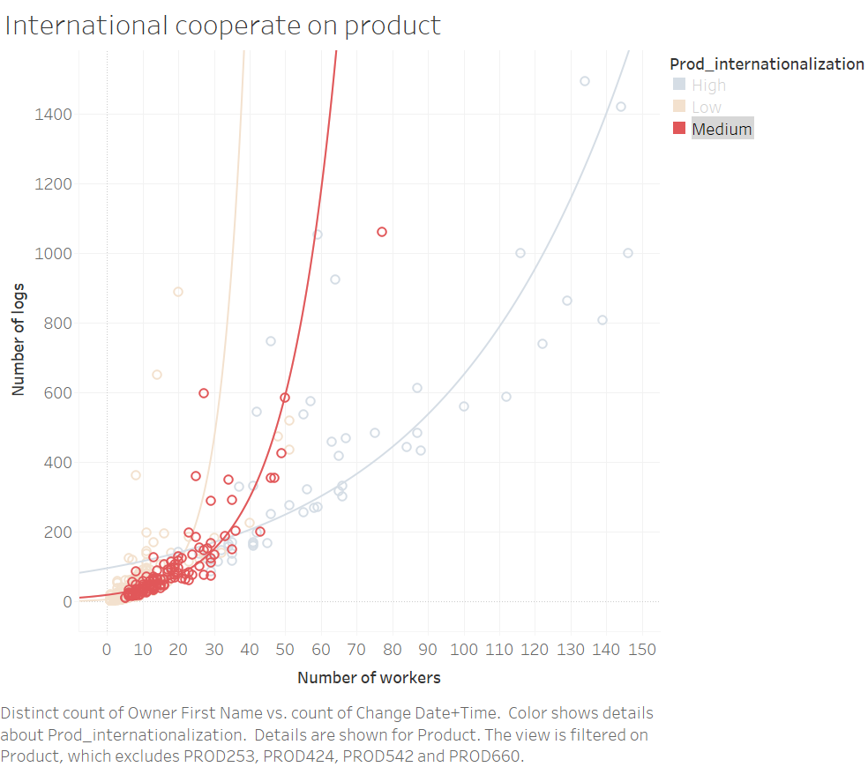

Slide 17
Example: Medium level
Trend line parameters:
P-value < 0.0001
Equation: y = 0.0685716*x + 2.95749
R-squared = 0.760
t-value = 20.1383
The R-square of “Low”, “Medium”, “High” is 0.613, 0.760, 0.698 respectively.

Slide 18
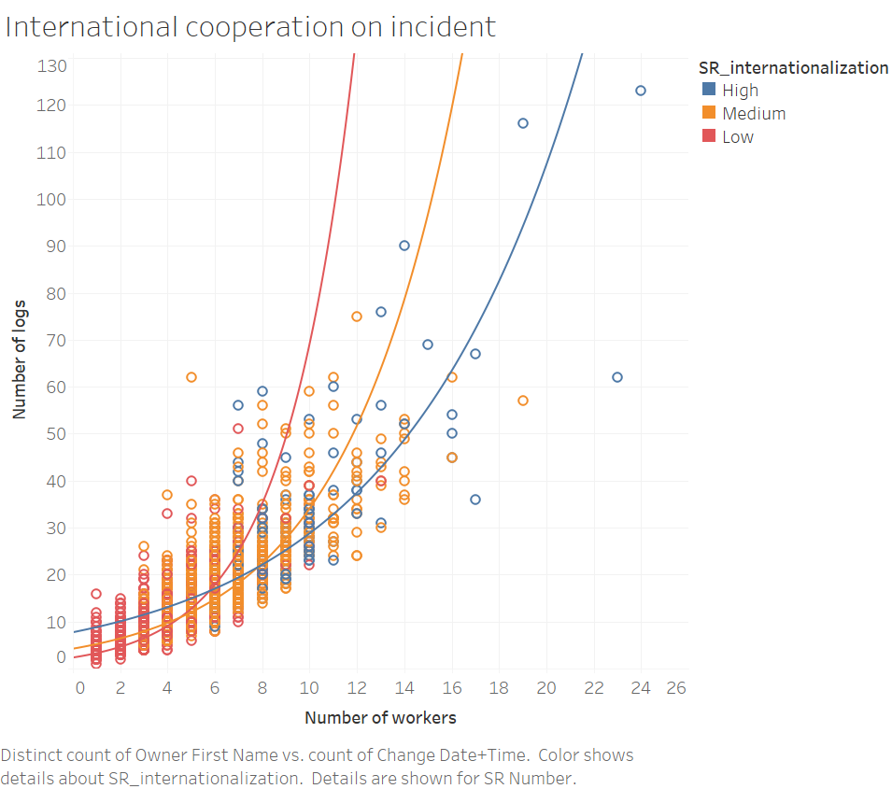

Slide 19
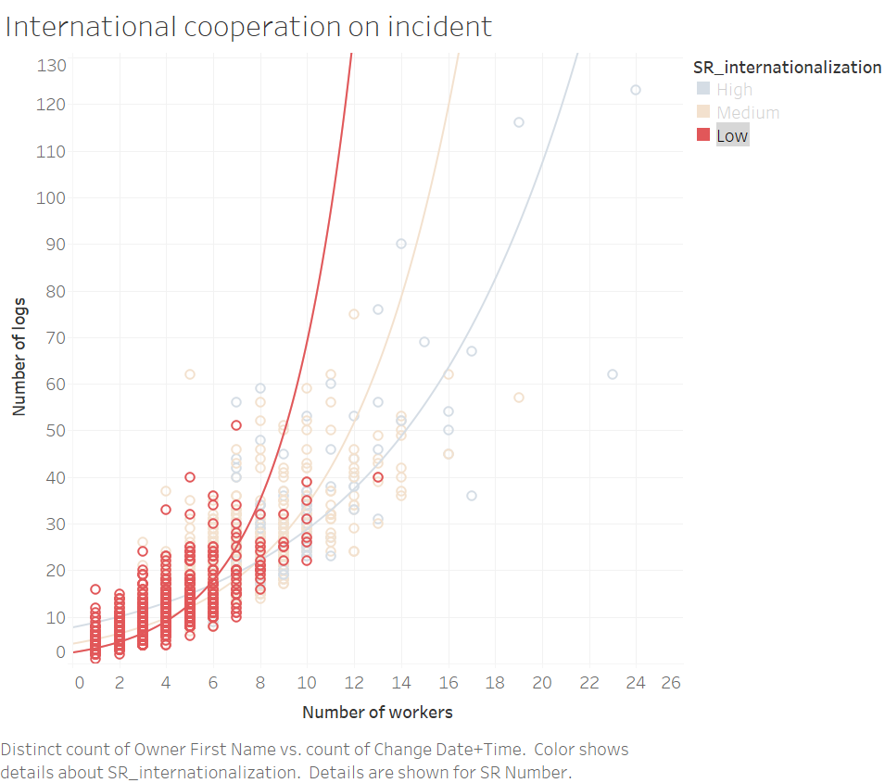

Slide 20
Incident’s level of internationalization
The analysis approach is quite similar with the product’s. However, the sample size of incidents are much larger than products, yet workers participated in might be less.
The R-squared is 0.793, 0.688, 0.631 respectively, from low to high.
If the incident involved with workers from more than four countries, then this product is denoted as “High” international cooperation.
If the incident involved with workers from more than two countries and less than five countries, it will be denoted as “Medium”.
Others will be ascribe as “Low”.

Slide 21
Conclusion 3(from slide 14 to 20)
The result is quite surprising. In this sense, by the definition of “efficiency”, the general trend of the efficiency would be High > Medium > Low (in terms of internationalization), when more people working together on the same project.
However, we should notice that the graph also should that when a few people is working together, the “Low” international cooperation would be favored for higher efficiency.
This quite true according to common knowledge.

Slide 22
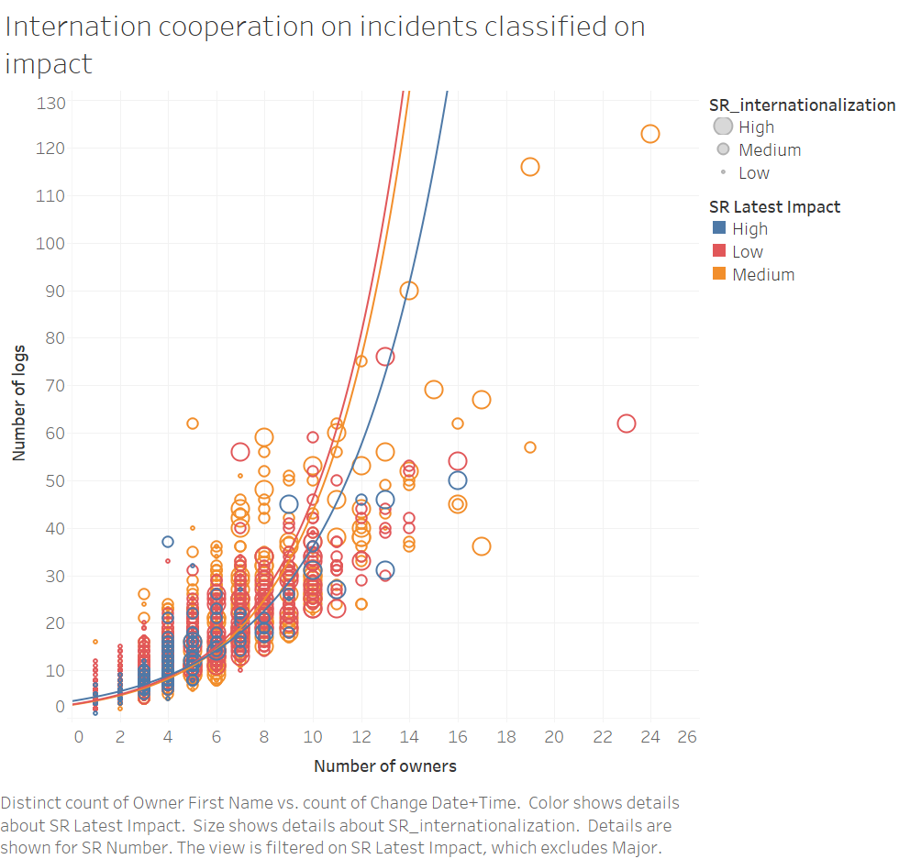

Slide 23
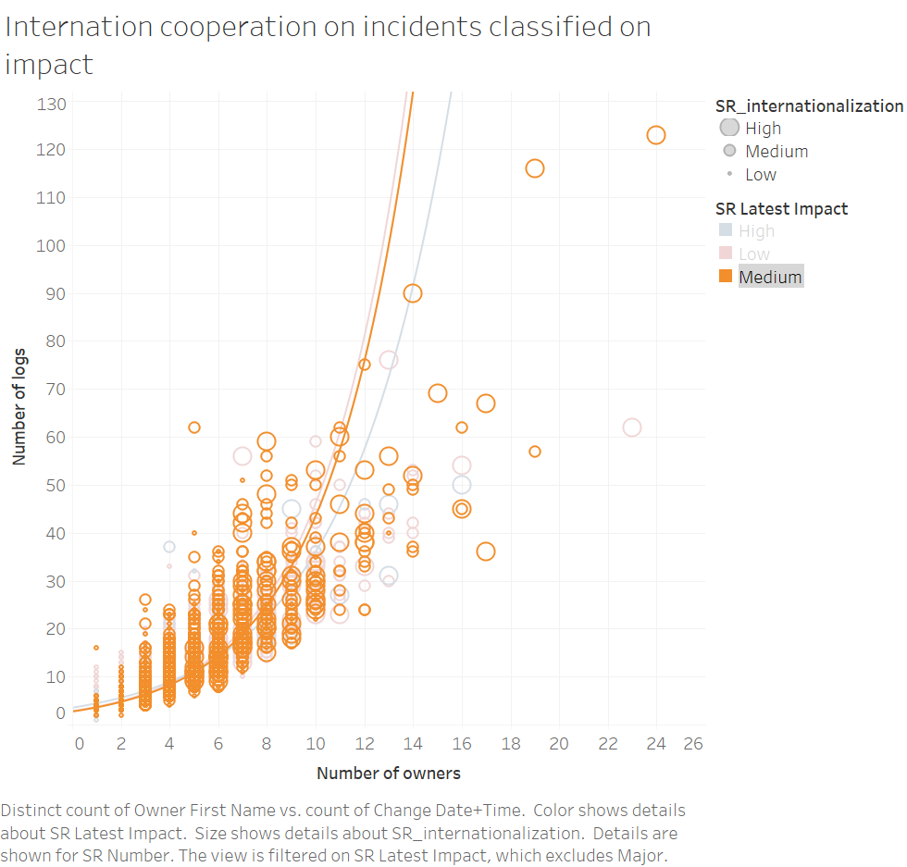

Slide 24
Impact and Internationalization
It would also be interesting to know about the what incidents with different impacts would affect the level of internationalization.
Every dot on the graph is an incident.
The largeness of the dot indicates the level of internationalization.
The color is the impact of the incident.
But, the result is, we can see no difference on “Low” and “Medium” level of impact, but those with “High” impact do get more attention and with slightly higher working efficiency.

Slide 25
Other graphs
Potentially useful

Slide 26
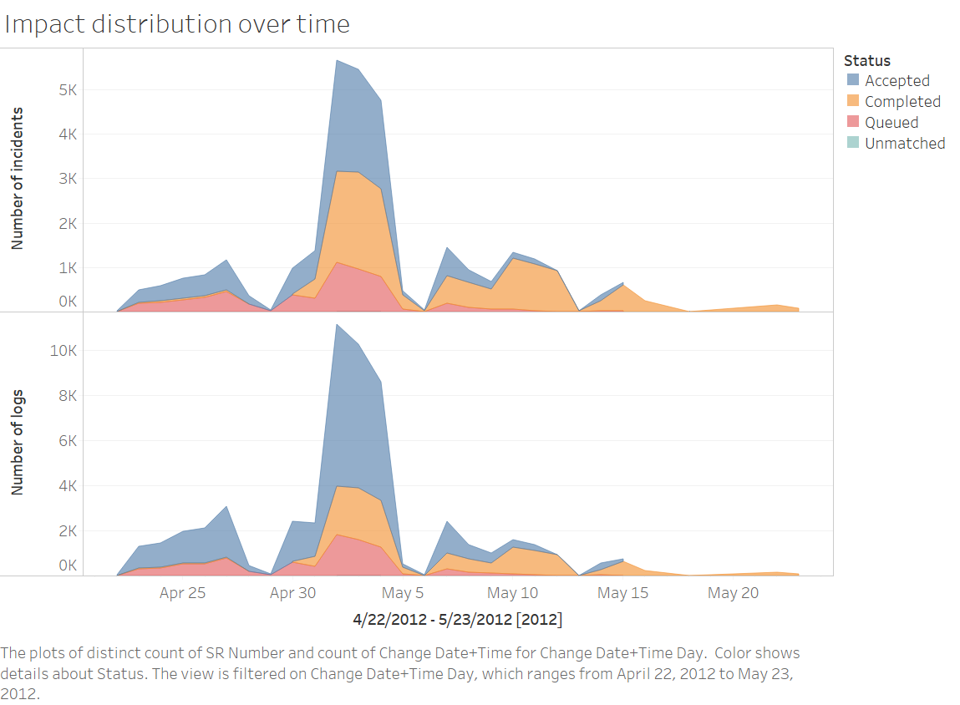

Slide 28
