Slide 1
Tentative meeting schedule
Self-introduction by Wenqian and Kaijun (in an academic way)
Opening & Summary report by Chengzhong
Tentative work allocation proposed by Chengzhong
Revise and clarify tasks by Siyuan (Dr.)
Understanding of work nature, voice from Wenqian and Kaijun
Breakdown works and set up milestones by Siyuan (Dr.)
Setup deadlines by Wenqian and Kaijun
Remarks and free Q&A hosted by Chengzhong

Slide 2
Self-introduction
Wenqian (UC Santa Cruz, Major in Economy)
Kaijun (HKUST, Major in Computer Science)

Slide 3
Summary on Visualizations
Introduction & Work distribution

Slide 4
Data Introduction, more detailed analysis can be found on report at 0220
SR Number
Incident ID, each has only one corresponding product
Country
The incident origin country
Product
Product name, one product can have many SR number
Owner first name
Owner identity, usually count distinctly
Change Date+Time
Usually used to count logs, as this part of data is quite “dirty”
Volvo
Owner Country
Where the owner worked at
SR Latest Impact
Impact of the incident
Status
Status of the incident

Slide 5

Visualization outcomes, mainly a summary on report at 0311
Owner country
Level of domestic
handling with “work
efficacy”
Internationalized
On products or incidents with impact (optional), yield different “working efficacy”
Liner Internationalized Exponential
Incident country
Incidents from different
countries have different
“difficulty level”
Node link
Visualization on aggregated handoffs between two countries

Slide 6
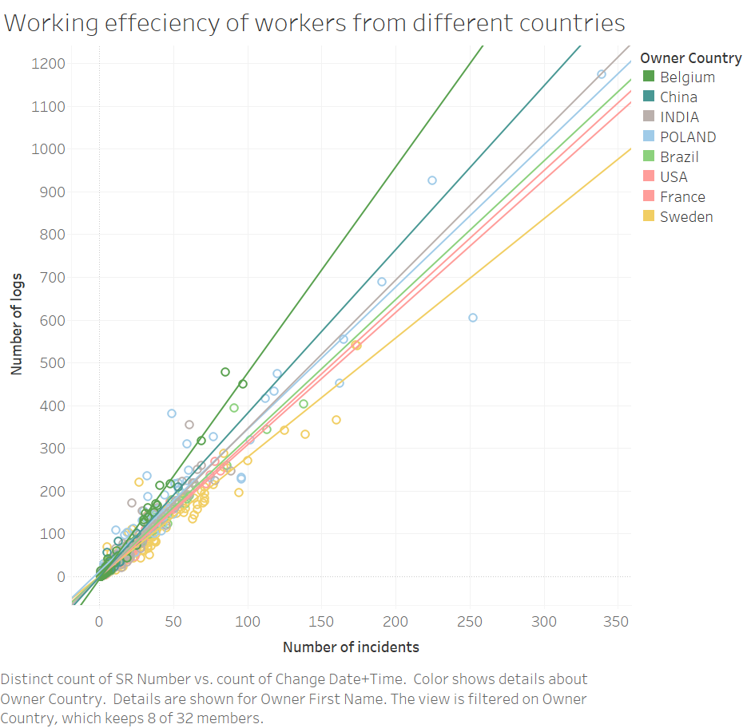
Example of Owner countries

Slide 7
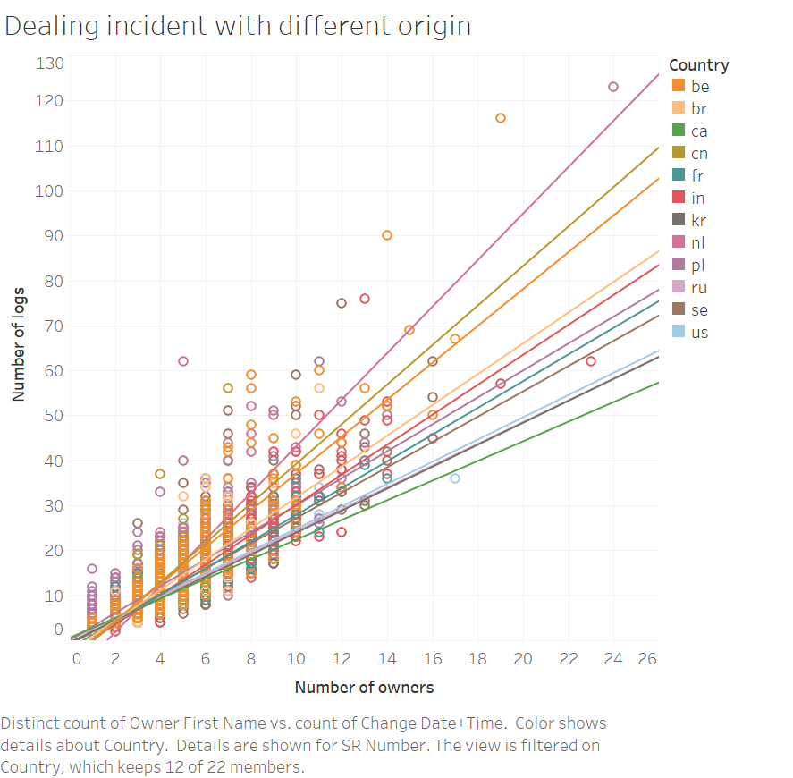
Example of incident countries

Slide 8
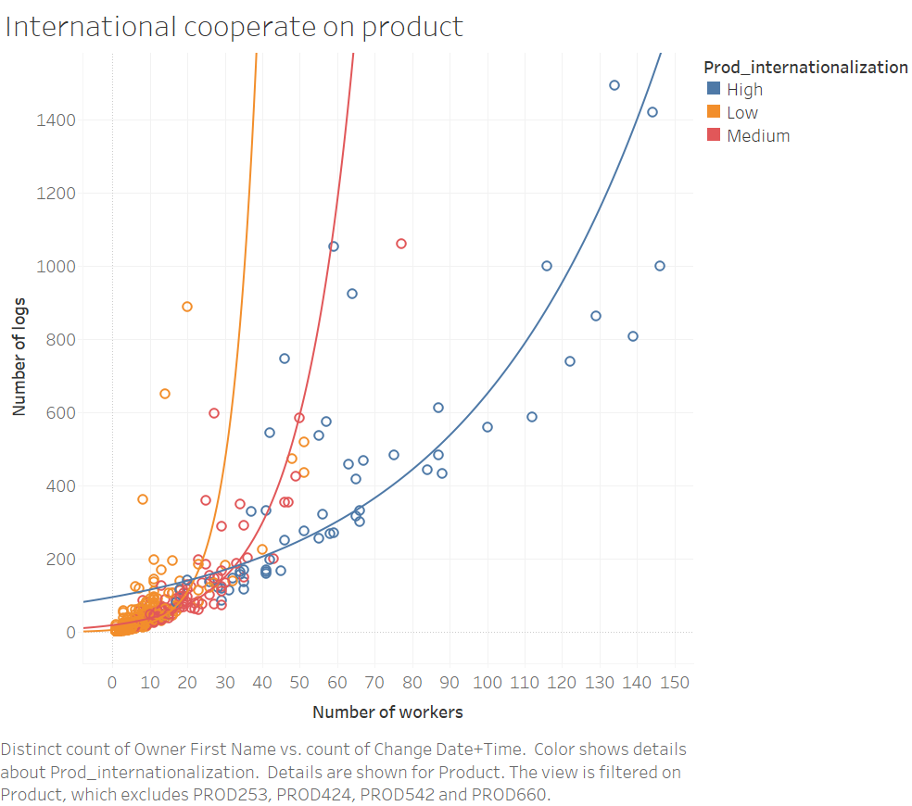
Examples on internationalized

Slide 9
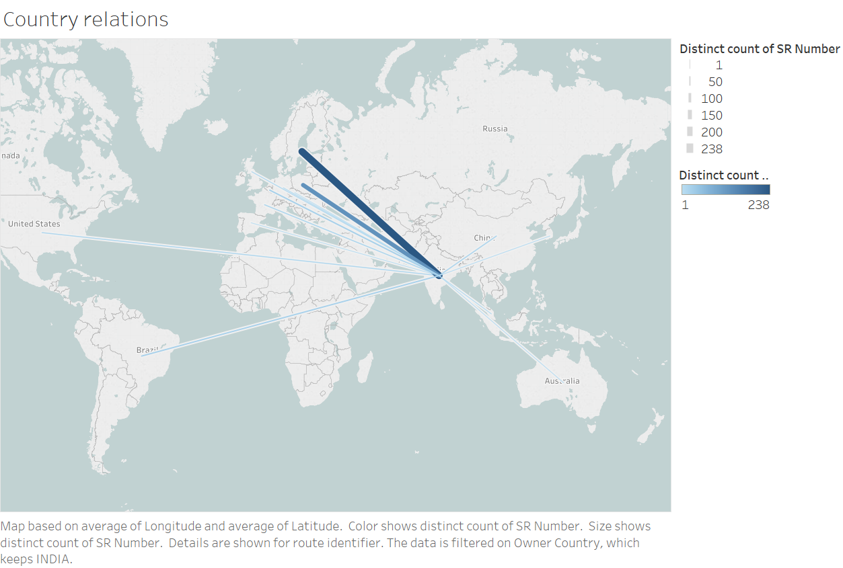
Examples of Node link

Slide 10
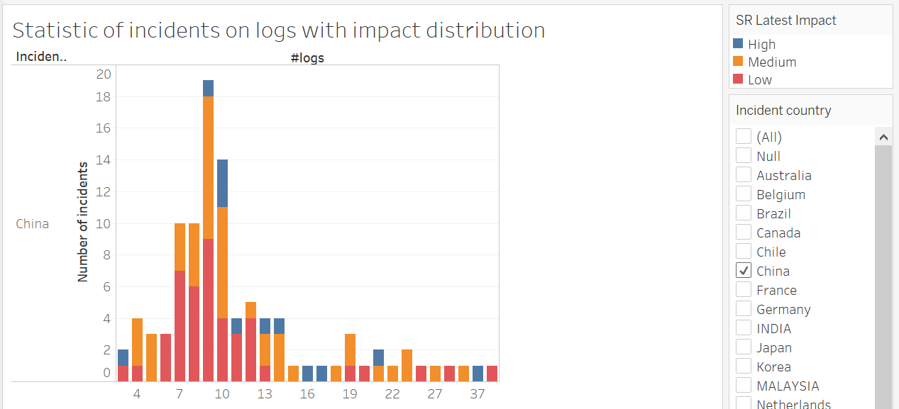
Other noticeable graph

Slide 11
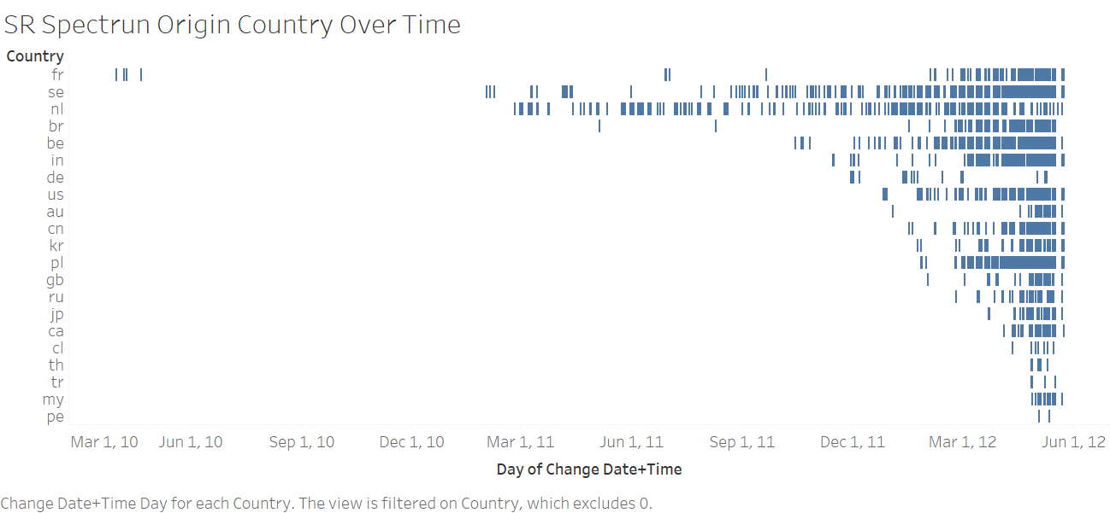
Other noticeable graph

Slide 12


03
分析寻找影响要素 (Wenqian)
Analysis model by Kaijun
Find impact factors
展示可视化成果 (Chengzhong)
Improve current outcome
Provided visualization support
01
04
因果关系分析 (Wenqian)
Make stories
Find external resources
针对性建立模型 (Kaijun)
Statistic formulation
Regression, statistic tests
02

Slide 13
Detailed tasks checklist, by Siyuan (Dr.)

Slide 14
Understanding from Wenqian and Kaijun

Slide 15
Breakdown milestones by Siyuan (Dr.)

Slide 16
Remarks and free Q&A hosted by Chengzhong

