Slide 1
Some findings
20180406

Slide 2
Index Page
Regional Network (in seven parts)
Impact distributions on countries
Status distributions on countries
Status distributions on countries (exclude “Accepted”)

Slide 3
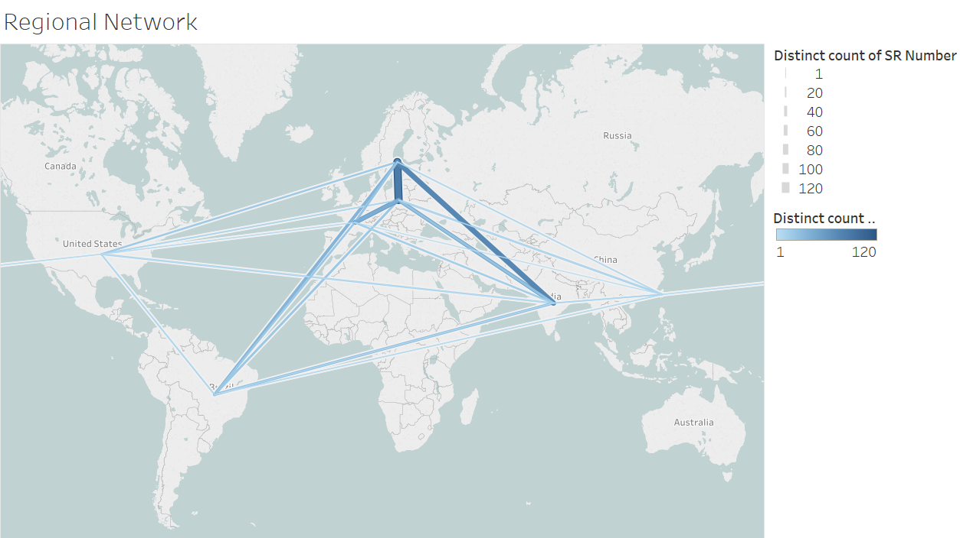

Slide 4
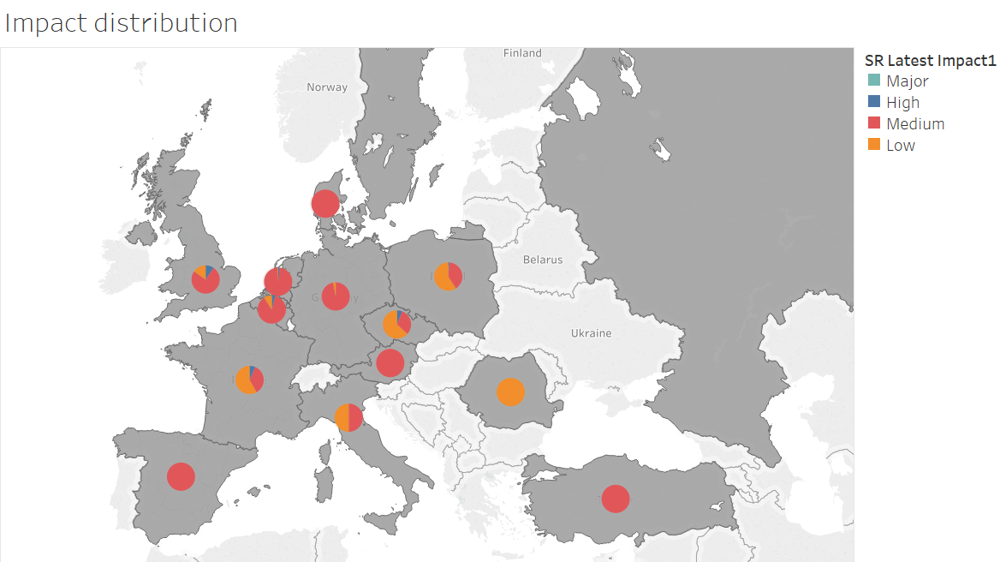

Slide 5
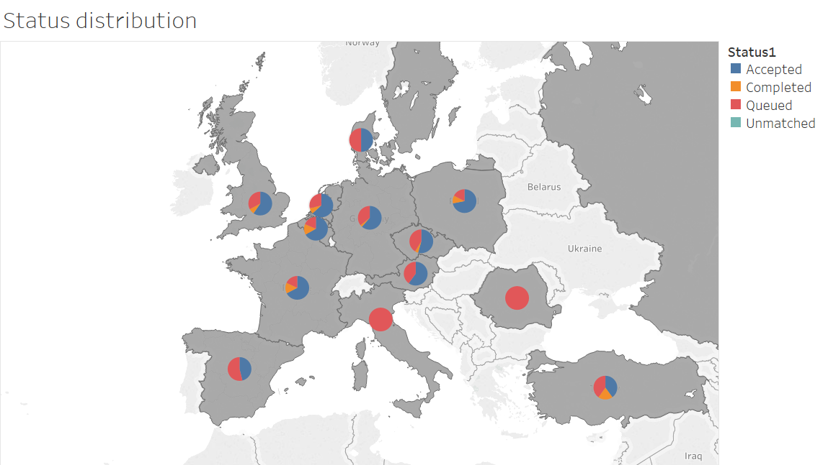

Slide 6
