Slide 1
Visualization analysis on performance of international cooperation
A business intelligence approach on the Volvo IT Incident Management Process

Slide 2
Paper structure
Abstract
Introduction
Literature review
Data
The finding/phenomenon
Ruling out impact factor
Business nature of different countries
Robustness testing (prove correctness)
Reference

Slide 3
Abstract
research interests: using business intelligence approach to explore how level of international cooperation would affect performance
methodology used: with the aid of data visualization, identify impact factors behind the phenomenon
Summaries of findings & implication: level of internationalization is the primary impact factor, and some implication on business type or characteristic of different country (detailed work on how to quantify is left for future work)

Slide 4
Introduction
Address importance: why study international cooperation, purpose indicators such as “efficiency” and its definition
The business intelligence process: general speak about how we rule out potential variable, the logic of deriving final conclusion; country analysis (big 8 countries) and some qualitative results about country performance (“level of domestic”)
Contributions: more intuitive analysis with visualization (methodology), practical for general business analysis; demonstrate that international cooperation has impacts on “efficiency” and give insights about how to quantify “style” of different countries

Slide 5
Literature review
Previous work on international cooperation and how does that affect overall performance
Brief summarization of focuses of previous work
How is our focus different/how can we shed light on this field
Previous understanding/application of business intelligence

Slide 6
Data
General introduction of the data: origin, background, some explanations on dimensions (which dimensions are not useful)
Give general some visualizations on data (see report on 0220)
Some correlation with annual report (the demography of employees, numbers corresponding to the figure provided on annual report, see report on 0114)

Slide 7
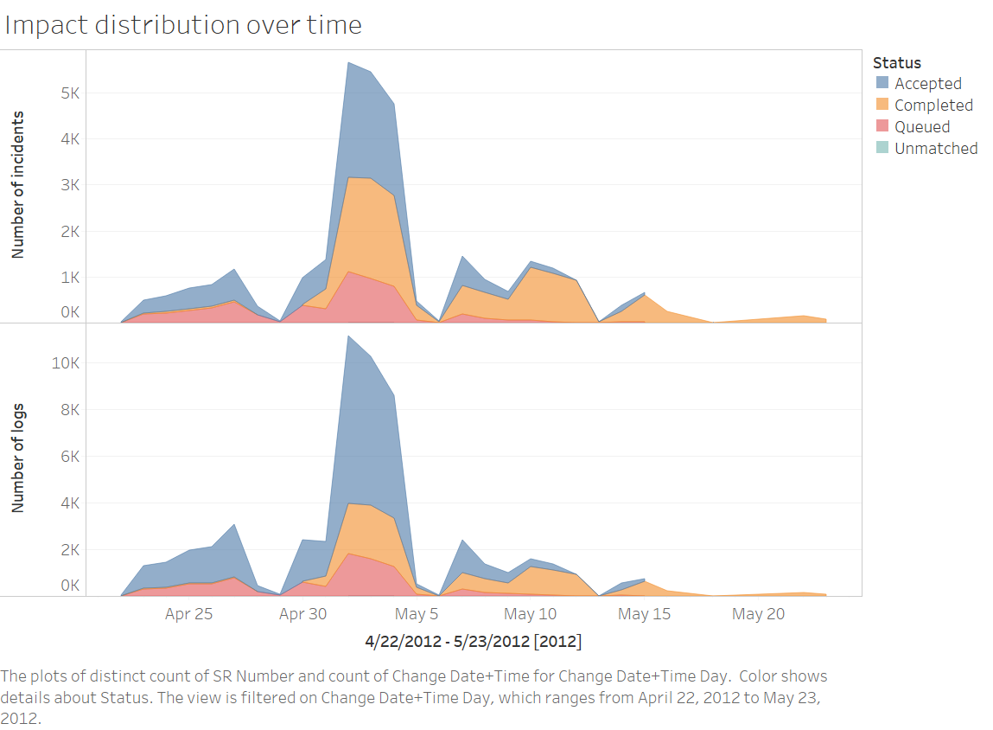

Slide 8
The finding/phenomenon
General trend: with the increase of participants in one product, the higher internationalized one has higher efficiency (see viz)
In practice, there is too few low internationalized products with enough participants, see overall low internationalized products have better “efficiency” (see viz)

Slide 9
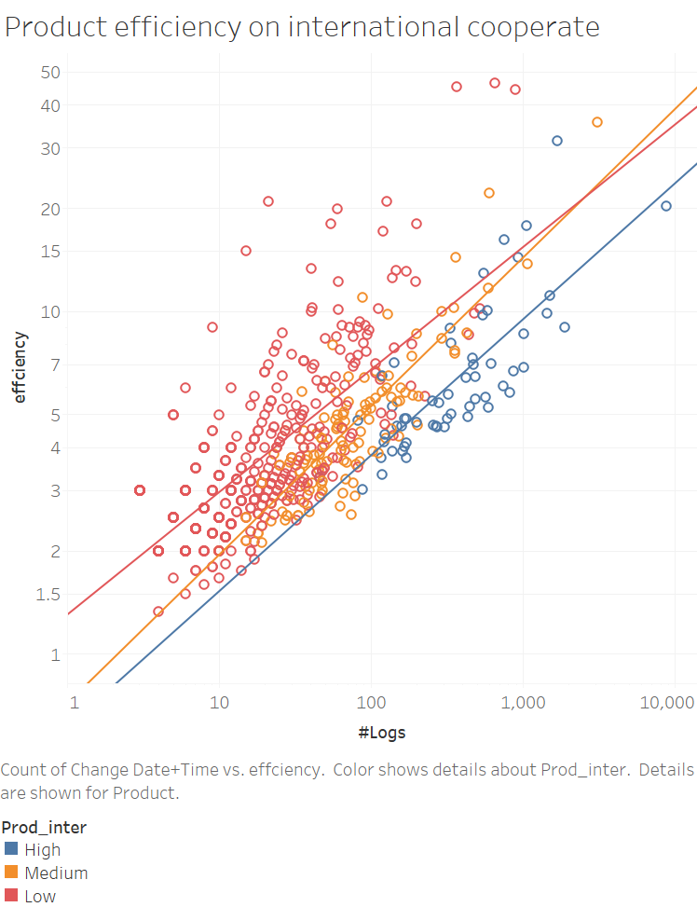
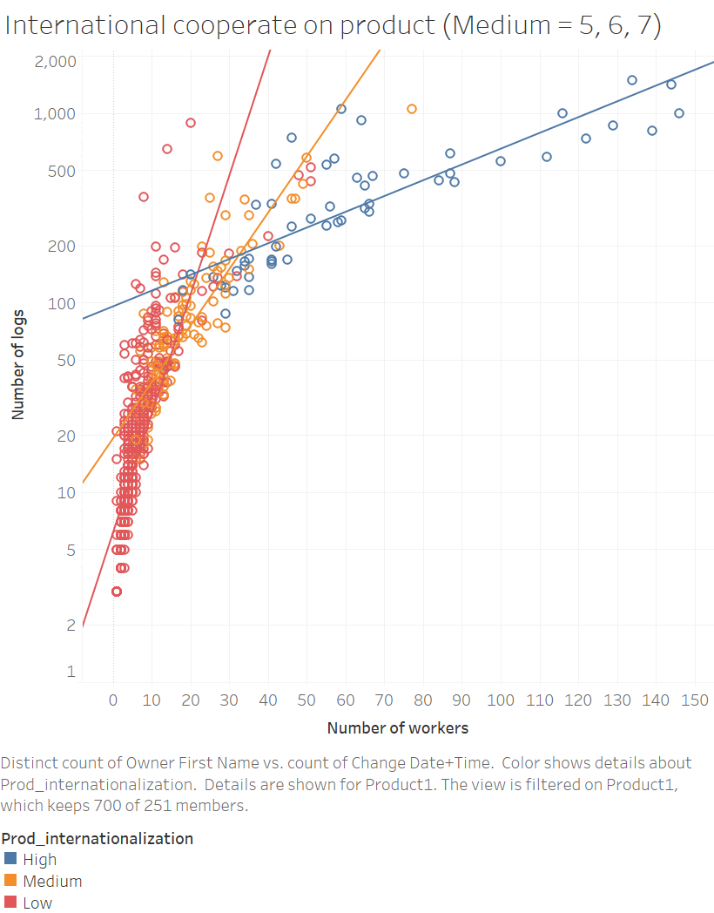

Slide 10
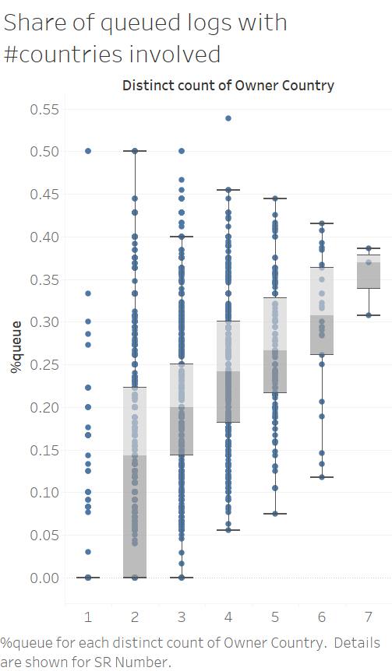
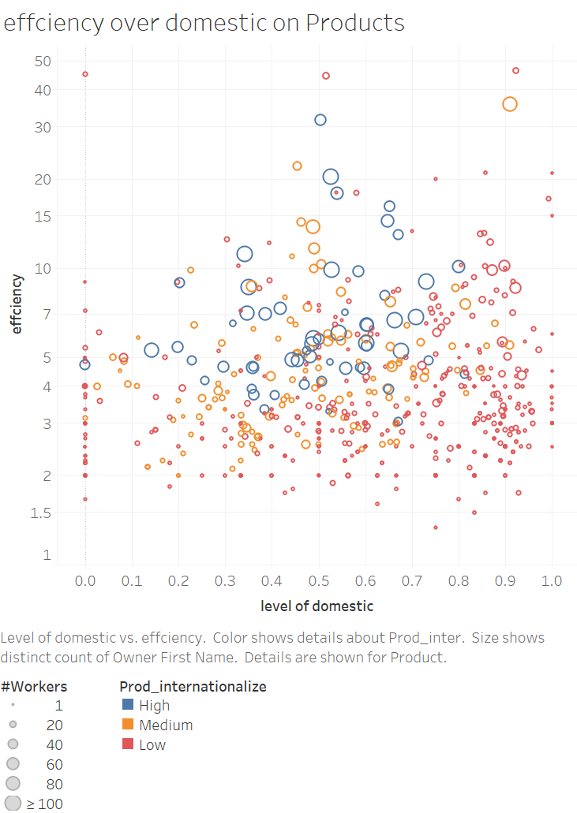

Slide 11
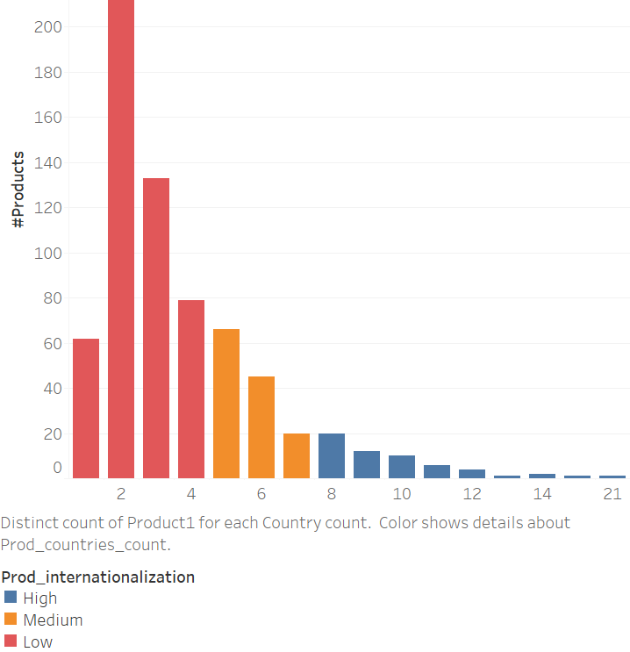
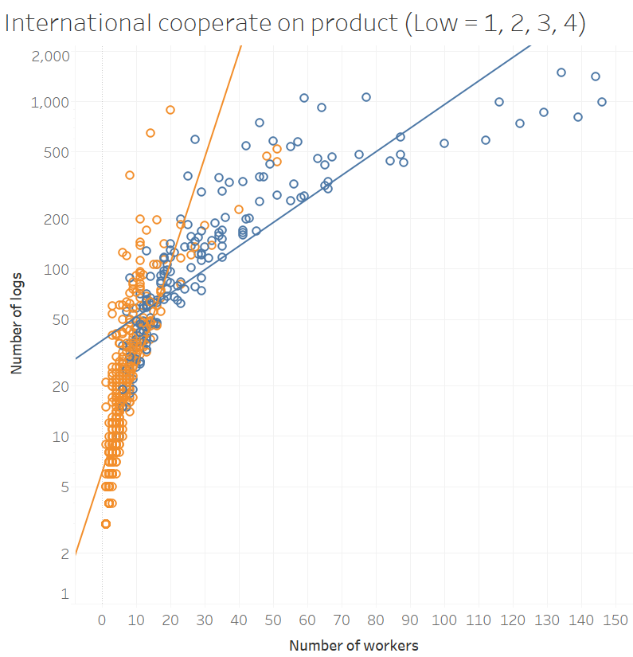

Slide 12
Ruling out impact factor
SR Impact (NO)
Incident per employee (NO)
Employees per ST (NO)
Incident per ST (NO)
Employees’ efficiency (NO)
ST’s efficiency (NO)

Slide 13
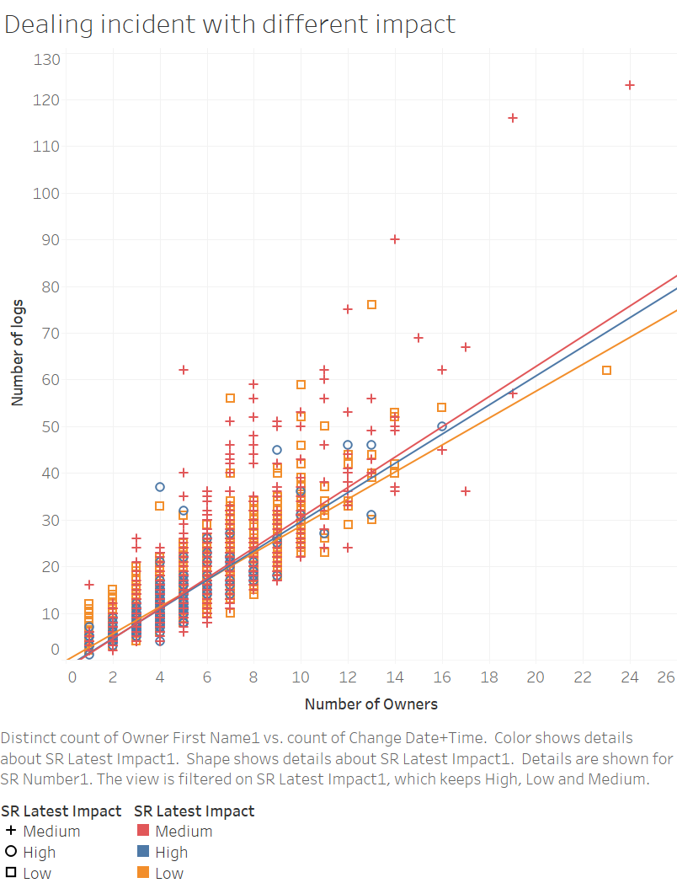
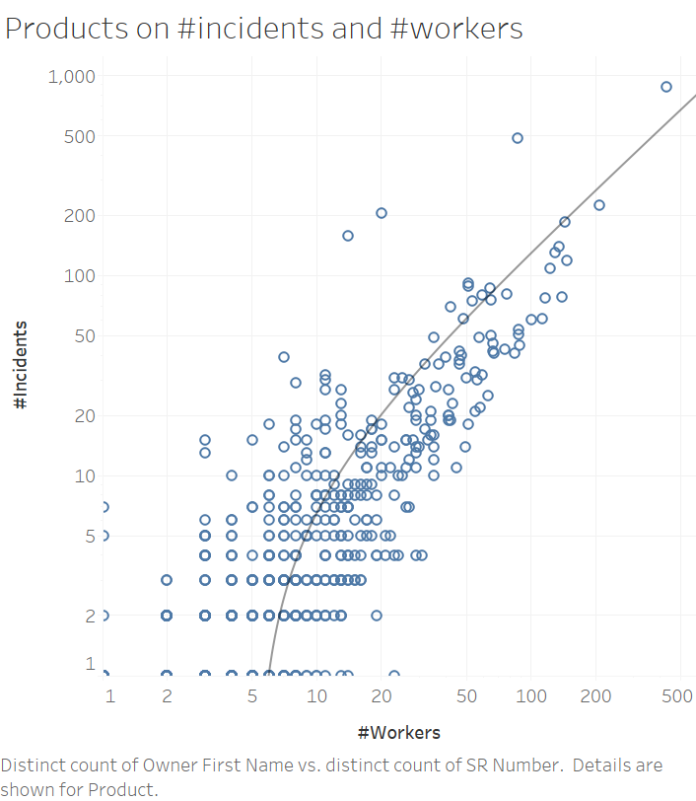

Slide 14
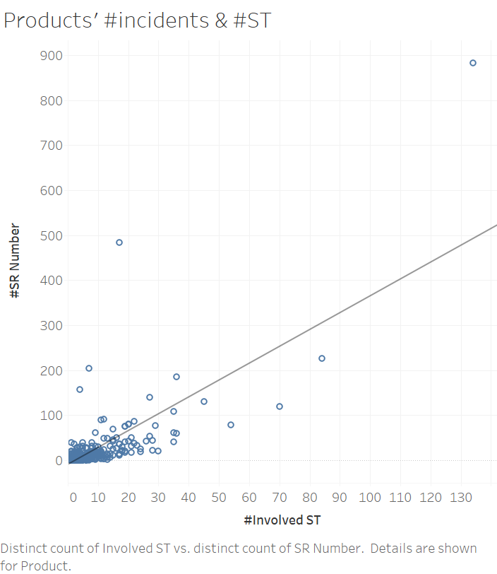
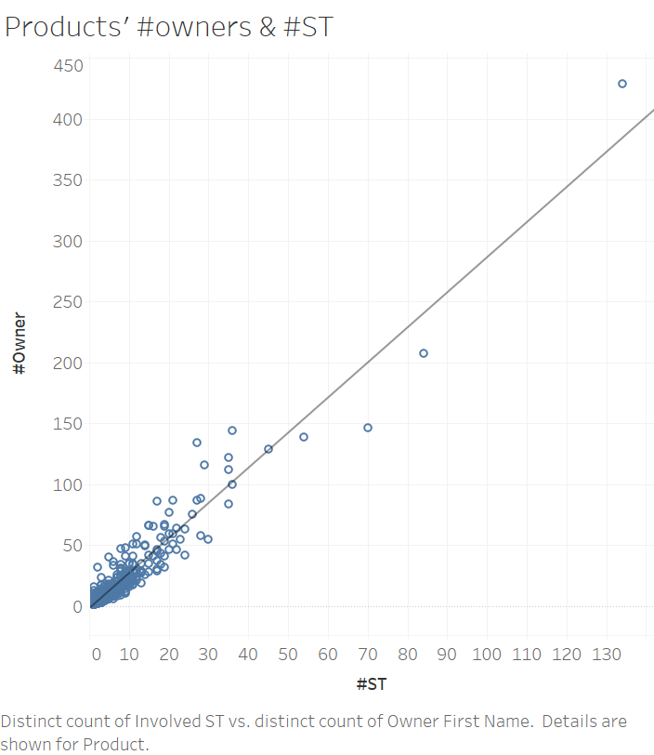

Slide 15
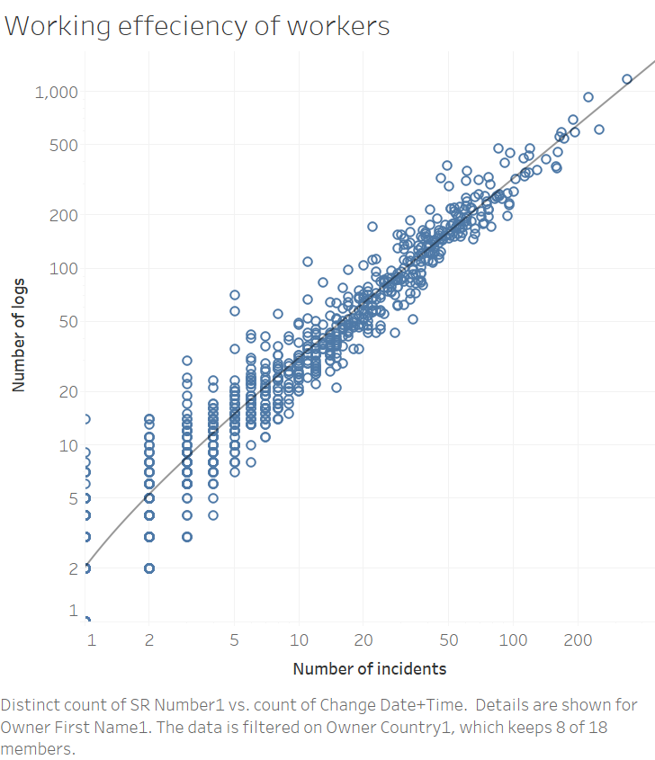
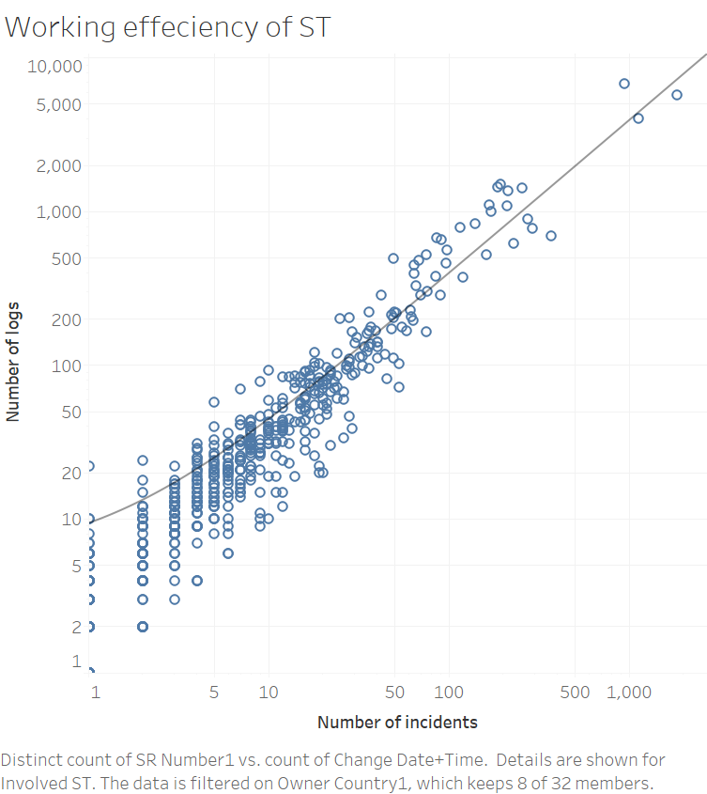

Slide 16
Business nature of different countries
The level of internationalization is true impact factor, but this impact factor is too rough. So it is worthy to study how to visualize performance of different countries.
Big 8 reasoning
General graphs (Poland exception)
Detailed graphs (external resources on business nature of Volvo in different country)

Slide 17
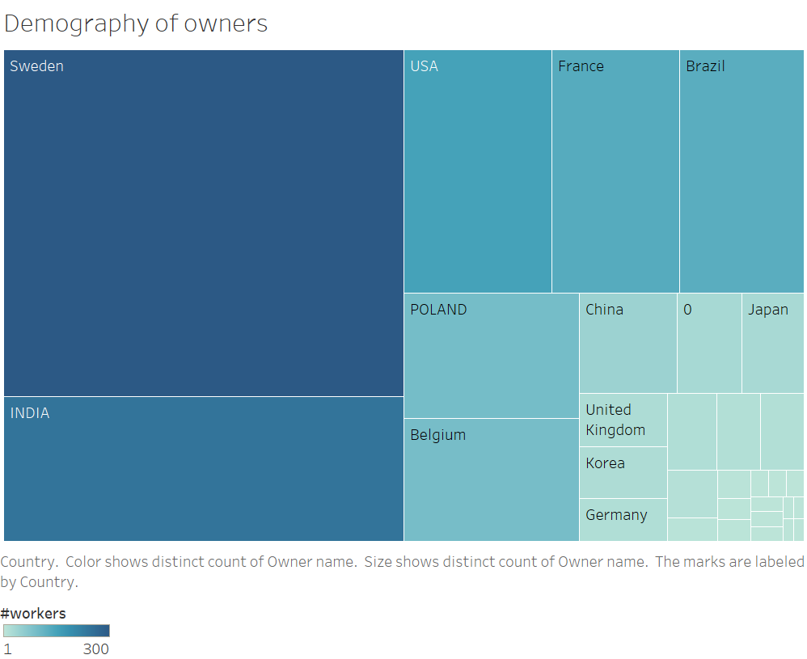

Slide 18
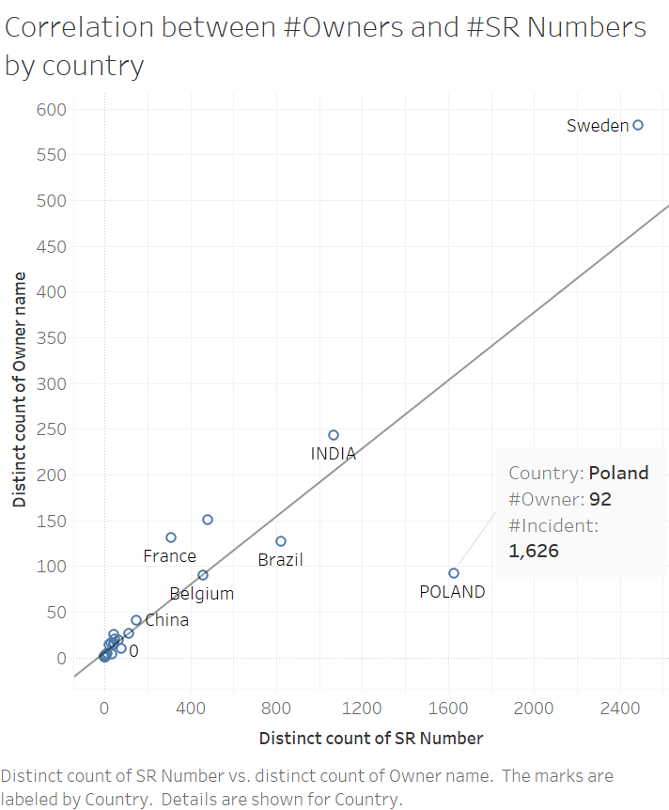
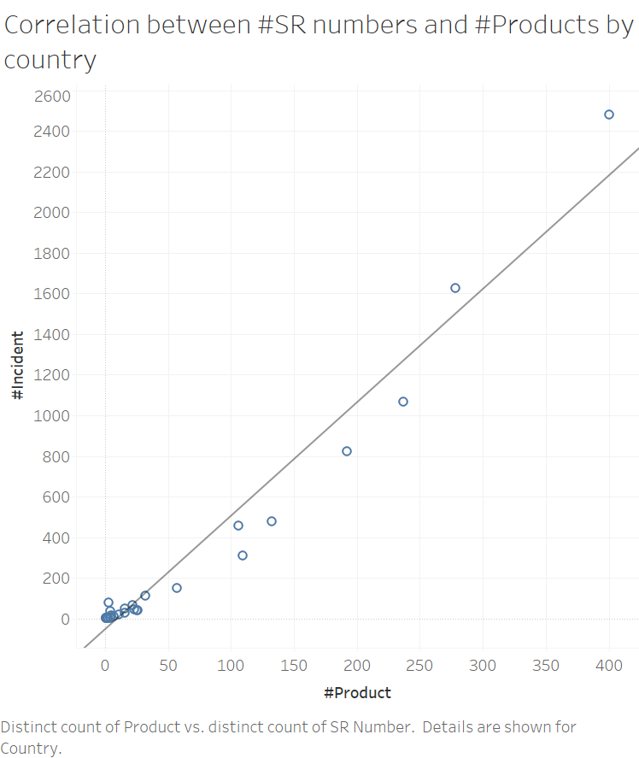

Slide 19
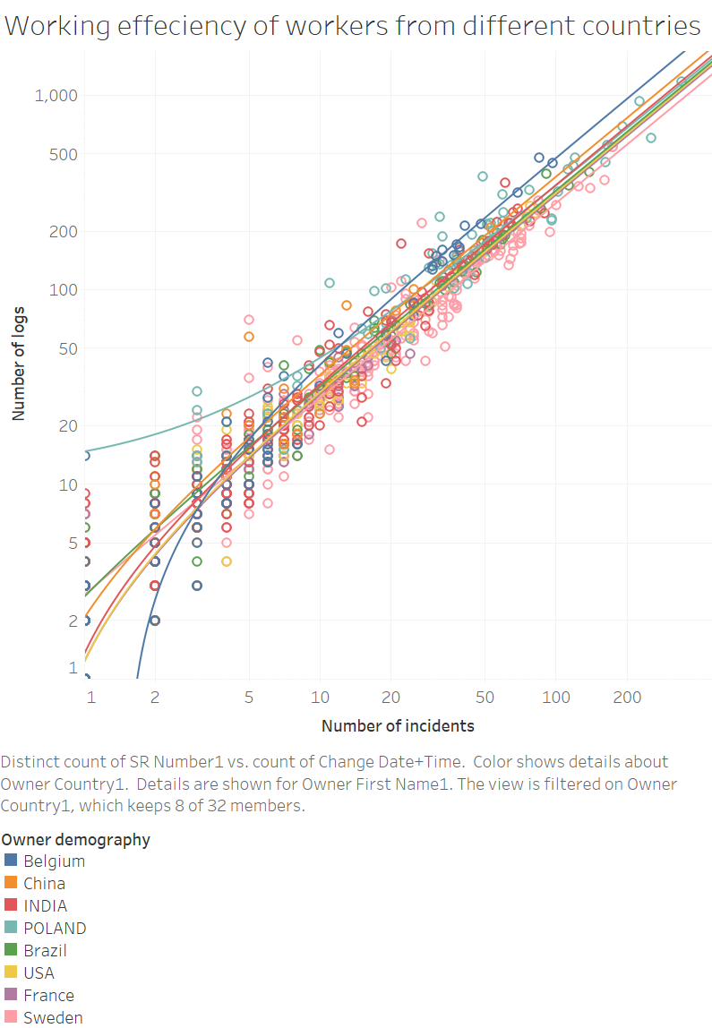
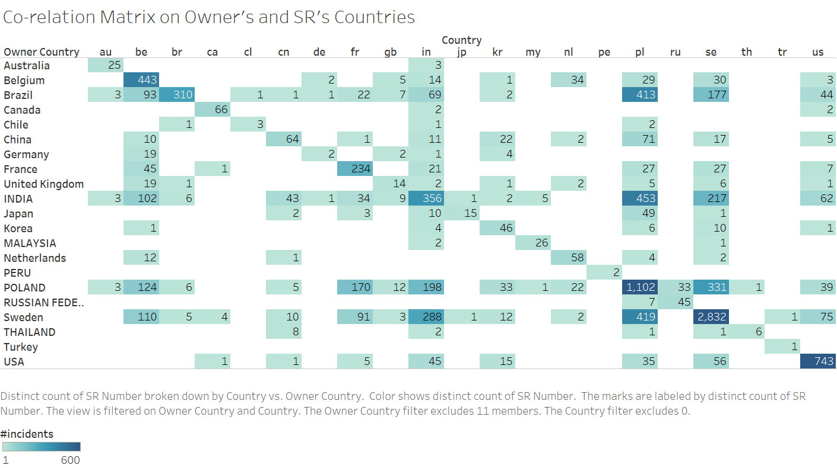

Slide 20
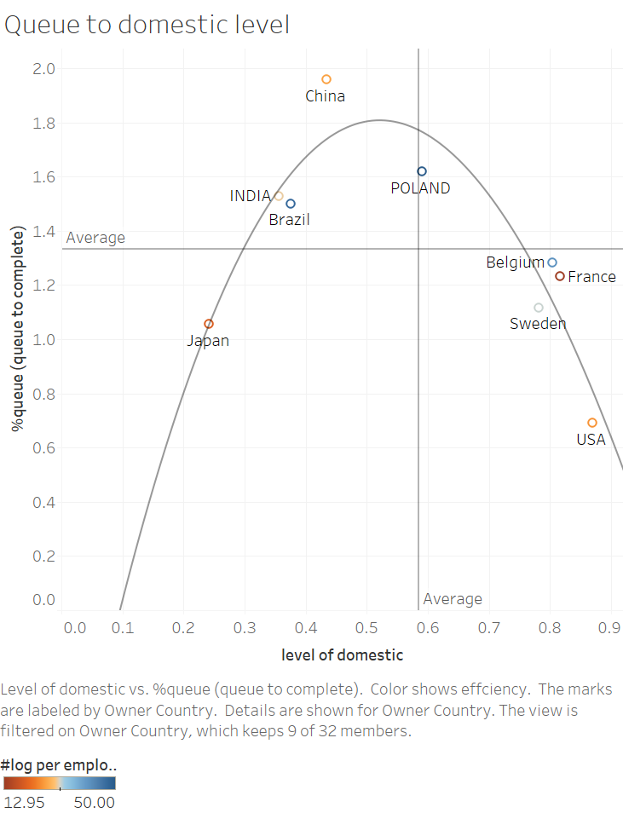
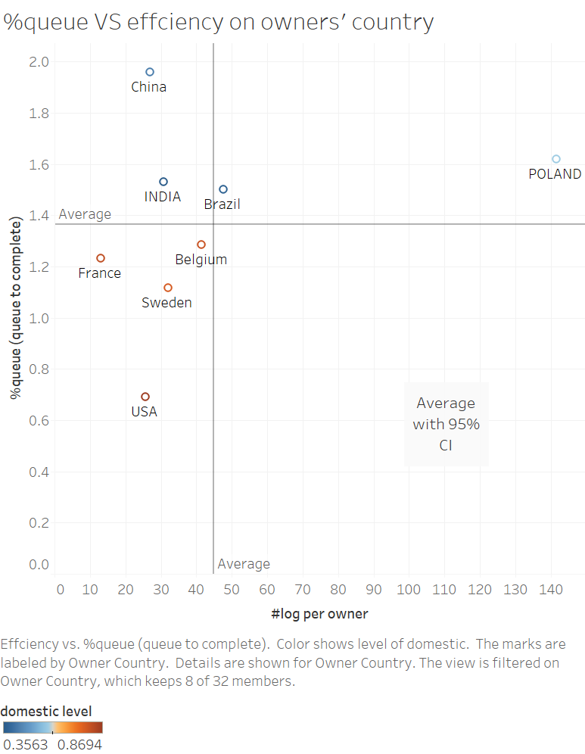

Slide 21
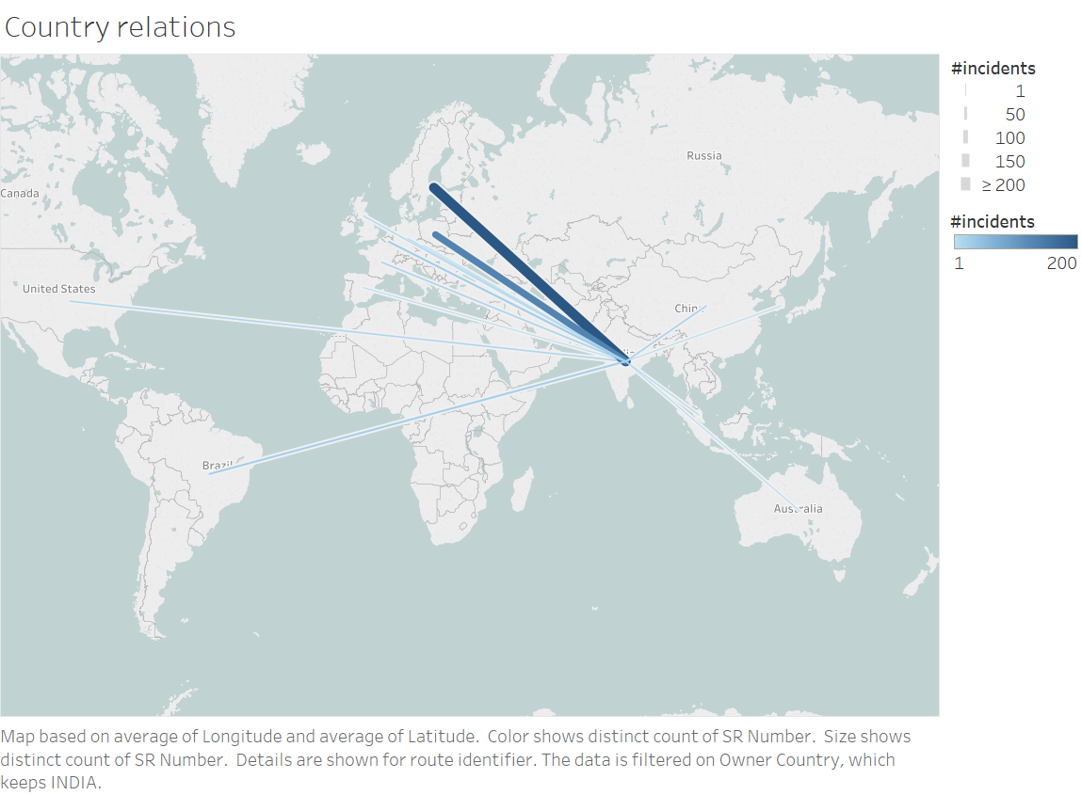

Slide 22
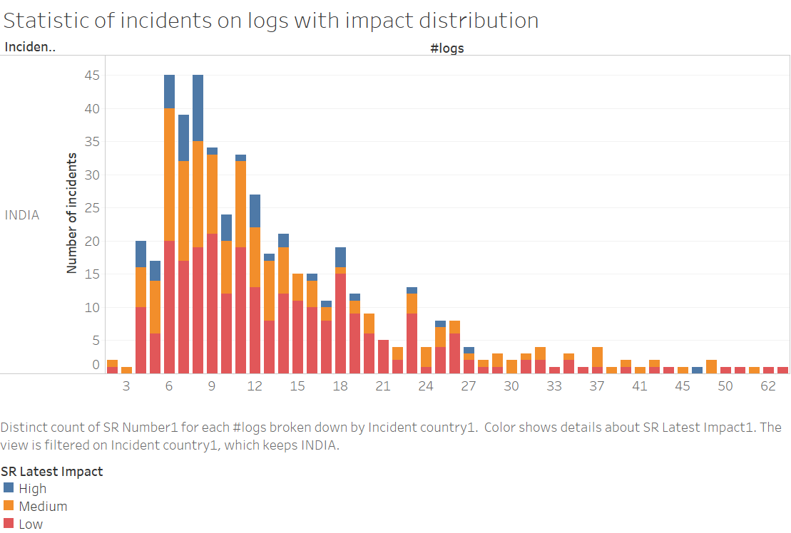

Slide 23
Robustness testing (prove correctness)
Test against variable purposed on “Ruling out impact factor”
Test against additional variable, such as time
This part will prove the correctness of our methodology

Slide 24
Conclusion/discussion and future work
More work can be done on how to visualize the performance of a company, what indicator can be used to quantify

Slide 25
Reference
Papers on international cooperation (general)
Papers on handoffs (incident flow in detail)
Papers on visualization (Node link, scatter graph)
Reference on Volvo, the company (annual report)
Tableau tech support, the documentation

