Slide 1
Visualization analysis on performance of international cooperation
A business intelligence approach on the Volvo IT Incident Management Process

Slide 2
Paper structure
Abstract
Introduction
Literature review
Data
The finding/phenomenon
Testing impact factor
Business nature of different countries
Robustness testing (prove correctness)
Reference

Slide 3
Methodology flow
Give out phenomenon analysis from visualization (the international cooperation have good trend in improving efficiency with increasing number of employees participated in, but bad in reality as many products do not have that many employees participated)
Examine potential impact factors. Analyze them with the aid of appropriate visualization and giving out some remarks.
Extend the study on the country’s role in international cooperation, to see which country has strange behavior. Try to analysis this phenomenon with external resources (annual reports) and aid of visualization on dataset.

Slide 4
Abstract
research interests: using business intelligence approach to explore how level of international cooperation would affect performance
methodology used: with the aid of data visualization, identify impact factors behind the phenomenon
Summaries of findings & implication: level of internationalization is the primary impact factor, and some implication on business type or characteristic of different country (detailed work on how to quantify is left for future work)

Slide 5
Introduction
Address importance: why study international cooperation, purpose indicators such as “efficiency” and its definition
The business intelligence process: general speak about how we rule out potential variable, the logic of deriving final conclusion; country analysis (big 8 countries) and some qualitative results about country performance (“level of domestic”)
Contributions: more intuitive analysis with visualization (methodology), practical for general business analysis; demonstrate that international cooperation has impacts on “efficiency” and give insights about how to quantify “style” of different countries

Slide 6
Literature review
Previous work on international cooperation and how does that affect overall performance
Brief summarization of focuses of previous work
How is our focus different/how can we shed light on this field
Previous understanding/application of business intelligence

Slide 7
Data
General introduction of the data: origin, background, some explanations on dimensions (which dimensions are not useful)
The usage (which column to drop)
Give general some visualizations on data
Some correlation with annual report

Slide 8
The finding/phenomenon
General trend: with the increase of participants in one product, the higher internationalized one has higher efficiency (see viz)
In practice, there is too few low internationalized products with enough participants, see overall low internationalized products have better “efficiency” (see viz)

Slide 9
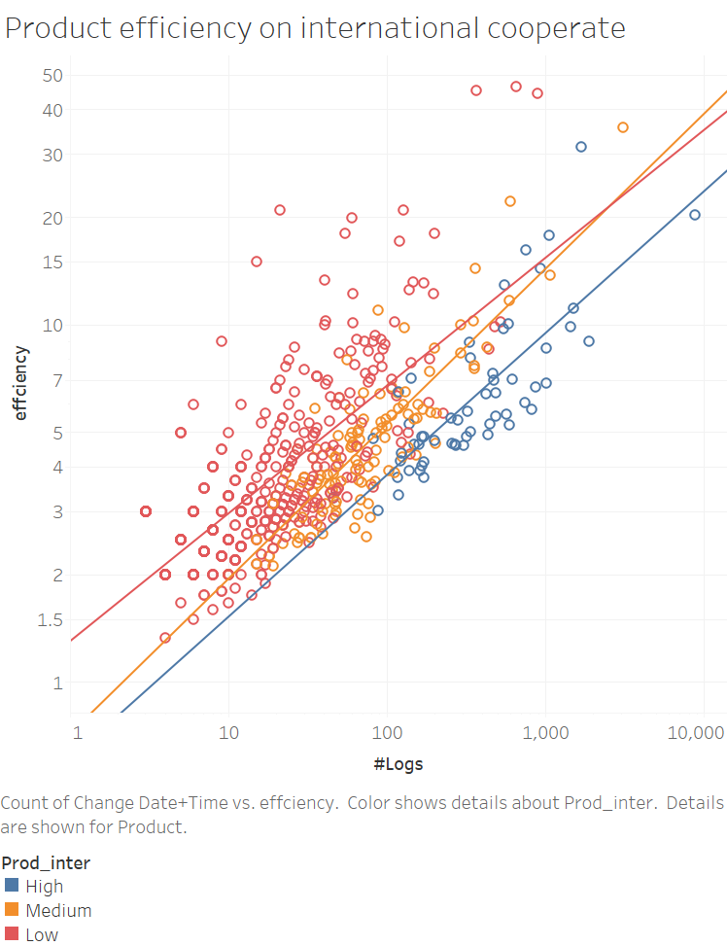
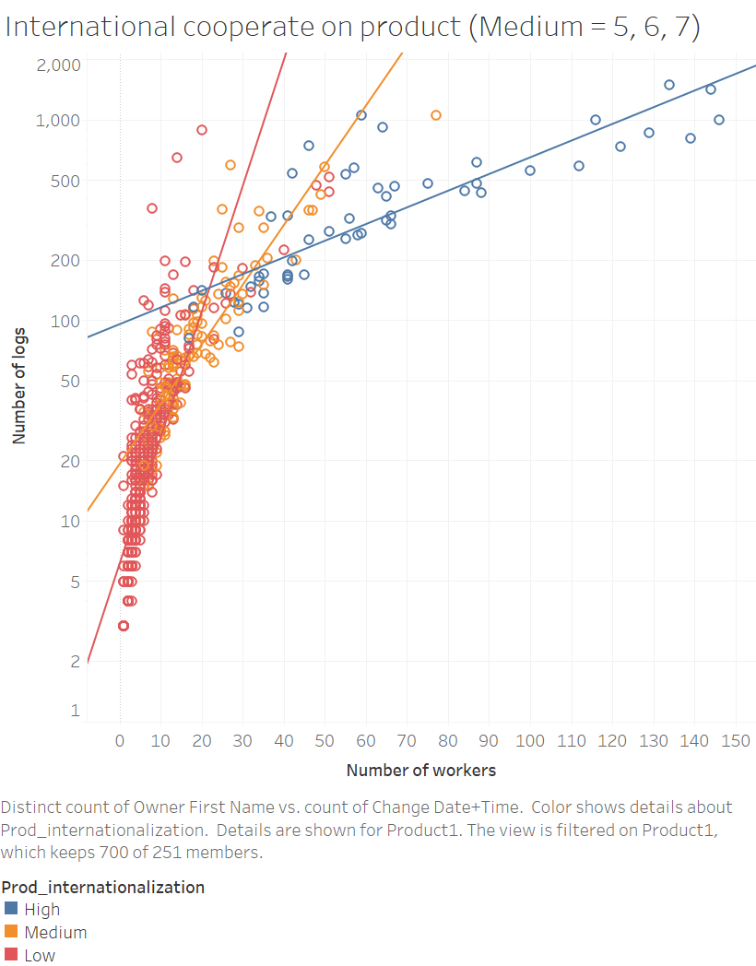

Slide 10
Testing impact factor (various visualizations)
SR Impact
Incident per employee
Employees per ST
Incident per ST
Employees’ efficiency
ST’s efficiency

Slide 11
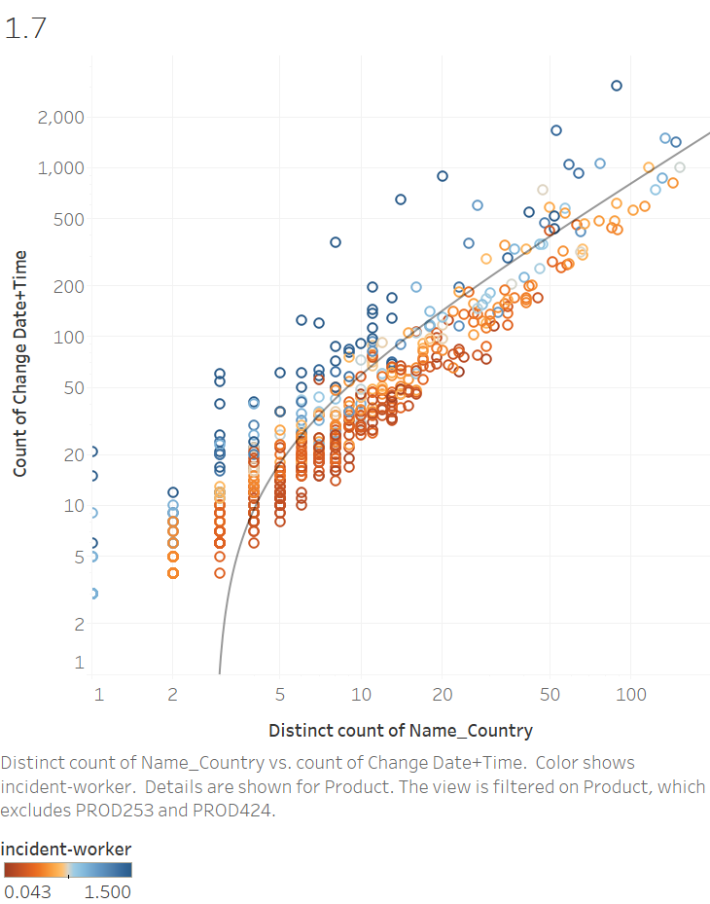

Slide 12
Business nature of different countries
The level of internationalization is true impact factor, but this impact factor is too rough. So it is worthy to study how to visualize performance of different countries in the cooperation.
Graphs on top 8 countries with most employees
General graphs (Poland exception)
Detailed graphs (external resources on business nature of Volvo in different country)

Slide 13
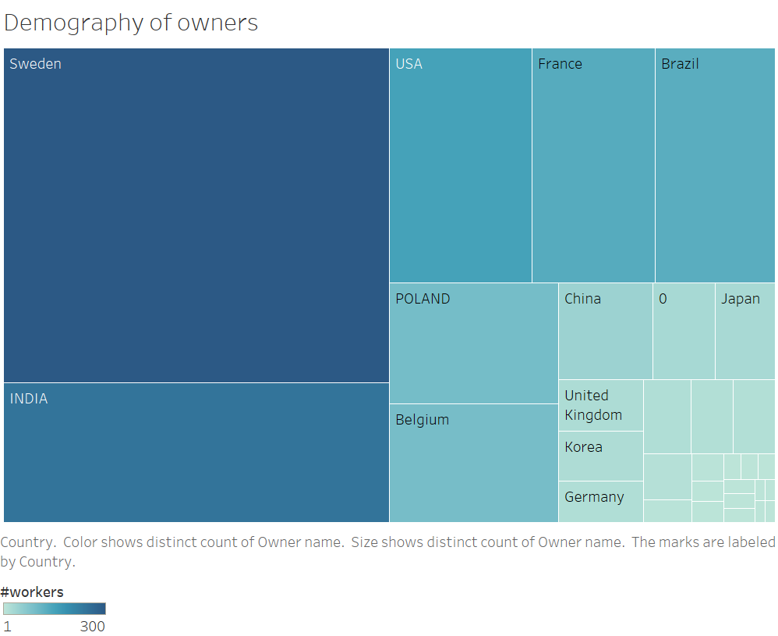

Slide 14
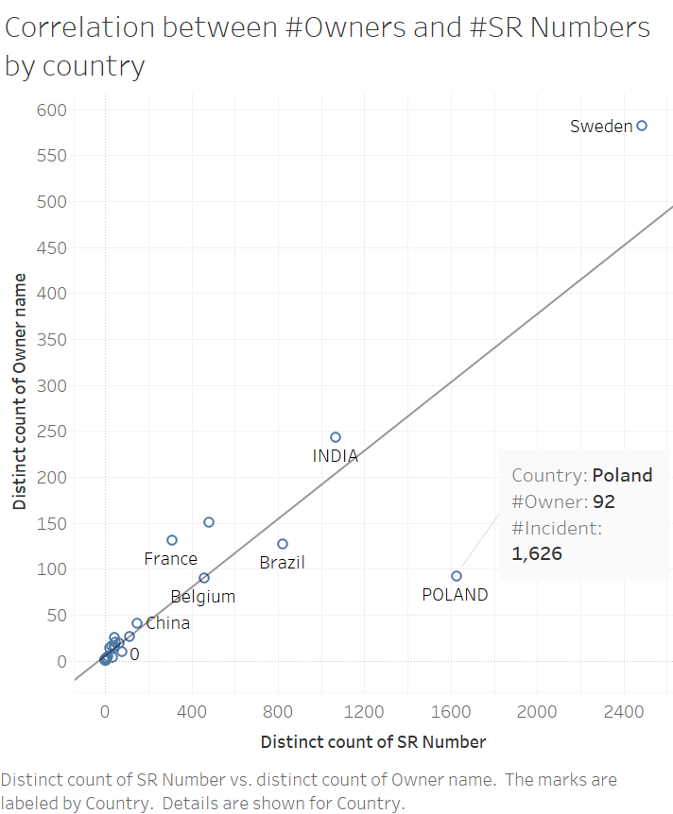
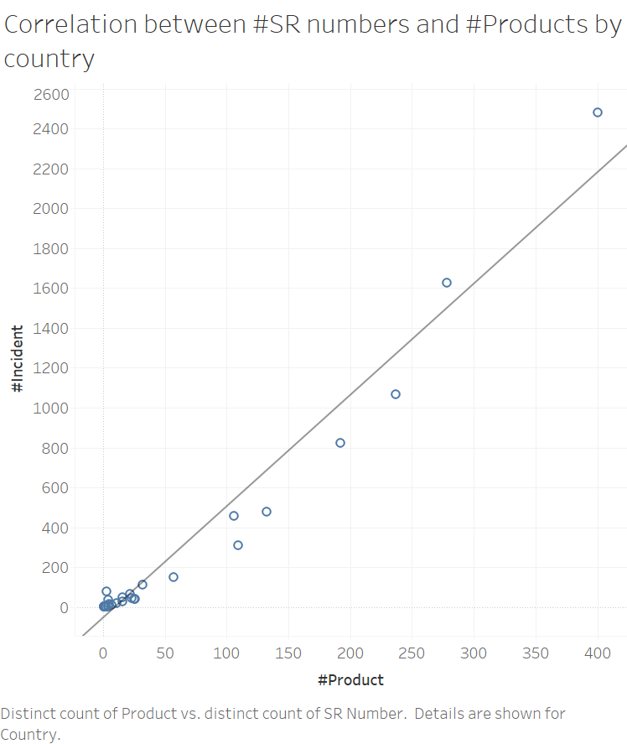

Slide 15
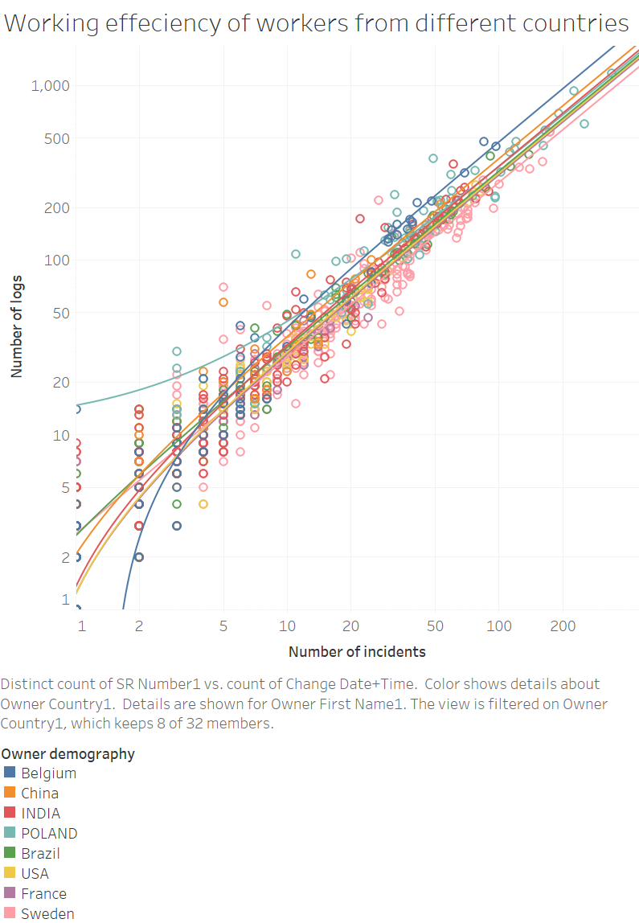
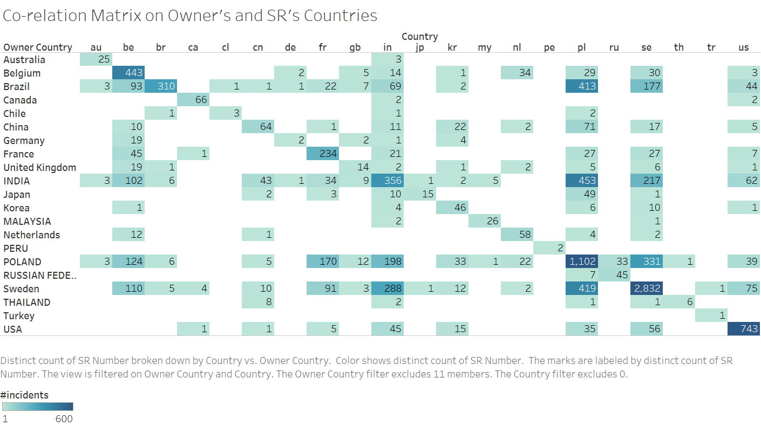

Slide 16
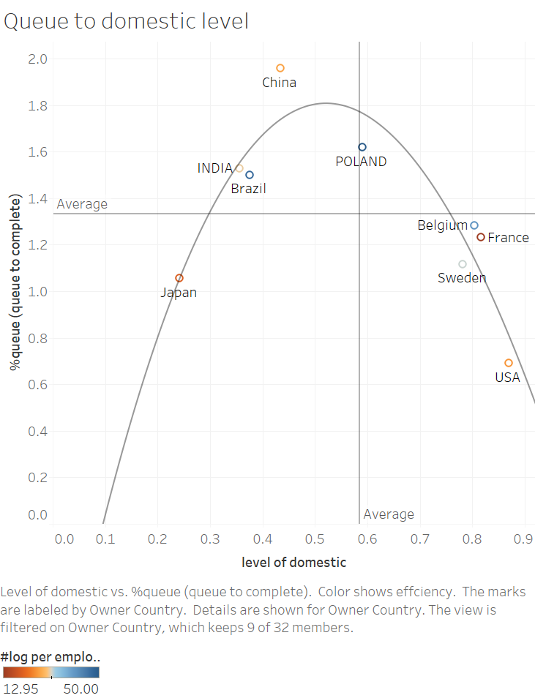
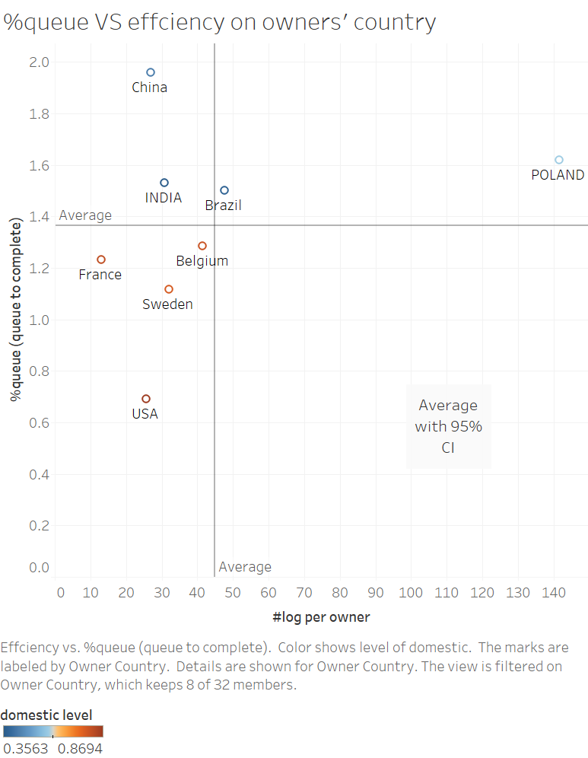

Slide 17
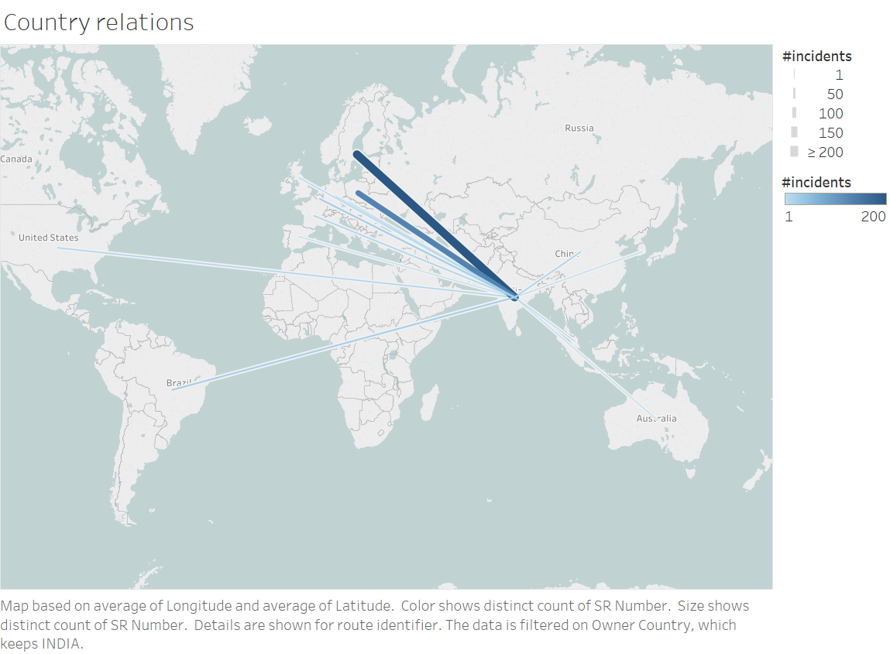

Slide 18
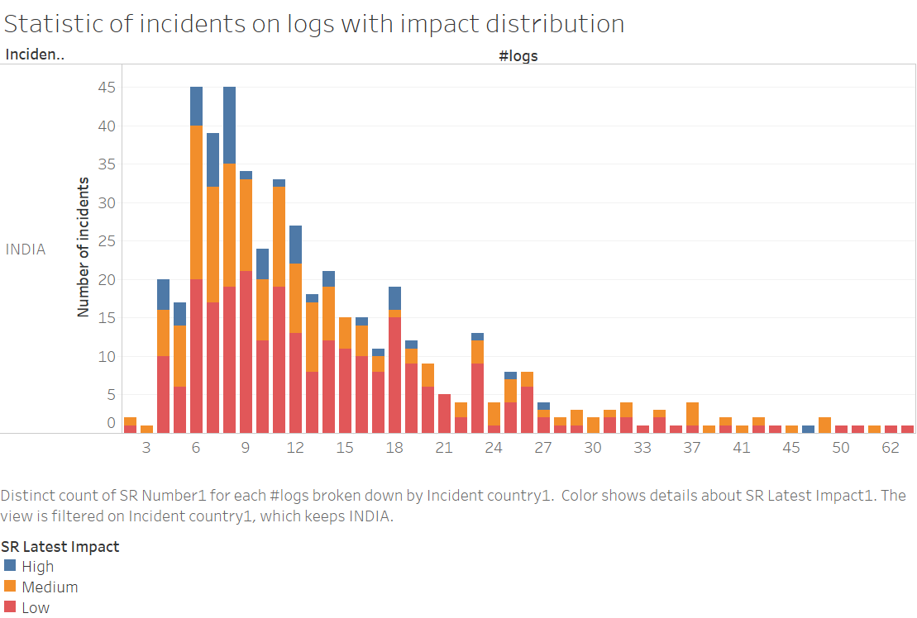

Slide 19
Robustness testing (prove correctness)
Test against variable purposed on “Ruling out impact factor”
Test against additional variable, such as time
This part will prove the correctness of our methodology

Slide 20
Conclusion/discussion and future work
More work can be done on how to visualize the performance of a company, what indicator can be used to quantify

Slide 21
Reference
Papers on international cooperation (general)
Papers on handoffs (incident flow in detail)
Papers on visualization (Node link, scatter graph)
Reference on Volvo, the company (annual report)
Tableau tech support, the documentation

