Slide 1

Unsupervised Learning

Slide 2



Supervised Learning
Data with correct answers
model
New Data without answers
Predicted answers
model

Slide 3

Unsupervised Learning
Unlabeled Data (no answers)
structure
Making a map to better understand data

Slide 4
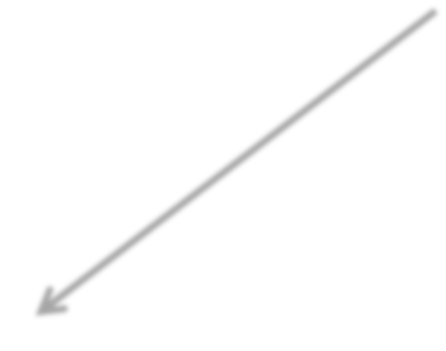
Unsupervised Learning
Unlabeled Data (no answers)
structure
New Unlabeled Data
Place of new data in the structure
Supervised model
Notes:
We as humans can group points, then figure out the best label. Then, we have a training set!

Slide 5

Classification: model with category labels
Color, shape, weight, sweetness, sourness for a bunch of apples, bananas & peaches
model
Predict apple, banana or peach
Color, shape, weight,
sweetness, sourness (without fruit type)
model

Slide 6

Clustering: Finding separate groups in data
Identify diﬀerent fruits (still don’t know what each group is)
Color, shape, weight, sweetness, sourness for a bunch of alien fruits
Notes:
We do this heuristically as humans for plants and animals, until we can sequence DNA

Slide 7
Finding units with similar behavior
(friend groups, similar products, etc.)
Market segmentation
Understanding a complex system
(like purchases or friendships or ﬂows)
Finding meaningful categories for your items
Fewer classes for classification by grouping
(change the resolution of the problem)
Notes:
What metrics for performance?
Can you calculate accuracy?

Slide 8
Users of a web app
1 Feature: Age
Age

Slide 9
Users of a web app
1 Feature: Age
2 clusters
Age

Slide 10
Users of a web app
1 Feature: Age
3 clusters
Age

Slide 11
Users of a web app
1 Feature: Age
5 clusters
Age

Slide 12
Users of a web app
1 Feature: Age
5 clusters
No “correct” answer
Not one way to map the structure
Age

Slide 13
Users of a web app
1 Feature: Age
5 clusters
No “correct” answer
But there are better/worse maps within the same structure
Age

Slide 14
2 Features: Age, Income
2 clusters
Income

Slide 15
Features: Age, Income
3 clusters
Income

Slide 16
Features: Age, Income
clusters OR?
Income

Slide 17
2 Features: Age, Income
4 clusters
Income

Slide 18
2 Features: Age, Income
4 clusters OR?
Income

Slide 19
Supervised Learning
Income

Slide 20

Supervised Learning
Find decision boundary using labels
Income

Slide 21
Unsupervised Learning
Income

Slide 22
Unsupervised Learning
Find structure in unlabeled data
Income

Slide 23
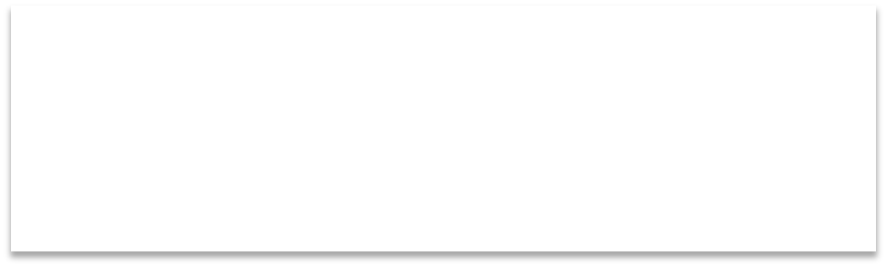


Unsupervised Learning
Find structure in unlabeled data
OK. HOW?
Income

Slide 24
K-Means algorithm
K=2 (ﬁnd 2 clusters)
Income

Slide 25
K-Means K=2
Randomly assign two cluster centers
Income

Slide 26
K-Means K=2
Each point belongs to closest center
Income

Slide 27
K-Means K=2
Move each center to the cluster’s mean
Income

Slide 28
K-Means K=2
Each point belongs to the closest center
Income

Slide 29
K-Means K=2
Move each center to the cluster’s mean
Income

Slide 30
K-Means K=2
Each point belongs to the closest center
Income

Slide 31
K-Means K=2
Move each center to the cluster’s mean
Income

Slide 32
K-Means K=2
Points don’t change anymore.
Converged!
Income

Slide 33
K-Means K=3
Result:
Income

Slide 34
K-Means K=3
Depending on random initial assignment, results can diﬀer.
Income

Slide 35
K-Means K=3
Depending on random initial assignment, results can diﬀer.
Income

Slide 36
Users of a web app
1 Feature: Age
5 clusters
No “correct” answer
But there are better/worse maps within the same structure
Age

Slide 37
Some maps are better than others: Let’s ﬁnd a score for each
Income

Slide 38
Inertia: sum of square distances in each cluster (low inertia = high density)
Income

Slide 39
Initiate at random a bunch of times,
Take the clustering with the best score!
Income

Slide 40
Inertia = 12.645
Income

Slide 41
Inertia = 12.943
Income

Slide 42
Inertia = 13.112
Income

Slide 43
Inertia = 12.645 ← MIN
Income

Slide 44
With higher dimensions, I may have to try a lot! Smarter way to initialize?
Income

Slide 45
K-means++
Income

Slide 46
K-means++
Pick one point at random as initial point
Income

Slide 47
K-means++
Pick next point with prob increasing with distance² to ﬁrst point
Income

Slide 48
K-means++
Pick next point with prob increasing with distance² to the others
Income

Slide 49
K-means++
Pick next point with prob increasing with distance² to the others
Income

Slide 50
K-means++
Now proceed with regular K-means
Income

Slide 51
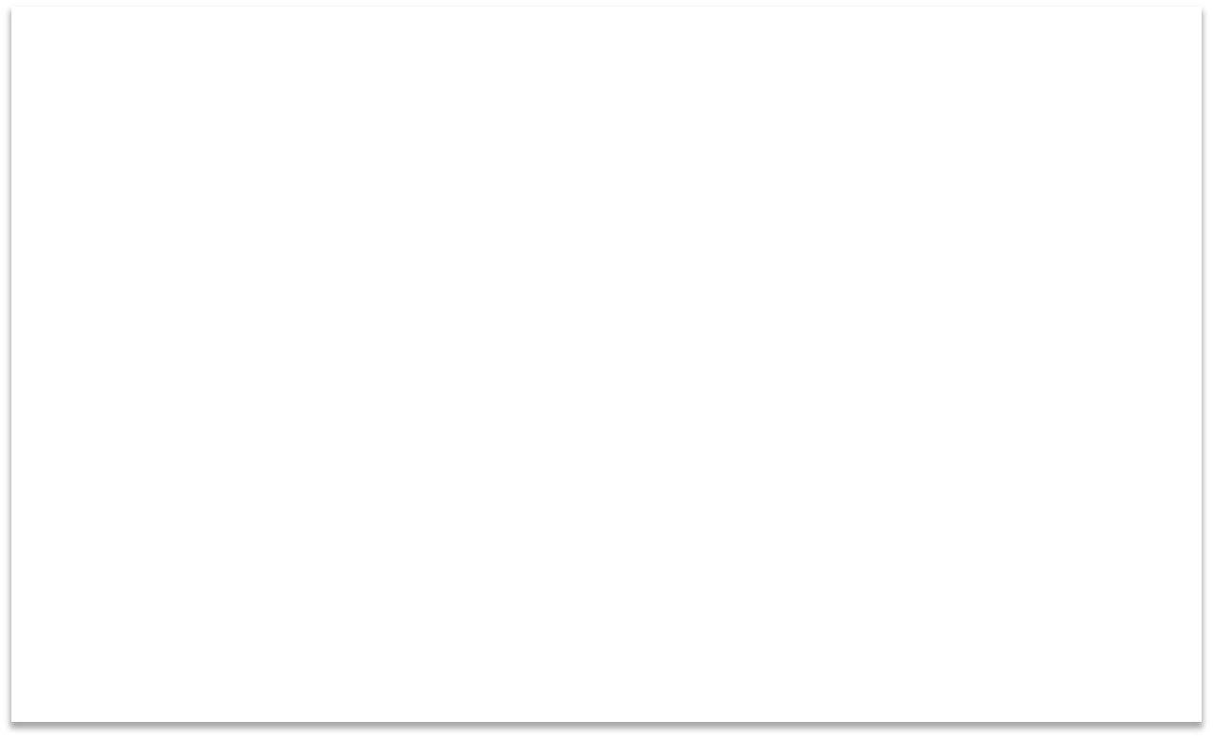

K-means++
Now proceed with regular K-means
Great. How
will I know
Income
what K to use?

Slide 52
Sometimes the question has a K
I have 4 CPU cores. I need to cluster similar jobs so I can send each group to one CPU (K=4)

Slide 53
Sometimes the question has a K
I have 4 CPU cores. I need to cluster similar jobs so I can send each group to one CPU (K=4)
We want to make jeans that can cover many diﬀerent body shapes. We took a lot of measurements. Come up with 10 diﬀerent sizes to cover most people (K=10)

Slide 54
Sometimes the question has a K
I have 4 CPU cores. I need to cluster similar jobs so I can send each group to one CPU (K=4)
We want to make jeans that can cover many diﬀerent body shapes. We took a lot of measurements. Come up with 10 diﬀerent sizes to cover most people (K=10)
I want to build a navigation interface for browsing scientific papers. My design dictates dividing them into 20 disciplines (K=20)

Slide 55
Sometimes the question has a K
I have 4 CPU cores. I need to cluster similar jobs so I can send each group to one CPU (K=4)
We want to make jeans that can cover many diﬀerent body shapes. We took a lot of measurements. Come up with 10 diﬀerent sizes to cover most people (K=10)
I want to build a navigation interface for browsing scientific papers. My design dictates dividing them into 20 disciplines (K=20)
Yeah, I don’t really have that. :/

Slide 56





Our score: Inertia
Higher within-cluster density with higher K, inertia will go down
Inertia
1 2 3 4 5 6 7 8 9 10
K

Slide 57


Our score: Inertia
Higher within-cluster density with higher K, inertia will go down
Inertia
1
2
3
4
5
6
K
7
8
9
10

Slide 58





Our score: Inertia
Higher within-cluster density with higher K, inertia will go down
?
Inertia
1
2
3
4
5
6
K
7
8
9
10

Slide 59
For anything with distances,
scaling is very important!
sklearn.preprocessing.scale(X)

Slide 60
from sklearn.cluster import Kmeans
model = Kmeans.ﬁt(X) clusters = model.predict(X)
or…
clusters = Kmeans.ﬁt_predict(X)

