Slide 1
An Exploration in Minute by Minute Trading
Subramanian Iyer
Presentation template by SlidesCarnival
Notes:
Maybe mention future pipeline

Slide 2
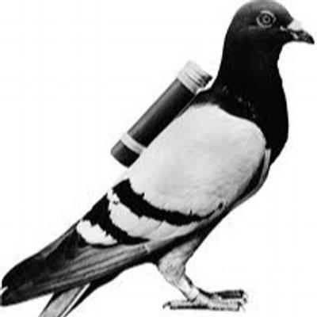
Brief History of High Frequency Trading (HFT)
1851 : Julius Reuter transitions from carrier pigeons to telegraph cables

Slide 3
Deutsche Börse Data
1 month (Feb 2018) of minute by minute trading data put in Amazon S3 Bucket
Kept data on the 10 most frequently traded Companies on the exchange
We have minute by minute data, so we’ll trade minute by minute

Slide 4
Companies
BASF SE (Chemicals)
Bayer AG (Pharmaceuticals)
E.ON SE (Energy)
BMW (Automotive)
SAP SE (Software)
Volkswagen (Automotive)
Allianze SE (Financial Services)
Deutsche Bank (Financial Services)
Diamler AG (Automotive)
Siemens (Conglomerate)

Slide 5
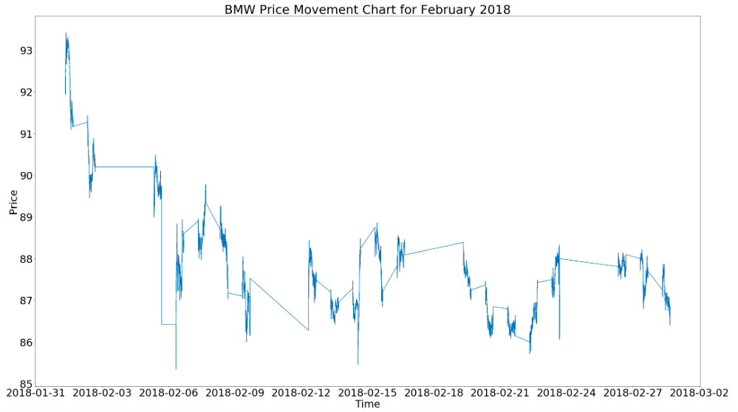

Slide 6
The Plan
Investment Decision
Input Data
Predictive Model
Notes:
Minute By Minute Classification
Mention Thresholds

Slide 7
Assumptions
-Can enter and exit positions without moving price
-Transaction Costs

Slide 8

Baseline
Average Annualized Movement:
-17.7%

Slide 9
Baseline Models
Random Forest Model:
Avg. Return of: -1.16% over 6
day test set
(-37.4% Annualized)
Logistic Regression Model:
Avg. Return of 0.41% over 6 day
test set
(17.7% Annualized)

Slide 10
Logistic Regression Investigation
Positive Returns On:
BASF SE
Bayer AG
E.ON SE
BMW
SAP SE
Allianze SE
Daimler AG
Negative Returns On:
Volkswagen
Deutsche Bank
Siemens

Slide 11

LSTM Neural Network
LSTM NN - Ideal for predicting time series data
1.4% average return over 6 day test set
(74% Annualized)

Slide 12
LSTM Neural Network
Positive Returns On:
BASF SE
Bayer AG
E.ON SE
BMW
SAP SE
Volkswagen
Allianze SE
Daimler AG
Siemens
Negative Returns On:
Deutsche Bank

Slide 13
Adding Transaction Costs
Tried LSTM again with spread of .2 cents
Tried predicting forward 10 minutes to trade less
With 10 minute look ahead period, 24.62% annualized return

Slide 14
Thank you.
Subramanian Iyer
riyersk@gmail.com

