Slide 1
Rock Climbing Route Recommender
Browning Gentry

Slide 2
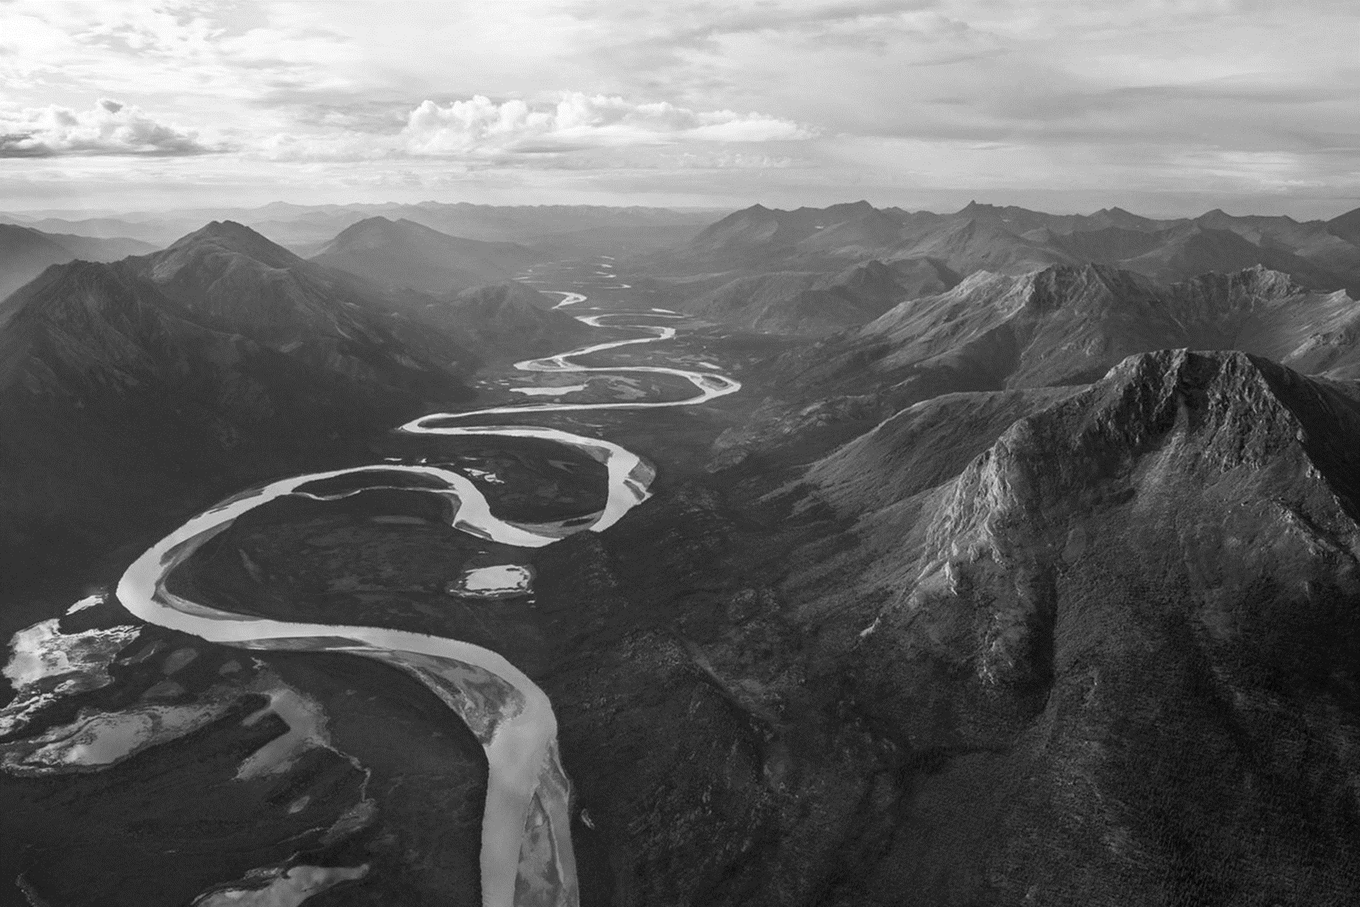
Recommendations
When climbing in a new area it is often difficult to identify which routes to attempt
Can we build a day of climbing personalized for the user?
Factors:
User’s Route History
Preferred Route Difficulty
Popularity
Climbing Style
Location
Amount of travel in day

Slide 3
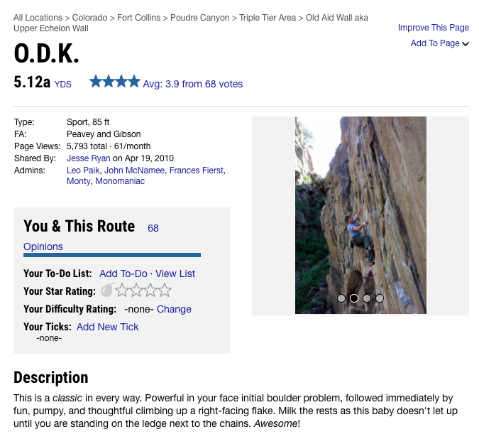
Data Source

Slide 4
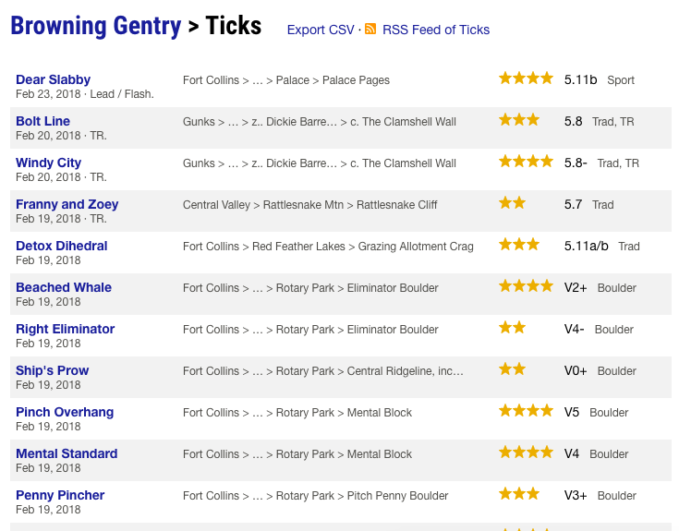
Data Source

Slide 5
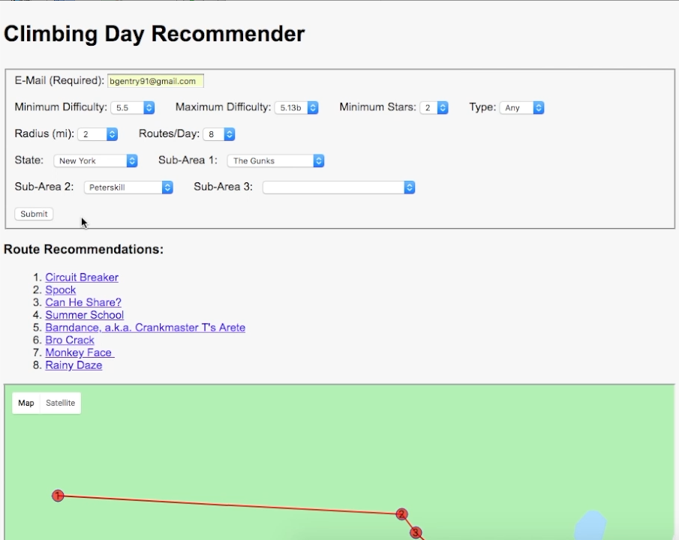
Demo

Slide 6
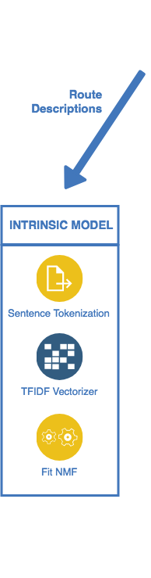
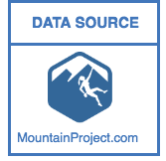
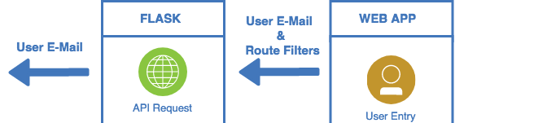
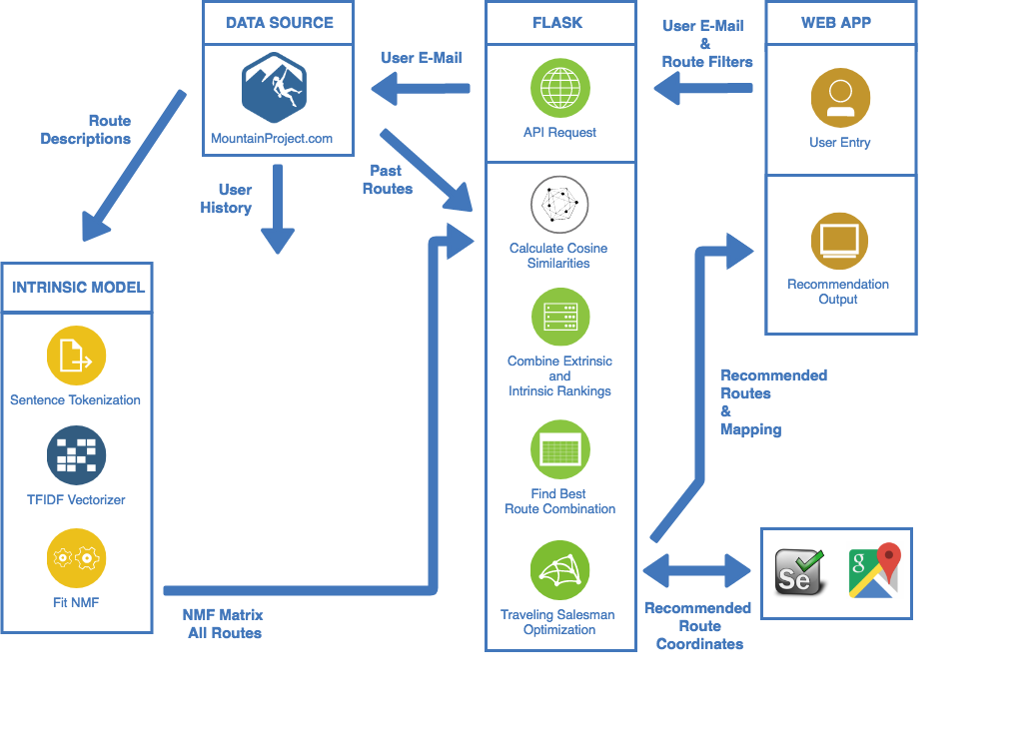
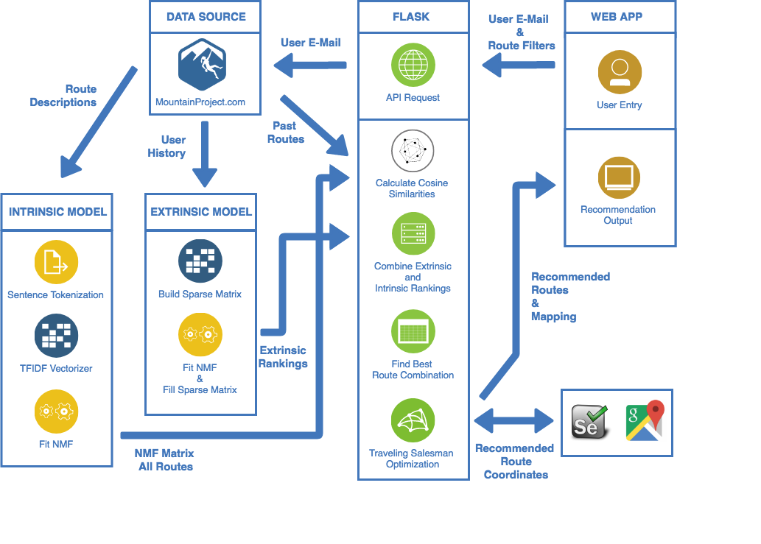
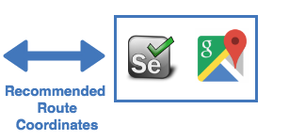
Web App Structure

Slide 7
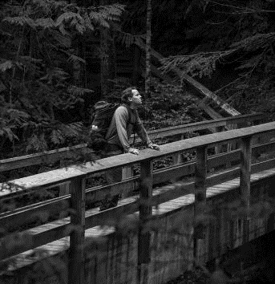
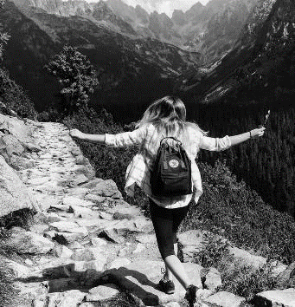
Next Steps
Import more user data to improve extrinsic model
Create slider for route popularity – vary weights of the extrinsic and intrinsic models
Include user ratings into extrinsic model
Questions?

Slide 8
Appendix – Intrinsic Model
Break each document (description) down into sentences
Vectorize each sentence (TFIDF)
NMF to topic model each sentence
 |  | Topic
Route | Sentence | 1 | 2 | 3 | …
1 | 1
1 | 2
1 | 3
2 | 1
2 | 2
... | ...

Slide 9
Appendix – Intrinsic Model
Bring in user data from Mountain Project to pare down “training” routes
User filters from web app to pare down potential routes
Build a matrix of cosine similarities between “training” routes and potential routes
Cosine Similarity Matrix |  |  | User Completed Routes
 |  | Route | A | A | B | …
Potential Routes | Route | Sentence | 1 | 2 | 1 | …
 | 1 | 1
 | 1 | 2
 | 1 | 3
 | 2 | 1
 | 2 | 2
 | ... | ...

Slide 10
Appendix – Intrinsic Model
Take top 5 similarities from each route combination
Mitigates issues with varying description lengths
Average these top similarities
Cosine Similarity Matrix |  |  | User Completed Routes
 |  | Route | A | A | B | …
Potential Routes | Route | Sentence | 1 | 2 | 1 | …
 | 1 | 1
 | 1 | 2
 | 1 | 3
 | 2 | 1
 | 2 | 2
 | ... | ...
Cosine Similarity Matrix |  |  | User Completed Routes
 |  | Route | A | A | B | …
Potential Routes | Route | Sentence | 1 | 2 | 1 | …
 | 1 | 1
 | 1 | 2
 | 1 | 3
 | 2 | 1
 | 2 | 2
 | ... | ...

Slide 11
Appendix – Intrinsic Model
Build new matrix with averaged route similarities
Sum each potential route over all user complete routes to get an overall score
Rank each potential route by score
 |  | User Completed Routes
 |  | A | B | …
Potential Routes | 1
 | 2
 | 3
 | 4
 | 5
 | ...
Total | Ranking
12 | 4
8 | 3
3 | 2
15 | 5
1 | 1
… | …

Slide 12
Appendix – Extrinsic Model
Import user completed routes from Mountain Project API
Create sparse matrix of users & routes
 |  | Users
 |  | 1 | 2 | 3 | …
Routes | A | 0 | 1 | 0
 | B | 0 | 0 | 0
 | C | 1 | 0 | 0
 | D | 0 | 0 | 0
 | E | 0 | 1 | 1
 | ...

Slide 13
Appendix – Extrinsic Model
NMF to output Routes by Topics (probabilities) and Users by Routes (components) matrices
Take the dot product of these two matrices to create “dense” version of sparse matrix
 | Topics
Routes
 | Users
Topics
 | Users
Routes

Slide 14
Appendix – Extrinsic Model
Filter down new dense matrix by same potential routes as in extrinsic model
Select given from web app
Rank each potential route for each user
 |  | Users
 |  | 1
Potential Routes | A
 | B
 | D
 | F
 | K
 | ...
Rank
5
1
3
2
4
…

Slide 15
Appendix – Hybridization
Join intrinsic and extrinsic models for each route
Sum intrinsic and extrinsic scores for each route to get final recommender score
Rank each potential route for each user
 |  | I.R. | E.R.
Potential Routes | A | 4 | 5
 | B | 3 | 1
 | D | 2 | 3
 | F | 5 | 2
 | K | 1 | 4
 | ... | … | …
Overall Ranking
9
4
5
7
5
…

Slide 16
Appendix – Hybridization
Take every combination of routes in user defined radius
Radius calculated via Haversine distance and route coordinates provided on Mountain Project
User defines number of routes desired
Find best total score from all combinations
Utilize TSP to optimize travel distance between routes in best combination

