Slide 1

Where Goes the Neighborhood: Starring the Line
Christine Liu
March 29, 2018

Slide 2
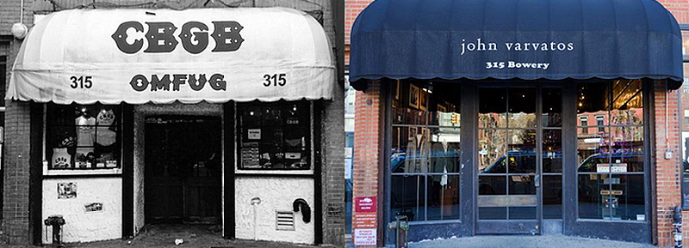
Background

Slide 3



Methodology
Gentrification
Risk Baseline
Geographical Movement of Yelp Reviews
Investigating Feature Importance
Feature Engineering with Yelp Review Language

Slide 4
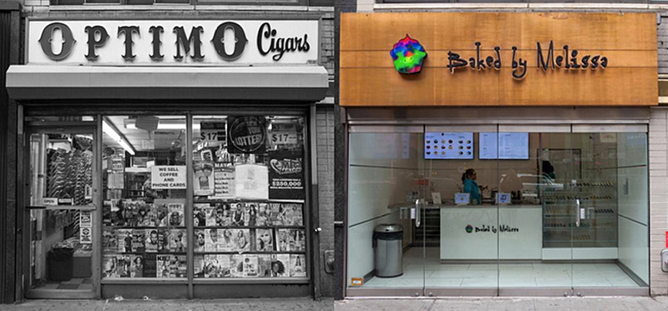
Gentrification Baseline

Slide 5
Gentrification Risk
Annual NYC Sales Data
Change in Property Value
Applied Threshold
7.5% - 10.5% Blocks in Scope at Gentrification Risk

Slide 6
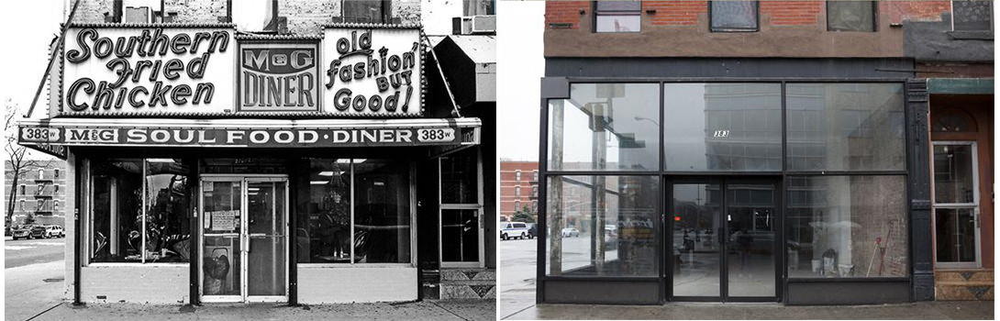
Yelp Exploration

Slide 7
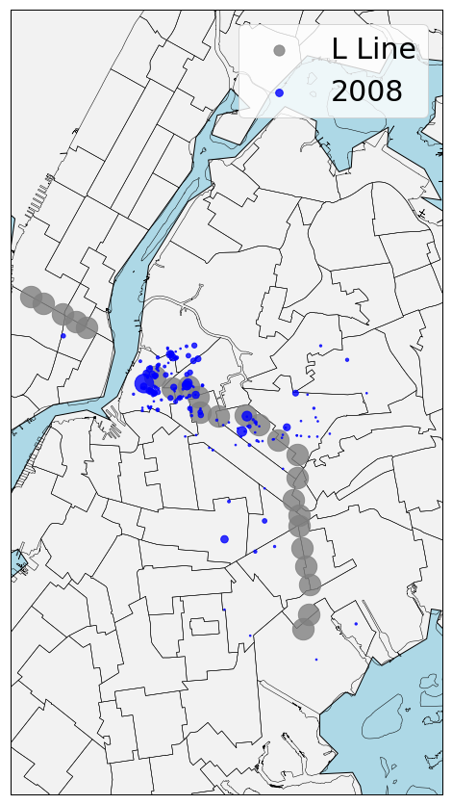
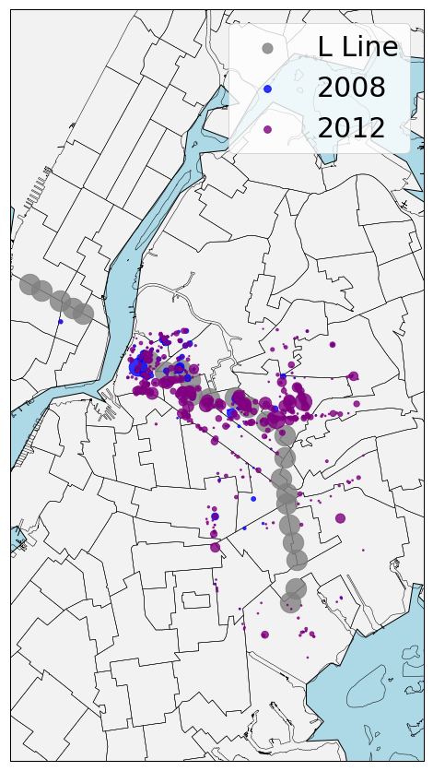
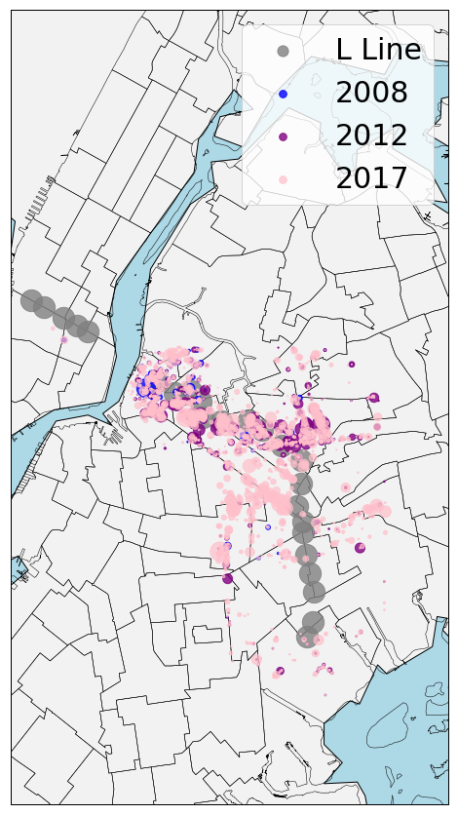

Slide 8
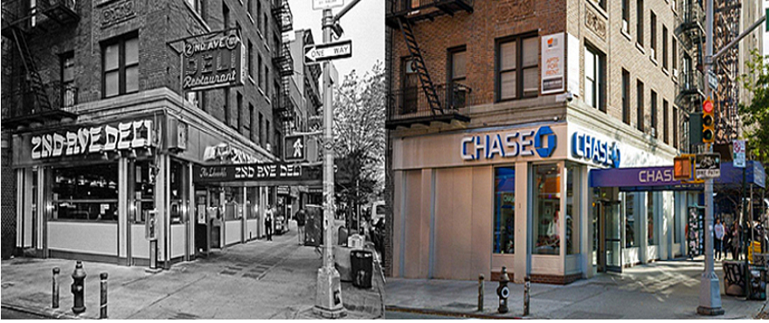
Feature Engineering

Slide 9
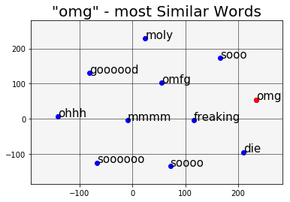
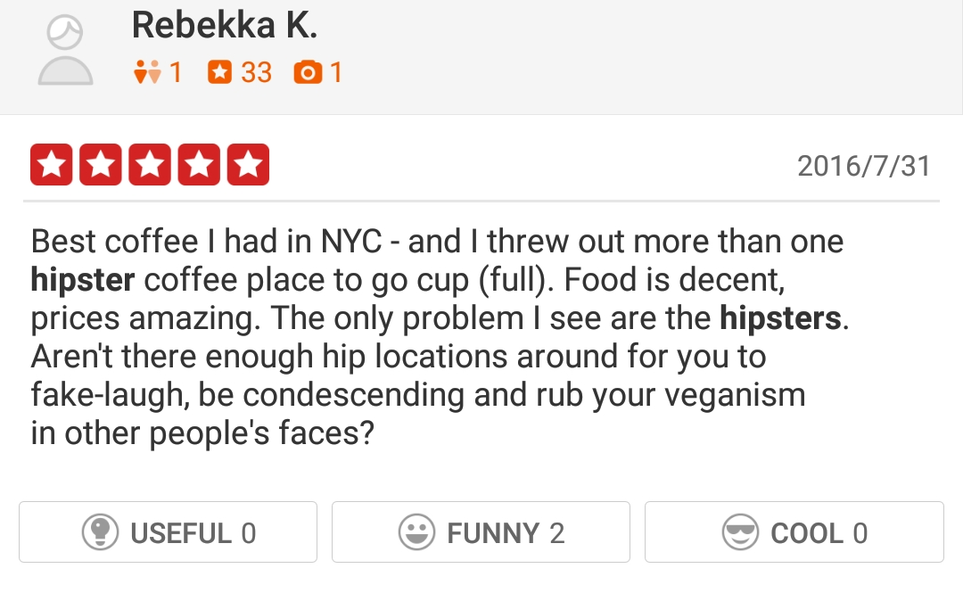
Gentrification “Score” Generator with Natural Language Processing
Word2Vec
quaint
gentrified
hipster
omg
divey
300k Yelp Reviews

Slide 10
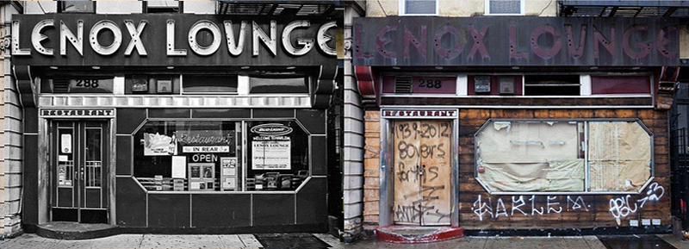
Classification

Slide 11
Gentrification Classification
Target Variable
2017 Gentrification Risk | 2016 Gentrification Risk
Feature Importance
2016 Property Value | 2015 Property Value
2015 “Omg” Score | 2013 “Omg” Score
2015 “Hipster” Score | 2014 “Hipster” Score
2015 “Gentrified” Score | 2013 “Gentrified” Score

Slide 12
Takeaways
Over the past five years, more Yelp Reviews appear going east on the L line
Words from Yelp Reviews can predict gentrifying areas 2 – 3 years ahead of time

Slide 13
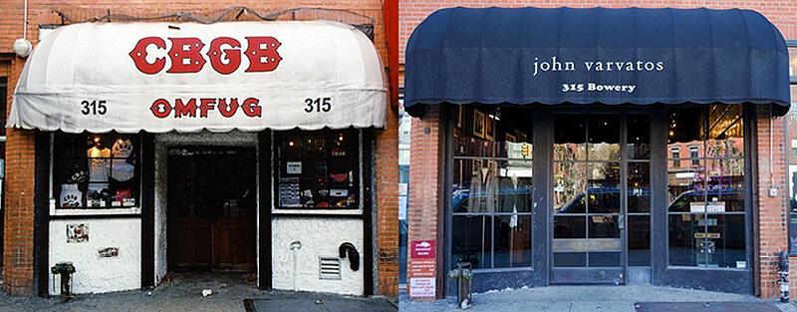
Thank You!
Christine Liu
ccl2140@columbia.edu

