Slide 1
Browning Gentry

Slide 2
Rat Inspections
Rat inspections are carried out by the Health Department based on 311 calls and via proactive indexed inspections
Follow-up “compliance” inspections are to be performed 7 days after a failed inspection
Performs “baiting” operations in an attempt to reduce rat populations
Focuses most of it’s inspection and baiting efforts on Manhattan and the Bronx
400 MILLION
12 THOUSAND
13 YEARS
40+ OFFICES
USERS
NEW CLIENTS A DAY
OF AWESOME
EXPERIENCE
PLACED
WORLDWIDE

Slide 3


Data Sources
The Health Department publishes data on each rat inspection and baiting visit on the NYC Open Data portal
Date and time of inspection or baiting visit
Result of inspection
Data for 2009-2017
Only Manhattan and Bronx data included
in model
The Department of City Planning publishes “tax lot” information in their PLUTO database
Coordinates
Tax value
Zoning information
Lot size information
Building qualities (basement, floors, units)
Year built, year renovated
12 THOUSAND
13 YEARS
40+ OFFICES
NEW CLIENTS A DAY
OF AWESOME
EXPERIENCE
PLACED
WORLDWIDE

Slide 4
Engineered Features
Because the rat inspections are performed over time, status of a given building could change based on the conditions surrounding the inspection
For the previous year for given block and 5 closest blocks, calculated previous year totals for:
Total Inspections
Failed Inspections
Baiting Operations
Total Compliance Visits
Failed Compliance Visits
12 THOUSAND
13 YEARS
40+ OFFICES
NEW CLIENTS A DAY
OF AWESOME
EXPERIENCE
PLACED
WORLDWIDE

Slide 5
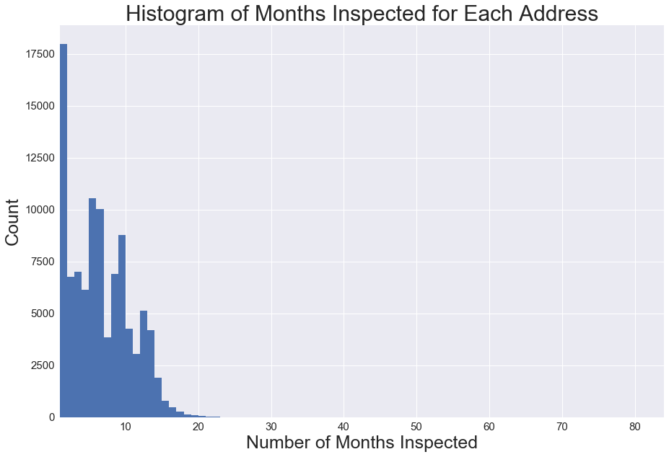
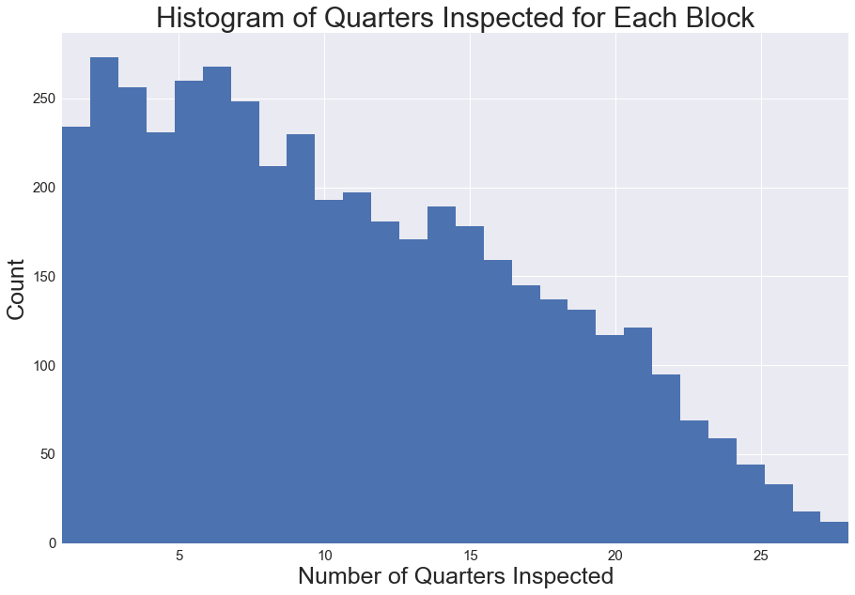
Data Transformation
The city does not consistently inspect all buildings
Binned inspections by quarter and by tax block
If any building failed during a given quarter, then the entire block is considered to have failed
13 YEARS
OF AWESOME
EXPERIENCE
12 THOUSAND
40+ OFFICES
NEW CLIENTS A DAY
PLACED
WORLDWIDE

Slide 6
Data Visualization
12 THOUSAND
13 YEARS
40+ OFFICES
NEW CLIENTS A DAY
OF AWESOME
EXPERIENCE
PLACED
WORLDWIDE

Slide 7
Model Results
Highest Feature Importances
Total Rat Inspections (LY)
Total Compliance Inspections (LY)
X Coordinate
Number of Times Baited (LY)
Building Footprint as a Percent of Lot Area
Closest 3 Neighbors Positive Inspections (LY)
Model | Accuracy
Logistic Regression | .55
Random Forest | .71
Gaussian Naïve Bayes | .65
12 THOUSAND
13 YEARS
40+ OFFICES
NEW CLIENTS A DAY
OF AWESOME
EXPERIENCE
PLACED
WORLDWIDE
Block | Total Inspections | Positive Inspections | 2018 Q1 Prediction
858 - WeWork NoMad | 5 | 0 | Negative
835 – Empire State Building | 8 | 2 | Negative
282 – Melt Shop | 14 | 11 | Positive

Slide 8
Further Investigation
Sewer mapping data
Geographical mapping data
More detailed descriptions of inspection findings
Questions?

Slide 9
Appendix
Active rat signs (ARS) include any of six different signs:
fresh tracks
fresh droppings
active burrows
active runways and rub marks
fresh gnawing marks
live rats
Method:
During each indexing round, inspectors walked every block of each neighborhood, inspecting as much of the exterior of the property as could be accessed, including front, side, and rear yards or garbage areas, looking for ARS. A finding of any ARS resulted in a failure on initial inspection.
2014 – 7,182 rat-related 311 complaints, 61,321 total inspections
Source – NYC EPI Data Brief, July 2016

Slide 10
Appendix
Confusion Matrix
 | Rats (Predicted) | Rat-Free (Predicted)
Rats (Actual) | 5773 | 2176
Rat Free (Actual) | 2331 | 4891

Slide 11
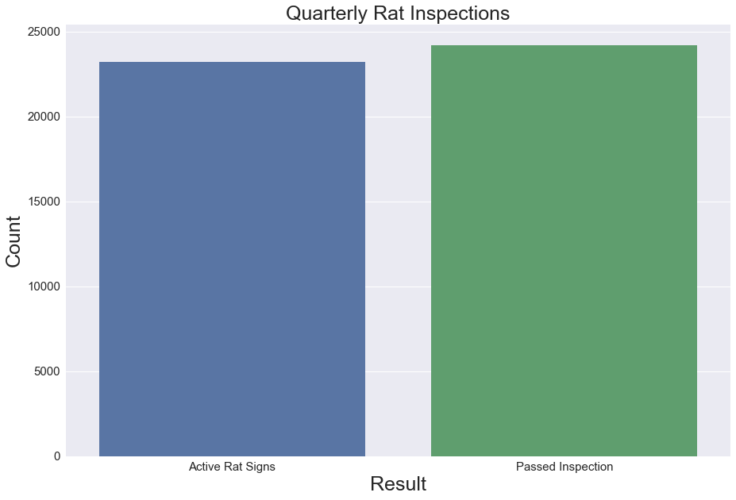
Appendix

Slide 12
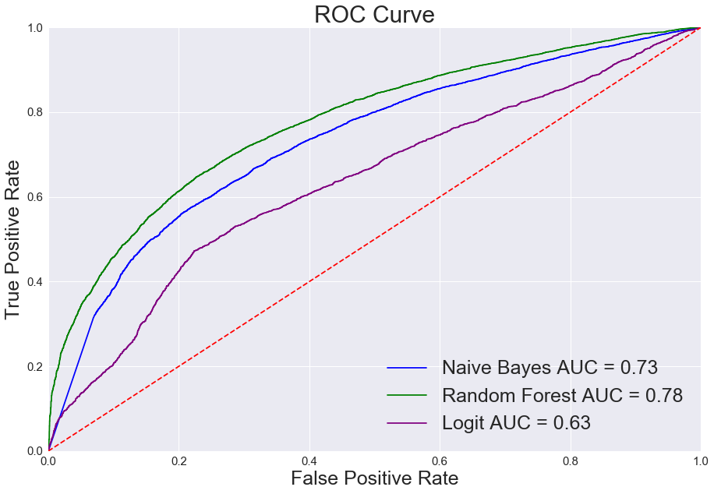
Model Results
Model | Accuracy | Precision | Recall
Logistic Regression | .55 | .63 | .34
Random Forest | .71 | .71 | .74
Gaussian Naïve Bayes | .65 | .62 | .89
12 THOUSAND
13 YEARS
40+ OFFICES
NEW CLIENTS A DAY
OF AWESOME
EXPERIENCE
PLACED
WORLDWIDE

