Slide 1

Get Started with Pearson’s MyLab and Mastering in eCourseware How to register and Enroll in your Course Nick Umberger nicholas.umberger@pearson.com
I
Image by Tang Yau Hoong
Presentation Title Arial Bold 7 pt
1

Slide 2
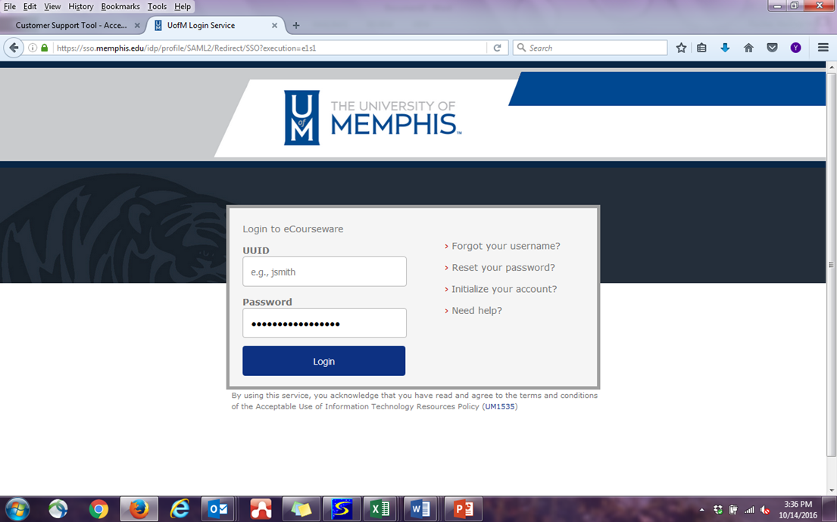
Step 1: Go to your course here - https://elearn.memphis.edu/

Slide 3
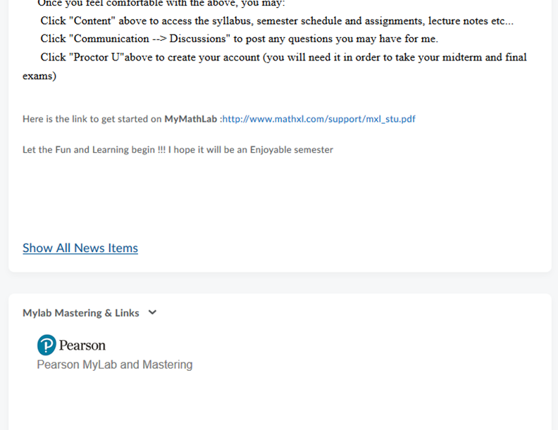
Step 2: Find the Pearson Link
Find your course and then within your eCourseware course, click on the Pearson MyLab and Mastering Link:

Slide 4
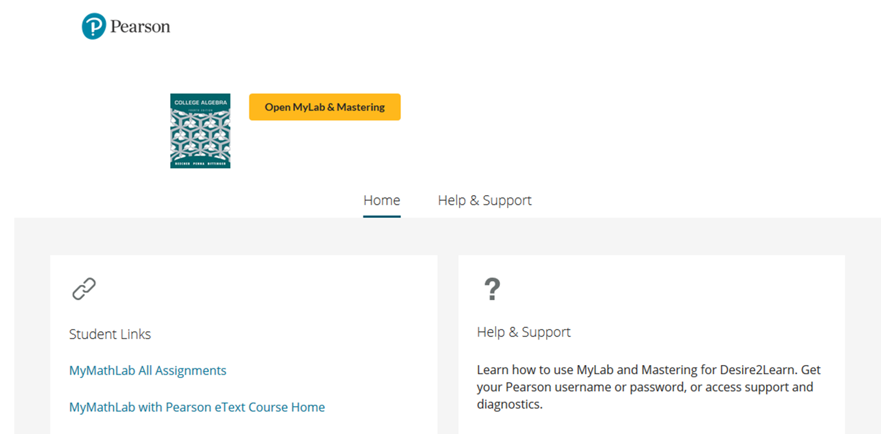
Click “Open MyLab & Mastering”

Slide 5
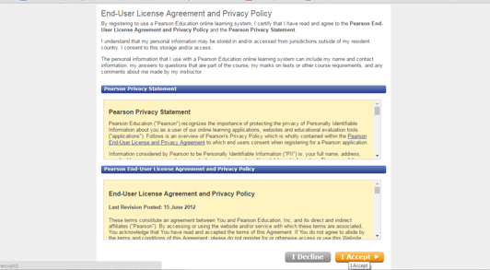
Step 3: Accept the Privacy Agreement:

Slide 6
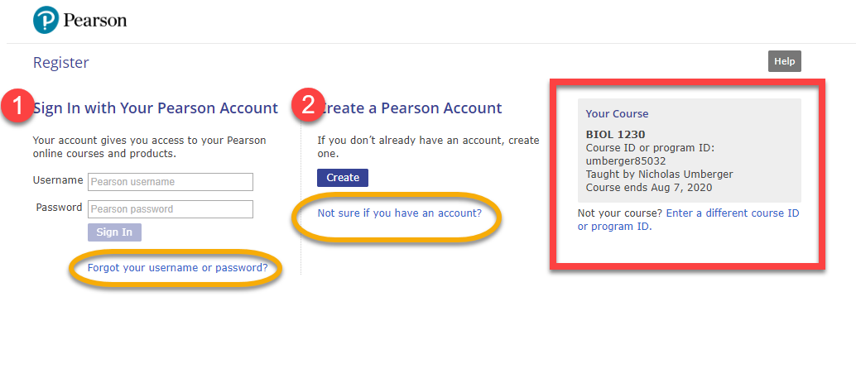
Step 4: Create a Pearson Username and Password
Or Sign In with a username and password you already have, if you’ve used another Pearson
MyLab & Mastering product before.

Slide 7

Why shouldn’t I just create a new account? When you create multiple accounts like this;
You end up having these issues;
“I am having problems with my homework website. It has me locked out and I can't get into it. I have been trying since Friday,”
From: student with multiple accounts
Notes:
Creating multiple accounts leads to confusion at times because you end up forgetting which login you should be using for which class. Please don’t create multiple accounts.

Slide 8
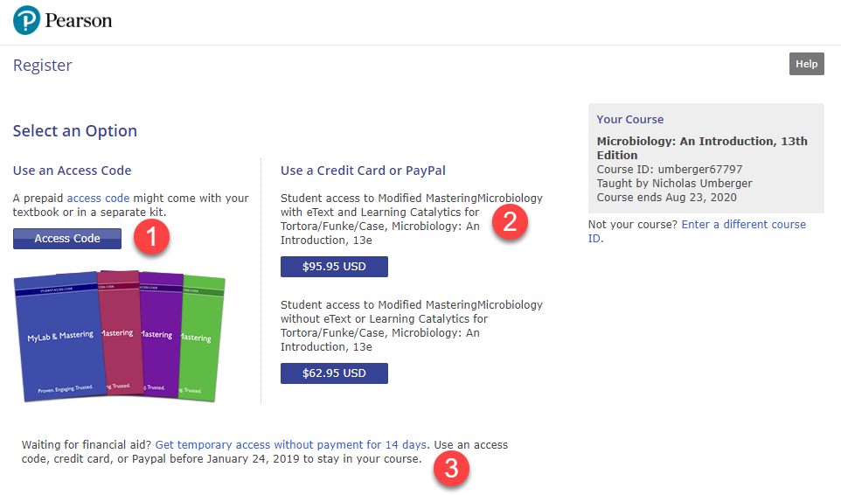
Step 5: Select a Purchase Option
Select Access Code if you’ve already purchased one.
Use a Credit Card or PayPal to purchase directly from Pearson.
Get temporary access without payment for 14 days. You can start your work while waiting on your aid.

Slide 9
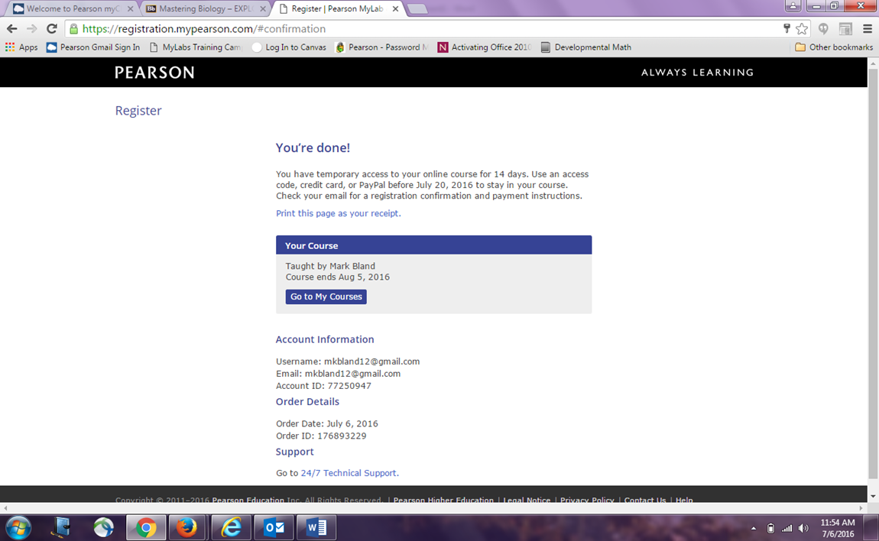
Congratulations! You’re now enrolled in your MyLab or Mastering course!

Slide 10
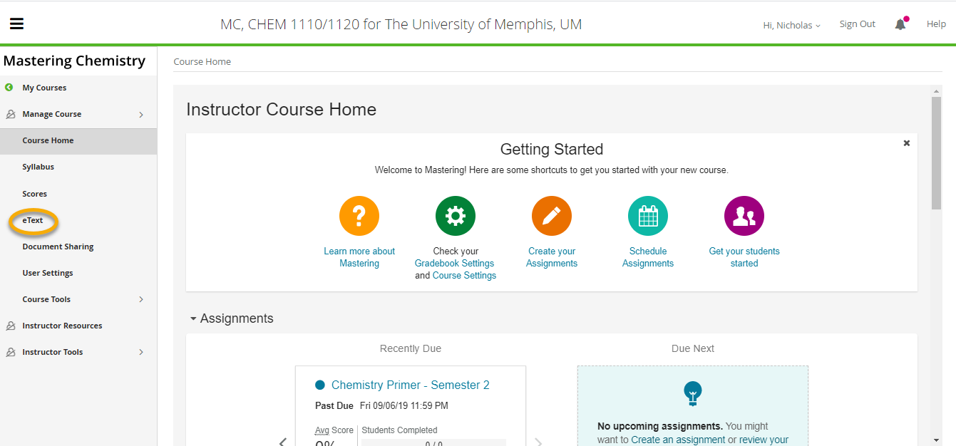
Your course should look something like this. Please pay attention to the left-hand navigation bar for links to assignments, eText, study tools, etc. Depending on your course there should be a link to purchase a print offer to your text in the eText tab Please log in through eCourseware every time for the best experience. However, if eCourseware is down you can enter through pearsonmylabandmastering.com

Slide 11
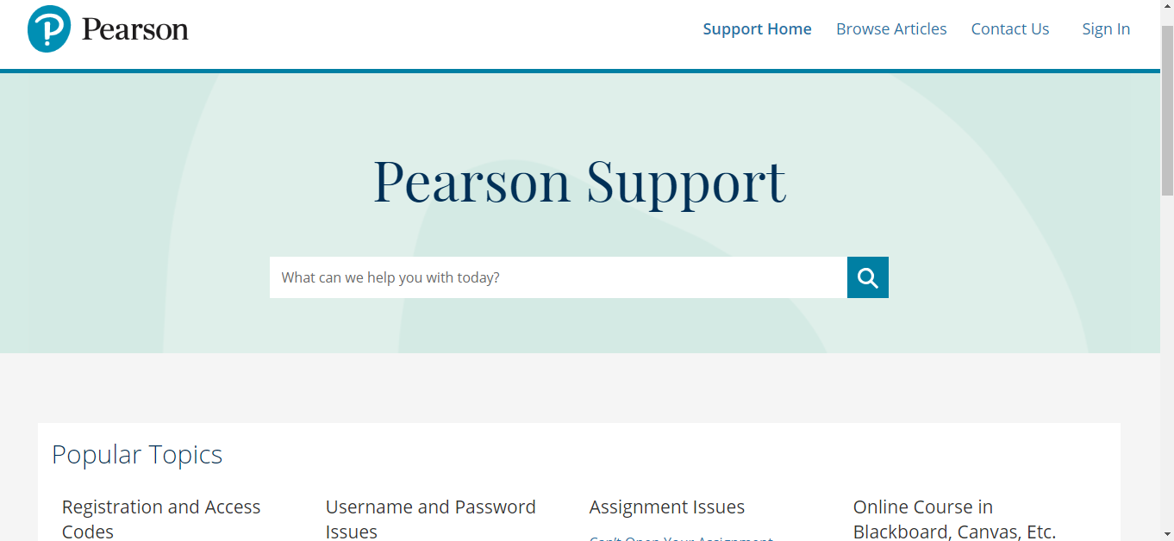
Need Help?
Contact Pearson Support, 24/7, at https://support.pearson.com/getsupport/s/
Live chat or call dedicated student support at 1-844-292-7015

Slide 12
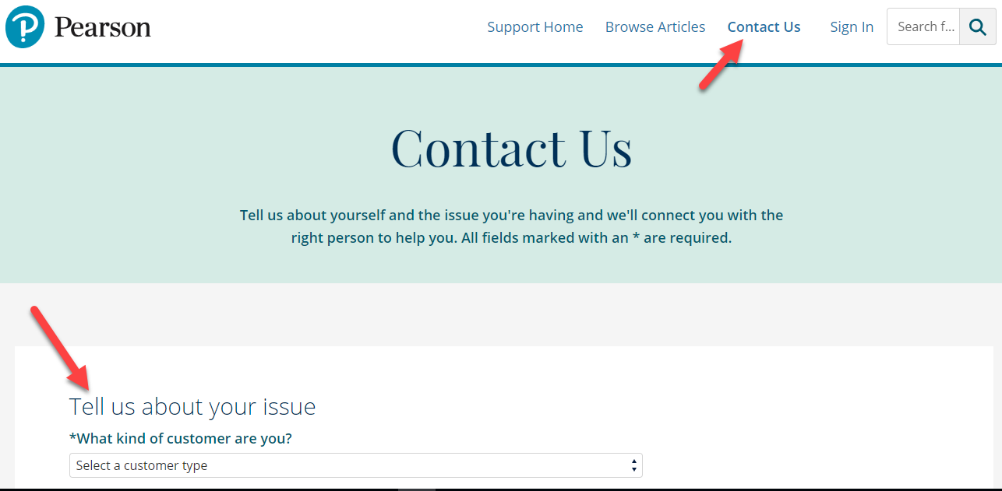
If you do not see your topic in the list below click Contact Us to create a Technical Support Case. When you complete the form you will get a Case Number. Email me your Case Number with a short description of your issue.

Slide 13
Most common issues
Browser Settings:
Pop-ups must be enabled.
Cookies must be enabled.
JavaScript must be enabled.
Browser and Operating System Check
To make our products work smoothly, our system checks that your device uses a supported web browser and operating system for the product you are accessing.
We recommend using Google Chrome or Firefox
Notes:
Recommended browsers discussed here. Make sure to talk about safari settings.

Slide 14
Nick Umberger
Nicholas.umberger@pearson.com

