Slide 1

Customer Insights
Learnings from December EBC/CEC visits
James Woloszyn, Global Customer Advocacy

Slide 2
Customer Advocacy Insights
Objective
This report provides a monthly view of valuable customer and partner insights from the Executive Briefing Center and Customer Engagement Centers.
Centers in scope
Time period
Data sources
Action items
Customer survey responses:
Which solutions would you like to learn more about?
What would you suggest to our CEO
Additional comments
Post engagement summaries
Briefing Program Manager interviews
Palo Alto
Houston
New York
London
Singapore
Monthly data
Notes:
Critical issues that are raised in any briefing are handled through our standard 24 hour escalation mechanisms
Meetings that do not require surveys and post engagement summaries are out of scope.

Slide 3



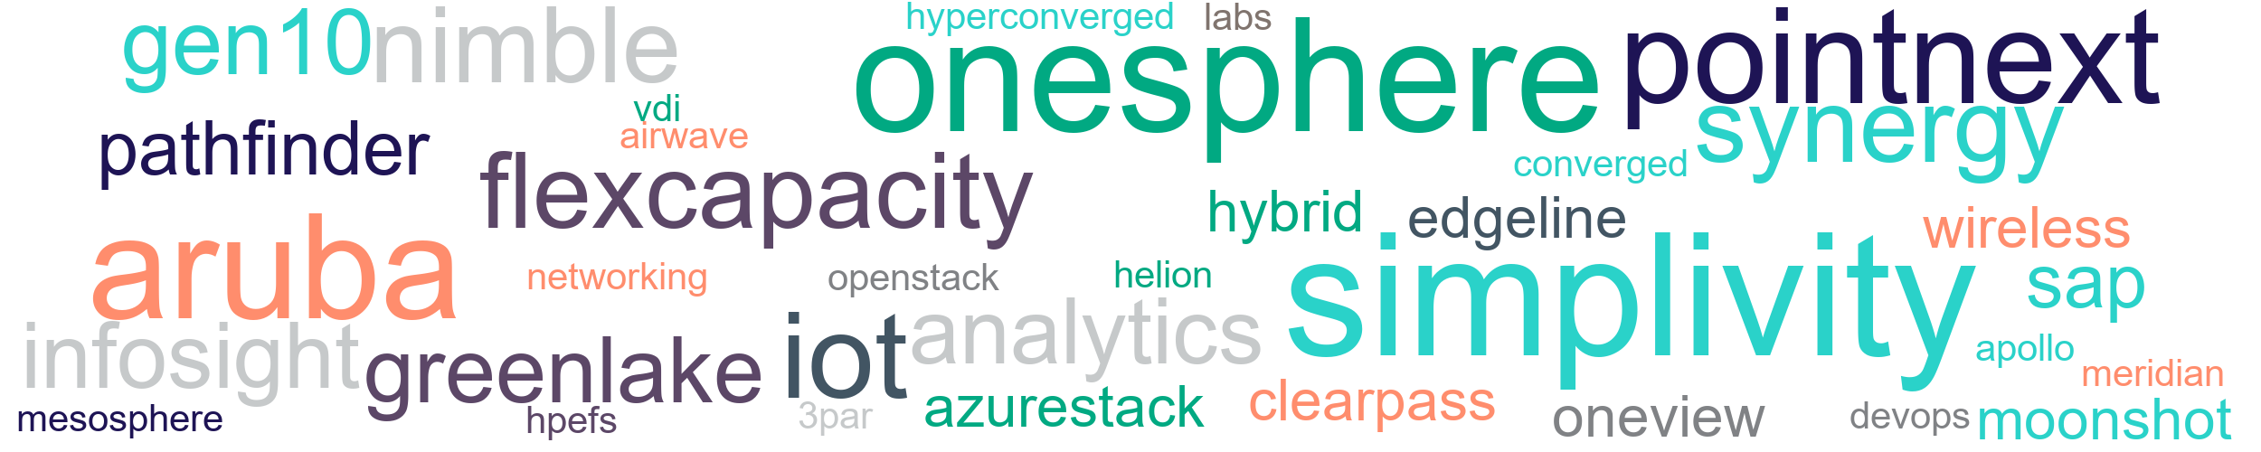
In December customers wanted to learn more about...
Top three customer interests
simplivity
onesphere
aruba

Slide 4
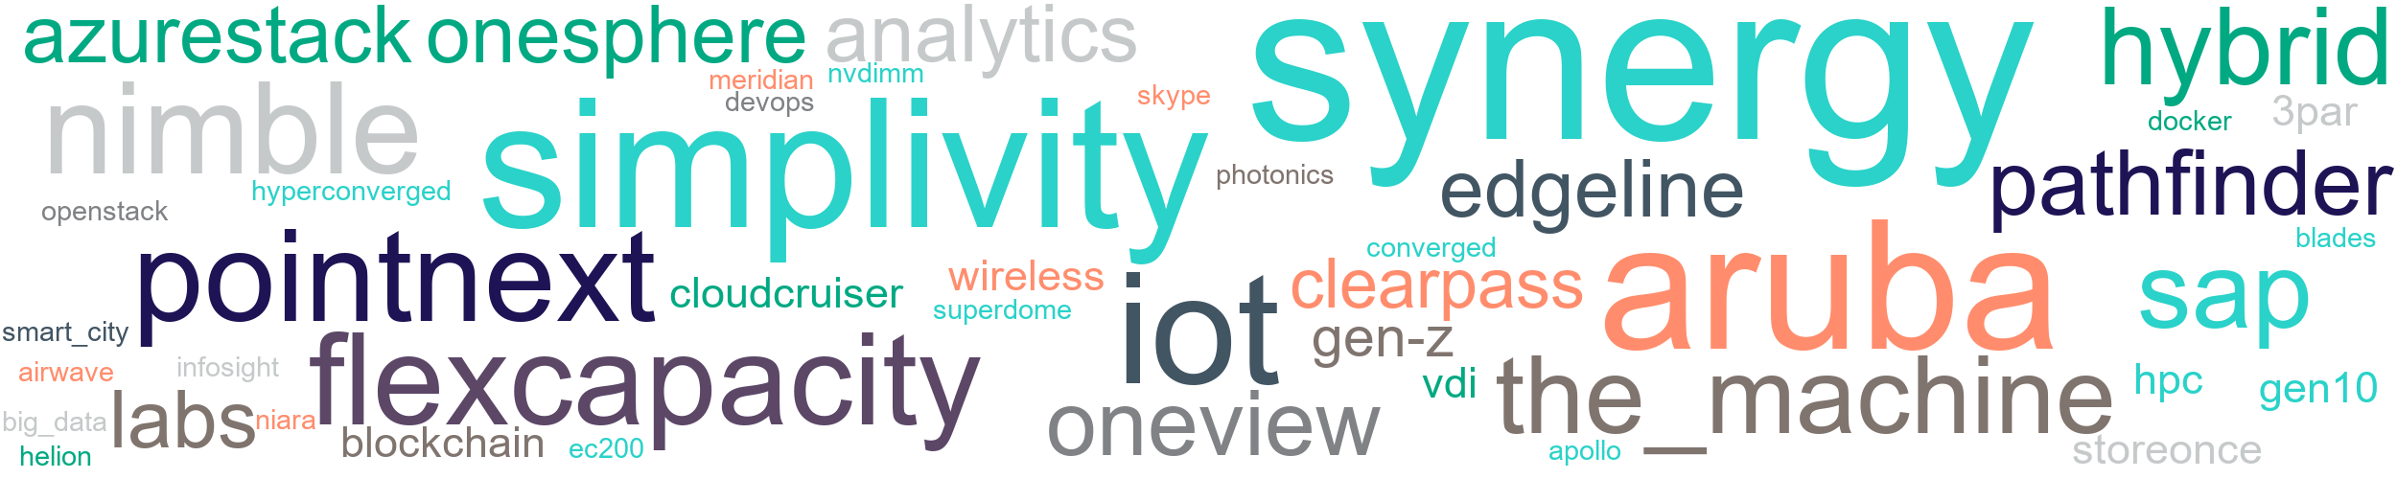
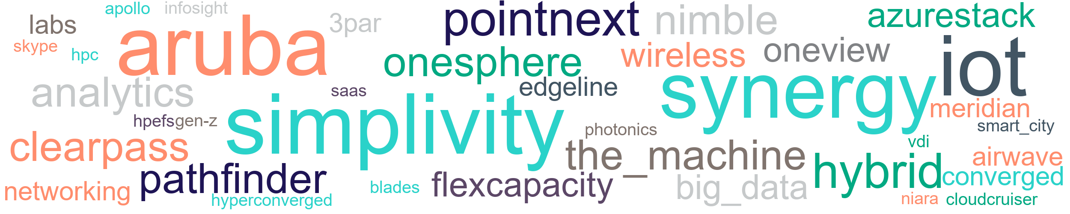
3 month trend: Increasing interest in…
October
November
December

Slide 5
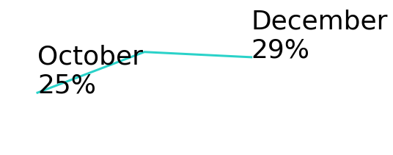
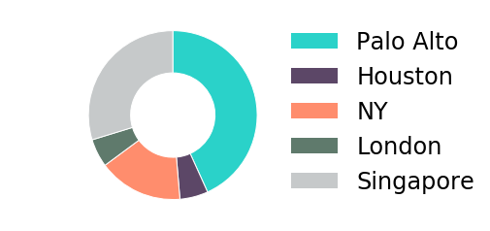
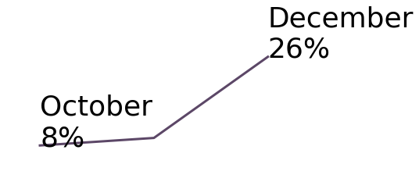
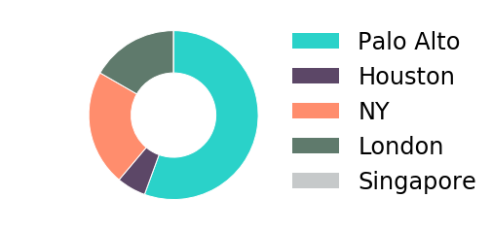
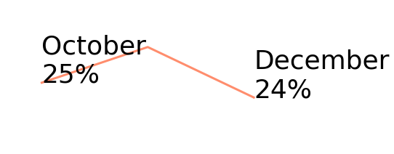
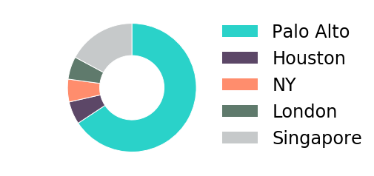
Top 3 Customer Interests: October-December
simplivity
onesphere
aruba
WW% of visits expressing interest post briefings
distribution of visits expressing interest post briefing
WW% of visits expressing interest post briefings
distribution of visits expressing interest post briefing
WW% of visits expressing interest post briefings
distribution of visits expressing interest post briefing
Observations
Observation1
Observations
Observation2
Observations
Observation3
Briefings
Regent University
Deloitte
Ctc Corporation
Security Service Federal Credit Union
Hpe Simplivity Customer Workshop
Synopsys, Inc.
Hilton Worldwide Holdings Inc.
Softbank Corp.
Mindef Singapore
Ls Global Co.
Briefings
Regent University
Deloitte
Royal Mail Group Limited
Firstenergy Corp.
Synopsys, Inc.
Visa
Kroger
Softbank Corp.
Mufg
Briefings
Regent University
Jr East Information Systems Company
Swiss Re Ag
Ctc Corporation
Protective Life Insurance Company
It Services And Management
Kroger
Softbank Corp.

Slide 6



In August, Customers were telling us…
They want to collaborate with HPE
Want to be more than an user, want to be a partner
Interested in HPE on HPE best practices
Request more HPE engagement in specific countries
What we can improve
Continue to address demands for demos and use cases
Get the word out on HPE products
Root cause and corrective action for product issues
Feedback about strategy
Interested in our innovation
Like where the company is headed
Continue to seek clarity

Slide 7
Most frequent customer requests & recommendations
Briefing Insights
Observations
August Customers
“Bring us more upfront in your developments“
- Gayle Chan, DSTA Deputy Director Digital Hub
“Suggest creating Smart Building showcase in Surbana Jurong’s new facility” – Surbana Technologies briefing
“Request HPE on HPE transformation information - consolidation, automation, and cloud first” - Telefonica O2 briefing
“More investment in China market.“
- Eduardo Chiuciuchian, Nestle RGO North America Director
Customers requesting to have earlier access to technology
Customers want to showcase solutions
Customers want to learn from HPE on HPE
More than a user
Pepsi Co.
Surbana Technologies
DSTA
University of Texas at Arlington
SEATH Customers
Best Practices
Global Affairs Canada
Telefonica O2
Canon Inc.
Health Management Systems, Inc.
Country requests
Saudi Telecom Company
Nestle RGO North America
DSTA
American Chamber of Commerce Peru
Want to collaborate
Customers appreciate real-life examples of how others are using products
SimpliVity is the top demo requested
Requesting delivery of 3PAR OS patch
Demos/use cases
Health Management Systems, Inc.
Global Affairs Canada
Deloitte
Aramark
RMM Solutions Multi Client Briefing
Tokyo Gas Co., Ltd.
SEATH Customers
American Chamber of Commerce Peru
Canon Inc.
Laguna Development Corporation
Marketing campaign
Telefonica O2
Gap Inc.
Austin Radiological Association
Nestle RGO North America
Product issues
Mitsubishi Electric Information Network Corporation
Nestle RGO North America
“Real life cases site visit to hear from real customer“
- Kah Yi Chin, Sabah Net Technical Advisor
“More communication regarding new products.“
- Jack Yudell, Austin Radiological Assoc., Enterprise Architect
Areas to improve
“Help us in 3 areas: Adoption of Synergy, (b) faster provisioning of VMs and flex capacity, (c) intelligent edge“
- Shyam Venkat, Pepsi Co. CTO
“Extremely innovative - forward thinking partner.”
- Ned Dupont, W/S Packaging Group, Inc. Director
“Communicate more about HPE. We did not know about this split.”
- Denisse Cuellar, Banco de Crédito del Perú
Our strategy is resonating with customers
There are still customers who are learning about the HPE/HPI separation
Innovation
RMM Solutions Multi Client Briefing
Westlake Chemical Corporation
Like Strategy
PepsiCo Inc
RMM Solutions Multi Client Briefing
Learned strategy
American Chamber of Commerce Peru
Feedback on strategy

Slide 8
Additional quotes
Collaborate
Recommendations
Strategy
“Find couple of critical opportunities and jointly invest to co-solve critical opportunity in Hybrid IT / Edge computing.”
- Eric Jackson,
Pepsi Co., Director
“Very appreciative of the attention of Senior staff to help inform our transformation journey.
- Arun Thangaraj,
Global Affairs Canada, CFO
“Let's discuss co-innovation..”
- Carlos Gian G. Santos III,
MERALCO, Corporate Solutions Manager
“Requested to learn how HPE has addressed Engineering IT challenges - to decide which vendor Canon trusts. Also interested in HPE’s internal use/adoption of HPC.”
- Kastumi Iijima,
Canon Inc, CIO
“Need to move faster to distinguish yourself on innovations & "wow" factor..”
- Jimmy Lee,
Surbana Technologies Principal Consultant
“Need to be more international, pegging the pitch at a global level, future challenges, counter terrorism.”
- Hwee Kwang Lim,
DSTA, Deputy Director Enterprise IT
“Engaging more with smaller, under $20 million business.”
- Christian Damstra,
Damstra Technology CEO “
“Keep heading in the same direction. It's exciting to see future plans..”
- Steve Weinheimer,
MEC Inc., Senior Systems Administrator
“Continue to be innovative. I was very pleased to hear about several products or new features being offered or will be offered in the near future..”
- Larry Turner,
Westlake Chemical Corporation Manager

Slide 9
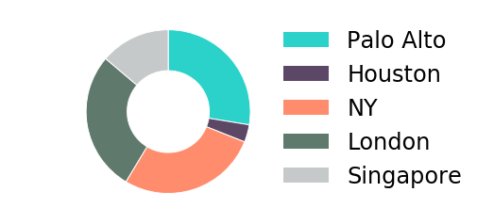
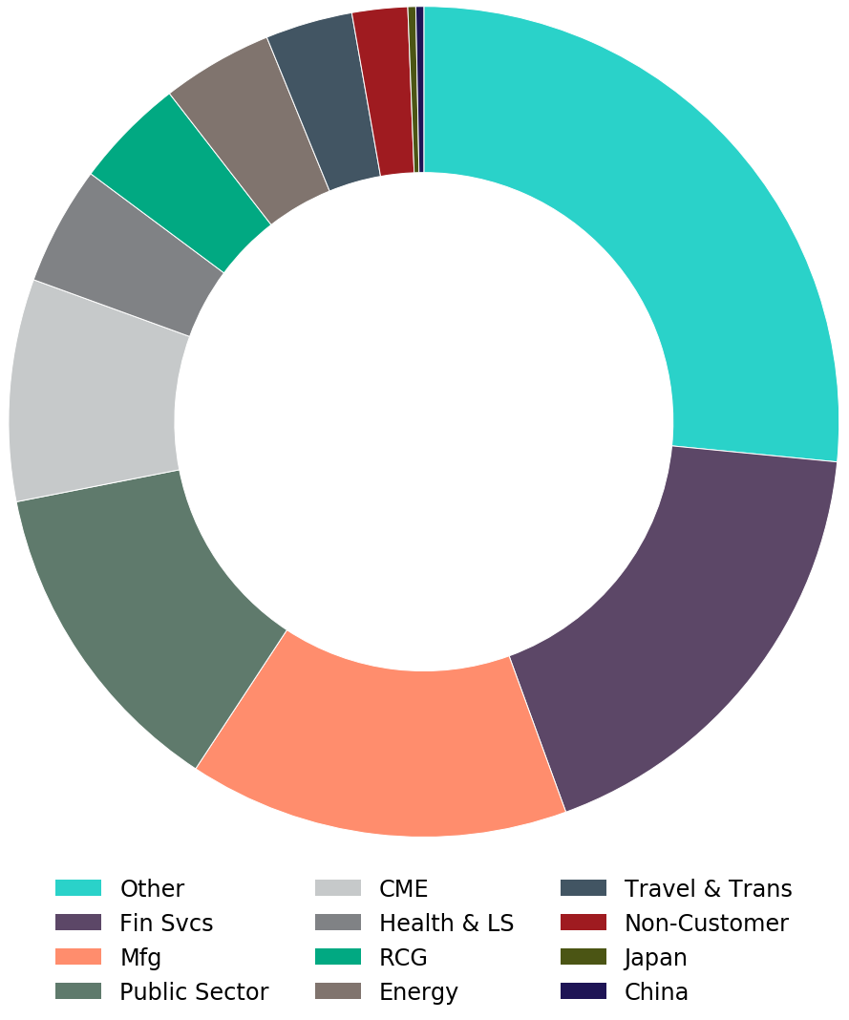
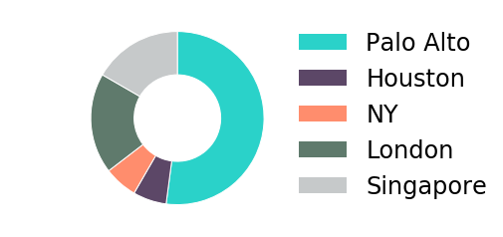
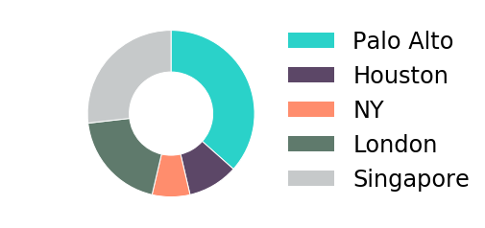
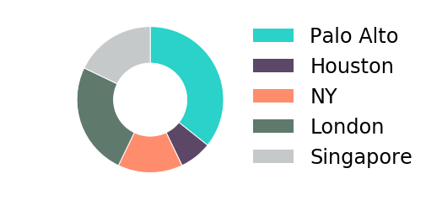
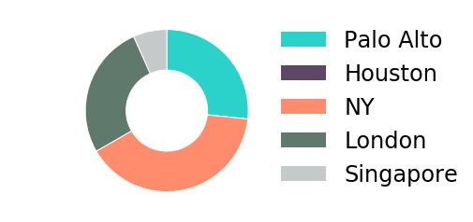
Industry Insights October-December
Briefing volume by Industry
Briefings by center
Top Interests - Financial services
- synergy
- onesphere
- aruba
- flexcapacity
Financial services
Briefings by center
Top Interests - Manufacturing
- aruba
- synergy
- simplivity
- iot
Manufacturing
Public Sector
Briefings by center
Top Interests - Public Sector
- simplivity
- synergy
- iot
- aruba
Comms Media & Entertainment
Briefings by center
Top Interests - Comms Media & Entertainment
- pointnext
- aruba
- simplivity
- iot
Briefings by center
Top Interests - Health & Life Sciences
- pathfinder
- synergy
- the_machine
- simplivity
Health & Life Sciences

Slide 10
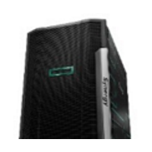
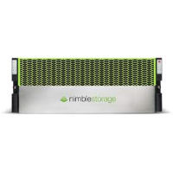
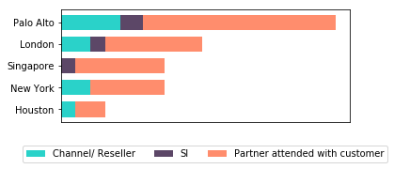
Partner Insights (October-December)
Insights from Channel/Reseller and System Integrator engagements
Top Partner Interests
Partner recommendations
“Pointnext could work better with and through partners rather than direct to customer.”
Jonathan Melia, Computacenter manager
“Supply Chain and Support issues need to get resolved.”
John Czapko, Logicalis Director
“Believe that by continuing to offer customers access to the EBC will continue to enable HPE a stronger and strategic partner.”
Mike Owens, Brookfield Zoo VP from American Digital/Brookfield Zoo briefing
“Provide more sales enablement tools...thought leading content in specific verticals and marketing materials for sales to engage customers.”
Ed Little , Momentum Sales manager
“Consider better alignment with the reseller who hosted the visit. For example, it appeared that HPE was suggesting reduction to one data center and backing up to the cloud, whereas our reseller would lose business if we did that”
Mark Lisinski, TreeHouse Foods, Inc Director
synergy
simplivity
aruba
nimble
38%
36%
22%
22%
Partner engagement volume by Center
Notes:
“Improved support options - contract support for C7000. We are really struggling in this area.”
Steve Tippet, Nationwide Mutual Insurance Company Technology Consultant
“Any future training on HPE Synergy wouuld be great“ – Wipro Limited
"Consider better alignment with the reseller who hosted the visit. Some topics recommended actions inconsistent with our resellers offerings. For example, it appeared that HPE was suggesting reduction to one data center and backing up to the cloud, whereas our reseller would lose business if we did that.“ – TreeHouse Foods, Inc
“This is our second time here and next month we are bringing our customers here. It shows you our commitment to HPE.”
Sudianto Oei, CEO, Hypernet
“What is our channel GTM? Joint selling vs. delivery only. How do we not directly compete?”
Presidio Inc

Slide 11





Breakdown by centre (July-December)
 | Top 5 interests |  |  |  |  | Top 3 Industries & Associated Interests
Palo Alto
Houston
New York
London
Singapore
synergy
aruba
simplivity
iot
pointnext
Mfg
- synergy - 39%
- simplivity - 35%
- iot - 35%
- aruba - 30%
Fin Svcs
- synergy - 42%
- aruba - 32%
- onesphere - 26%
- pathfinder - 21%
Public Sector
- the_machine - 25%
- pointnext - 25%
- analytics - 19%
- labs - 19%
synergy
simplivity
oneview
iot
aruba
Energy
- iot - 60%
- aruba - 40%
- analytics - 40%
- sap - 20%
Mfg
- simplivity - 50%
- nimble - 38%
- oneview - 38%
- synergy - 25%
Public Sector
- synergy - 43%
- airwave - 29%
- gen-z - 14%
- hpc - 14%
simplivity
synergy
flexcapacity
nimble
pointnext
Fin Svcs
- flexcapacity - 100%
- pointnext - 67%
- onesphere - 67%
- synergy - 33%
Health & LS
- nimble - 100%
- oneview - 100%
- niara - 100%
- sap - 0%
CME
- synergy - 67%
- pointnext - 67%
- simplivity - 33%
- oneview - 33%
synergy
nimble
simplivity
iot
hybrid
Fin Svcs
- synergy - 57%
- analytics - 29%
- onesphere - 29%
- gen10 - 14%
Public Sector
- clearpass - 36%
- wireless - 36%
- aruba - 27%
- nimble - 27%
RCG
- synergy - 67%
- hybrid - 67%
- sap - 33%
- ec200 - 33%
simplivity
synergy
aruba
iot
hybrid
Public Sector
- aruba - 35%
- simplivity - 35%
- synergy - 29%
- analytics - 18%
Fin Svcs
- synergy - 43%
- gen10 - 14%
- blades - 14%
- simplivity - 14%
Mfg
- simplivity - 45%
- iot - 45%
- edgeline - 36%
- aruba - 27%

Slide 12
Thank you

Slide 13
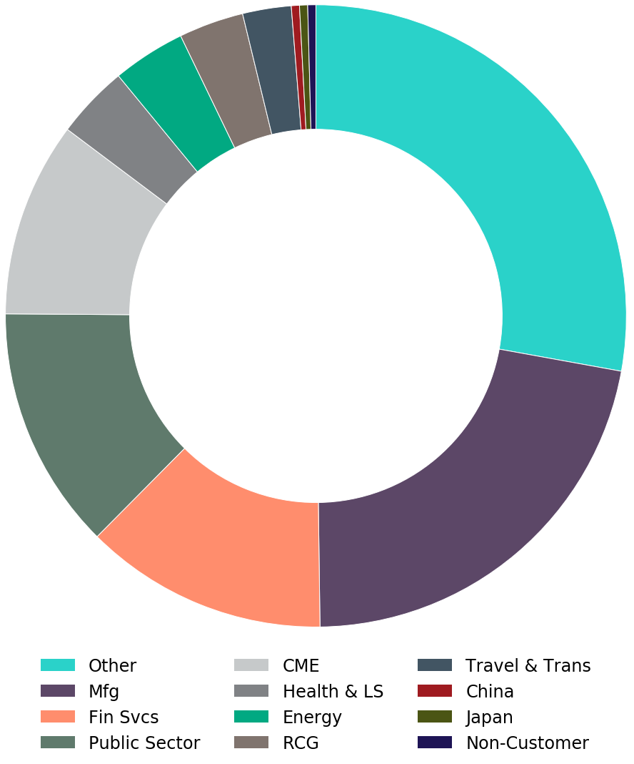
EBC six month view (July-December)
Palo Alto volume by Industry
 | Top 5 interests
Palo Alto
synergy
aruba
simplivity
iot
pointnext
 | Top 3 Industries & Associated Interests
Palo Alto
Mfg
- synergy - 39%
- simplivity - 35%
- iot - 35%
- aruba - 30%
Fin Svcs
- synergy - 42%
- aruba - 32%
- onesphere - 26%
- pathfinder - 21%
Public Sector
- the_machine - 25%
- pointnext - 25%
- analytics - 19%
- labs - 19%

