Slide 1

Customer Insights
Learnings from August EBC/CEC visits
James Woloszyn, Global Customer Advocacy

Slide 2
Customer Advocacy Insights
Objective
This report provides a monthly view of valuable customer and partner insights from the Executive Briefing Center and Customer Engagement Centers.
Centers in scope
Time period
Data sources
Action items
Customer survey responses:
Which solutions would you like to learn more about?
What would you suggest to our CEO
Additional comments
Post engagement summaries
Briefing Program Manager interviews
Palo Alto
Houston
New York
London
Singapore
Monthly data
Notes:
Critical issues that are raised in any briefing are handled through our standard 24 hour escalation mechanisms
Meetings that do not require surveys and post engagement summaries are out of scope.

Slide 3
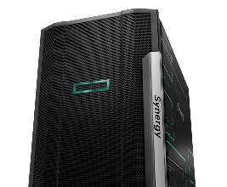

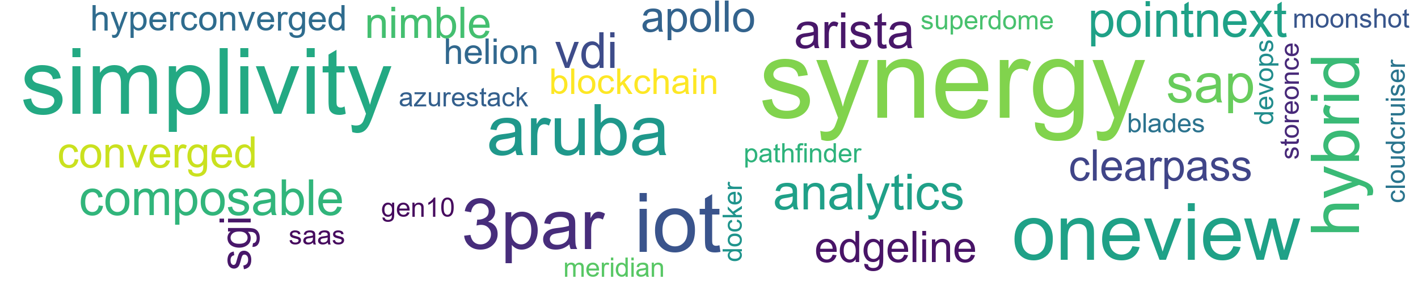
In August customers wanted to learn more about...
Top three customer interests
Synergy
IoT
SimpliVity

Slide 4
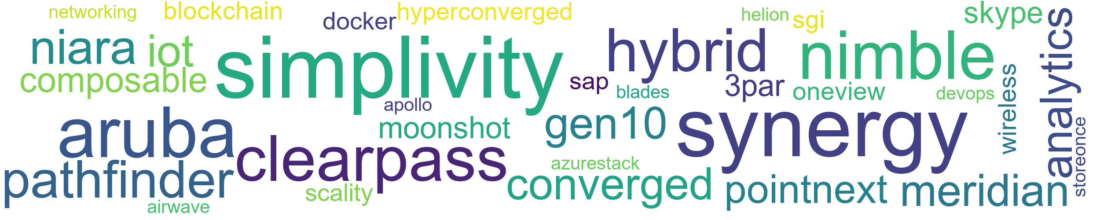
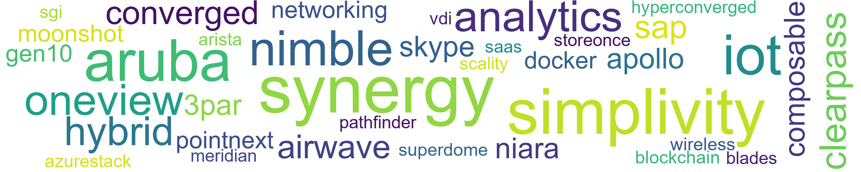
3 month trend: Increasing interest in…
June
July
August

Slide 5
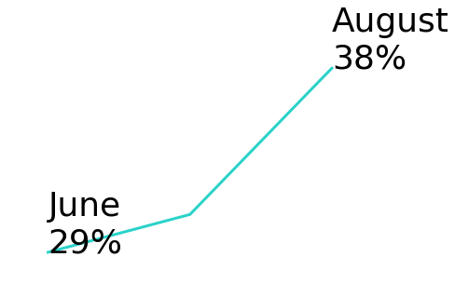
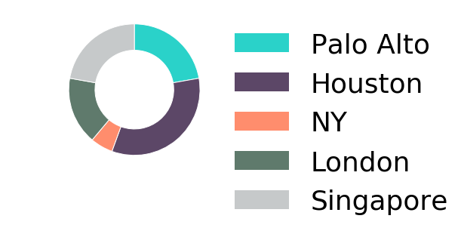
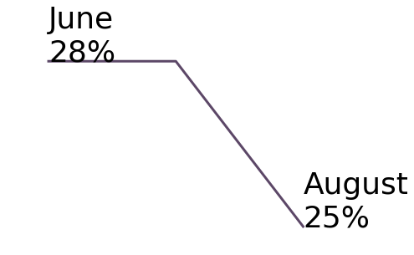
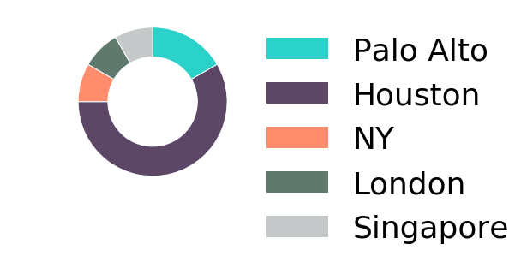
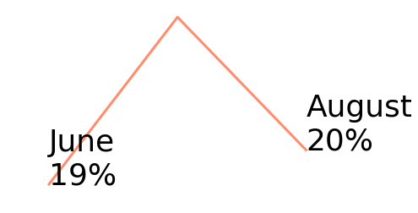
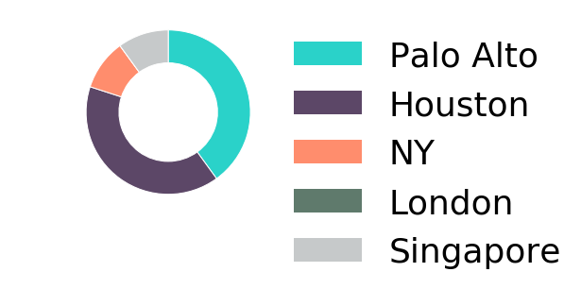
Top 3 Customer Interests: June-August
synergy
simplivity
iot
WW% of visits expressing interest post briefings
distribution of visits expressing interest post briefing
WW% of visits expressing interest post briefings
distribution of visits expressing interest post briefing
WW% of visits expressing interest post briefings
distribution of visits expressing interest post briefing
Observations
Observation1
Observations
Observation2
Observations
Observation3
Customers
Health Management Systems, Inc.
Saudi Telecom Company
Deloitte
Tech Data
Maldives Government - 2 Days
Ingram Micro
Softcat
Gap Inc.
Austin Radiological Association
Citibank Singapore
Nimbus Hosting - Synergy Technical Deepdive
Latam Multiple Customers
Tenaris Global Services (Usa) Corporation
Mark Iii Systems, Inc.
Laguna Development Corporation
Starhub / (Ebg/Essd)
Directorate Jendral Pajak (Tax Authority Of Indonesia)
Government Institution Pension Fund
Customers
Health Management Systems, Inc.
Tech Data
Aramark
Ingram Micro
Softcat
Canon Inc.
Pepsico Inc.
Rmm Solutions Multi Client Briefing
Latam Multiple Customers
Mark Iii Systems, Inc.
Starhub / (Ebg/Essd)
Korea Development Bank
Customers
American Chamber Of Commerce Peru
Ingram Micro
Canon Inc.
Rmm Solutions Multi Client Briefing
Capgemini America, Inc.
Latam Multiple Customers
Mark Iii Systems, Inc.
Tokyo Gas Co., Ltd.
Mz
Reimagine Yes - Sub Event

Slide 6



In August, Customers were telling us…
They want to collaborate with HPE
Want to be more than an user, want to be a partner
Interested in HPE on HPE best practices
Request more HPE engagement in specific countries
What we can improve
Continue to address demands for demos and use cases
Get the word out on HPE products
Root cause and corrective action for product issues
Feedback about strategy
Interested in our innovation
Like where the company is headed
Continue to seek clarity

Slide 7
Most frequent customer requests & recommendations
Briefing Insights
Observations
August Customers
“Bring us more upfront in your developments“
- Gayle Chan, DSTA Deputy Director Digital Hub
“Suggest creating Smart Building showcase in Surbana Jurong’s new facility” – Surbana Technologies briefing
“Request HPE on HPE transformation information - consolidation, automation, and cloud first” - Telefonica O2 briefing
“More investment in China market.“
- Eduardo Chiuciuchian, Nestle RGO North America Director
Customers requesting to have earlier access to technology
Customers want to showcase solutions
Customers want to learn from HPE on HPE
More than a user
Pepsi Co.
Surbana Technologies
DSTA
University of Texas at Arlington
SEATH Customers
Best Practices
Global Affairs Canada
Telefonica O2
Canon Inc.
Health Management Systems, Inc.
Country requests
Saudi Telecom Company
Nestle RGO North America
DSTA
American Chamber of Commerce Peru
Want to collaborate
Customers appreciate real-life examples of how others are using products
SimpliVity is the top demo requested
Requesting delivery of 3PAR OS patch
Demos/use cases
Health Management Systems, Inc.
Global Affairs Canada
Deloitte
Aramark
RMM Solutions Multi Client Briefing
Tokyo Gas Co., Ltd.
SEATH Customers
American Chamber of Commerce Peru
Canon Inc.
Laguna Development Corporation
Marketing campaign
Telefonica O2
Gap Inc.
Austin Radiological Association
Nestle RGO North America
Product issues
Mitsubishi Electric Information Network Corporation
Nestle RGO North America
“Real life cases site visit to hear from real customer“
- Kah Yi Chin, Sabah Net Technical Advisor
“More communication regarding new products.“
- Jack Yudell, Austin Radiological Assoc., Enterprise Architect
Areas to improve
“Help us in 3 areas: Adoption of Synergy, (b) faster provisioning of VMs and flex capacity, (c) intelligent edge“
- Shyam Venkat, Pepsi Co. CTO
“Extremely innovative - forward thinking partner.”
- Ned Dupont, W/S Packaging Group, Inc. Director
“Communicate more about HPE. We did not know about this split.”
- Denisse Cuellar, Banco de Crédito del Perú
Our strategy is resonating with customers
There are still customers who are learning about the HPE/HPI separation
Innovation
RMM Solutions Multi Client Briefing
Westlake Chemical Corporation
Like Strategy
PepsiCo Inc
RMM Solutions Multi Client Briefing
Learned strategy
American Chamber of Commerce Peru
Feedback on strategy

Slide 8
Additional quotes
Collaborate
Recommendations
Strategy
“Find couple of critical opportunities and jointly invest to co-solve critical opportunity in Hybrid IT / Edge computing.”
- Eric Jackson,
Pepsi Co., Director
“Very appreciative of the attention of Senior staff to help inform our transformation journey.
- Arun Thangaraj,
Global Affairs Canada, CFO
“Let's discuss co-innovation..”
- Carlos Gian G. Santos III,
MERALCO, Corporate Solutions Manager
“Requested to learn how HPE has addressed Engineering IT challenges - to decide which vendor Canon trusts. Also interested in HPE’s internal use/adoption of HPC.”
- Kastumi Iijima,
Canon Inc, CIO
“Need to move faster to distinguish yourself on innovations & "wow" factor..”
- Jimmy Lee,
Surbana Technologies Principal Consultant
“Need to be more international, pegging the pitch at a global level, future challenges, counter terrorism.”
- Hwee Kwang Lim,
DSTA, Deputy Director Enterprise IT
“Engaging more with smaller, under $20 million business.”
- Christian Damstra,
Damstra Technology CEO “
“Keep heading in the same direction. It's exciting to see future plans..”
- Steve Weinheimer,
MEC Inc., Senior Systems Administrator
“Continue to be innovative. I was very pleased to hear about several products or new features being offered or will be offered in the near future..”
- Larry Turner,
Westlake Chemical Corporation Manager

Slide 9
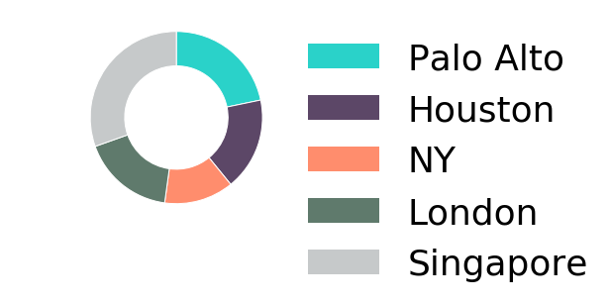
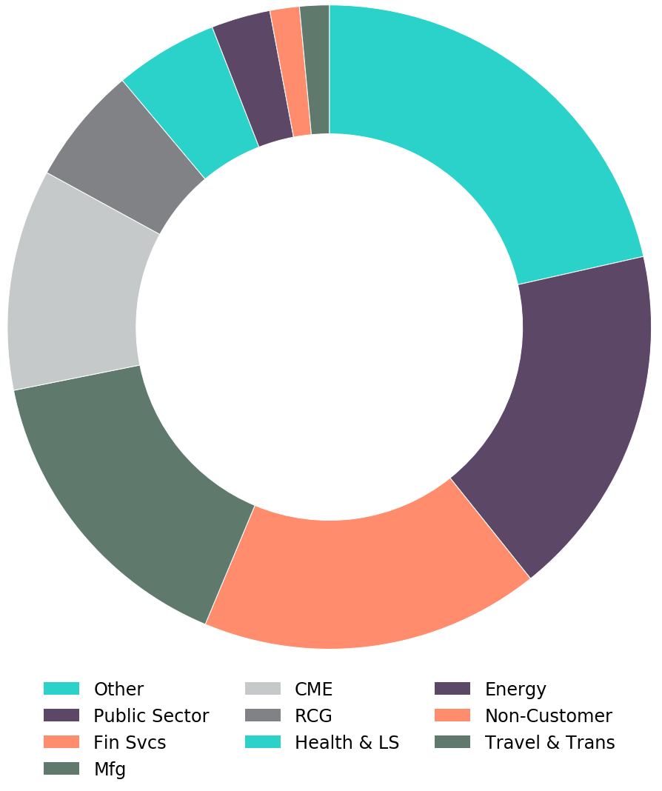
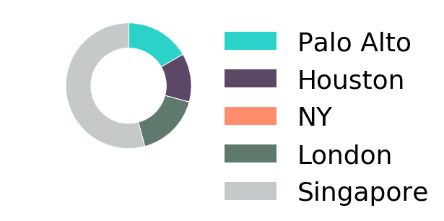
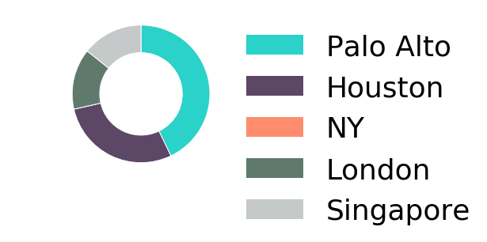
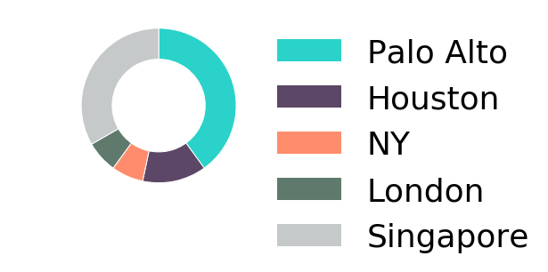
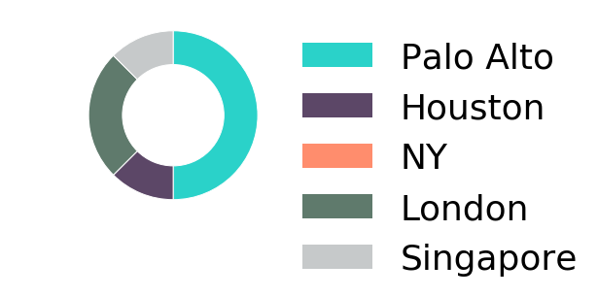
Industry Insights June-August
Briefing volume by Industry
Financial Services
Briefings by center
Top Interests - FS
synergy - 57%
simplivity - 43%
sgi - 43%
oneview - 29%
Public Sector
Briefings by center
Top Interests - PS
synergy - 33%
analytics - 25%
aruba - 17%
3par - 17%
Manufacturing
Briefings by center
Top Interests - Mfg
simplivity - 40%
iot - 30%
nimble - 20%
oneview - 20%
Communications, Media & Entertainment
Briefings by center
Top Interests - CME
simplivity - 29%
synergy - 29%
hybrid - 29%
superdome - 14%
Retail &
Consumer goods
Briefings by center
Top Interests - RCG
converged - 67%
sap - 67%
clearpass - 33%
simplivity - 33%

Slide 10
Thank you

