Slide 1
UAV Systems & Control Lecture 9
Waypoint Control
Sensors

Slide 2
UAV System
Throttle & Control Surface Commands
UAV Dynamic Response
Trajectory Commands
Flight Control Algorithms
Forces & Moments
Kinematics & Dynamics
State Estimation
Sensors
(GPS, gyros, accelerometers, pressure sensors, etc.)
Estimates of
Kin. States
Measured Observations of Kin. States
Kinematic States
Autopilot
UAV Model
In the previous lectures we:
Developed lateral and longitudinal controllers using truth for feedback
In this section we will:
Develop simple waypoint cycling and trajectory logic
Develop mathematical models for common UAV sensors

Slide 3
Trajectory Control
At this point, we’ve developed flight control logic to:
Achieve a desired altitude
Achieve a desired airspeed
Achieve a desired course
A Trajectory Controller is used to set each of the flight control commands based on the desired flight
Course commands are generally used to fly either:
Circular loiters (aka orbits)
Waypoint-defined trajectory segments
Altitude and airspeed commands are often constant throughout flight, but may change (e.g. at waypoints) in order to:
Climb to avoid terrain or obstacles
Speed up to cover ground faster
Speed up/down at different altitudes
etc.

Slide 4

Loiter/Orbit Trajectories
Loiter/Orbit Circles
E.g. used for maintaining station or providing imagery of a fixed location
Defined by:
Center location
Radius
Direction (CW or CCW)
Duration (Time or # of periods)
Controlled by:
Course or roll commands to fly along circle e.g.:
Example:
CW:
CCW:

Slide 5
Waypoint Trajectories
1
Waypoints
Sequential list of geographic positions
May be repeating e.g. 1→ 2→ 3→ 4→ 1→…
UAV
Flies toward each waypoint
Cycles to next waypoint when near enough (or past) current waypoint
May also regulate crosstrack position error
May change altitude or airspeed command at each waypoint
Controlled by:
Course or roll commands to fly waypoints e.g.:
4
Cycle waypoint when within specified radius
2
3
Note: This is an overly simplistic waypoint steering example method. Superior methods exist.

Slide 6
Controller Command Switching
Example command switching represented
- Rudder not shown
UAVs generally have multiple user-specified flight modes
Multiple command switches
Airspeed-to-Throttle Cntrlr
Trajectory Commands
Loiters/Orbits
Cycled Waypoints
Altitude
Airspeed
Fixed Throttle via Mode
Airspeed-to-Pitch Cntrlr
Fixed Pitch via Mode
Alt-to-Pitch Controller
Pitch-to-Elevator Controller
Course-to-Roll Controller
Roll-to-Aileron Controller

Slide 7
Sensors for UAVs
Note: None of these sensors directly observe pitch or roll
The following types of sensors are commonly used for guidance and control of UAVs
Accelerometers
Observe acceleration relative to free-fall
rate gyros
Observe body rates: p, q, r
pressure sensors
Observe altitude and airspeed: h=-p_{d}, V_{a}
magnetometers (digital compasses)
Observe yaw: ψ
GPS
Observe inertial position and velocity:
Kin States
Observed via
p_{n} | GPS
p_{e} | GPS
h=p_{d} | GPS and/or baro altimeter
u | v_{NED} from GPS, V_{a} from pitot
v | v_{NED} from GPS
w | v_{NED} from GPS
φ | Fusion of sensors
θ | Fusion of sensors
ψ | Magnetometer
p | x-gyro
q | y-gyro
r | z-gyro

Slide 8
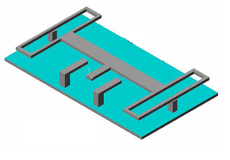
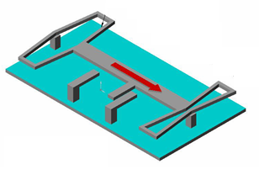
MEMS Proof-Mass Accelerometers
Acceleration
x_{b}
δ
Base, or Housing
x_{m}
At Rest, or Constant Velocity
Spring
x_{b}
x_{m}
Proof Mass
Spring
MEMS Accelerometer modeled as a Proof Mass suspended in a Base
Stationary Electrode
Moving Electrode
Summing Forces acting on Proof Mass via Newton’s 2nd Law:
Spring (k/2)
x_{b}
x_{m}
δ
Spring (k/2)
Acceleration
Measure Capacitance to determine δ
Motion damped via surrounding air (damping: b)
2nd Order Response:
At frequencies below BW, δ is proportional to acceleration!
http://www.engr.sjsu.edu/trhsu/ME189_Chapter%202.pdf

Slide 9
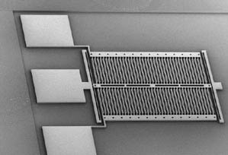
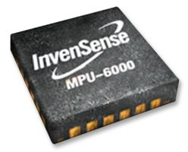
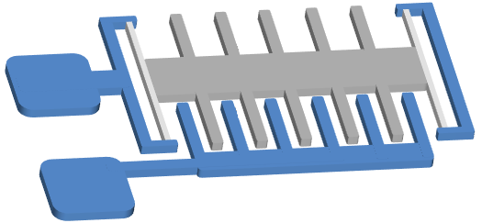
MEMS Accelerometers
Inertial Measurement Units (IMUs) typically have a triad of orthogonal accelerometers
http://www.wtec.org/loyola/mcc/mems_eu/Pages/Chapter-5.html
Fig. 5.11. Low-g accelerometer on SOI (Source:LETI)
x
3g
2g
1g
0g
-1g
-2g
-3g
m
3g
2g
1g
0g
-1g
-2g
-3g
3g
m
2g
1g
y
0g
m
-1g
Top comb of electrodes not shown
Spring
-2g
Spring
-3g
Proof Mass
Measure Capacitance to determine PM displacement, hence acceleration
z
Example MEMS IMU (triad of accelerometers & gyros). Specific implementation may differ from that described.
Measures Acceleration along this dimension

Slide 10
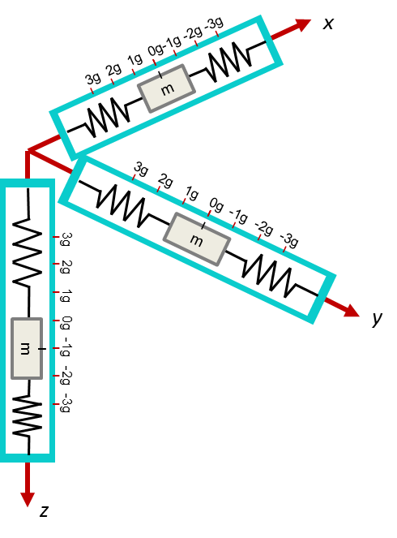
Accelerometer Measurements
Accelerometers measure acceleration, but not perfectly
Accelerometers have a bandwidth
Valid measurements only at frequencies below bandwidth
Typically 50-100 Hz for a MEMS accelerometer
Range (e.g. ±2g, ±10g, etc.)
Biases
Non-linearities
Cross-axis sensitivity
e.g. a_{x} affecting a_{y} measurement
Ratiometry
e.g. scaling at lower voltages
Temperature dependence
Chips have temp. corrections
Noise (Noise Density)
Measured in
Typical for MEMS: 100 – 500
Example:
The majority of error sources are removed via factory and/or pre-flight calibration. For our purposes, we will assume resulting measurements are truth plus noise:
etc.
Gaussian Dist.
Bandwidth: 100 Hz Noise Density: 250

Slide 11
Accels Read Acceleration relative to Gravity
Tricky concept:
Measured acceleration is the total acceleration of the accelerometer casing minus the acceleration of gravity
Positive
Orientation
Positive
Orientation
Positive
Orientation
On an plane, Lift exerts 1g of force upward. Reading: 1g up
z accelerometer is positive downward.
-3g
-3g
-3g
3g
-2g
-2g
-2g
g
Reading: -1g down
= 1g up
-1g
-1g
-1g
1g
0g
m
0g
On a table, table exerts 1g of force upward. Reading: 1g up
0g
0g
1g
1g
m
1g
m
m
-1g
2g
2g
2g
-2g
3g
3g
3g
-3g
Airplane
Positive
Orientation
In free-fall, acceleration of case and proof mass are equal. Reading: 0g
1g up
1g up
(e.g. straight and level flight)

Slide 12
Accelerometer Measurements
Recall from translational dynamics:
Total External Forces in body frame
Total Acceleration in body frame
Accelerometer measures total acceleration minus gravity:
Total Acceleration in body frame
Minus gravity
Total Acceleration in body frame
Minus gravity
Can form accelerometer measurements in two ways:
or
We will find this way more convenient for our simulation
Notes:
\par\noindent Recall from Chapter 3, that
\[
\mass\left(\frac{d\mathbf{v}}{dt_b} + \boldsymbol{\omega}_{b/i}\times\mathbf{v}\right)
= \mathbf{F}_{\text{total}}.
\]
Using the expression
\[
\mathbf{a}_\text{measured} = \frac{1}{\mass}\left(\mathbf{F}_{\text{total}} - \mathbf{F}_{\text{gravity}}\right),
\]
the output of the accelerometer can be expressed as
\[
\mathbf{a}_\text{measured} = \frac{d\mathbf{v}}{dt_b} + \boldsymbol{\omega}_{b/i}\times\mathbf{v} - \frac{1}{\mass}\mathbf{F}_{\text{gravity}}.
\]
Expressing this relationship in the body frame gives
\begin{align*}
a_x &= \dot{u} + qw-rv + g\sin\theta \\
a_y &= \dot{v} + ru-pw - g\cos\theta\sin\phi \\
a_z &= \dot{w} + pv-qu - g\cos\theta\cos\phi
\end{align*}

Slide 13
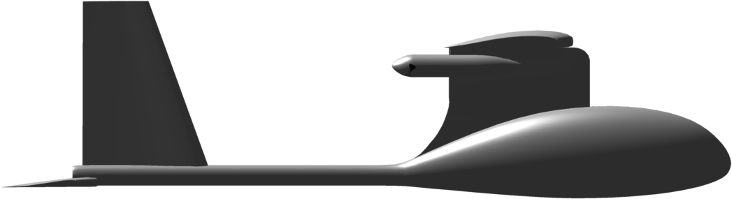

Acceleration on Fixed-Wing Aircraft
At rest or
constant velocity
Parts of slide courtesy of book website: Beard & McLain, “Small Unmanned Aircraft”, Princeton University Press, 2012
Notes:
\mathbf{a}_{\text{measured}} &= \frac{1}{\mass}\left(\mathbf{F}_{\text{total}} - \mathbf{F}_{\text{gravity}}\right) \\
&= \frac{1}{\mass}\left( \left(\mathbf{F}_{\text{lift}}+\mathbf{F}_{\text{drag}}+\mathbf{F}_{\text{thrust}}+\mathbf{F}_{\text{gravity}}\right) - \mathbf{F}_{\text{gravity}}\right) \\
&= \frac{1}{\mass}\left( \mathbf{F}_{\text{lift}}+\mathbf{F}_{\text{drag}}+\mathbf{F}_{\text{thrust}}\right)

Slide 14
Gyroscopes (Gyros)
p
p
Gyros measure angular rates (e.g. body rates: p, q, r)
MEMS gyros observe angular rates through Coriolis acceleration
q
r
(1)
Start with vector differentiation
(2)
Want to differentiate a 2nd time
Coriolis Acceleration
Causes hurricanes to spin counter-clockwise in northern hemisphere
Can be derived by taking the 2nd derivative of a vector (p) on a rotating frame
Apply vector diff. rule again
(3)
(4)
(1) Into (3)
(5)
(6)
Result:
Accel viewed in rotating frame
Accel viewed in inertial frame
Euler accel due to rotation rate change
Coriolis Acceleration
Centripetal accel
14

Slide 15
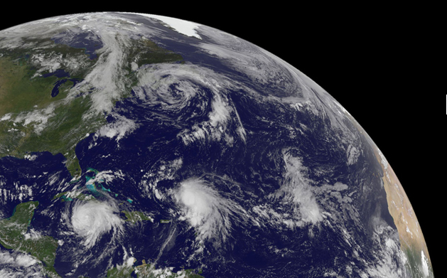
Coriolis Acceleration
The motion of a falling ball:
What is the Coriolis Effect?
See Lecture 2, slides 24-26 also
The “perceived” deflection of an inertially moving object when viewed from a rotating frame
Coriolis Acceleration:
As viewed from an inertial observer
As viewed from a rotating observer
Causes hurricane rotation
v
LP
a_{C}
Air particles attracted to low pressure (LP) center, but deflected by Earth rotation
Northern Hemisphere: CCW Southern Hemisphere: CW
nasa.gov
Notes:
Lecture 2 definition – The rate of change of vb as viewed in Fi due to the rotation of Fb relative to Fi.

Slide 16
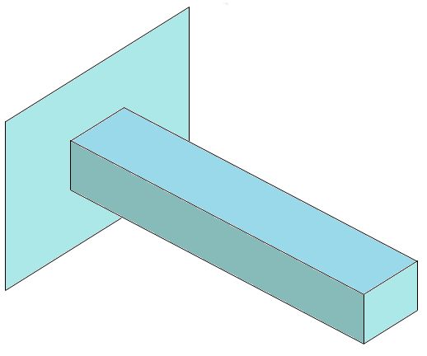
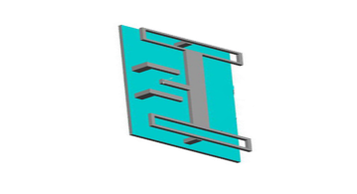
MEMS Gyro
A particle translating on a rotating body experiences a Coriolis acceleration:
Note: Equation differs from book by a sign. I believe this interpretation of positive Coriolis acceleration is more appropriate and correct. (But I could be wrong.)
MEMS gyros measure rotation rate (ω_{r/i}) by:
Oscillating in a direction orthogonal to the rotation axis:
Measuring the acceleration (due to Coriolis) orthogonal to the oscillation:
Example: Vibrating Beam Gyro (Other types of MEMS gyros exist, all based on Coriolis)
Measure resulting oscillatory acceleration along “measurement” axis
Cross product goes away because of orthogonal axes
Deriving rotation rate (ω_{r/i}) from measured acceleration:
Forced high frequency oscillation along “drive” axis
Rotation sensing axis

Slide 17
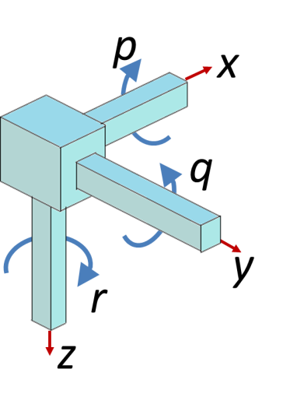
Gyro Measurements
Gyros measure angular rates, but not perfectly
Gyros have a bandwidth
Valid measurements only at frequencies below bandwidth
Typically 50-100 Hz for a MEMS gyro
Range (e.g. ±300º/s, ±1000º/s, etc.)
Biases
Non-linearities
Cross-axis sensitivity
e.g. p affecting q measurement
Ratiometry
e.g. scaling at lower voltages
Temperature dependence
Chips have temp. corrections
Noise (Noise Density)
Measured in
Typical for MEMS: 30-100
Example:
The majority of error sources are removed via factory and/or pre-flight calibration. For our purposes, we will assume resulting measurements are truth plus noise:
etc.
Gaussian Dist.
Bandwidth: 80 Hz Noise Density: 0.015

Slide 18
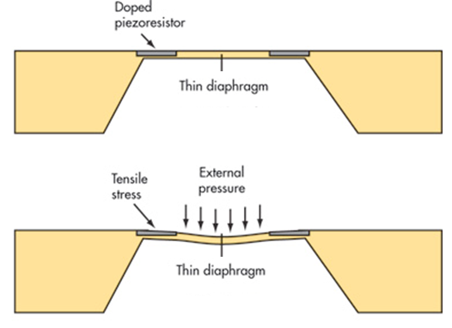
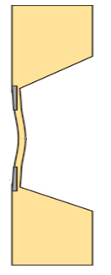
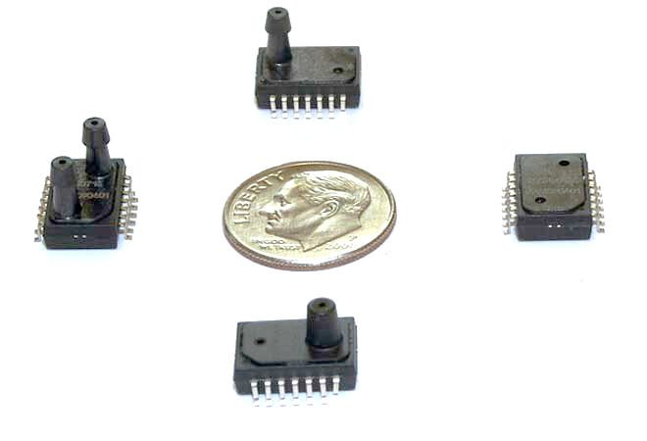
Pressure Measurement
MEMS Pressure Sensors
Are used to estimate both altitude and airspeed
Use a piezoresistor to measure the deformation of a thin diaphram
Diaphragm separates a cavity at “reference pressure” from the external environment
Deformation caused by a pressure difference
Reference Pressure
Reference Pressure

Slide 19
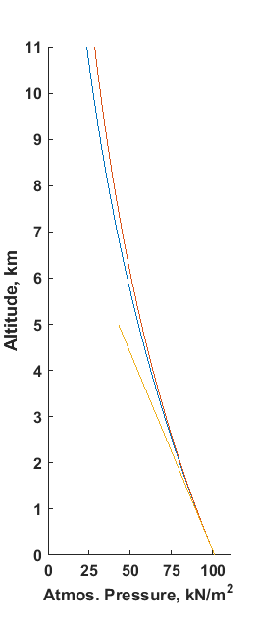
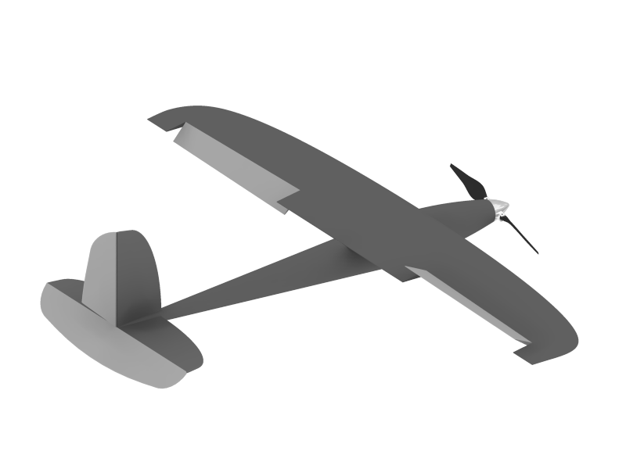

Barometric Formula
Atmospheric pressure decreases with altitude
Multiple “barometic formula” equations commonly used to model pressure
Models use “average” atmospheric quantities at sea level
Actual atmospheric quantities vary
P₀ : Standard pressure at sea-level, 101,325 N/m²
T₀ : Temperature at sea-level, K (Kelvin)
L₀ : Temp. lapse rate, -0.0065 K/m
g : Gravitational constant, 9.80655 m/s²
ρ : Air density, 1.2682 kg/m³
R : Univ. gas constant for air, 8.3142 N-m/(mol-K)
M : Molar mass of atm. air, 0.0289644 kg/mol
assumes temperature decreases linearly with altitude
Height of UAV above sea level
Abs. Pressure at UAV
Height of UAV above launch point
assumes constant air temperature
Height of launch point above sea level
assumes constant air density, ρ
Atmospheric Conditions at Sea Level:
101,325 N/m² = 14.7 psi (lbs/in²)
Notes:
The basic equation of hydrostatics is
\[
P_2 - P_1 = \rho g (z_2 - z_1)
\]
Using the ground as reference, and assuming constant air density gives
\begin{align*}
P-P_{\text{ground}}
&=-\rho g (h-h_{\text{ground}}) \\
&=-\rho g h_{\text{AGL}}\
\end{align*}
Below 11,000 m, can use barometric formula:
\[
P = P_0 \left[ \frac{T_0}{T_0+L_0 h_{\text{ASL}}} \right] ^\frac{g M}{R L_0},
\]
where
\noindent
$P_0$: standard pressure at sea level \\
$T_0$: standard temperature at sea level \\
$L_0$: rate of temperature decrease \\
$g$: gravitational constant \\
$R$: universal gas constant for air \\
$M$: standard molar mass of atmospheric air, \\ \\
which takes into account change in density with altitude and temperature.

Slide 20
Barometric Altitude Measurement
Generally can’t use barometric formula directly to find h_{ASL} because we may not actually know the current atmospheric conditions at sea level, or the temperature gradient
UAVs will generally use a pressure sensor to estimate altitude “above launch point”
Process:
Modeling example using “constant temperature” assumption:
Measure absolute pressure at launch point prior to launch
Estimate altitude by comparing in-flight meas. with pre-launch meas.
3) Autopilot uses measured pressure and temperature to estimate height above launch point
Measured atmospheric conditions at UAV
Height of UAV above launch point
Bias
Noise
2) Measure noisy static pressure at UAV altitude in-flight, with bias to account for atmospheric drift and assumption errors
Measured absolute pressure at launch
1) Measure absolute pressure at launch altitude pre-flight (Modeled using baro. formula at h_{Launch,ASL} without errors)
Atmospheric Conditions at Sea Level:
Notes:
The basic equation of hydrostatics is
\[
P_2 - P_1 = \rho g (z_2 - z_1)
\]
Using the ground as reference, and assuming constant air density gives
\begin{align*}
P-P_{\text{ground}}
&=-\rho g (h-h_{\text{ground}}) \\
&=-\rho g h_{\text{AGL}}\
\end{align*}
Below 11,000 m, can use barometric formula:
\[
P = P_0 \left[ \frac{T_0}{T_0+L_0 h_{\text{ASL}}} \right] ^\frac{g M}{R L_0},
\]
where
\noindent
$P_0$: standard pressure at sea level \\
$T_0$: standard temperature at sea level \\
$L_0$: rate of temperature decrease \\
$g$: gravitational constant \\
$R$: universal gas constant for air \\
$M$: standard molar mass of atmospheric air, \\ \\
which takes into account change in density with altitude and temperature.

Slide 21
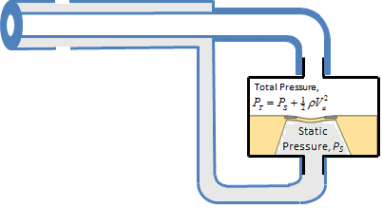
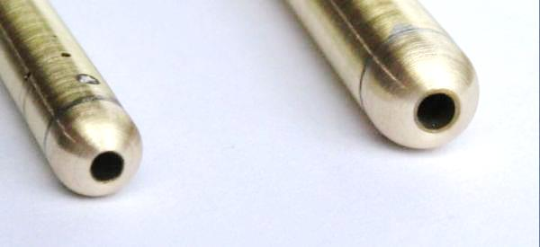
Airspeed Measurement
Note: an improved airspeed sensor model would account for the directionality of pitot tube (i.e. only use axial component of airspeed)
From Bernoulli’s equation:
or
Pitot-static pressure sensor measures dynamic pressure:
Estimate airspeed:
Dynamic Pressure
Bias
Noise
ρ : Air density, kg/m³
Strain-sensing diaphragm measures P_{T}-P_{S}
Tube oriented into airstream
Incoming Airspeed, V_{a}
Open to ambient pressure
Static port
V_{a}
P_{S}
Total Pressure,
P_{S}
Open to ambient pressure
Aircraft often use a special “Pitot-Static” tube which connects to both pressure ports.
P_{S}
Static
Pressure, P_{S}
Diydrones.com
Dynamic port
P_{S}
Open to ambient pressure
Notes:
\noindent From Bernoulli's equation:
\[
P_t = P_s + \frac{\rho V_a^2}{2}
\qquad \text{~or~} \qquad
\frac{\rho V_a^2}{2} = P_t - P_s
\]
Pitot-static pressure sensor measures dynamic pressure:
\[
y_{\text{diff pres}} = \frac{\rho V_a^2}{2} + \beta_{\text{diff pres}} + \eta_{\text{diff pres}}
\]

Slide 22
Magnetometers (Digital Compasses)
Magnetometers are used on some UAVs to help observe yaw angle
Magnetometers measure orientation of “magnetic north” relative to body
2D & 3D magnetometers are used
Magnetometer placement is tricky, and sensors require calibration to account for on-board iron and magnetic sources
Small fixed-wing vehicles will often forgo using a magnetometer
Fixed-wings can observe yaw via kinematic motion
Autonomous quadcopters require a magnetometer for yaw control
Magnetic North deviates from True North at any point on the Earth by:
Magnetic Declination: Horizontal angular difference between True North and Magnetic North
Magnetic Inclination: Vertical angular offset between horizontal and 3D magnetic attraction vector (i.e. the angle of the Earth’s magnetic field into the Earth from horizontal)

Slide 23
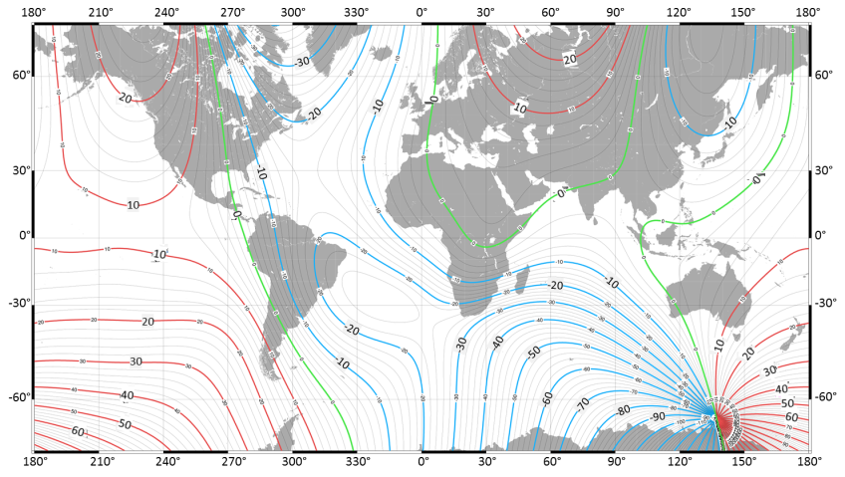
3D & 2D Magnetometer Measurements
True North
Magnetic Field is a 3D phenomenon, and can be measured as a unit vector by a MEMS 3D magnetometer fixed to the UAV body:
Toward 2D Mag. North
δ_{dec}
Local Horz.
East
δ_{inc}
3D Mag. Field Vector
Meas. errors due to noise and other mag. influences
Laurel, MD, 3/2015:
δ_{dec} ≈ -11° (Horizontal)
δ_{inc} ≈ 66° (Vertical)
More advanced state estimators will use 3D vector measurements
Down
For our purposes, we’ll just presume a 2D compass which outputs a declination-corrected measure of body yaw:
Map of declinations
True
Yaw
Bias
Noise

Slide 24


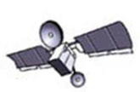







Global Positioning System
32 satellites (originally 24) orbiting the earth
Altitude 20,180 km
Any point on Earth’s surface can be seen by at least 4 satellites at all times
Time of flight of radio signal from 4 satellites to receiver used to trilaterate location of receiver in 3 dimensions
4 range measurements needed to account for clock offset error
4 nonlinear equations in 4 unknowns results:
latitude
longitude
altitude
receiver clock time offset
Further info: learn.sparkfun.com/tutorials/gps-basics
Slide courtesy of book website: Beard & McLain, “Small Unmanned Aircraft”, Princeton University Press, 2012

Slide 25


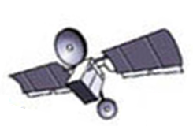
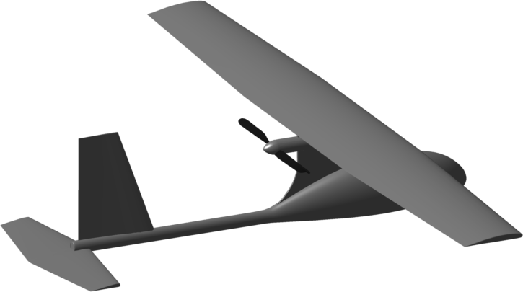
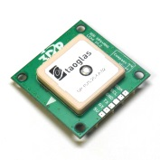
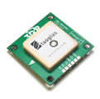
GPS
“Time of flight” of radio signal from satellite to receiver used to calculate “pseudorange”
10 ns timing error → 3 m pseudorange error
Ephemeris Error: satellites drift from their expected or orbital paths (1-5m of error)
Satellite Clock Error: atomic clocks drift by 10ns/per (1-2m of error)
Receiver Timing Error: Receiver has a less accurate clock, but uses measurements to estimate clock error(<0.5m of error)
True Range
Ionosphere: free electrons delay signal transmission (2-5m error)
Troposphere: atmospheric conditions (temperature, humidity, pressure) affect speed of light (1m of error)
Multipath: reflections (<1m of error)
Satellite transmits a known code
Receiver uses a Kalman Filter to estimate position, velocity, and clock error from at least 4 satellites
Receiver computes pseudorange to each satellite via speed of light, c:
Transmitted Code
Δt
Kalman
Filter
Received Code
PR_{i}=cΔt
Velocity vector derived from position
Receiver determines duration of transmission

Slide 26
GPS timing error explained
When you measure the distance to four located satellites, you can draw four spheres that all intersect at one point. Three spheres will intersect even if your numbers are way off, but four spheres will not intersect at one point if you've measured incorrectly. Since the receiver makes all its distance measurements using its own built-in clock, the distances will all be proportionally incorrect.
The receiver can easily calculate the necessary adjustment that will cause the four spheres to intersect at one point. Based on this, it resets its clock to be in sync with the satellite's atomic clock. The receiver does this constantly whenever it's on, which means it is nearly as accurate as the expensive atomic clocks in the satellites.
http://electronics.howstuffworks.com/gadgets/travel/gps3.htm

Slide 27
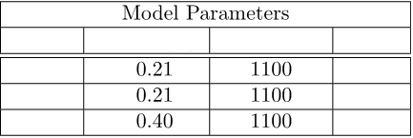
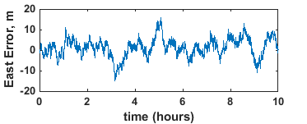
GPS Error Model for Simulation
Need a simple model capturing transient behavior of errors
We’ll use a sampled Gauss-Markov process to model GPS error
Book cites: Rankin, J., “GPS and differential GPS: An error model for sensor simulation,” in Position, Location, and Navigation Symposium, 1994
T_{S,GPS}: GPS Sampling Time, s
τ_{GPS}: GPS Error Time Constant, s
Observed average GPS errors (time-varying)
Roughly equivalent Gauss-Markov Parameters
τ_{GPS} (s)
T_{S,GPS} (s)
North
≤1.0
East
≤1.0
Altitude
≤1.0
GPS position measurements, at a discrete sampling rate (e.g. 1Hz – 5Hz):

Slide 28
GPS Error Model Implementation
4.7 m
6DOF implementation note:
Use parameters found in P structure
if( time==0 )
9.2 m
end
if( at GPS sampling time interval )
0.21 m
1100 s
Measurement = truth + error
1.0 s
end

Slide 29
GPS Velocity Vector Measurement
GPS filters derive the velocity vector from time-varying position estimates
Speed estimates are generally fairly accurate (0.01 – 0.1 m/s) because of carrier phase Doppler measurements
Model of GPS velocity vector measurements:
Note: Book generates GPS groundspeed and course measurements instead of full vector. Most modern GPS devices can provide full NED velocity components.

Slide 30
Lecture 9 Homework, 1/6
For problems 1-6, we’ll be adding noisy sensor models to “uavsim_sensors”. For each:
The sensor noise parameters can be found in “init_uavsim_params”
Turn off all winds
Keep the “Feedback Switch” set to “truth”
Run the simulation for 60 seconds
Use the following flight commands (in “uavsim_control”):
if time<10,
h_c=50; Va_c=13; chi_c=0*pi/180;
elseif time<20
h_c=50; Va_c=13; chi_c=60*pi/180;
else
h_c=100; Va_c=15; chi_c=0*pi/180;
end
Add truth-plus-noise gyro measurements to “uavsim_sensors”.
Use P.sigma_noise_gyro as the standard deviation of the measurement noise for each.
Each of the three gyro measurements should be independent.
Enable measurement variable logging: Set “log_measurements = 1;” in “uavsim_logging”
Show that the provided computation of P.sigma_noise_gyro matches the lecture example
Print out relevant portion of “uavsim_sensors”
Compare “out.p_dps” with “out.p_gyro_dps”, zoomed in to show noise & verify that the resulting noise level appears correct. (No need to plot q & r measurements, but be sure to verify that the results make sense.)

Slide 31
Lecture 9 Homework, 2/6
Add truth-plus-noise accelerometer measurements to “uavsim_sensors”.
Use P.sigma_noise_accel as the standard deviation of the measurement noise for each.
Show that the provided computation of P.sigma_noise_accel matches the lecture example
Print out relevant portion of “uavsim_sensors”
Plot the resulting out.ax_accel_mps2, out.ay_accel_mps2, and out.az_accel_mps2.
Do the resulting accelerometer measurements make sense based on the lecture description? Explain!!!!
Add a truth+bias+noise 2D compass measurement (i.e. psi_mag) to “uavsim_sensors”.
Use P.sigma_bias_mag to determine “bias_mag” at time zero. (bias_mag is a “persistent” variable, which means it will retain its value between calls to “uavsim_sensor”. Thus, it is a constant bias.)
Use P.sigma_noise_mag as the standard deviation of the magnetometer angle noise.
Print out the relevant portion of “uavsim_sensors”
Compare the resulting out.yaw_mag_deg with out.yaw_deg. Does the resulting measurement match the bias and noise you expect? Explain.

Slide 32
Lecture 9 Homework, 3/6
Add an absolute pressure sensor model using the “constant temperature” assumption, along with bias and noise.
Note: Sim refers to “static” pressure instead of “absolute” pressure. For our purposes, the terms are used interchangeably.
Use P.sigma_bias_static_press and P.sigma_noise_static_press to form measurement error.
Print out relevant portion of “uavsim_sensors”
Plot the resulting out.static_press_Npm2. Does the result make sense? Explain.
Add a dynamic (aka differential) pressure sensor model using truth+bias+noise.
Use the available truth data to form true (wind-relative) airspeed, and then form differential pressure.
The term “differential pressure” is interchangeable with “dynamic pressure”
Use P.sigma_bias_diff_press and P.sigma_noise_diff_press to form measurement error.
Print out relevant portion of “uavsim_sensors”
Plot the resulting out.diff_press_Npm2. Does the result make sense? Explain.

Slide 33
Lecture 9 Homework, 4/6
Add GPS position and velocity vector measurements
Use skeleton provided in “uavsim_sensors”
“persistent” variables are used to retain values between calls to “uavsim_sensors”
Refer to “Sensor parameters: GPS” in “init_uavsim_params” for GPS parameters
GPS measurements are sampled every P.Ts_gps seconds
Print out relevant portion of “uavsim_sensors”
Compare out.north_m with out.north_gps_m. Zoom to compare details.
Compare out.east_m with out.east_gps_m. Zoom to compare details.
Compare out.alt_m with out.alt_gps_m. Zoom to compare details.
Compare out.groundspeed_mps with out.groundspeed_gps_m. Zoom to compare details.
Compare out.course_deg with out.course_gps_deg. Zoom to compare details.

Slide 34
Lecture 9 Homework, 5/6
Add waypoint guidance to simulation
Add an “Interpreted MATLAB Fcn” block to “Trajectory Commands” (e.g. copy from another block)
The block should call a routine named “uavsim_trajectory_control” which should have the following input/output vectors:
A length-24 input vector consisting of the state estimates vector (length-23) and time
A length-3 output vector consisting of: [Va_c; h_c; chi_c]
Set the function name, output vector dimensions, and sampling time (P.Ts) by double-clicking the “interpreted MATLAB Fcn” block
Implement simple waypoint guidance in “uavsim_trajectory_control” with the provided trajectory command vectors
Set course command directly to each waypoint, in turn (don’t worry about regulating crosstrack position error)
Use a “persistent” variable keep track of which waypoint UAV is heading toward (initially head toward WP1)
Transition (cycle) waypoints when within 20m (horizontally) of each waypoint
Automatically cycle back toward WP1 when near enough to the final waypoint
Altitude and speed commands are for legs approaching each waypoint.
e.g. h_c=90 and Va_c=16 when approaching WP4
% Waypoints WP1 WP2 WP3 WP4 WP5
wp_east = [ 0 400 500 500 0]; % m
wp_north = [100 100 300 500 300]; % m
wp_alt = [ 50 60 90 90 60]; % m
wp_speed = [ 13 13 13 16 16]; % m/s
Continued…

Slide 35
Lecture 9 Homework, 6/6
… Continued
Make sure “uavsim_control” is using the waypoint trajectory commands: (h_c, Va_c, chi_c)
Turn ON gusting winds (but zero steady winds)
Simulate for 300 seconds
Compare east/north trajectory with waypoints: plot(wp_east,wp_north,’r.--’,out.east_m,out.north_m); axis equal
Compare out.alt_m and out.alt_cmd_m
Compare out.airspeed_mps and out.airspeed_cmd_mps
Compare out.course_deg and out.course_cmd_deg
Recommended Reading: Beard & McLain Chapter 7 Appendix H
Errata:
Page 128. The conversion from 1 N/m^2 = 3385 inches Hg is backwards. It should be 3385 N/m^2 = 1 inch Hg.
Triangulate in the caption of Figure 7.8 should be trilaterate.
Page 140, equation (7.22) should be chi=atan2(Ve,Vn)

